Slide 1
GSICS 2026 Agency Report
Korea Meteorological Administration
Eun-Jeong Cha, Euidong Hwang, Hanbyul Lee, Daehyeon Oh
Notes:
It is an honor to present the Agnecy Report, Korea Meteorological Administration in GSICS 2006 Annual Meeting.
My name is Eun Jeong Cha, and my team members supprot to prepare this report.

Slide 2
Proposed outlines
GSICS Activities (in support of GDWG and GRWG), Actions, and Achievements
KMA’s Support to GDWG/GRWG Activites
Calibration Major Updates (especially for reference sensors)
KMA’s Calibration Results
Notes:
I would like to present as follows, (1) GSICS Activities (in support of GDWG and GRWG), Actions, and Achievements,
(2) KMA’s Support to GDWG/GRWG Activites
(3) Calibration Major Updates (especially for reference sensors) and KMA’s Calibration Results.

Slide 3
GSICS Activities, Actions, and Achievements
Activities summary
  GK2A AMI IR channels
    Reviewed the AMI long-term IR calibration performance using MetOp-B and NOAA-20
    Updated the IR inter-calibration system for GK2A/AMI
  GK2A AMI VIS/NIR channels
    Updated Ray-matching (SNPP, NOAA-20 and -21 VIIRS)
    GSICS DCC (SNPP, NOAA-20 and -21 VIIRS)
    Lunar calibration (GIRO)
    AMI-AHI comparison
Achievements Summary
  Release of the COMS/MI – GK2A/AMI recalibration coefficients
  Development of the GEO-GEO (AMI-AHI9) VIS/NIR inter-calibration system
Notes:
This slide summarizes the activities and achievment in 2025.
For the GK2A AMI IR channels, we reviewed the AMI long-term IR calibration performance using MetOp-B and NOAA-20
using 6-year data from July 2019 to June 2025. For the two LEOs, the stability of the AMI IR channel was confirmed through daily and annual volatility and
uncertainty analysis using IASI. QC processing process of input data was added.
For the GK2A AMI VIS/NIR channels, four calibrations were performed as follows:
Updated Ray-matching (SNPP, NOAA-20 and -21 VIIRS), GSICS DCC (SNPP, NOAA-20 and -21 VIIRS), Lunar calibration (GIRO) and AMI-AHI comparison
The main achievements are release of the “COMS/MI-GK2A/AMI recalibration coefficients” and “development of the GEO-GEO (AMI-AHI9) VIS/NIR inter-calibration system”.

Slide 4
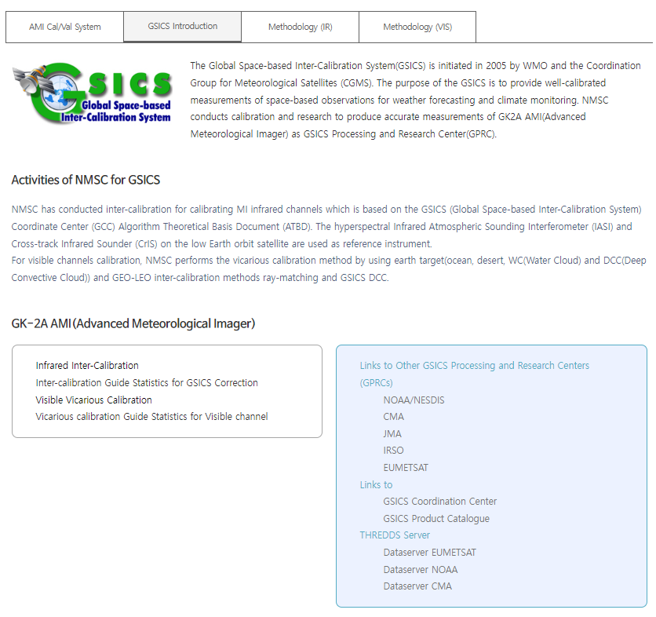
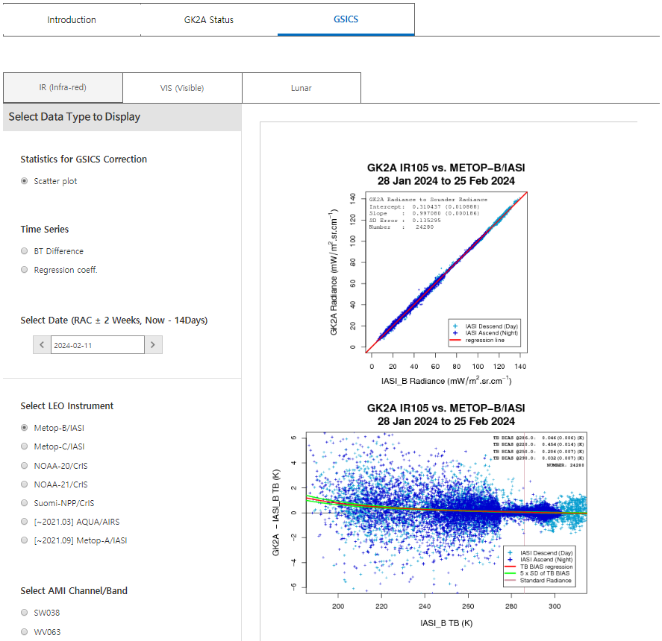
KMA’s Support to GDWG Activites
KMA GPRC Webpage
  Landing page
    https://nmsc.kma.go.kr/homepage/html/gsics/gsicsIntro.do (Korean, now open)
    http://nmsc.kma.go.kr/enhome/html/main/main.do (English, now open)
  Event logging: http
    http://nmsc.kma.go.kr/enhome/html/bbs/listNotice.do?bbsCd=00026
  GSICS monitoring pages
    IR (Metop-a/b/c IASI, NOAA-20/21, S-NPP CrIS)
    VIS Ray Matching(S-NPP, NOAA-20/21 VIIRS)
    Lunar(GIRO)
Notes:
This slide is KMA GDWG activites.
The KMA provides monitoring information as well as data including the accuracy of IR and VIS/NIR channels through its web page.
Currently, the dashboard is being discussed in GSICS, and we are planning to provide various information in connection with
the GPRC webpage according to the direction of GSICS promotion.
Last year, the GPRC webpage opened an English webpage, and new information has been updated.

Slide 5
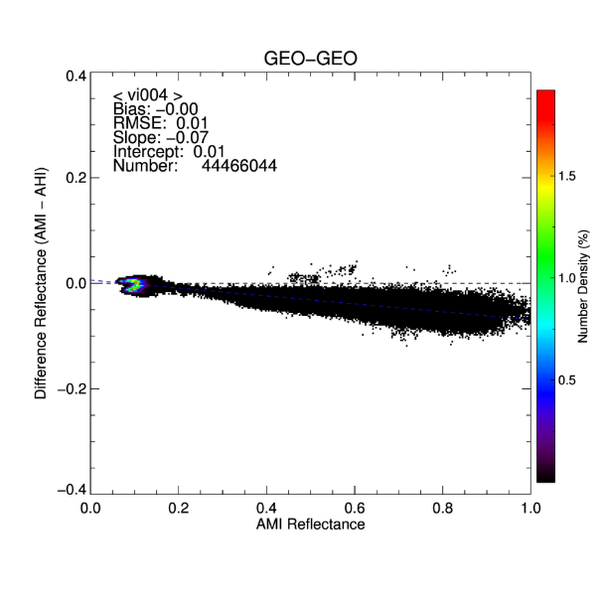
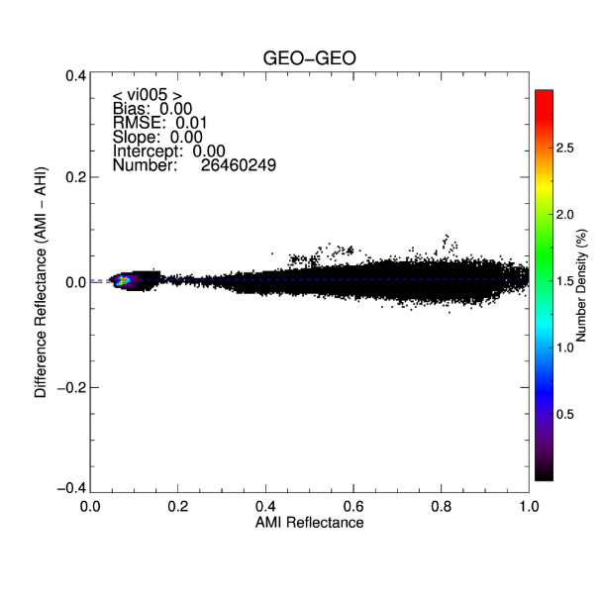
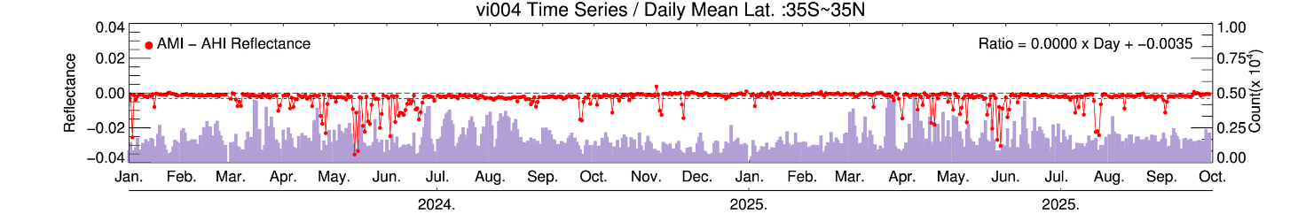
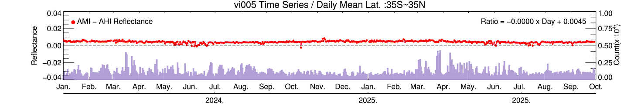
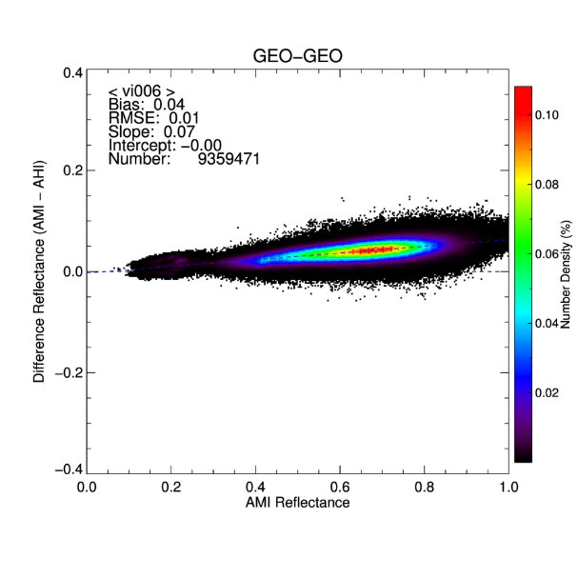
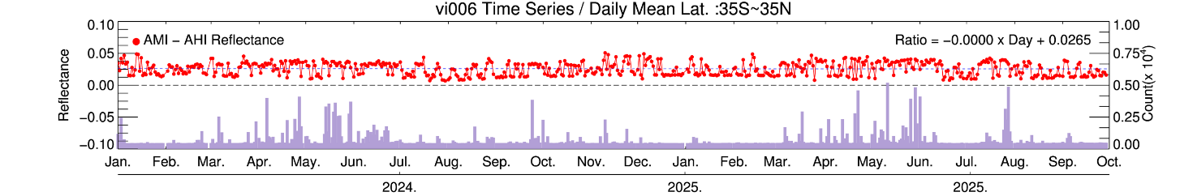
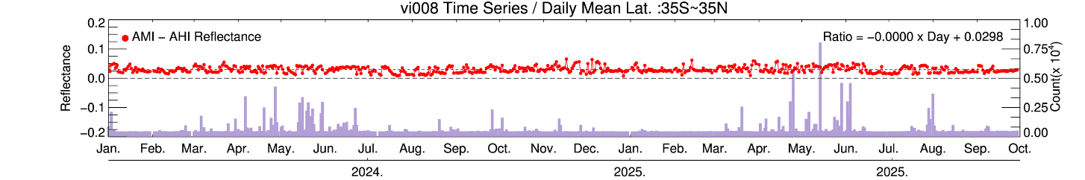
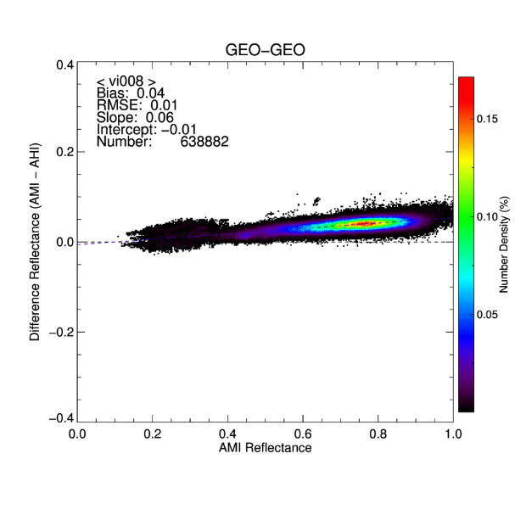
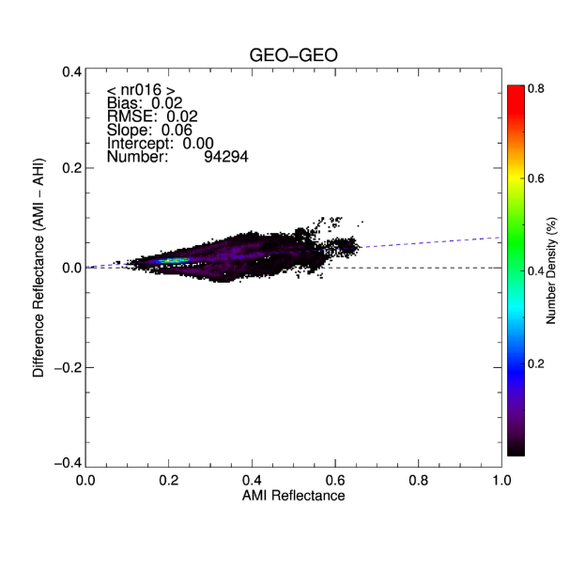
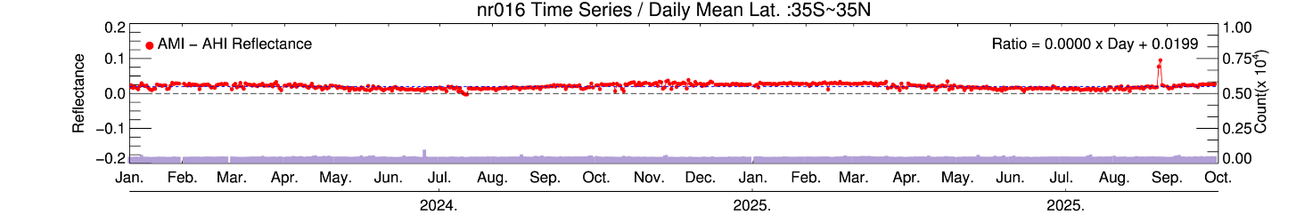
KMA’s Support to GRWG Activites
AMI-AHI differences generally increase with AMI reflectance, except for VI004
VI004: negative deviations during the summer season, likely related to parallax effects
Overall, stable behavior between the AMI and AHI
Notes:
The following is an update in the GRWG research part and mutual comparison between AMI and AHI/NIR was promoted for mutual test between geostationary satellites,
and AMI and AHI tend to generally conincide. Some important features are as follows.
First, looking at the relationship between the difference of AMI and AHI and AMI reflectance,
the slope increases to only VI004 and the rest to (+) origin. In the case of VI004 in the time series analysis results from January 2024 to October 2025,
because of the high volatility of clouds in the summer, a lof of (-) deviations occurred at this time.
In the rest of the channels, the variability was small and remained constant with time.
In conclusion, it was confirmed that AMI and AHI had a very high correlation.

Slide 6
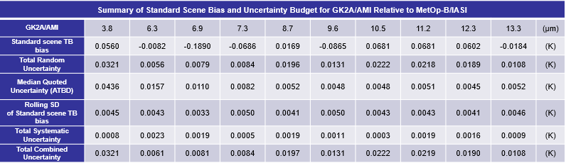
KMA’s Support to GRWG Activites
IR
  Long-term GEO-LEO monitoring using MetOp-B and NOAA-20
    Assessed daily and yearly quality stability from Jul 2019 to Jul 2025
    Validated the calibration coefficients through uncertainty analysis
  Reprocessing the long-term data from COMS/MI – GK2A/AMI
    Update the recalibration coefficients for 3.8µm channel
      Reduced sensor to sensor jump
Notes:
For IR, GEO-LEO comparison was analyzed using MetOp-B and NOAA 20 from July 2019 to July 2025, and the results will be submitted in the near future.
We validated the calibration coefficients through uncertainty analysis, and the results are summarized in the table.
A standard scene bias compared with random components, and the uncertainty was calculated very low.
About Reprocessing the long-term data from COMS/MI – GK2A/AMI, it will update the recalibration coefficents for 3.8 µm channel using RTM.

Slide 7
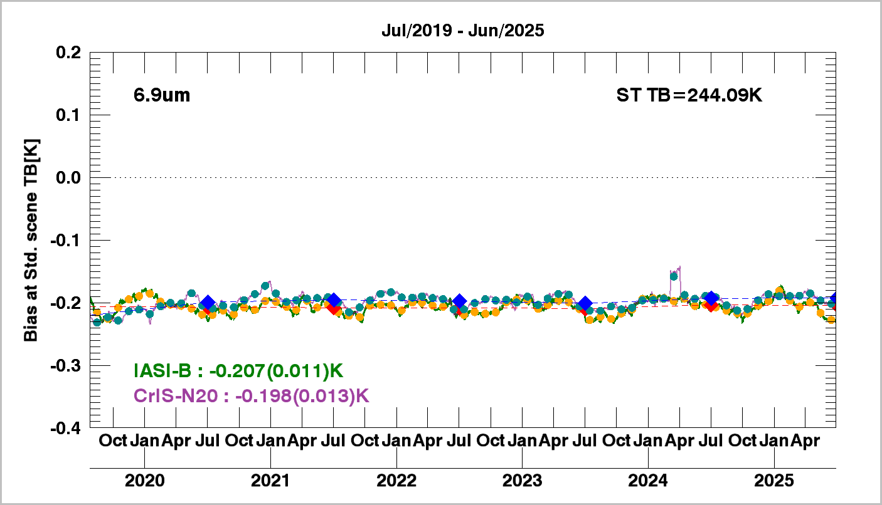
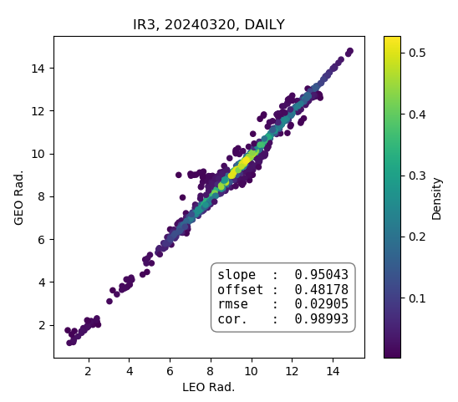
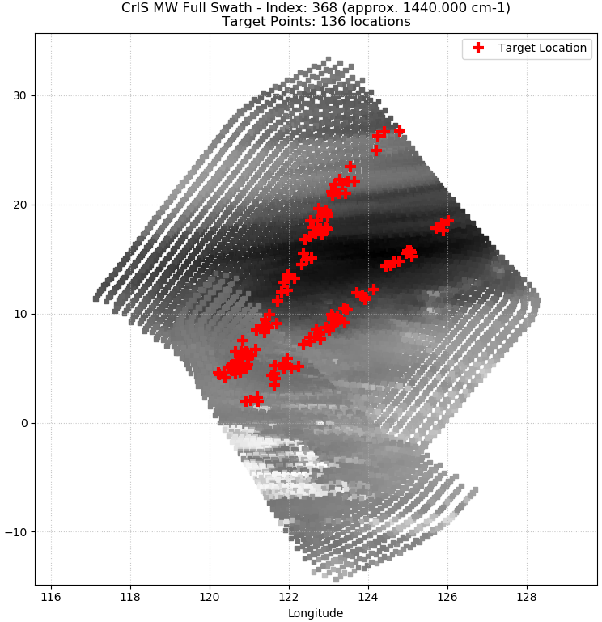
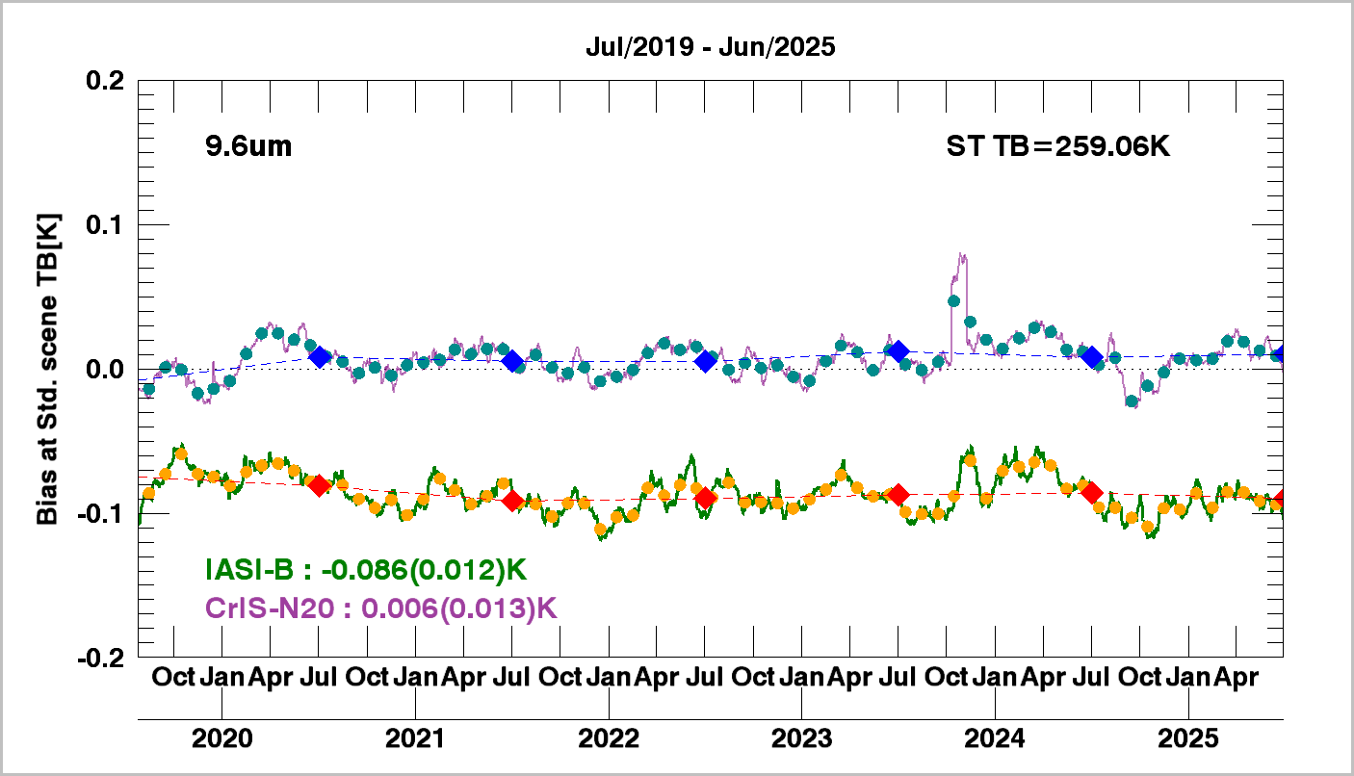
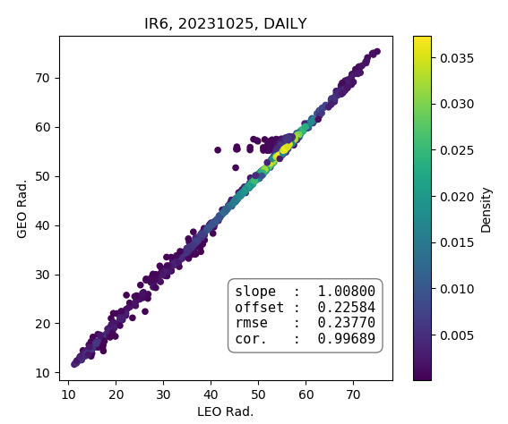
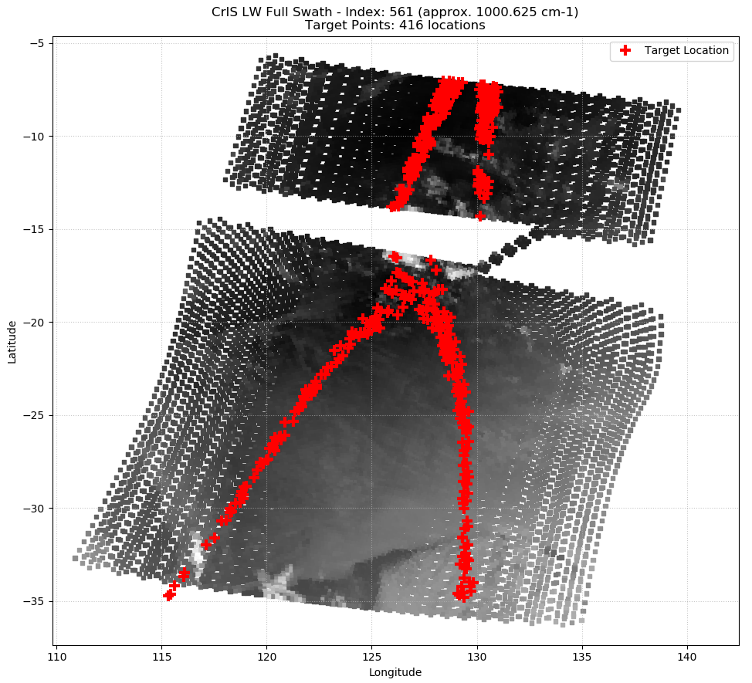
KMA’s Calibration Major Updates
Developing a Quality Control (QC) procedure for input data
②
Discontinuity,
Missing data,
Wrong INR
①
start of orbit
end of orbit
Notes:
Next topic is the calibration major updates.
The KMA is developing an additional QC procedure for input data.

Slide 8
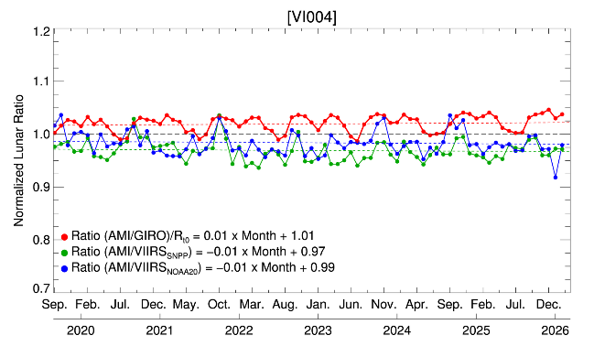
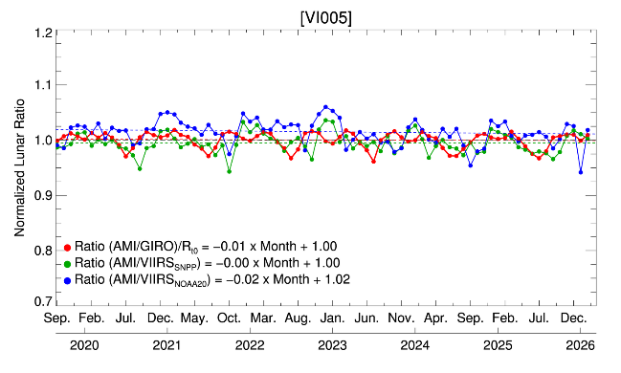
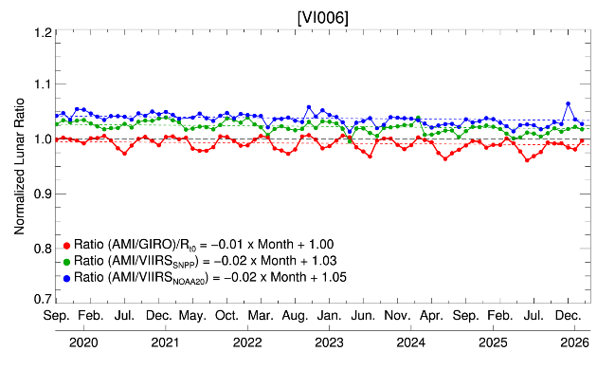
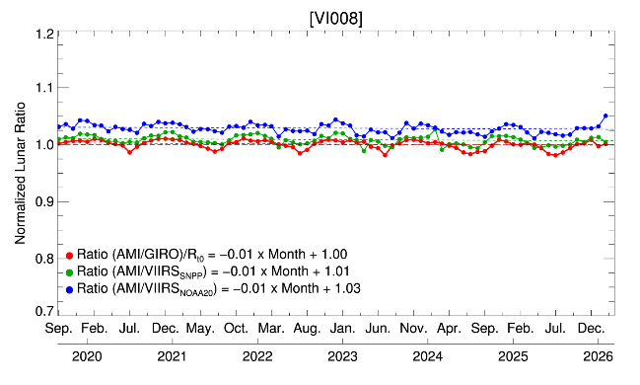
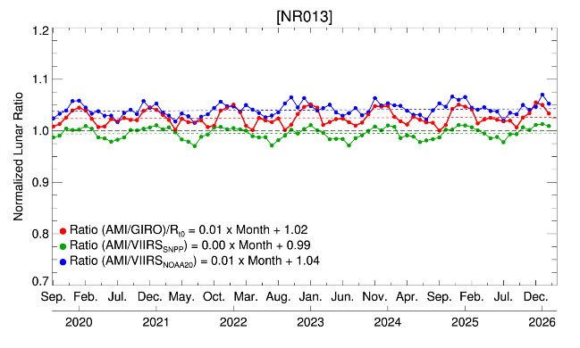
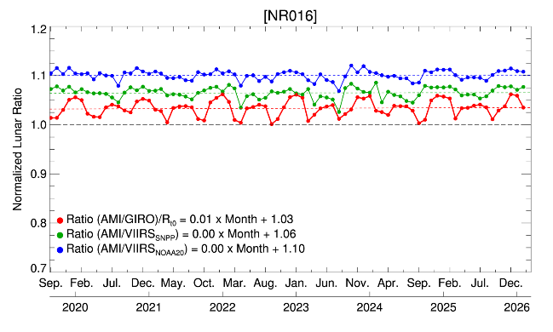
KMAs Calibration Results (VIS/NIR)
(Sep. 2019 ~ Jan. 2026)
Daily Mean Bias (Uncertainty)
 | VI004 | VI005 | VI006 | VI008 | NR013 | NR016
Lunar | -2.22 (±0.32 ) | -1.75 (±0.24) | -1.54 (±0.06) | -0.33 (±0.05) | 0.32 (±0.07) | 1.38 (±0.08)
S-NPP VIIRS | -3.73 (±2.11) | -0.45 (±1.08) | 1.79 (±0.98) | 0.29 (±1.06) | -1.87 (±0.68) | 4.98 (±0.96)
NOAA-20 VIIRS | -1.87 (±1.76) | 1.63 (±1.14) | 3.38 (±1.02) | 2.06 (±1.17) | 2.8 (±0.63) | 8.49 (±1.01)
Note : Sub-sampled lunar observations are shown, Ratio is normalized by Ratio_{t0} (t₀ : 1 Sep. 2019)
Notes:
For the GK2A AMI VIS/NIR channels, four calibrations were performed as follows:
Updated Ray-matching (SNPP, NOAA-20 and -21 VIIRS), GSICS DCC (SNPP, NOAA-20 and -21 VIIRS), Lunar calibration (GIRO) and AMI-AHI comparison

Slide 9
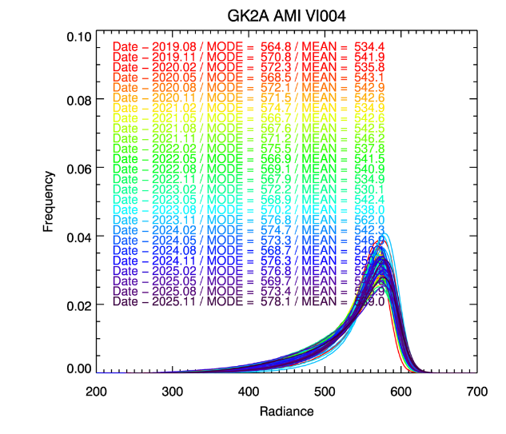
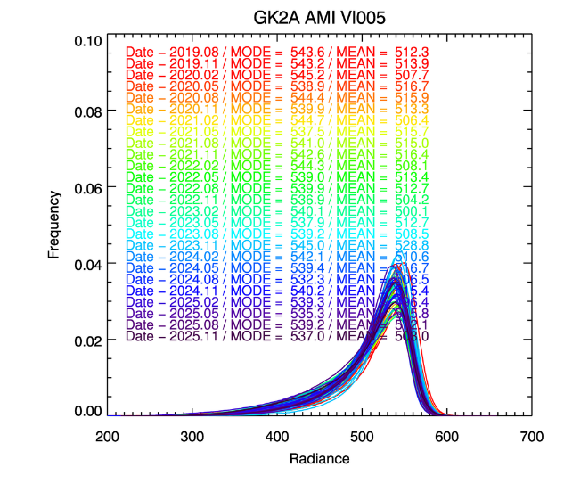
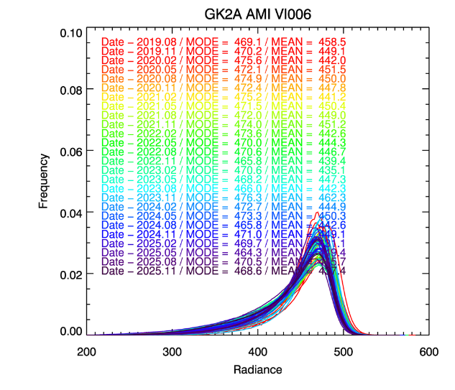
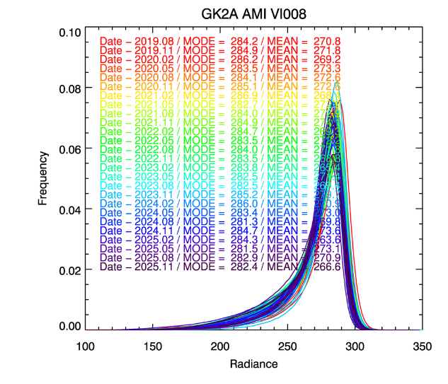
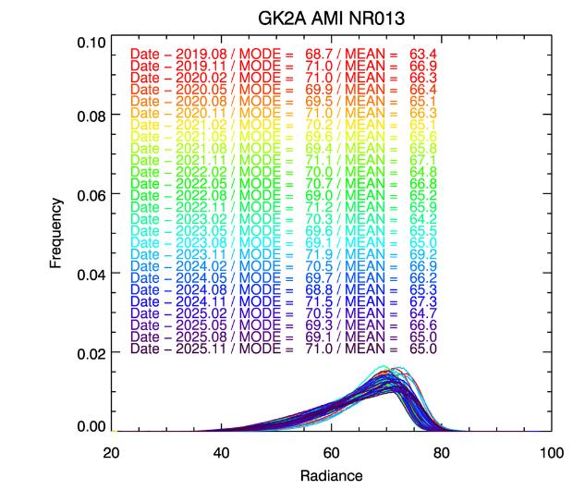
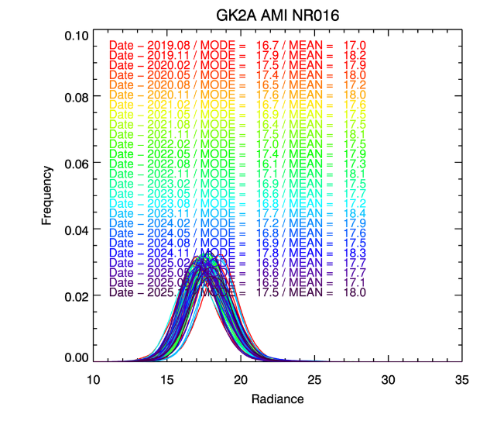
KMA’s Calibration Results (VIS/NIR)
GSICS DCC radiance histogram from Jan. 2020. to Jan. 2025.
Notes:
These figures show the results of GSICS DCC radiance histogram from January 2020 to January 2025.
As a result of the DCC calculation by channel of the AMI, the quality of the sensor is maintained well at present.

Slide 10
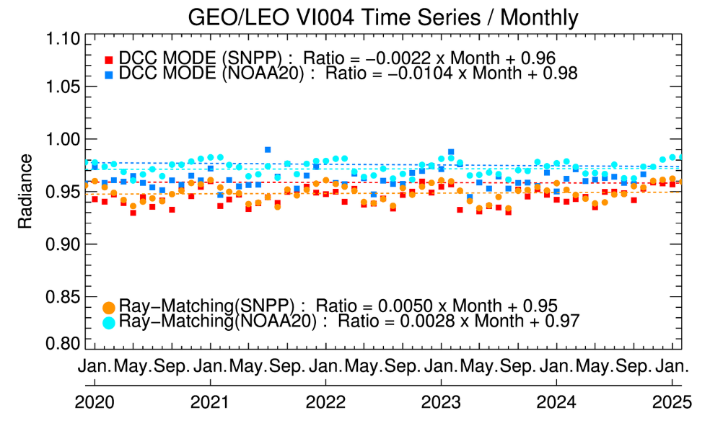
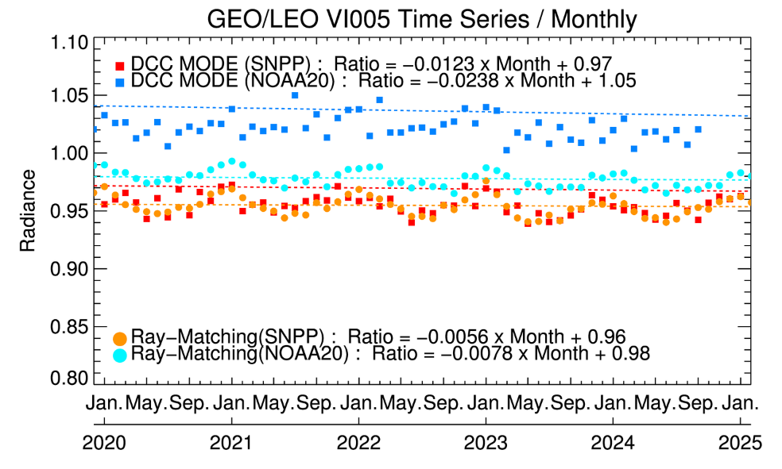
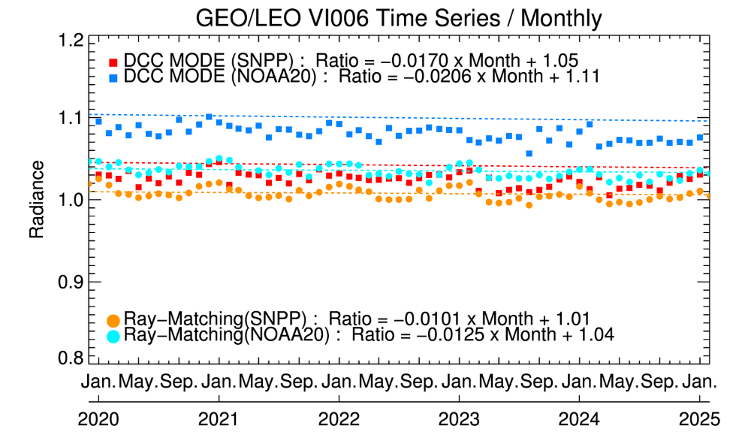
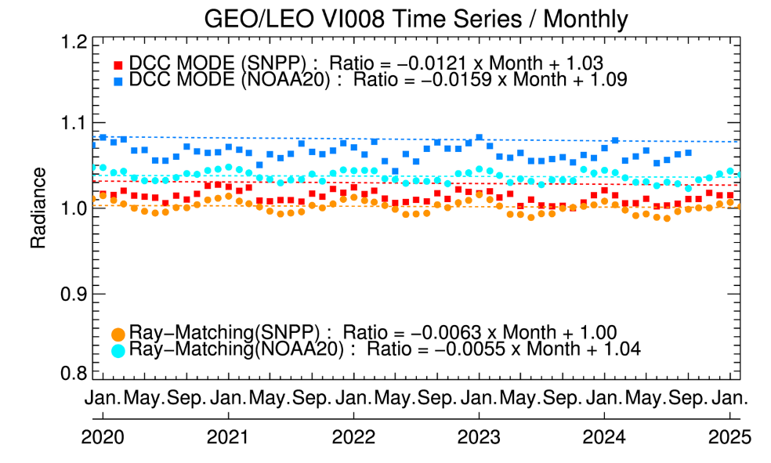
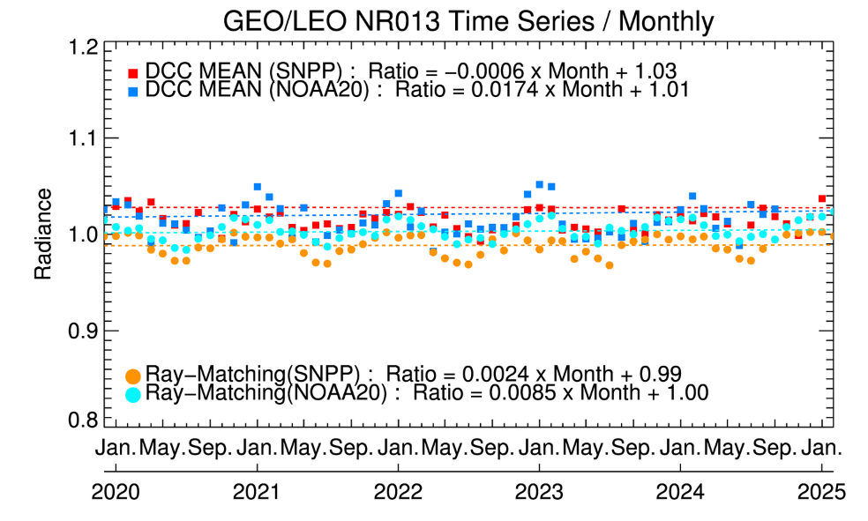
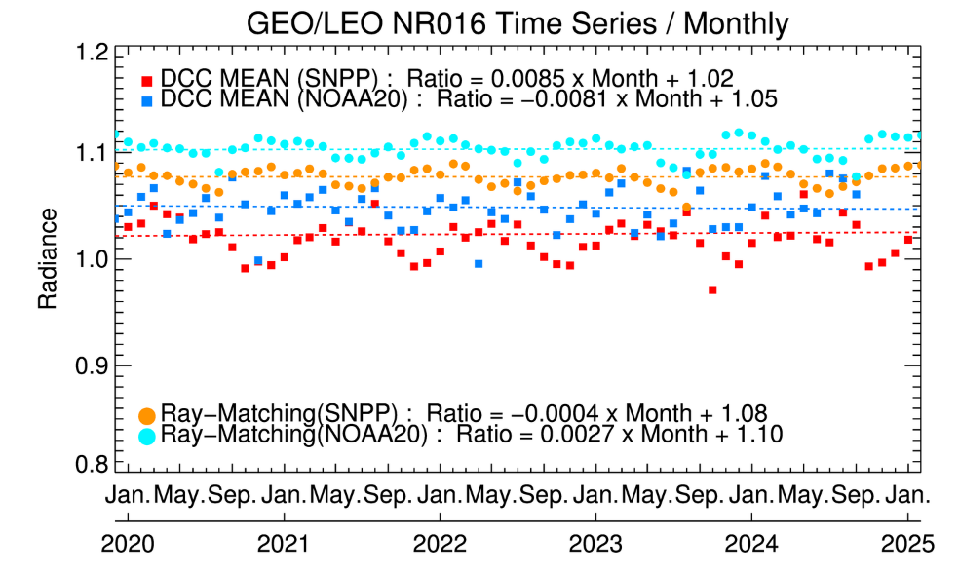
KMA’s Calibration Results (VIS/NIR)
GSICS DCC radiance mode and mean time series(with Ray-Matching) from Jan. 2020. to Jan. 2025
Notes:
The next item is a comparison between DCC and ray matching, and the SNPP and NOAA-20 are used as reference satellites,
the red and blue are DCC and the orange and cyan are the ray matching results.
DCC and ray matiching show a consistent trend for each satellite. However, for NOAA-20 on VI005
and VI006 channels DCC tends to be higher within 5% than ray matching.
In the DCC calculation results, MODE was used as the visible channel due to the characteristics of the channel,
Mean was used for NR013 and NR016, and in the case of NR016, the error was slightly different between DCC and
ray matching compared to othwe channesl, but this was also 5%.
It was calculated as a value within the error range. Therefore, the consistency and accuracy of the quality of the AMI VIS/NIR channel were
confirmed overall.

Slide 11
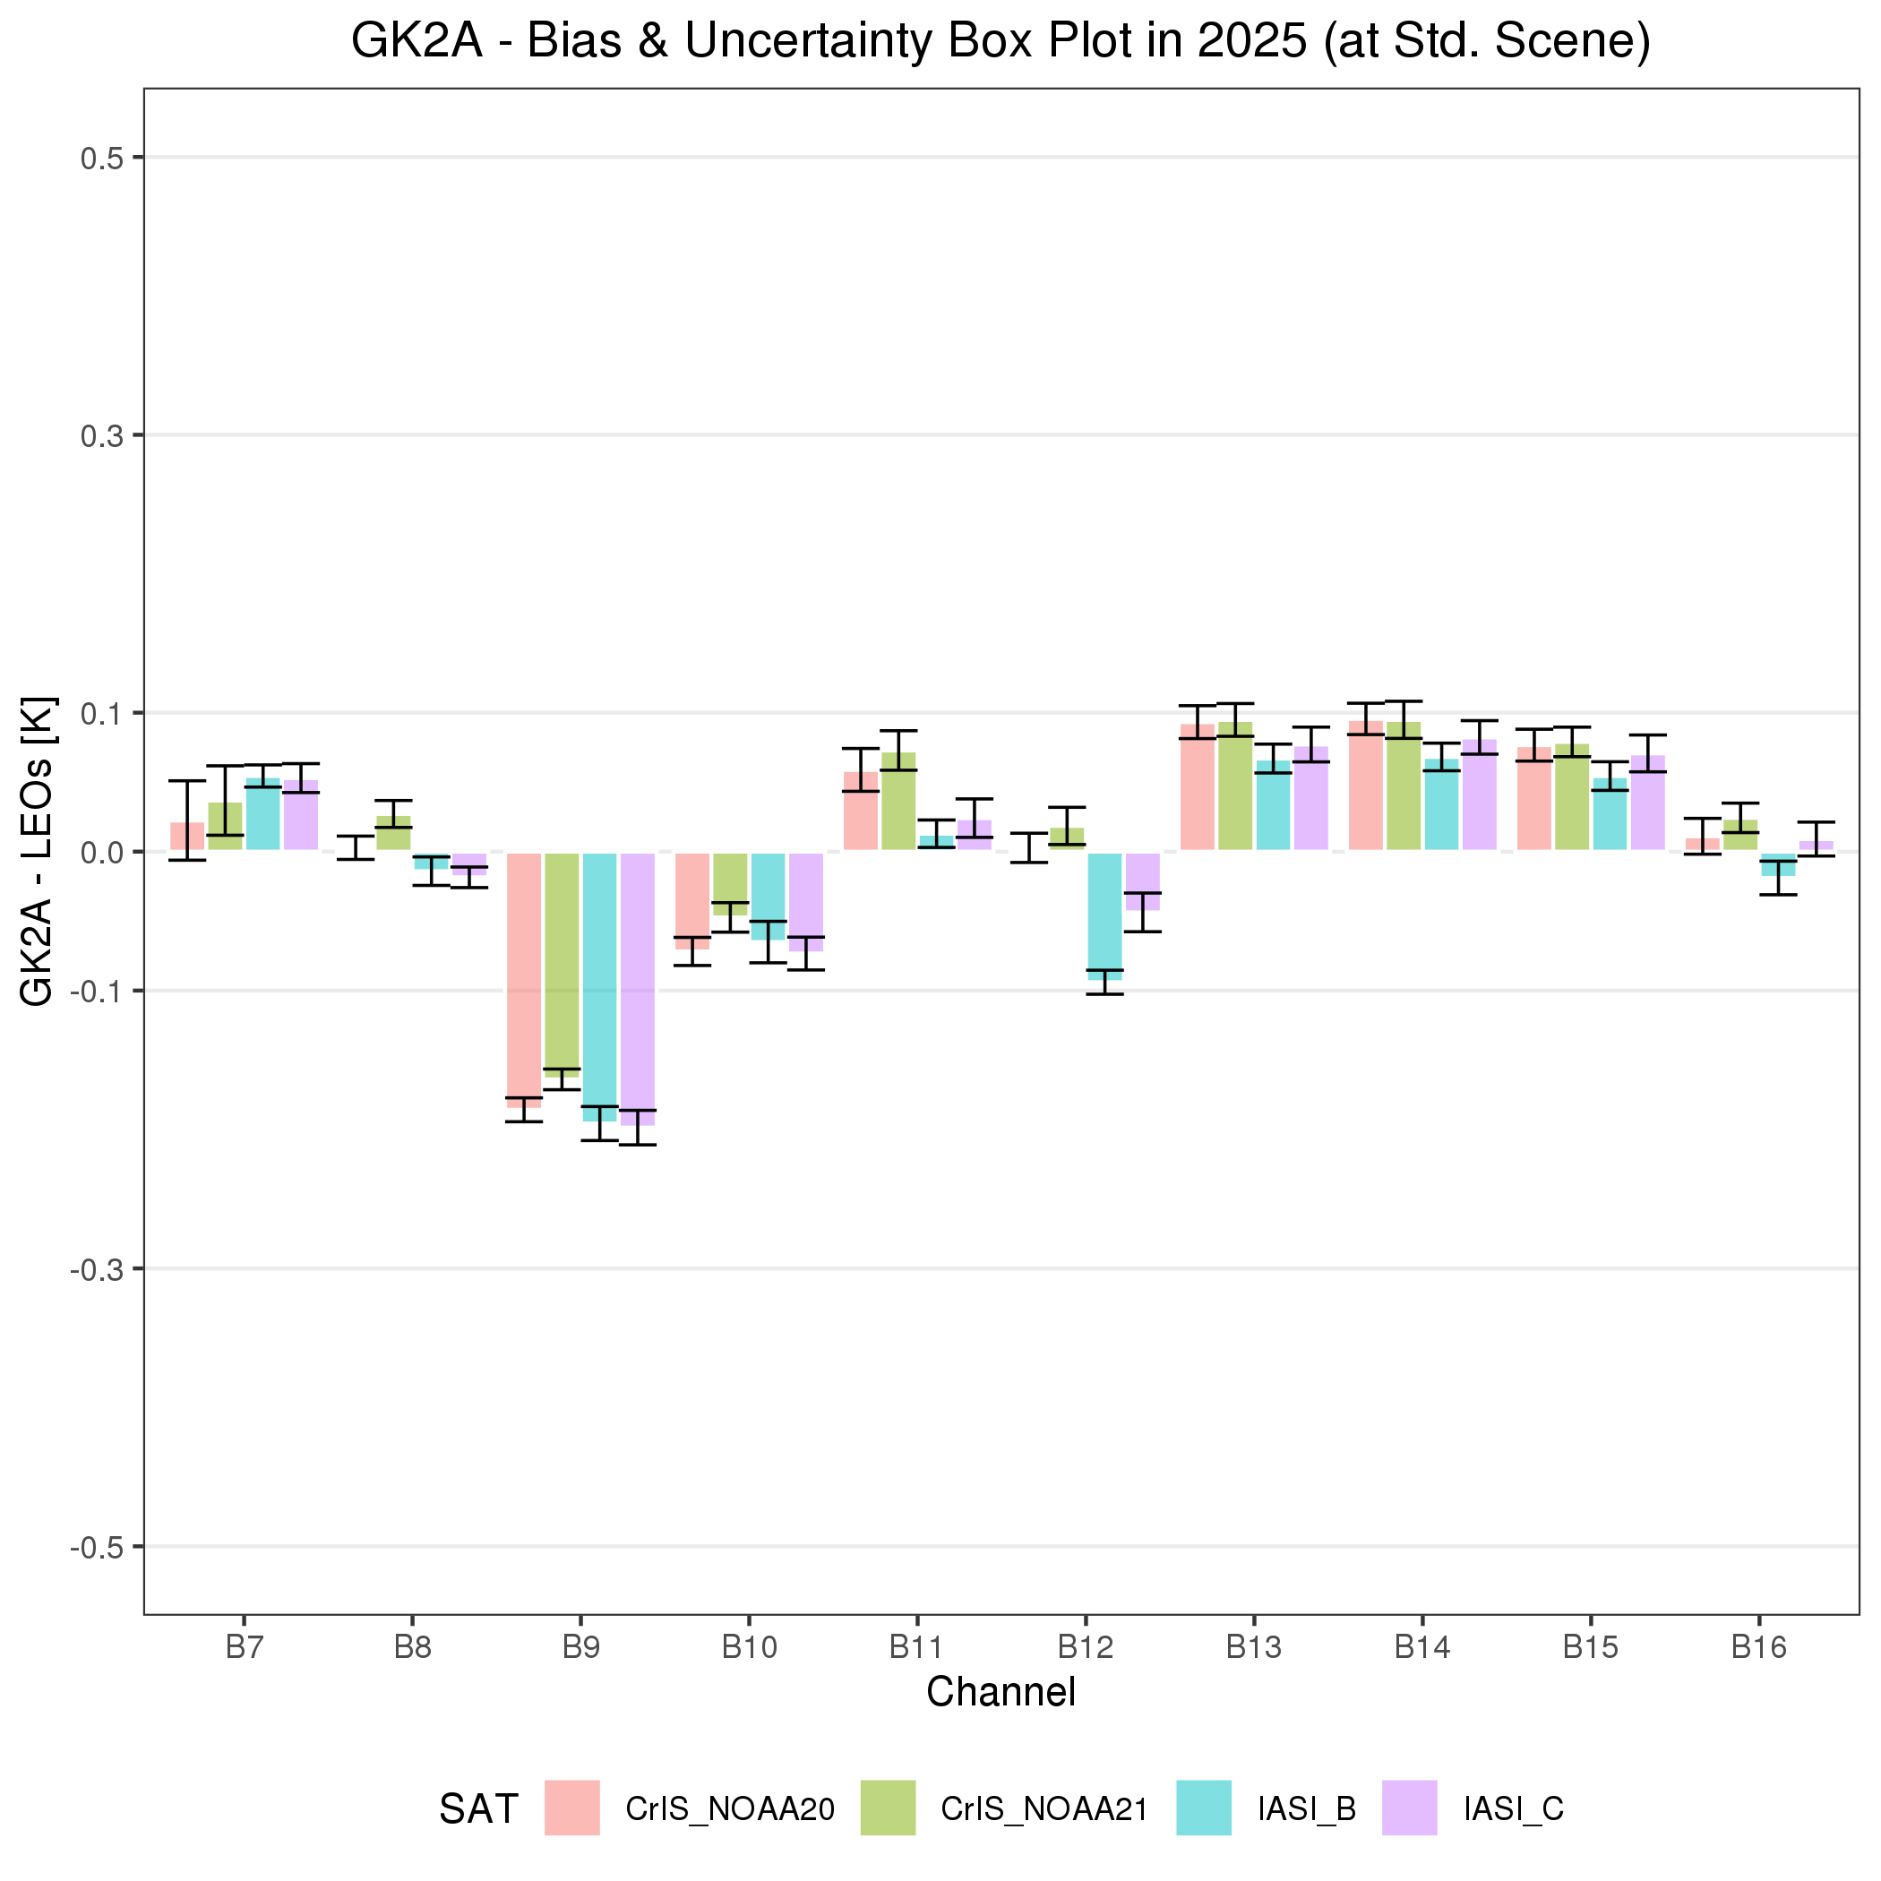
KMA’s Calibration Results (IR)
Statistical Summary of GK2A/AMI IR Calibration Performance in Jan. 1 ~ Dec. 31, 2025
GK2A AMI IR channels are stable
GK2A AMI has relatively large negative bias around -0.2K for 6.9µm, while the other channels are blow ±0.1K
The negative bias in the 6.9µm channel is presumed to be caused by SRF shift
Reference Satellite |  | Bias (Uncertainty)
 |  | SW038 (3.8㎛) | WV063 (6.3㎛) | WV069 (6.9㎛) | WV073 (7.3㎛) | IR087 (8.7㎛) | IR096 (9.6㎛) | IR105 (10.5㎛) | IR112 (11.2㎛) | IR123 (12.3㎛) | IR133 (13.3㎛)
CrIS | NOAA-20 | 0.02 (±0.03) | 0.00 (±0.01) | -0.19 (±0.01) | -0.07 (±0.01) | 0.06 (±0.02) | 0.00 (±0.01) | 0.09 (±0.01) | 0.10 (±0.01) | 0.08 (±0.01) | 0.01 (±0.01)
 | NOAA-21 | 0.04 (±0.02) | 0.03 (±0.01) | -0.16 (±0.01) | -0.05 (±0.01) | 0.07 (±0.01) | 0.02 (±0.01) | 0.09 (±0.01) | 0.09 (±0.01) | 0.08 (±0.01) | 0.02 (±0.01)
IASI | Metop-B | 0.05 (±0.01) | -0.01 (±0.01) | -0.20 (±0.01) | -0.07 (±0.01) | 0.01 (±0.01) | -0.09 (±0.01) | 0.07 (±0.01) | 0.07 (±0.01) | 0.05 (±0.01) | -0.02 (±0.01)
 | Metop-C | 0.05 (±0.01) | -0.02 (±0.01) | -0.20 (±0.01) | -0.07 (±0.01) | 0.02 (±0.01) | -0.04 (±0.01) | 0.08 (±0.01) | 0.08 (±0.01) | 0.07 (±0.01) | 0.01 (±0.01)
Standard Temp.(K) |  | 285.9 | 234.9 | 244.1 | 254.5 | 283.7 | 259.1 | 286.1 | 286.0 | 283.8 | 269.4
Notes:
This figure is the statistical summary for GK2A/AMI IR calibration performance in 2025.
Pink is CrIS-NOAA 20, green is CrIS-NOAA 21, sky is IASI-B, purple is IASI-C.
According to the figure and table, most of the channels in the GK2A IR show a positive error.
The IR133 channel shows the smallest error, indicating that it is the mpst stable channel,
and the WV069 channel shows a close error to -0.2 K and is the channel with the largest error.
Except for the WV069 channel, the rest of the channels show a very stable error within 0.1 K.

Slide 12
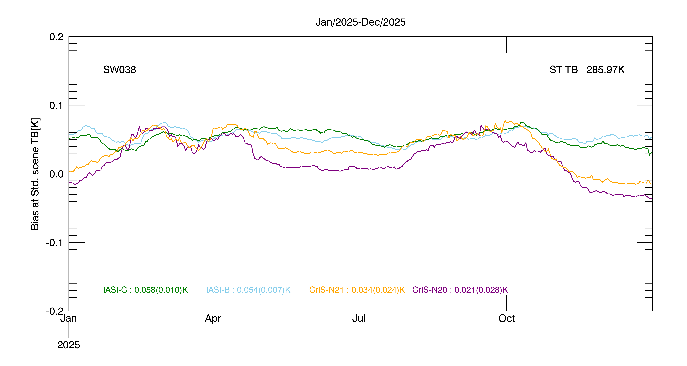
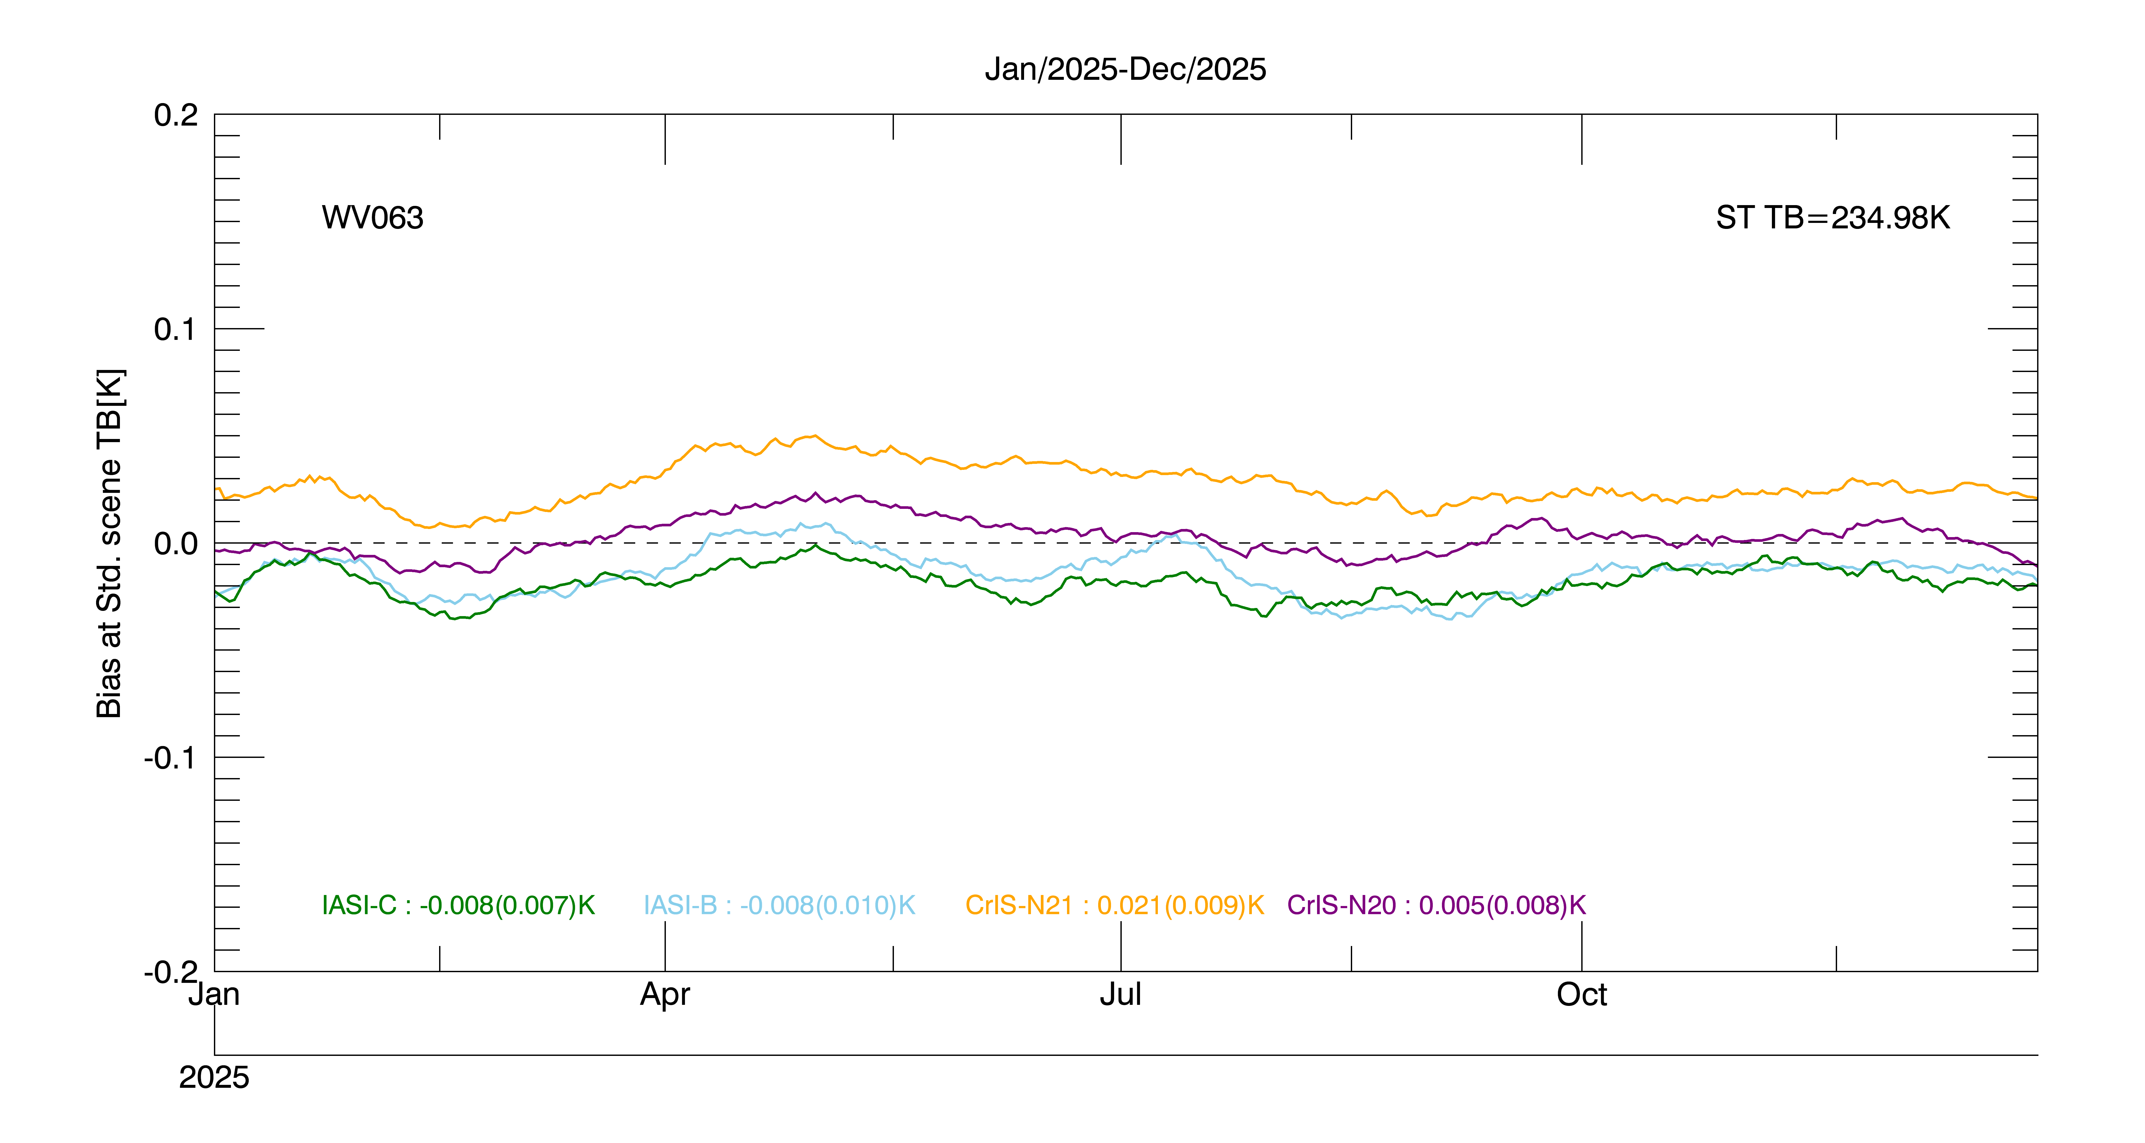
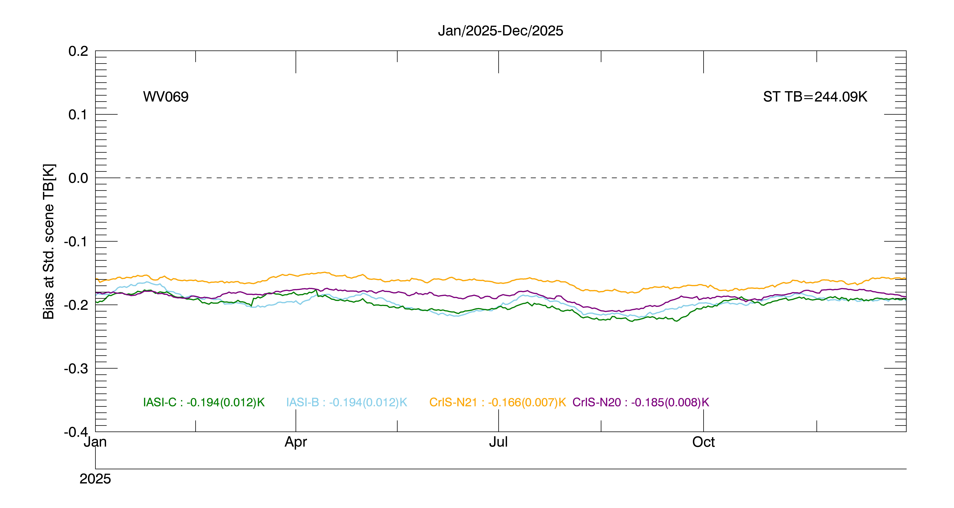
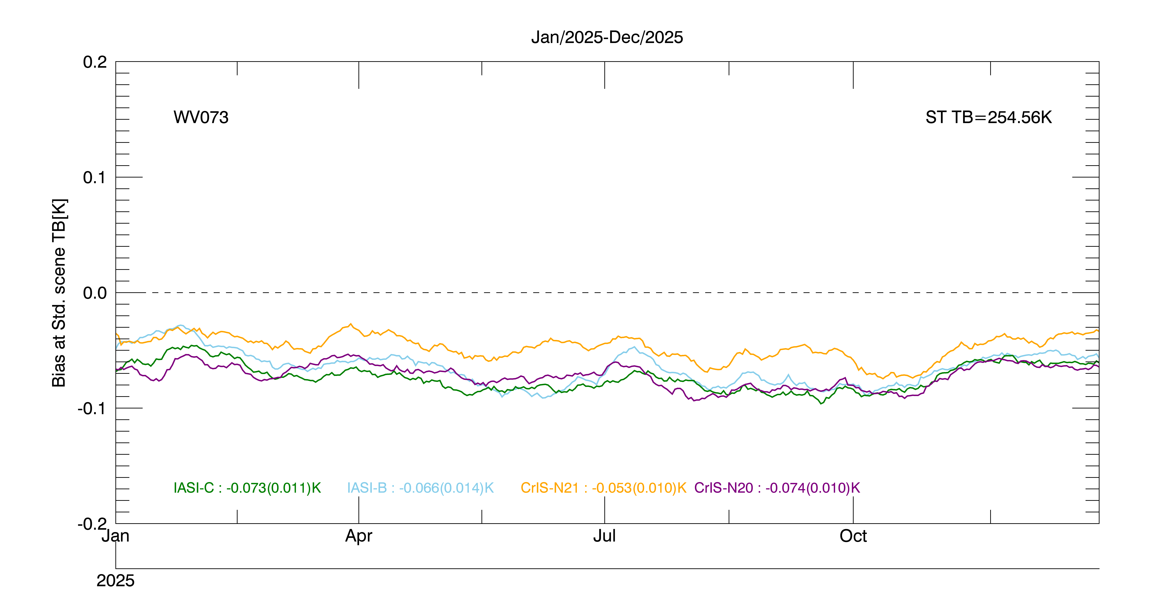
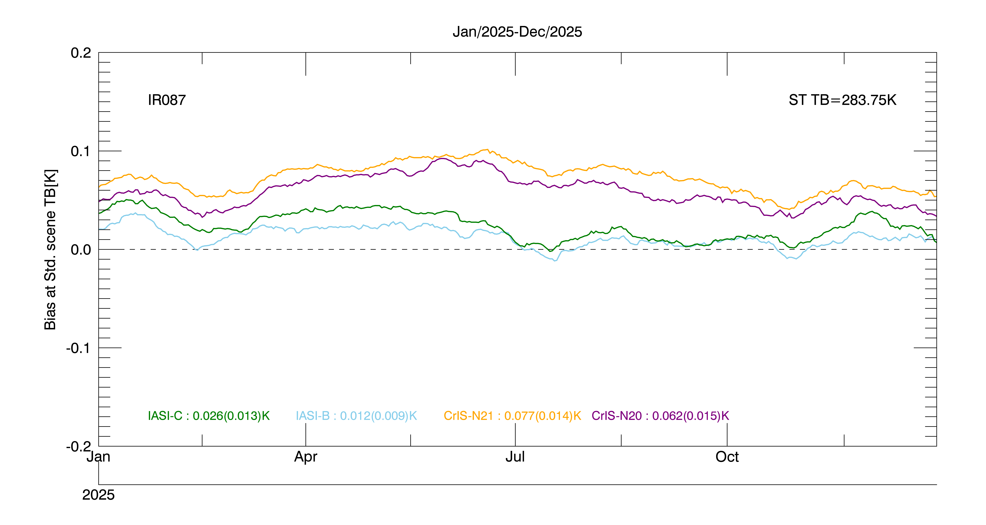
KMA’s Calibration Results (IR) - 1
Notes:
Slide number 12 and 13(nest slide) are the time series showing the IR calibration results in 2025.
The green line is IASI-C, Cyan is IASI-B, Orange is CrIS-N21 and Purple is CrIS-N20.
The difference between IASI and CrIS in the IR087 channel is that the Gap-filling method, which is the spectral reaction function simulation method
applied to CrIS, was used. Similarly, the reason why the results with CrIS on the SW038 channel are seaonal is an error according to the
Gap-filling method applied to the channel. THis error is due to the phenomenon that the bias in the negative direction increases in winter in the process
of simulating the spectrum of CrIS using the IASI spectrum, and this phenomenon is a result of succession to the time series analysis of GK2A.
However, the absolute magnitude of this bias is very small, and all IR channels of GK2A show a constant trend throughout the year
and have very stable test performance.

Slide 13
KMA’s Calibration Results (IR) - 2

