Slide 1
GSICS 2026 Agency Report
ESA
Timon Hummel
European Space Agency

Slide 2
Summary of Agency’s GSICS Actions
Action Id | Summary | Lead | Actual Completion | Status | Proposed Status (to be updated)
A.GDWG.20240312.4 | Paolo Castracane (ESA) to lead discussion with GCC and WMO on possible enhancement of GSICS websites following WGCV Cal/Val Portal as example. | Paolo Castracane | Ongoing | Open | Closed in favor of new GSICS developers’ website
A.GDWG.20240313.4 | Paolo Castracane to coordinate with Manik on reducing overlap of webpage on solar radiance at ESA, NOAA/wiki and LASP. | Paolo Castracane | Ongoing | Open | Closed in favor of new GSICS developers’ website
No assigned actions from 2025 annual meeting.

Slide 3
ESA Contributions to GSICS 2026
ESA’s contribution to GSICS Annual meeting 2026
ID | Presentation | Presenter |  | Session | Date/Time
9g | ESA Agency Report | Timon Hummel (ESA) | In Person | Agency Reports | 26.03 PM
7a,7h,7k,10a |  | Paolo Castracane (Starion for ESA) | In Person | GDWG and Cross-cutting | 26.03 AM and 27.03 AM
3c | Copernicus Sentinel-2 calibration and inter-calibration activities | Rosalinda Morrone (CS Group for ESA) | Remote | VIS/NIR | 24.03 AM
3e | Overview of Sentinel-3 vicarious and lunar calibration results | Silvia Scifoni (Serco for ESA) | Remote | VIS/NIR | 24.03 AM
3b | Harmonization of SPOT-VGT1, SPOT-VGT2, and PROBA-V time series, including per-pixel uncertainty: status of the FDR4VGT project | Sindy Sterckx (VITO) | Remote | VIS/NIR | 24.03 AM
3j | Current status of the LIME | Carlos Toledano (University of Valladolid) | In Person | Lunar | 24.03 AM
5k | An overview of the current TIRCalNet Status | Steffen Dransfeld (ESA) | Remote | IR | 26.03 AM
6a | 8 years TROPOMI: Long-term instrument degradation: derivation, validation and lessons learned | Erwin Loots (KNMI) | Remote | UVN-S | 24.03 PM
8a | Exploring Space Weather Monitoring Capabilities of ESA's Swarm and SMOS Missions | Lorenzo Trenchi (Serco for ESA) | Remote | Space Weather | 26.03 AM

Slide 4

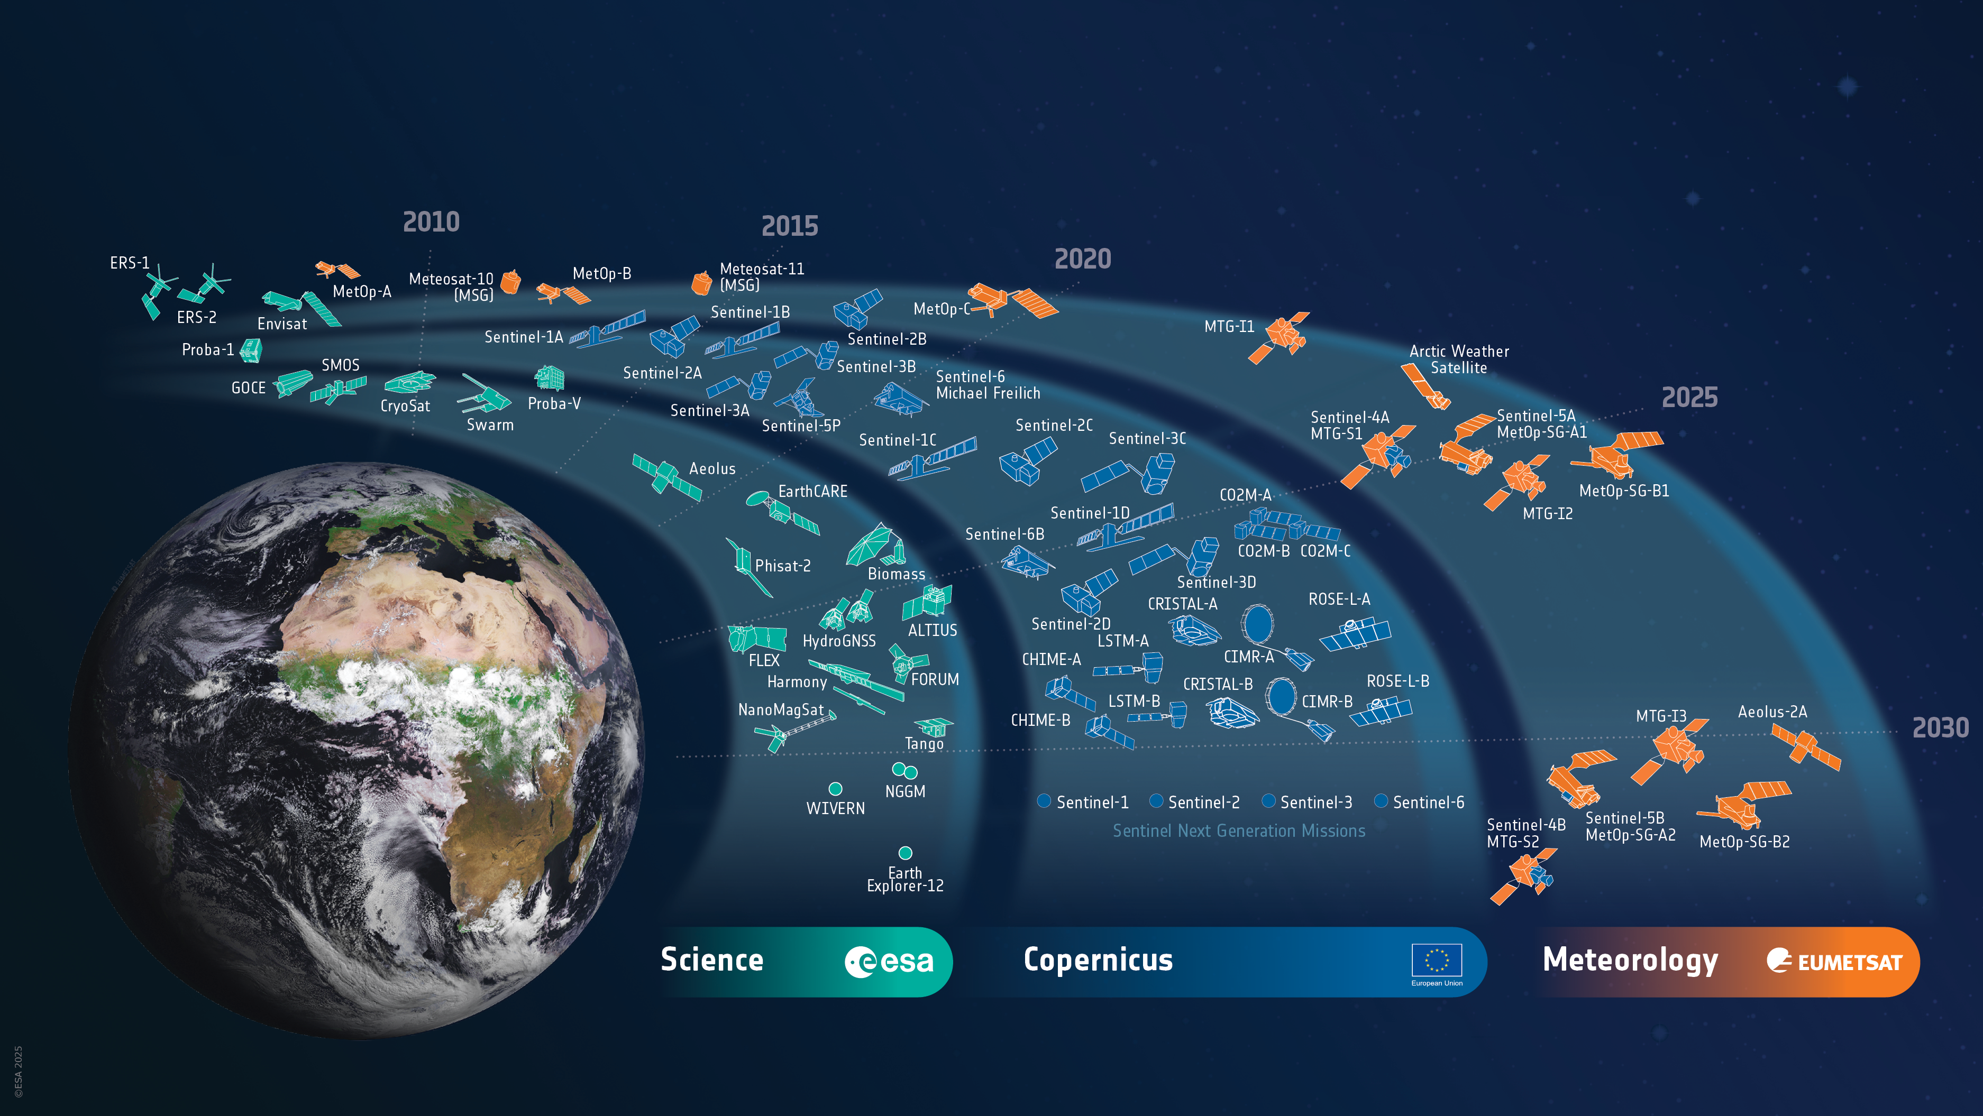

ESA’s EO Missions
Satellites: Heritage 08 / Operational 24 / Developing 38 / Preparing 39 / Total 109
World-class Earth Observation systems developed with European and global partners to address scientific & societal challenges
4
Notes:
OPERATIONAL
15 Missions (24 satellites)
Earth Expl.+ (7M/10S)
1 SMOS
1 CryoSat
3 Swarm
1 EarthCARE
1 Biomass
2 Scout-2 (HydroGNSS)
1 PhiSat-2
Earth Watch (1M/1S)
1 Arctic Weather Satellite
Sentinels (7M/13S)
3 Sentinel-1 (S1A/1C/1D)
3 Sentinel-2 (S2A/2B/2C)
2 Sentinel-3 (S3A/3B)
1 Sentinel-4 (S4A)
1 Sentinel-5 (S5A)
1 Sentinel-5P
2 Sentinel-6 (S6A/B)
Met Missions (5M/9S) (EUMETSAT managed so not counted in total)
3 Meteosat SG (#9-11)
1 Meteosat TG-I (MTG-I1)
1 Meteosat TG-S (MTG-S1)
3 MetOp (A/B/C)
1 MetOp SG (A1)
IN DEVELOPMENT
22 Missions (38 satellites)
Earth Expl.+ (6M/10S)
1 Flex
1 Forum
2 Harmony
1 WIVERN
3 Scout-3 (NanoMagSat)
2 Scout-4 (TANGO)
MoO (1M/2S)
2 NGGM
Earth Watch (1M/1S)
0 TRUTHS
1 ALTIUS
Sentinels (10M/19S)
0 Sentinel-1
1 Sentinel-2 (S2D)
2 Sentinel-3 (S3C/3D)
1 Sentinel-4 (S4B)
2 Sentinel-5 (S5B/5C)
0 Sentinel-6 ()
3 CO2M (A/B/C)
2 CRISTAL (A/B)
2 CIMR (A/B)
2 LSTM (A/B)
2 CHIME (A/B)
2 ROSE-L (A/B)
Met Missions (4M/6S)
1 Aeolus-2
3 Meteosat TG-I (MTG-I2/3/4)
1 Meteosat TG-S (MTG-S2)
1 MetOp SG (B1)
IN PREPARATION
14 Missions (39 satellites)
Earth Expl.+ (8M/8S)
4 EE12 (CryoRad , ECO, Hydroterra+, Keystone)
4 Scout 2nd cycle (HiBiDiS, NAIAD, SIRIUS, Sova-S)
Sentinels (5M/10S)
2 Sentinel-1 NG
(S-1NG A/B)
2 Sentinel-2 NG
(S-2NG A/B)
2 Sentinel-3 NG OPT
(S-3NGO A/B)
2 Sentinel-3 NG TOPO
(S-3NGT A/B)
0 Sentinel-6 (S6C)
2 Sentinel-6 NG
(S-6NG A/B)
Met Missions (1M/20S)
20 EPS-Sterna

Slide 5
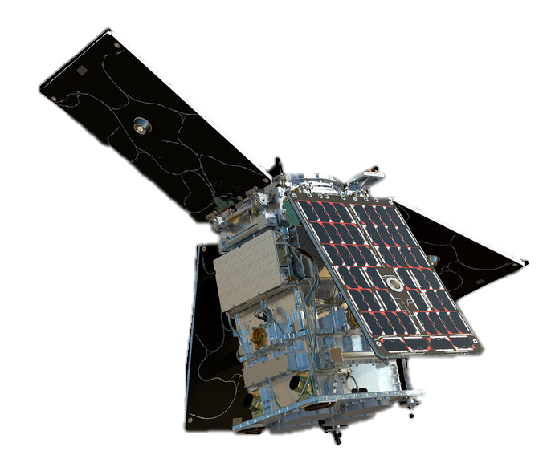
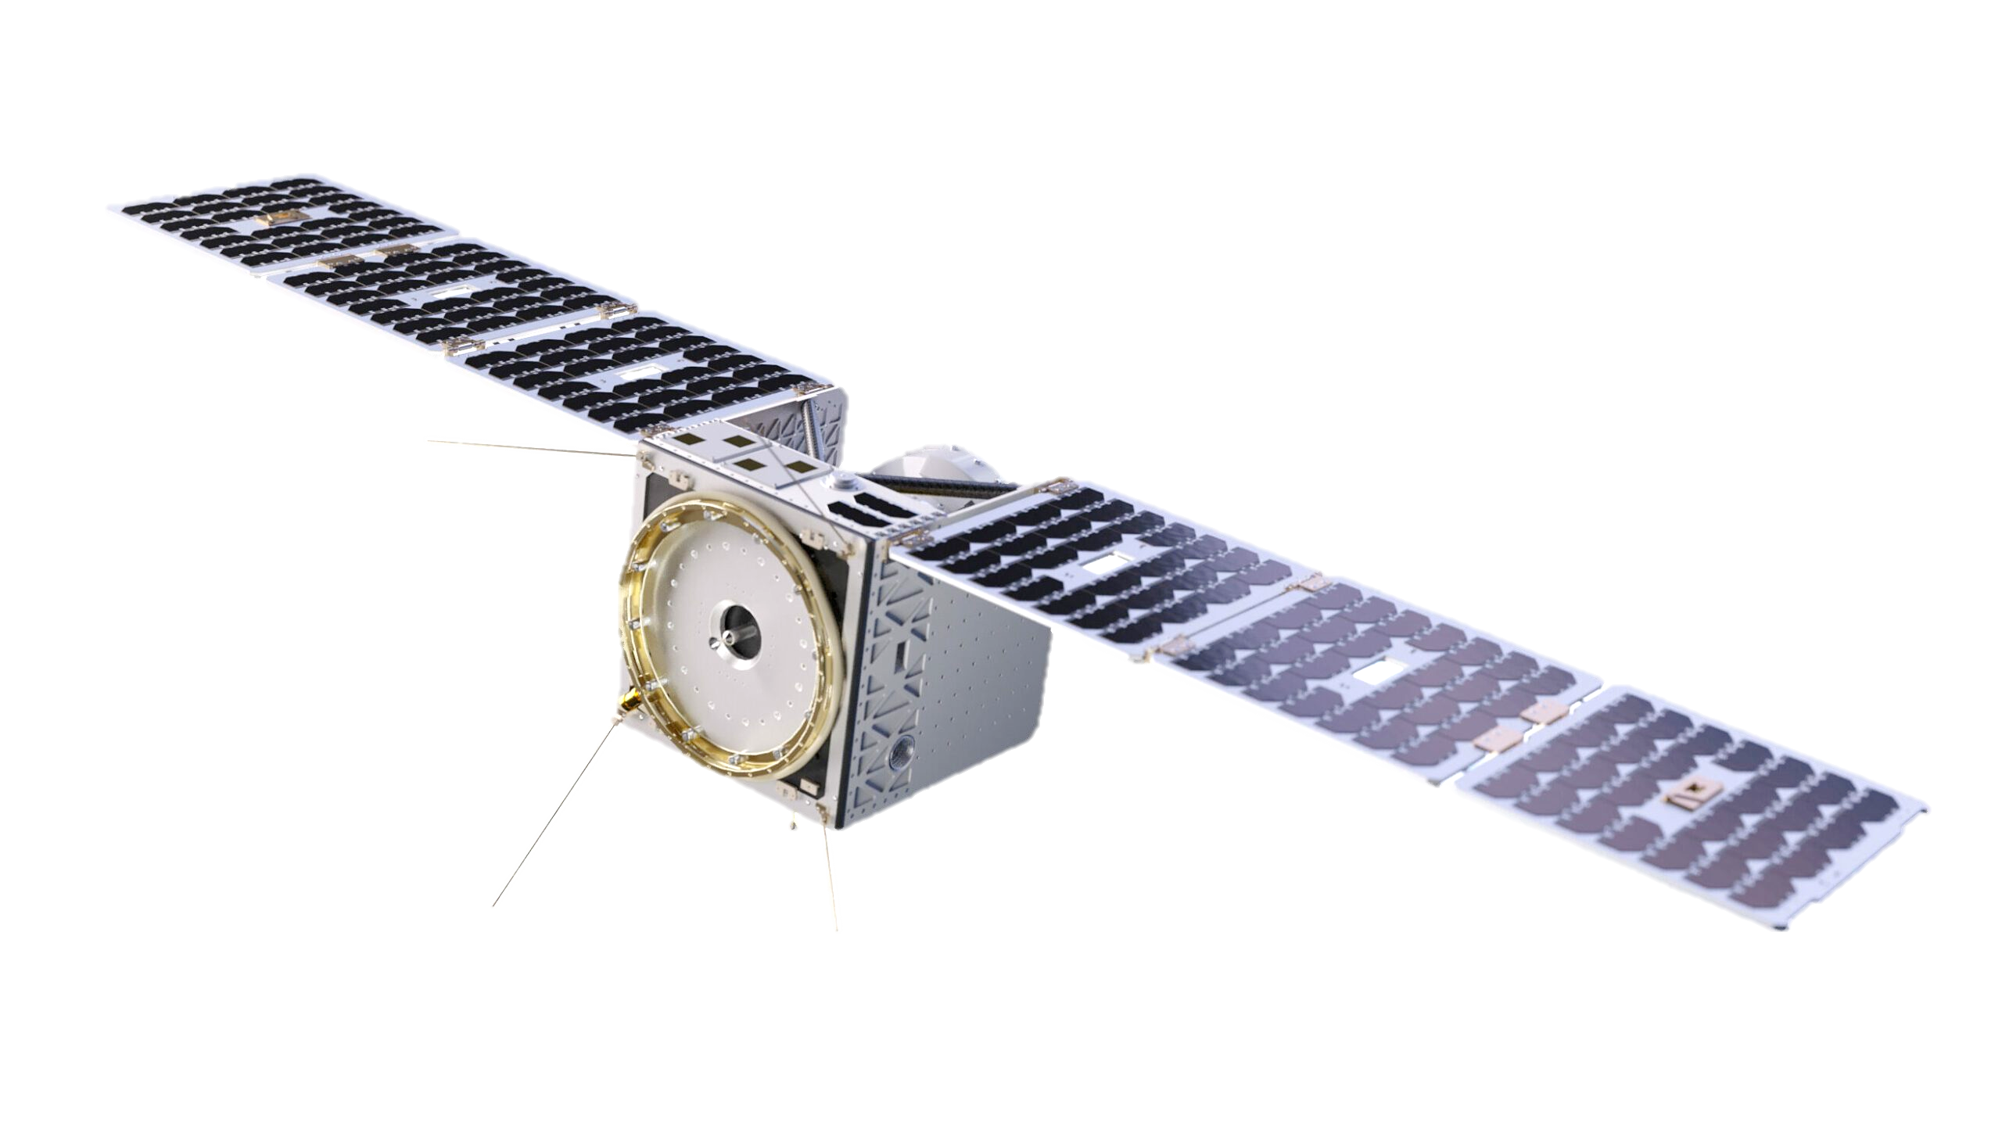
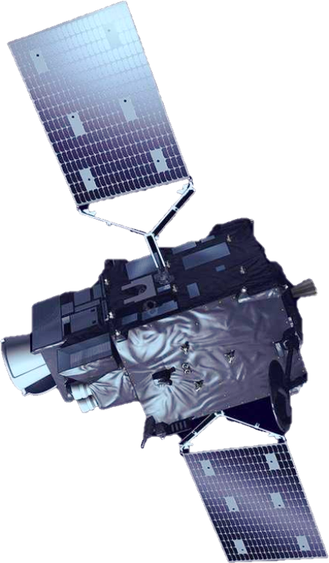
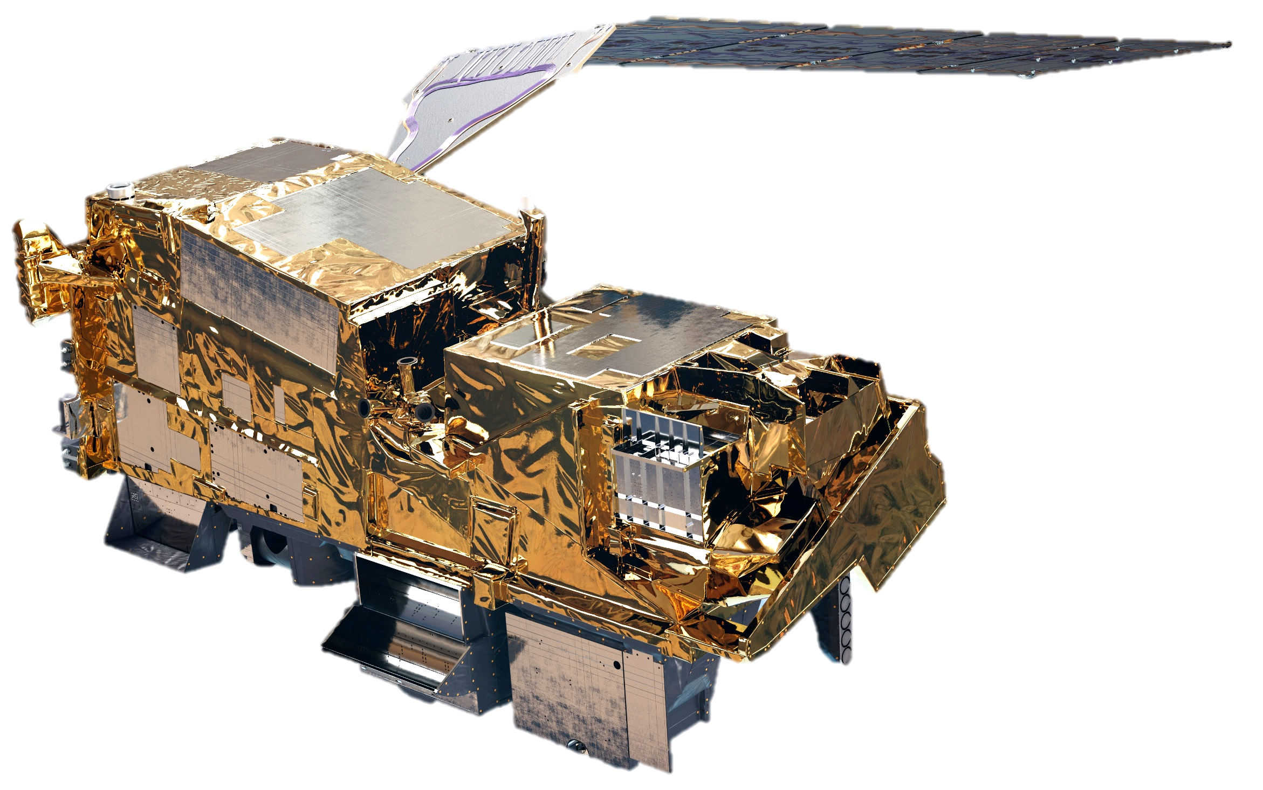
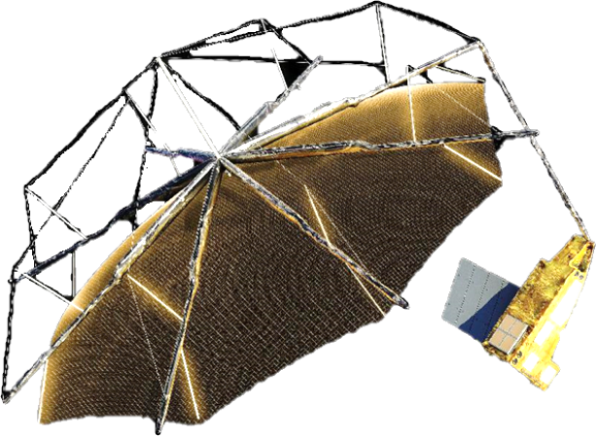
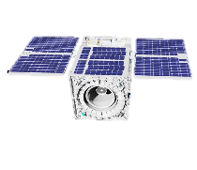
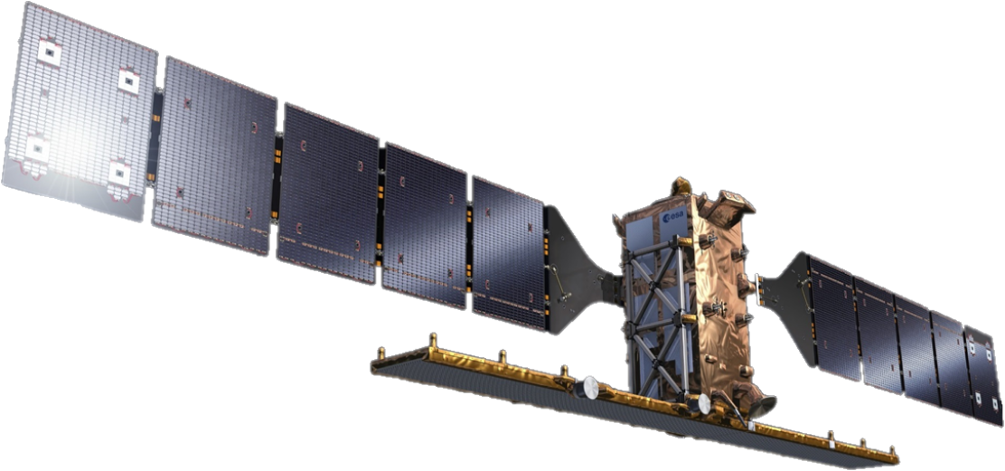
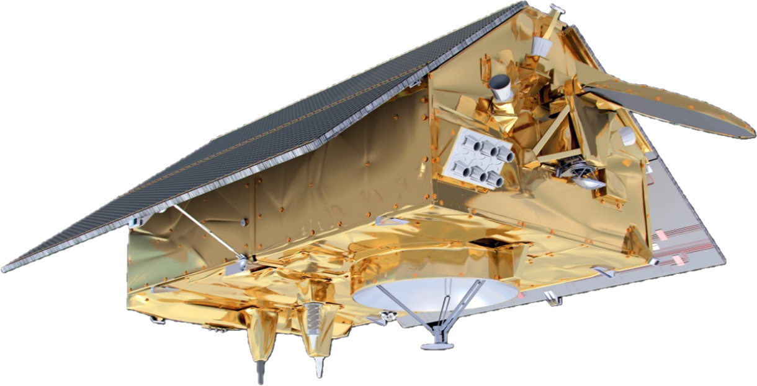
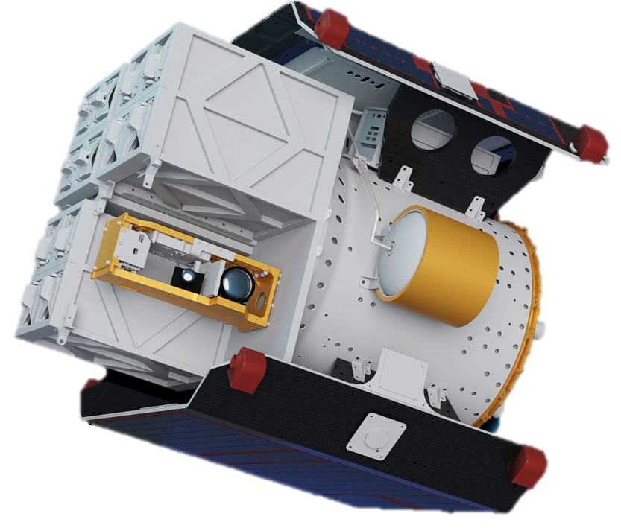
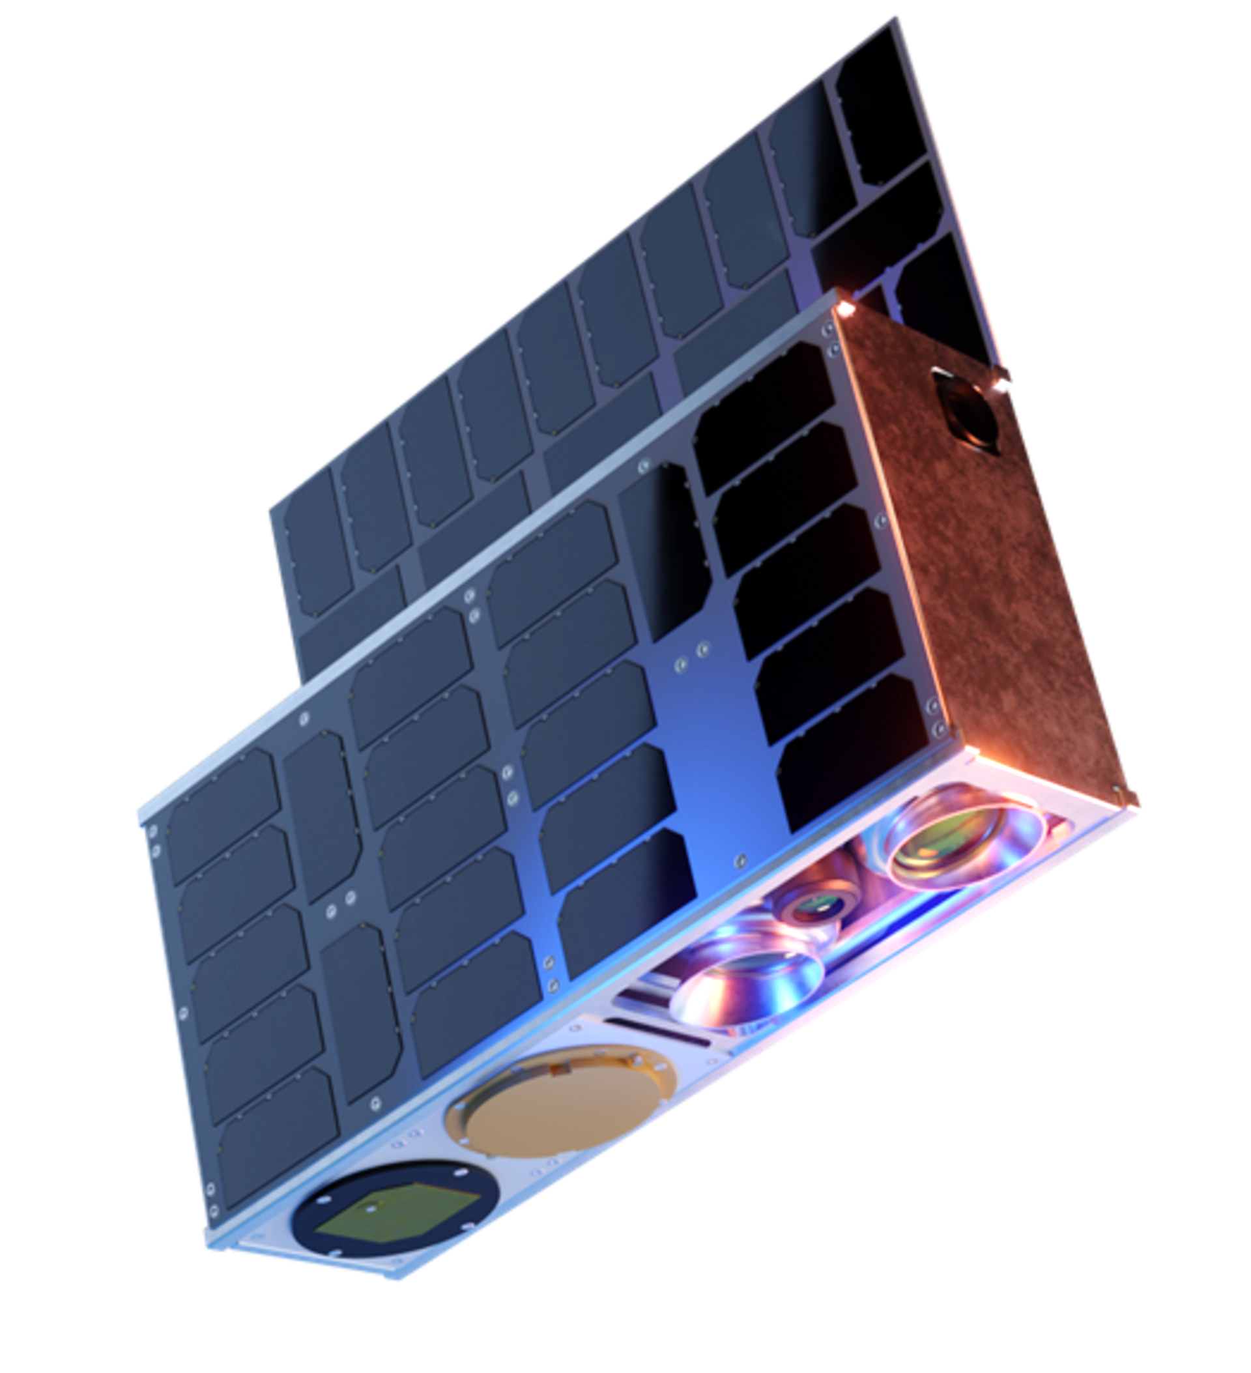
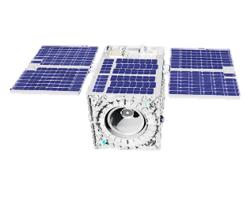
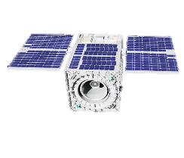
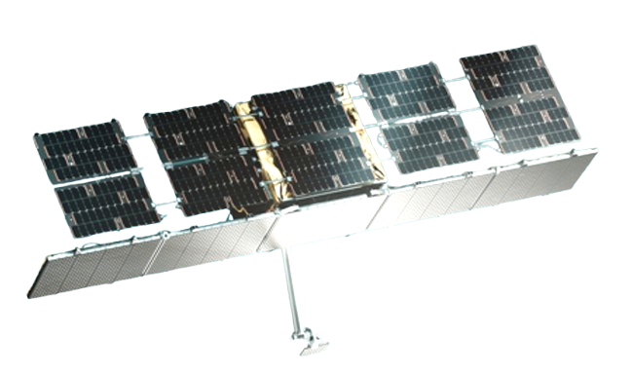
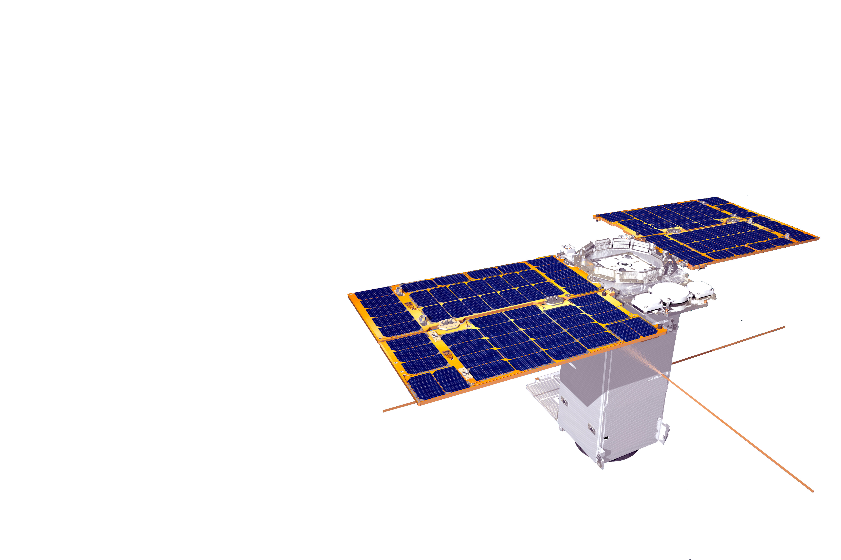
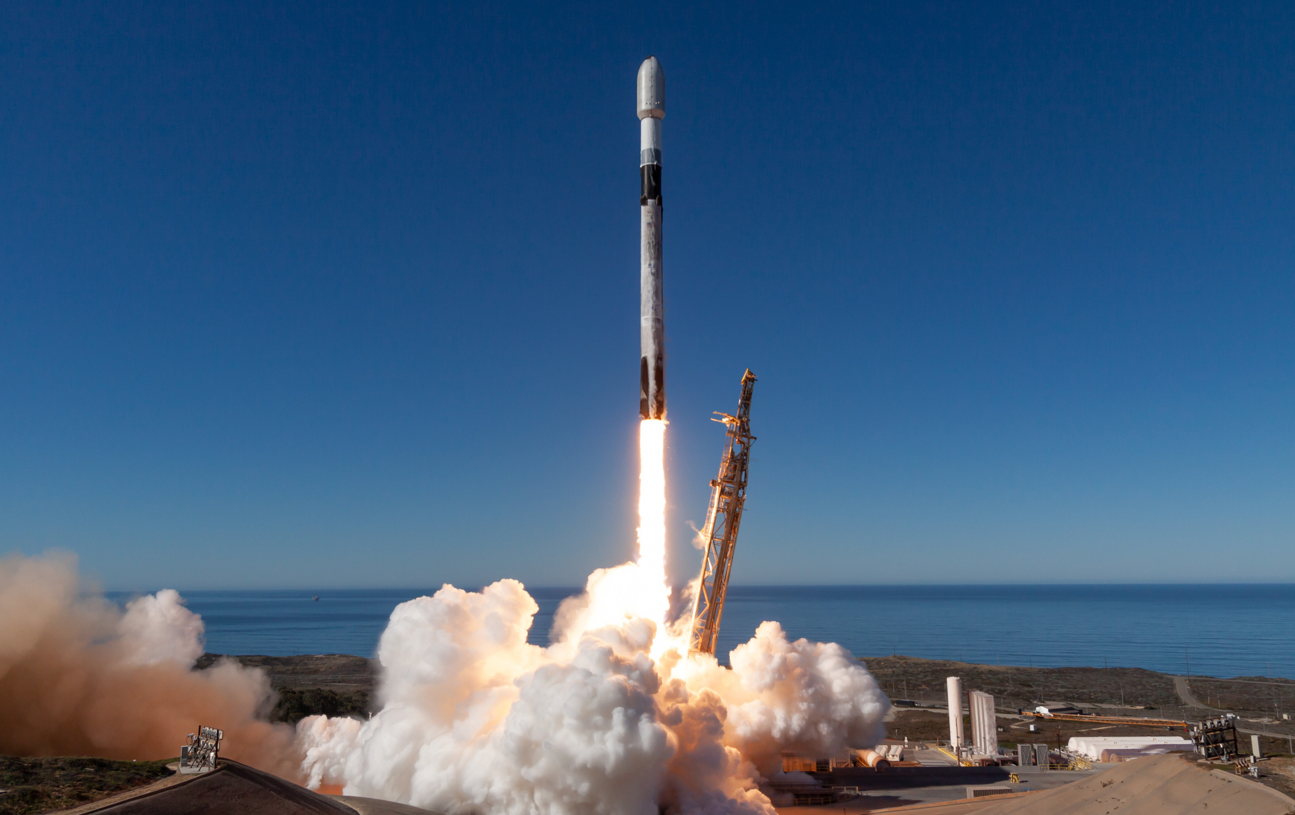
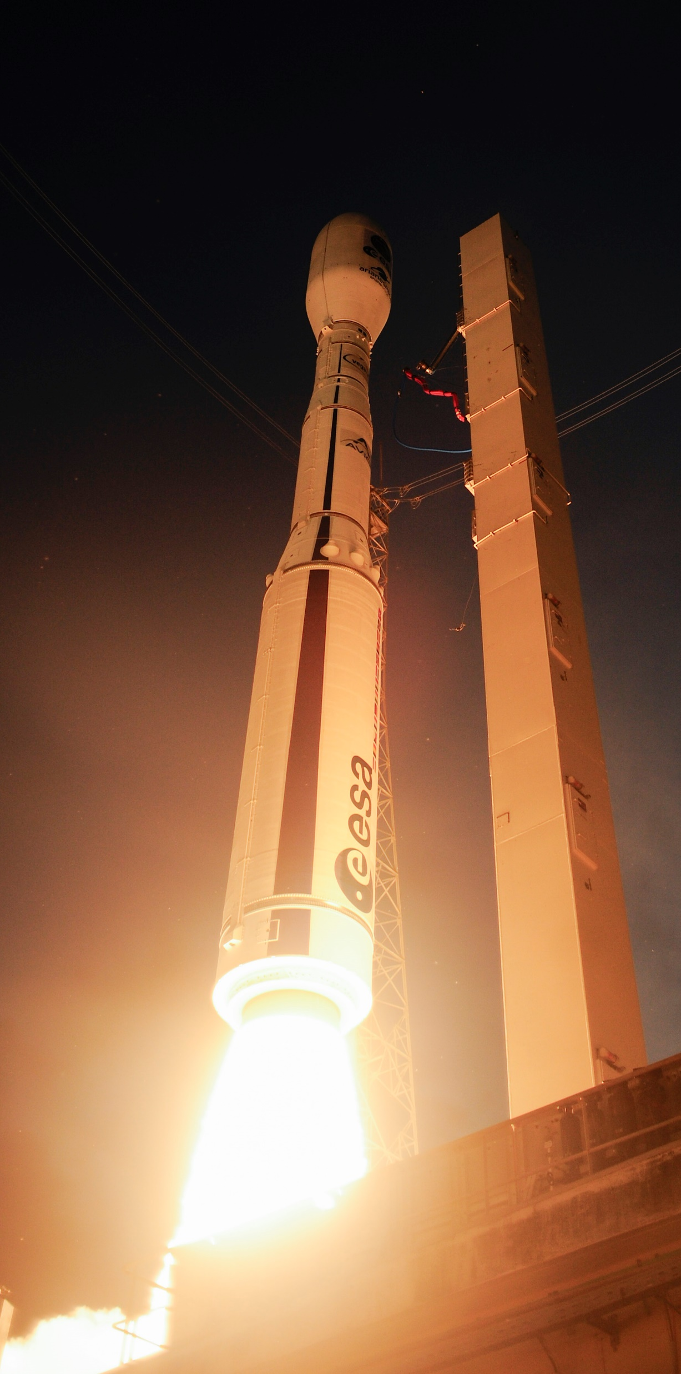
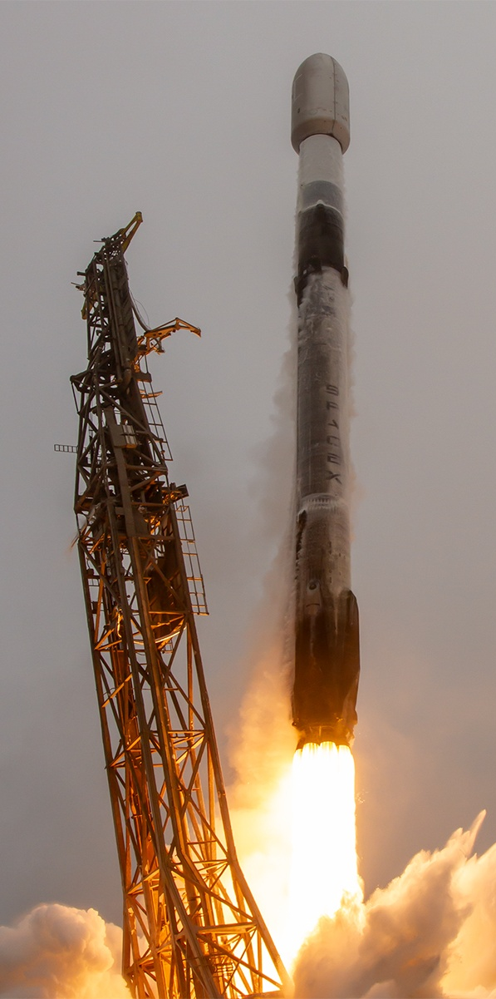
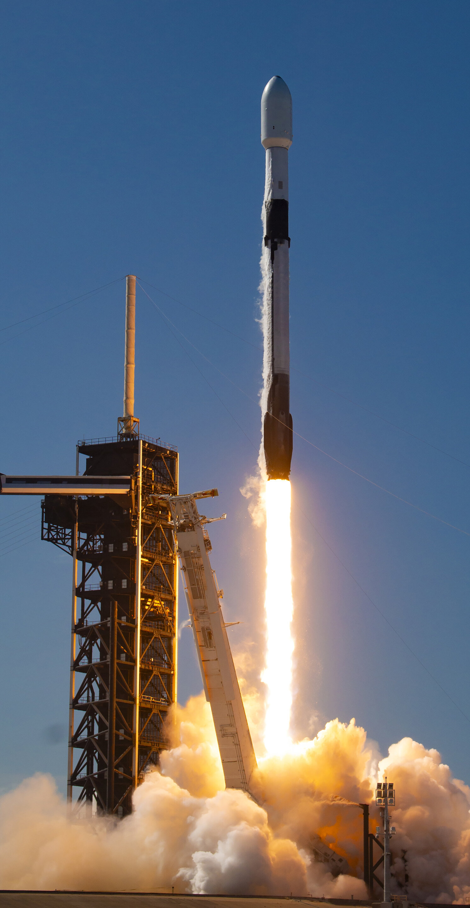
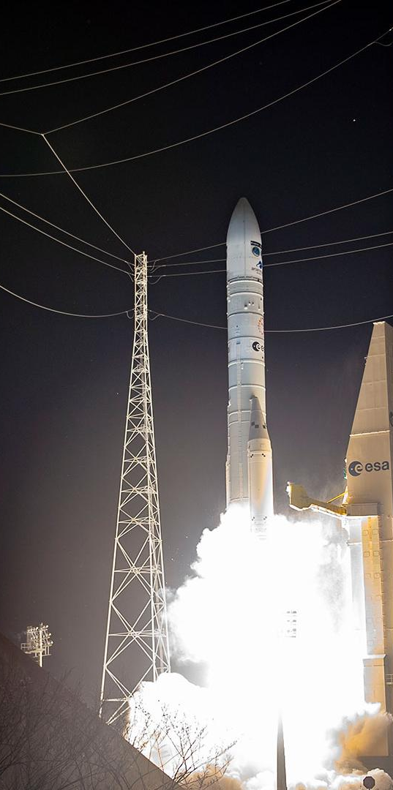
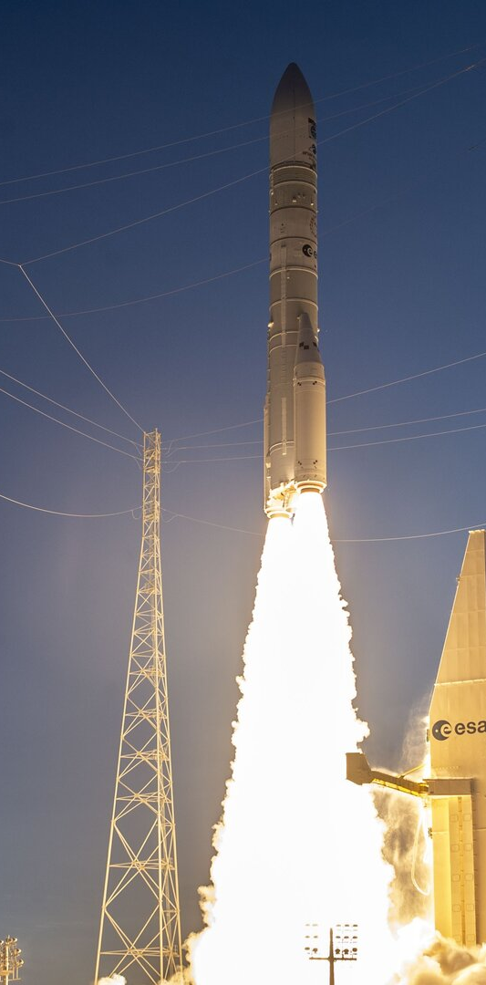
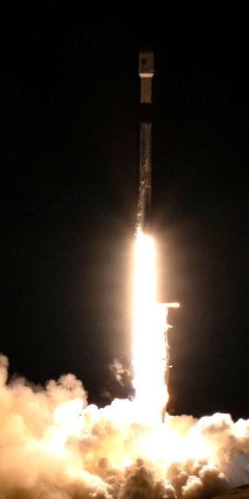
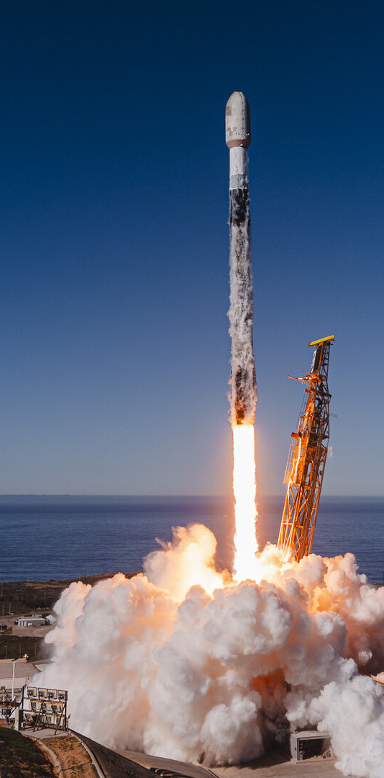
2025 - A Year of Successful Launches
AIX, Hive, Forest-3 (InCubed supported)
+ HEO Pathfinder (Iride precursor)
15 January
Biomass
29 April
7 HEO
(IRIDE first constellation)
23 June
MTG-S1
incl. Sentinel-4
1 July
MetOp-SG A1 incl. Sentinel-5
12 August
Sentinel-1D
4 November
Sentinel-6B
17 November
2 HydroGNSS (Scout)
+ 8 Eaglet (IRIDE)
+ 2 Iceye (GR nat. pr.)
+ IPERLITE (BELSPO)
28 November
5

Slide 6


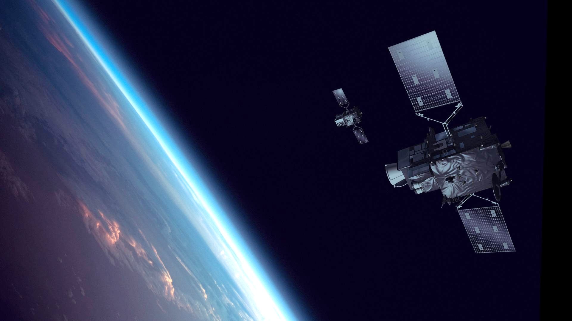
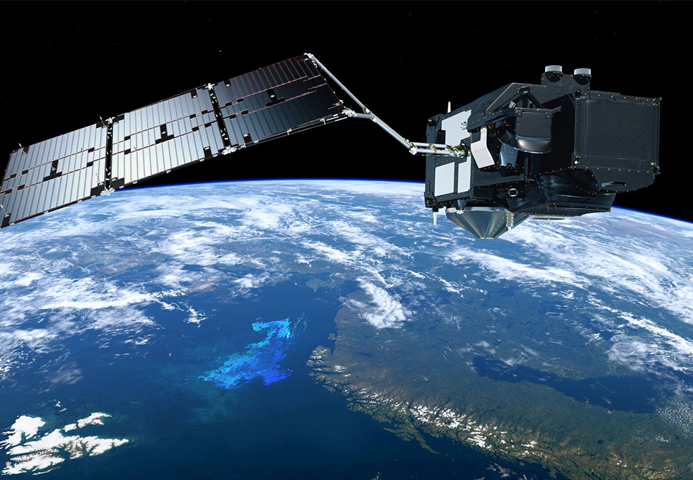

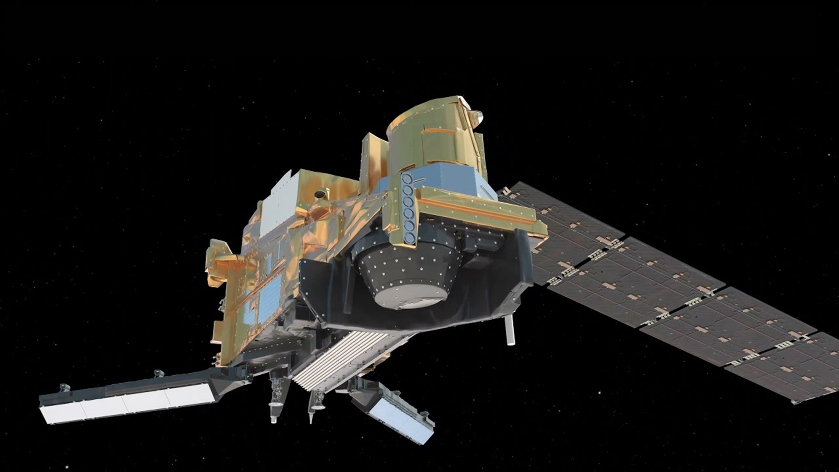
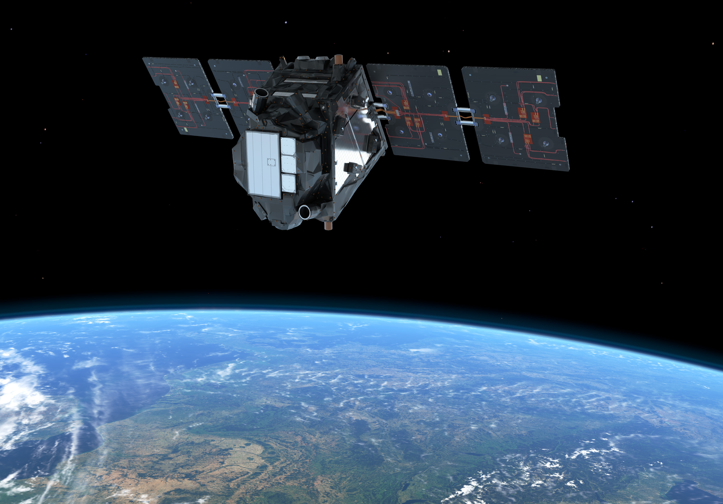
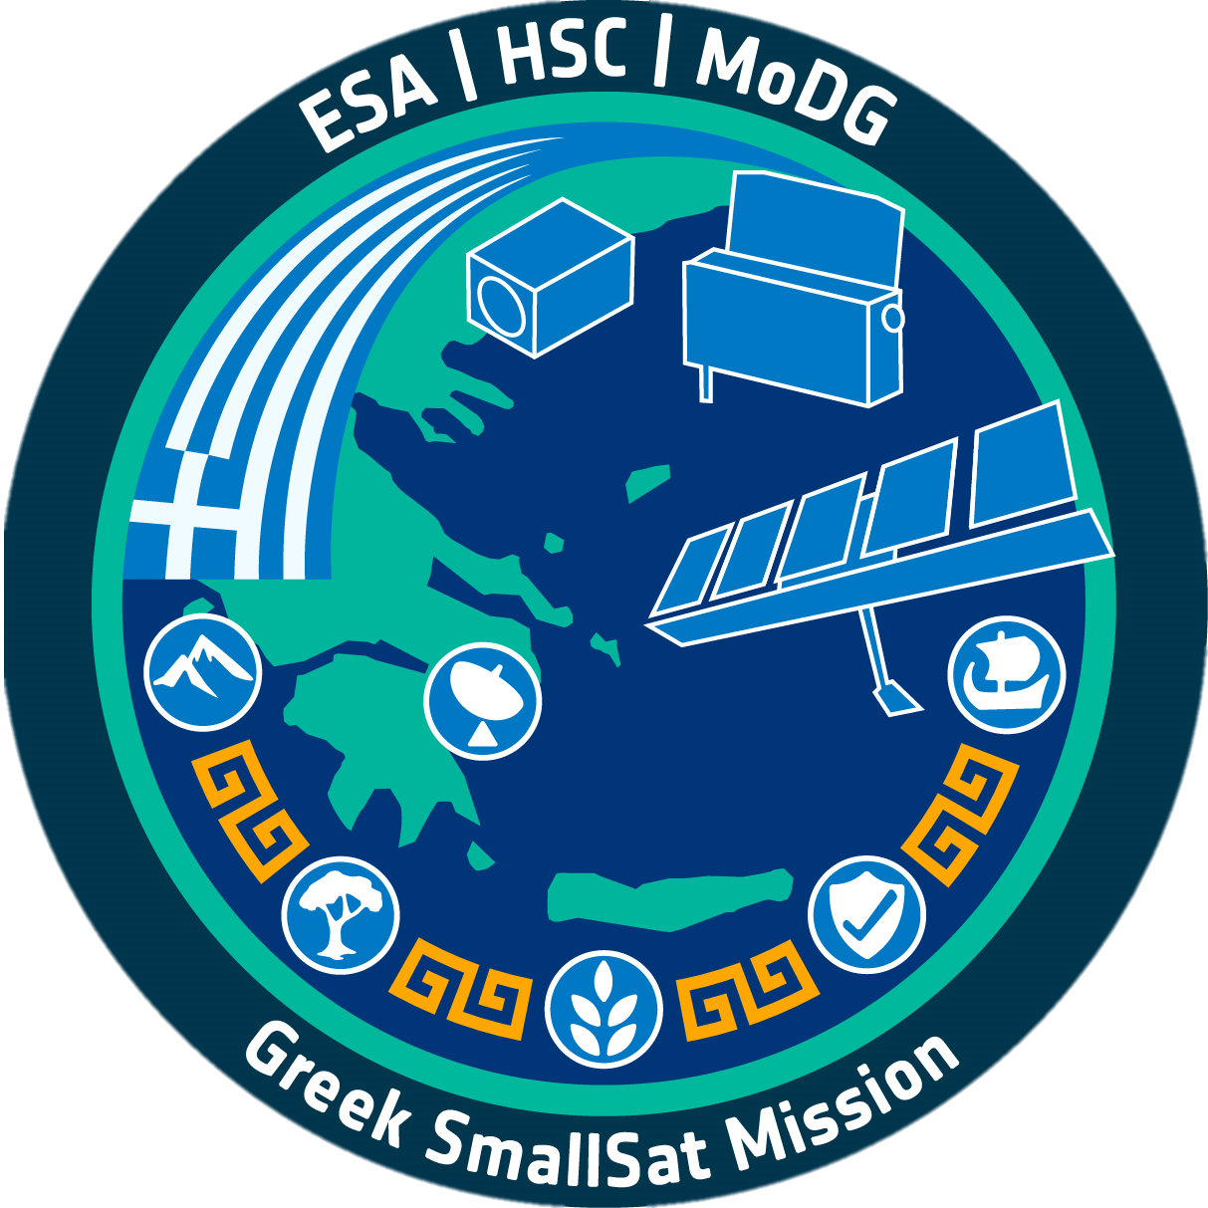
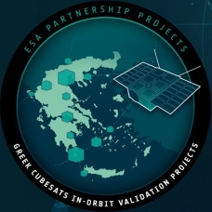
Planned Launches in 2026
Four planned launch campaigns
National missions
IRIDE
32 Satellites
MTG-I2 (Q3)
Sentinel-3C (Q3)
GNEO
11 Satellites
MetOp-SG B1 (Q4)
FLEX (Q3)
6

Slide 7
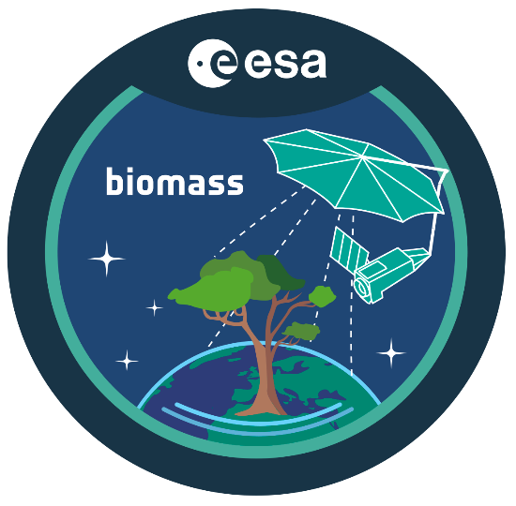
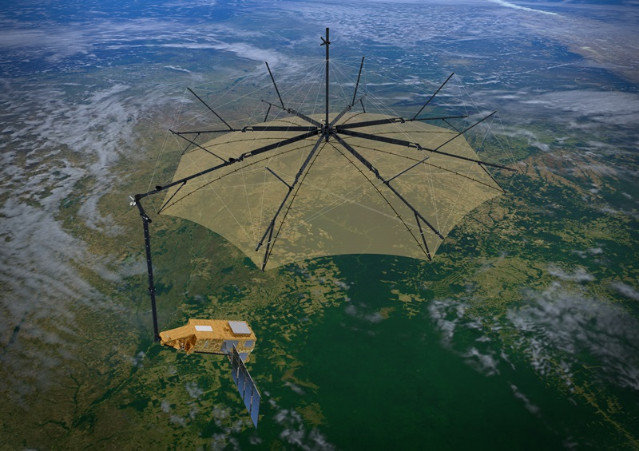
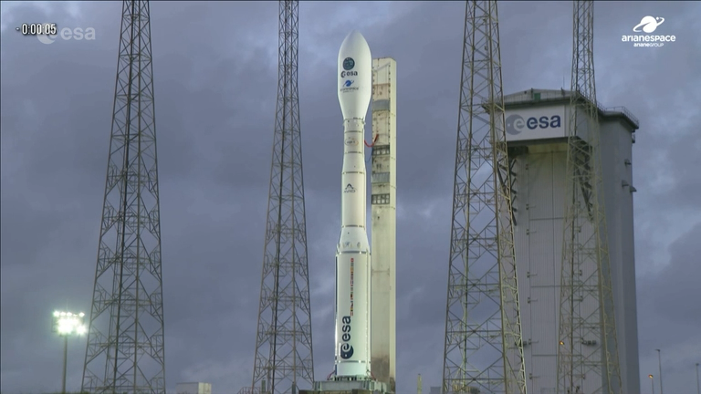
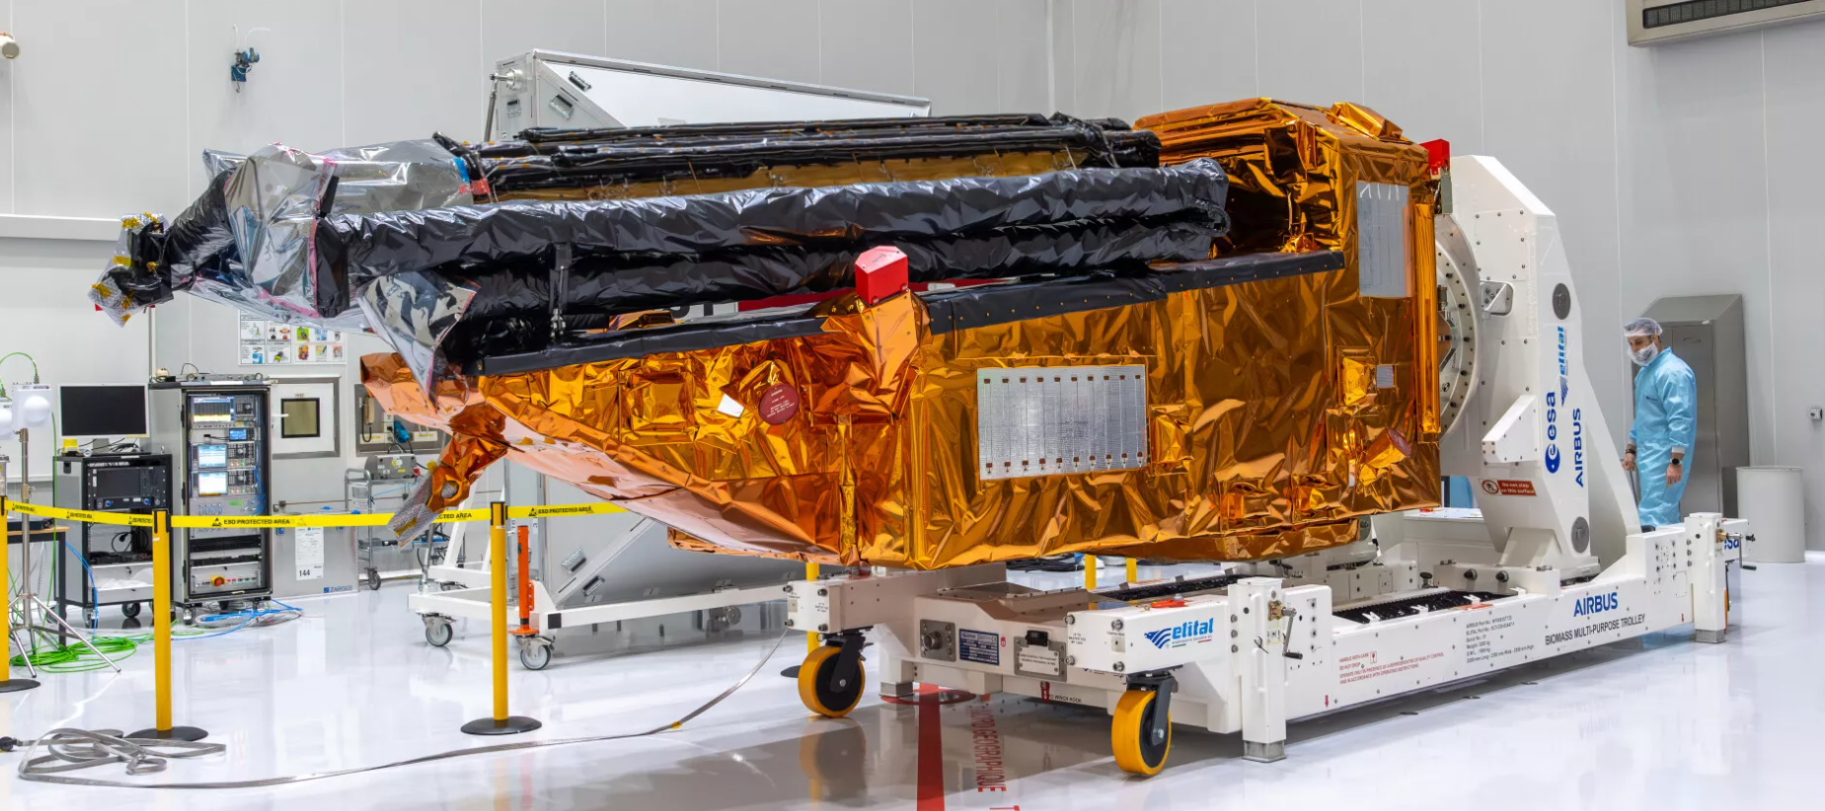
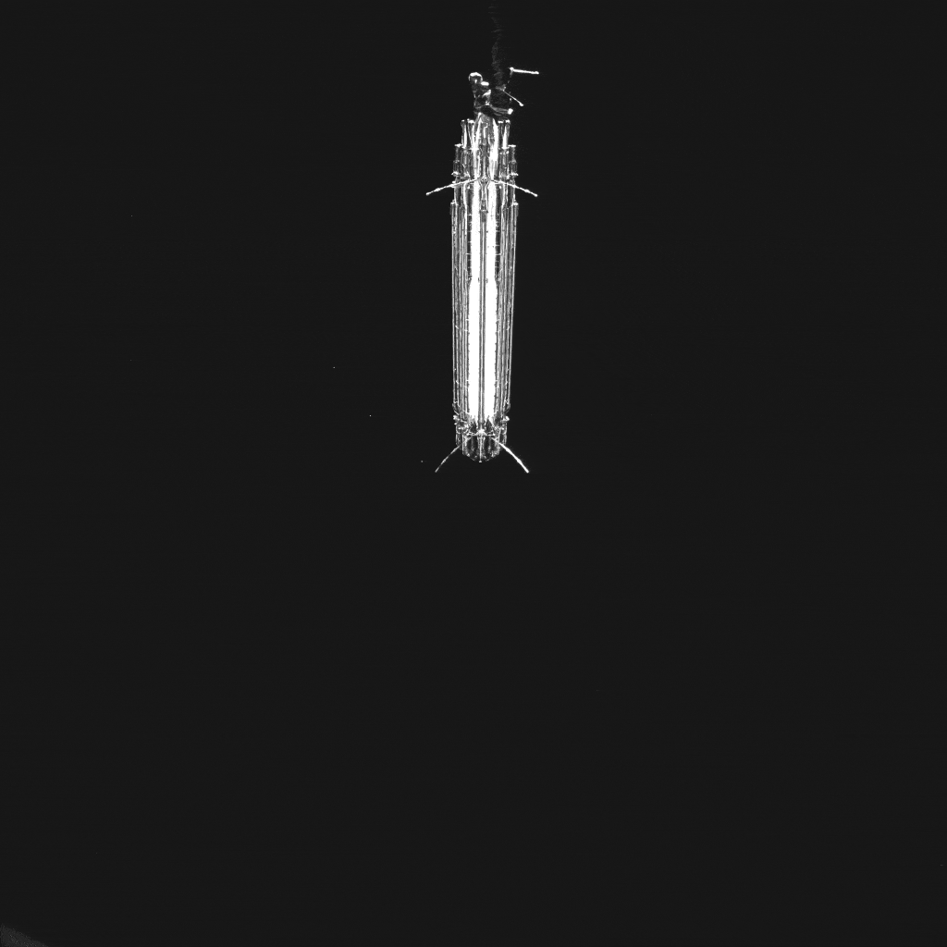
BIOMASS Mission highlights: Status
Successfully launched on 29th April
2025!
Full polarimetric, P-band (at 435 MHz with 6 MHz bandwidth) Synthetic Aperture Radar
Single satellite, operated in a polar sun-synchronous orbit
Two mission phases: PolInSAR and TomoSAR (1 global acquisition at the beginning of the mission)
Multi-repeat pass interferometry (3 passes in nominal operations) with a 3 days repeat cycle
5 years lifetime
Reflector deployment

Slide 8
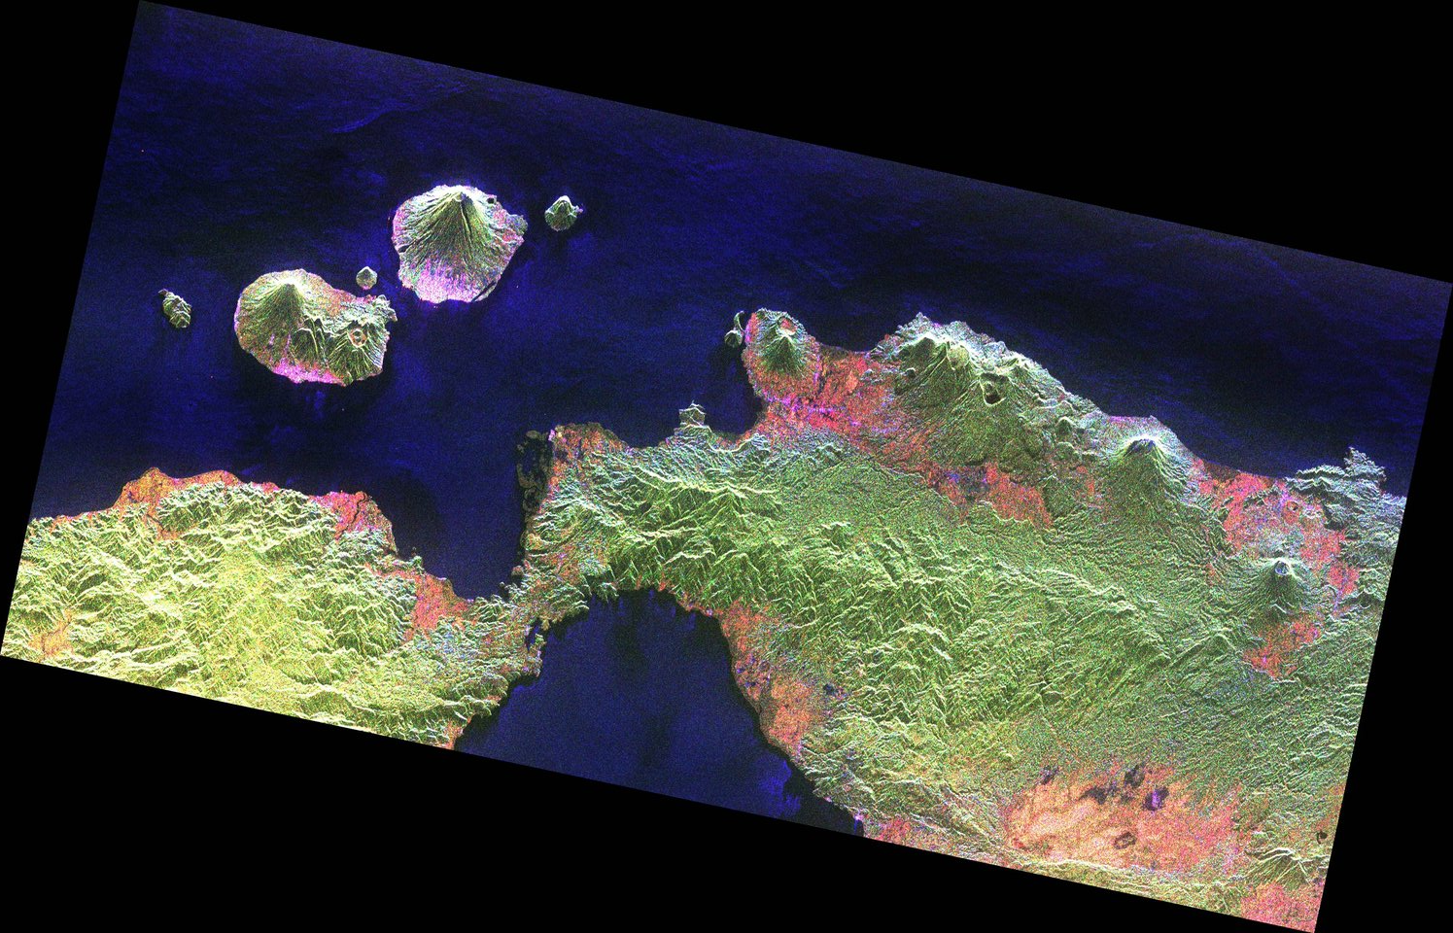
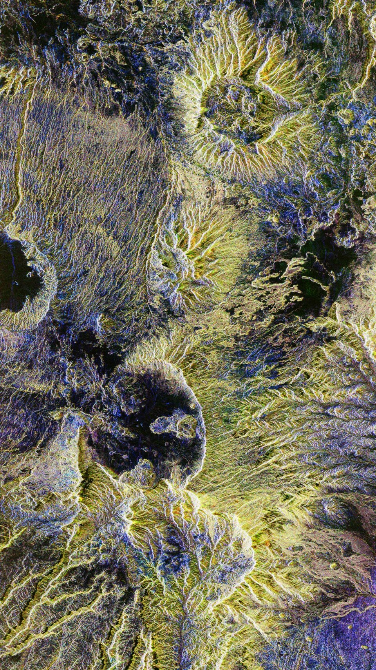
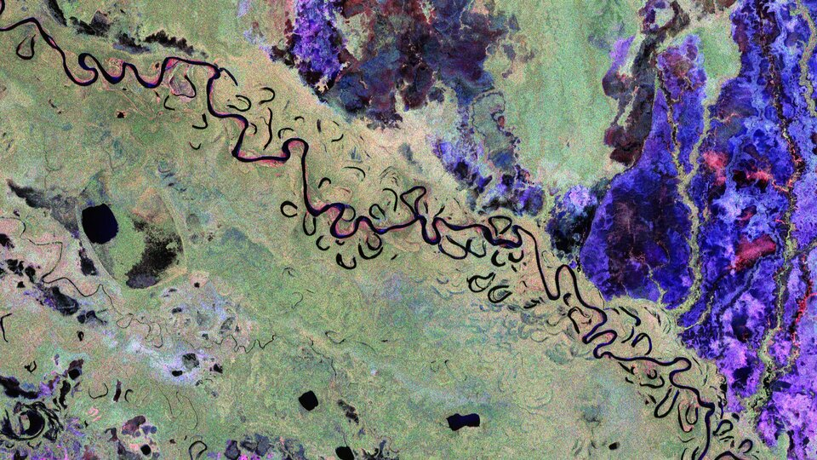
BIOMASS Mission highlights: First stunning images!
Indonesia – volcanoes on the radar / Desert structure in Chad
Bolivian forest and landscape from Biomass

Slide 9

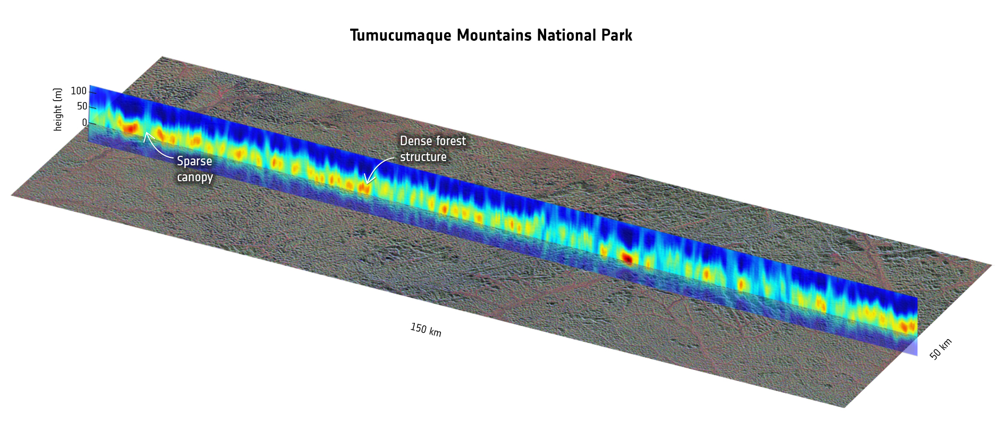
BIOMASS Mission highlights: First tomograms! (in 3D)

Slide 10
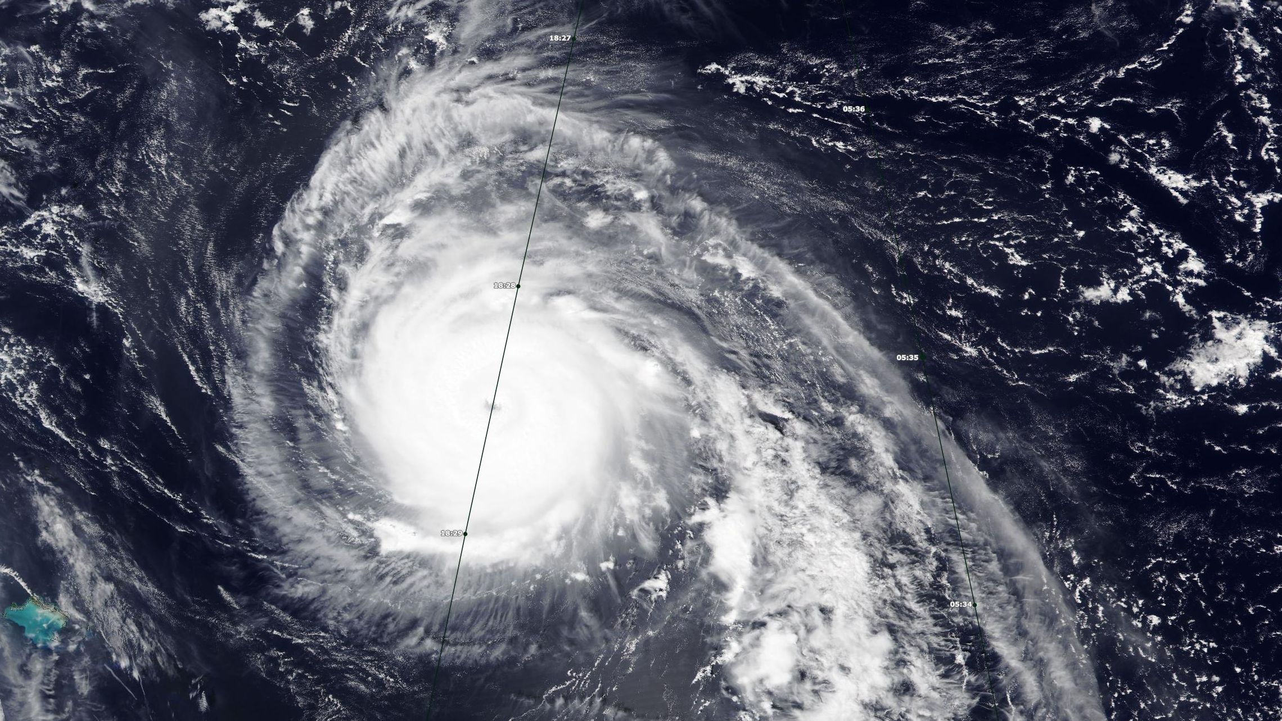
The day EarthCARE hit Hurricane Humberto
28 Sept 2025

Slide 11
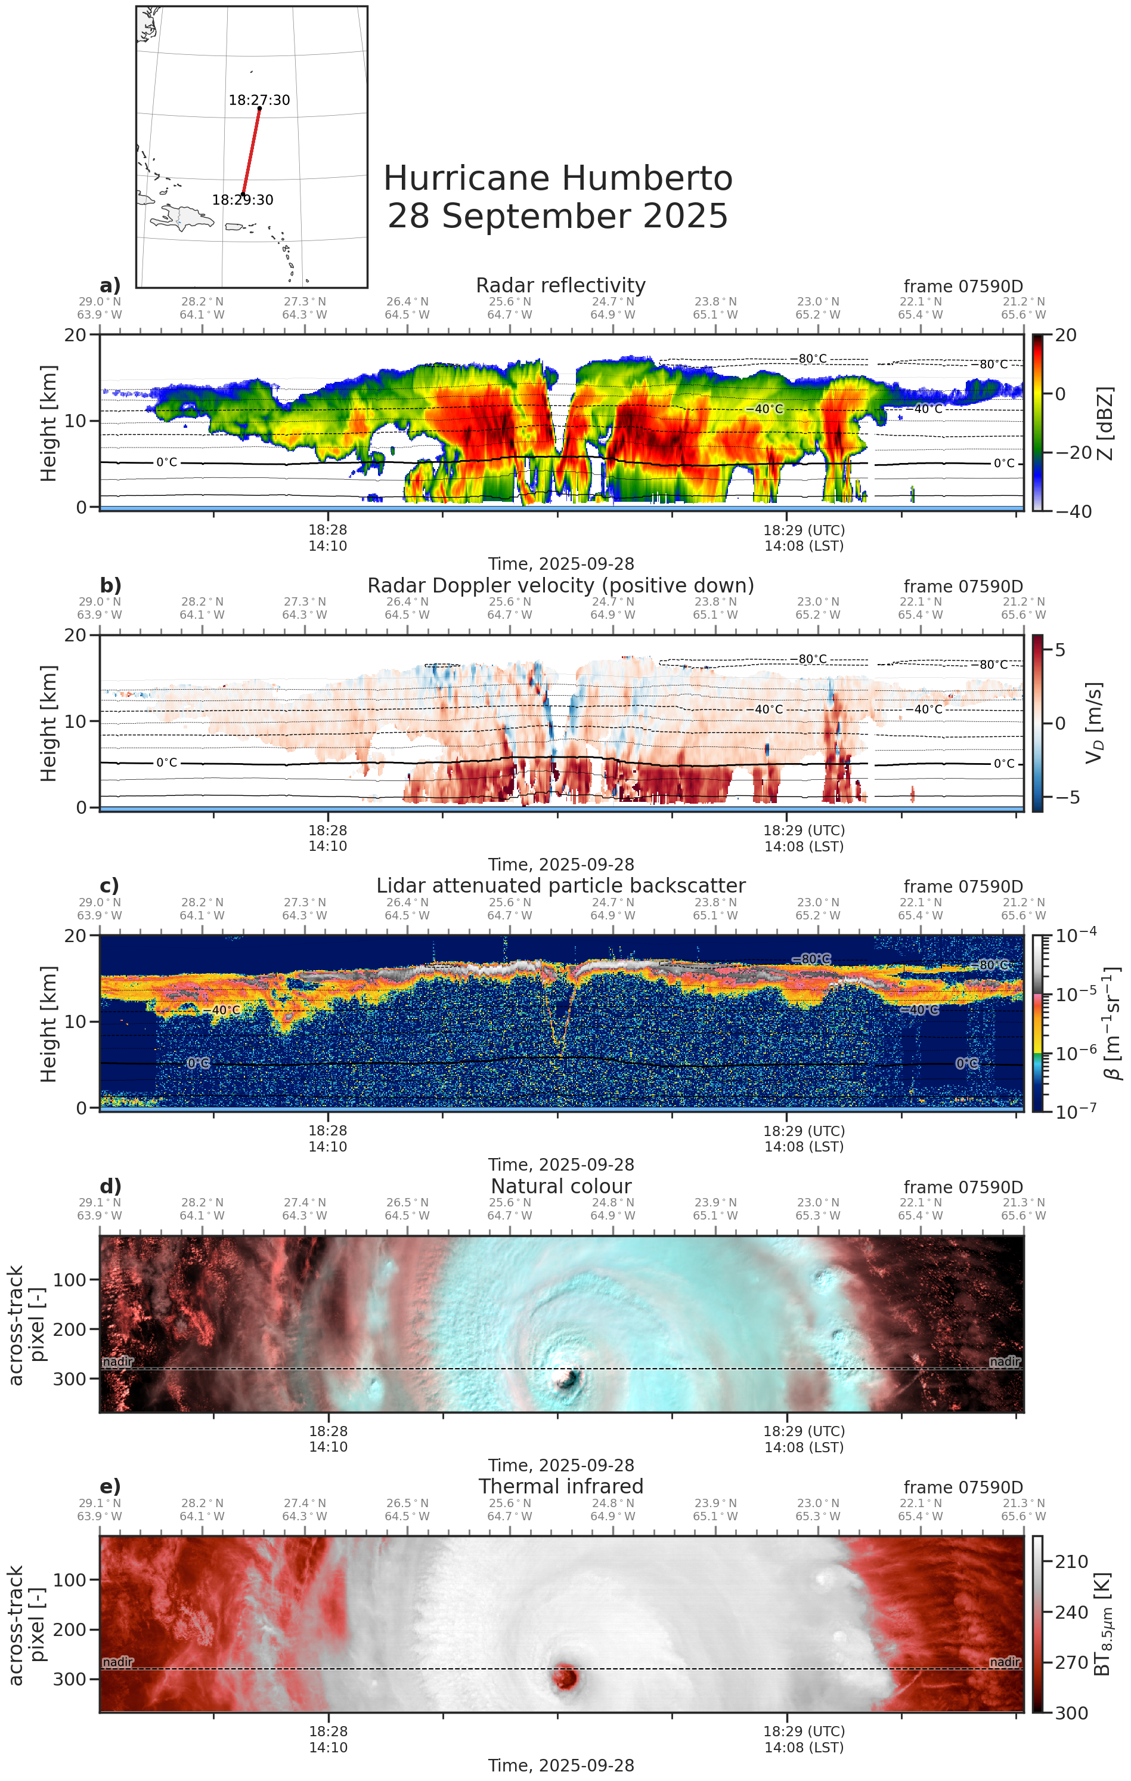
a
V-shaped eyewall
a
Convective rain band
Turbulence
Rising air in eyewall
First cloud band / secondary eyewall
“Natural Colour” scale
RGB = (1.65,0.87,0.67) μm:
Liquid clouds appear red,
Ice clouds appear cyan
Credits: Robin Hogan (ECMWF)

Slide 12
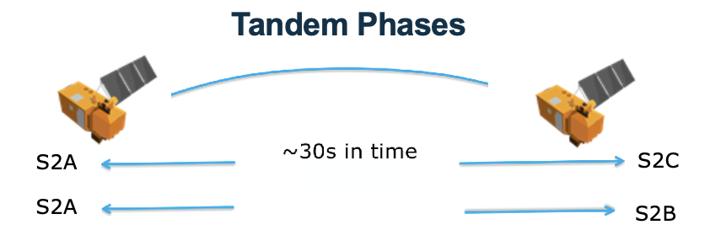
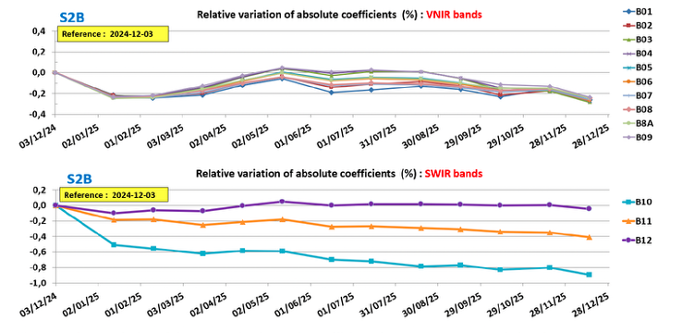
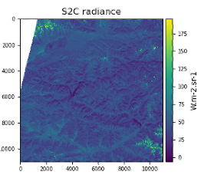
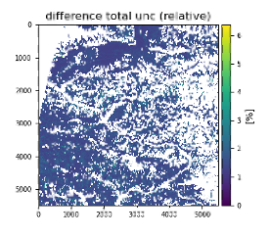
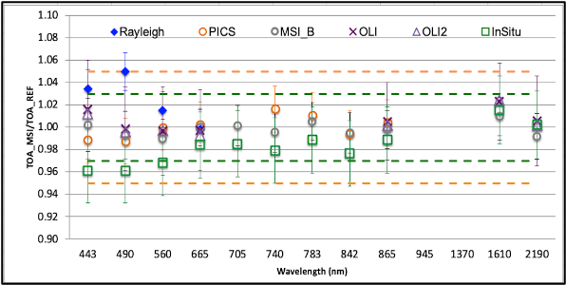
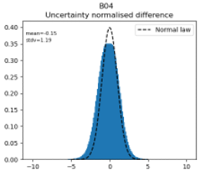
Sentinel-2 Calibration and Inter-Calibration
The Sentinel-2 MSI requires accurate radiometric calibration to ensure the reliability of Level-1 products and it is conducted monthly as part of routine operations.
Calibration
Time evolutions of the S2B absolute gains coefficients for 2025
Initial granule
S2C tile
Tandem Radiometric Uncertainty validation
Pixel-to-pixel comparison between matching S2A and S2C tiles and derived per-pixel uncertainty calculated from the S2-L1C Radiometric Uncertainty Tool (RUT)
Filtered total uncertainty from S2A & S2C
Validation
Comparison of radiometric accuracy of the different methods used for radiometric validation of S2A
S2C radiometry is correctly
aligned with S2A
Epsilon ratio histogram

Slide 13
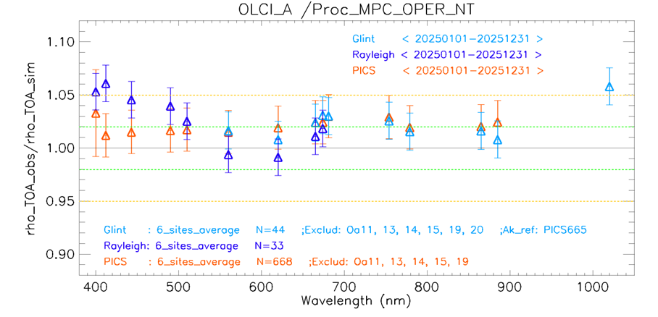
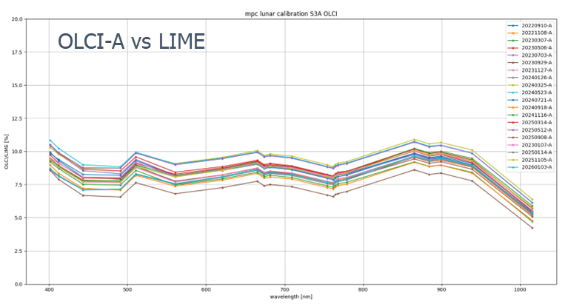
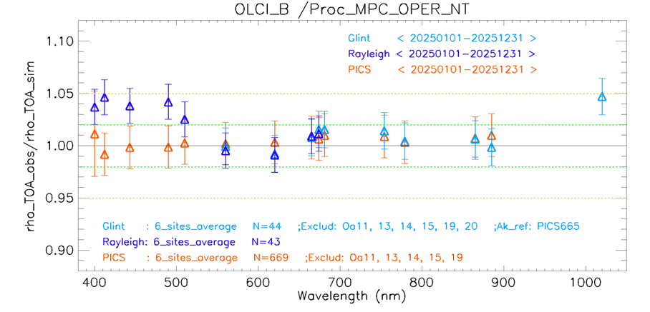
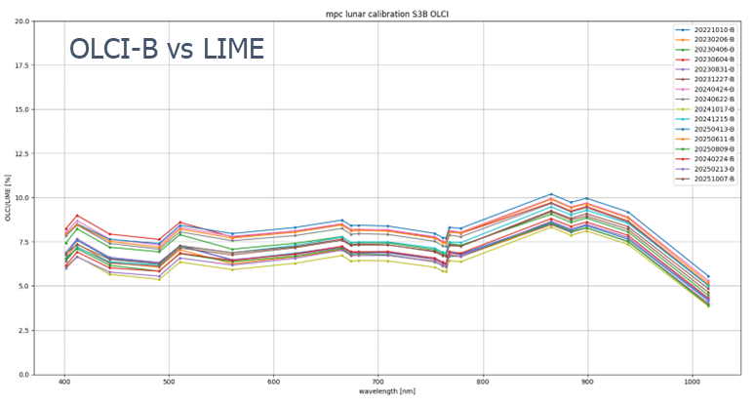
Sentinel-3 OLCI validation
OLCI L1 reprocessing is completed at EUMETSAT based on ESA provided Processing Baseline, and has been published by both Eumetsat and ESA.
      Consistent radiometric calibration for each OLCI-A and OLCI-B mission
      Geometric calibration improvement for early mission for OLCI-A and OLCI-B
      Radiometric uncertainties provided in L1 B products for entire mission
      New Spectral temporal based on in-flight spectral calibrations and accounts for OLCI spectral evolution over time
      TSIS-1 solar irradiance spectrum to replace Thuillier
Vicarious calibration results demonstrate persistent bright bias larger for OLCI-A than OLCI-B. ~2-3% for A and ~1-2% for B.
OLCI radiometric validation – LUNAR calibration
The Lunar dataset was reprocessed using TSIS solar irradiance model.
The profile of the results over the wavelengths show a very good agreement for both sensors with OLCI-A being brighter by 1-2%.

Slide 14

ESA - Reprocessing
ESA FDR projects:
Long-term commitment to data stewardship
Address GCOS requirements
Leverage heritage missions with state-of-the-art algorithmic advances
Deliver robust, traceable, and interoperable data records
Ensure continuity, consistency, and possibly climate-quality standards
ESA Infographic (2025)

Slide 15
Thank you

Slide 16




ESA - Reprocessing
Completed:
FDR4ALT project (2019-2023) generated FDRs and TDPs from ERS-1/-2 RA/MWR and Envisat RA-2/MWR instruments extending 20+ years (1991-2012). Eight different data collections released in 2024. Enhanced calibration and algorithm improvements ensure top-notch data quality, and long-term consistency: Fundamental Data Records maintain accuracy over extended periods, facilitating trend detection and analysis of subtle variations in sea levels, ice cover, and atmospheric conditions. Thematic Data Products offer insights into various Earth system components: inland waters, ocean and coastal topography, ocean waves, land ice (focusing on Greenland and Antarctica), and sea ice (for the Arctic and Antarctic regions). Uncertainty-quantified observations based on Metrological guidelines. Substantial enhancements when compared to the ESA mission reference products. The Sea-Ice TDP is the first continuous and homogeneous multi-decadal time series of sea-ice estimates derived from the ERS missions.
FDR4ATMOS (2019-2023) project produced harmonized FDR (irradiance/reflectance) for UV-VIS-NIR spectral regions targeting O3, NO2, SO2, and clouds retrievals from ENVISAT/SCIAMACHY and ERS-2/GOME (1995-2012). Released in 2024. Uncertainty-quantified observations provided. Pathfinder activity for potential future alignment with other UVN nadir viewing missions. First attempt to harmonise EO measurements from satellite-based spectrometers at the spectral data level (previously soft-calibration adjustments within the retrieval chain).
FDR4AVHRR (2024-2025) project extended ESA AVHRR L1b Data Set Version 1.0 beyond 2020 and produced harmonized FDR (reflectance, brightness temperature – Level 1c) for VNIR and TIR channels, derived from LAC data spanning the entire AVHRR time series (1981-2024) over Europe and selected regions outside Europe. Recovery of USGS historical stitched 1 km AVHRR Global Land Project data (1992 – 1999). Enhanced calibration, improved geocoding with orthorectification. uncertainty-quantified observations. To be released soon. Expected uptake from ESA’s CCI programme.
New ENVISAT/SCIAMACHY mission datasets (L1v10 and L2v7.1) in NetCDF format, improving instrument degradation and solving radiance problems in UV, correcting erroneous O3 trend. Released in 2024.
ENVISAT/MIPAS special modes mission data reprocessing addressed anomalies caused by Envisat CFI software v5.9 malfunctioning. New MIPAS products (~3300 orbits L1v8.0X and L2v8.22) and L1b data conversion to NetCDF format (currently data still in ENVISAT legacy format). First data reparation effort for ENVISAT – fixing issues at L0 through targeted intervention on the Instrument Source Packets (ISPs). The updated products are scheduled for release shortly.
FDR4AVHRR

Slide 17



ESA - Reprocessing
Upcoming:
FDR4VGT (2024-2026) delivering a consistent and harmonized 20+ years data record of surface reflectances from SPOT-VGT and PROBA-V archive (1998-2020) along with uncertainties at pixel level following FIDUCEO guidelines to be used as input for climate studies.
FDR4LDYN (2024 – 2026) to define Scatterometer product tailored for land dynamics processes studies (FRD4LDYN) assuring consistency and interoperability among C-band Scatterometer dataset (ESCAT, ASCAT).Prototype, based on ESCAT, a European processing node for Scatterometer Land product
.
FDR4(A)ATSR project (2023-2026) will re-generate all L1B data (5th reprocessing). The main objective of this task is to improve the traceability of the calibration of all ATSR-1, ATSR-2 and AATSR instruments over the full missions creating long term FDR dataset with updated calibration and geolocation. Updates: Pre-launch calibration reanalysis, Geometric Stability and Co-registration, Uncertainty Improvements, Orthorectification, Re-gridding, and S-3 SLSTR instrument alignments (coastline and inland water flag, Online Quality Flag)
FDR4ALT / FDR4ATMOS follow-on projects (2024-2027) aim at further improve and consolidate FDRs/TDPs: extension with GOME-2 Metop-A/B/C, computation of new orbital parameters for the ERS satellites and GPD+ WTC
FDR4AVHRR follow-on project (2026-2027) - Enhancing PyGAC with faster processing, cloud masking, and missing-scan handling, while incorporating additional recovered AVHRR data (over Brazil, Poland, Hawaii, Mongolia, …).
GOME-2/SCIAMACHY lunar FDR & improved LESSR lunar model in collaboration with EUMETSAT. individual readouts and averaged disk measurements. Format aligned with LSICS requirements.

Slide 18



ESA - Reprocessing
Completed
CRYOSAT:
*Ocean Baseline: The complete dataset of reprocessed CryoSat Ocean Baseline-D data covering July 2010 to September 2024 has been published and is now available for download. Update to latest SAMOSA physical retracker and dedicated SAR SSB computation, Updated Mean Sea Surface (MSS) and Mean Dynamic Topography (MDT) solutions, Fix SAR and SARIn bias and errors.
* Ice Baseline F reprocessing will begin Q2 2026: new Distance to Coast and Sea Ice Thickness fields added, new coherence based retracker, ice density aux file implemented, processing of Pseudo-low-resolution-mode data, update of several geophysical corrections and static AUX files.
* Cryo-TEMPO Baseline D thematic products. Main improvements: Snow depth: Release of a new reprocessed (and operational) dual-frequency snow depth over sea ice from CryoSat and ICESat-2 in Sea Ice products, Coastal Ocean: Updated uncertainty estimation and sea state bias correction, Winter sea ice: Improved retracking procedure and range uncertainty estimation, updated tide model, Summer sea ice: Updated CNN-based waveform classification, Polar ocean: Updated tide model and Ionospheric corrections, mitigated instrument intermode bias, Land ice: Updated Glaciological Drainage Basins ID and reference DEMs for Greenland and Antarctica, Improved LRM relocation (slope correction) over ice sheets, Improved surface elevation uncertainty computation in Antarctica, Inland water: Update L1B input data to more robust ICE chain.
Upcoming
SMOS
* 4th SMOS Mission reprocessing campaign started at Level 1 and it is ongoing.
The new dataset contains the following improvements: Improvements in the image reconstruction with better characterization of the synthetic scene, Reduction of Brightness Temperature spatial biases, Improvements in the estimation of the Sun Brightness Temperature.
* Level 2 reprocessing will follow Level 1 in Q3-2026.
* For Soil Moisture the new dataset contains the following improvements: Better characterization of the land cover using ESA CCI dataset, Better characterization of forest area using ALOS-2 Palsar 2 dataset, L-Band-vegetation optical depth initialization based on vegetation parameters derived from GEDI/ICESAT-2 dataset, RFI additional screening based on L1 flags.
For Sea Surface Salinity the new dataset contains the following improvements: Reduction of the seasonal and latitudinal biases, Revised sea water dielectric constant (cold waters), Improvements in the quality flags

