Slide 1
WMO Agency Report
Heikki Pohjola

Slide 2
Contents
WMO reorganization and Space Programme composition
Latest WMO Congress outcomes wrt space weather
Status of Task Team on Cryosphere and Polar Observation from Space (TT-CPOS)
WMO guide for standard RGB recipes
Reminders on open actions

Slide 3
WMO Space Programme Section
Natalia Donoho, Chief of Section
Staff
  Heikki Pohjola, Space-based observing system
  Zoya Andreeva, Capacity building
  Jesse Andreas, Space Weather
Short term consultants
  Mikael Rattenborg, DBNet
  Roger Saunders, OSCAR/Space
  Diego Sousa, Vlab Technical Support Officer
Space Program Section expert teams:
  ET-SSU, Expert Team on Space Systems and Utilization
    Cochairs Fiona Smith (BoM) and Lihang Zhou (NOAA)
  ET-SWX, Expert Team on Space Weather
    Cochairs Kirsti Kauristie (FMI) and Mpho Tshisaphungo (SAWS)
  ET-RFC, Expert Team on Radio Frequency Coordination
    Vice chair Alec Casey (ECCC) (Chair nomination TBD)

Slide 4

New WMO strucutre
Earth System Data & Prediction (ESDP)
Science, Services &
Capacity Development (SSCD)
Regional Coordination Office (RCO)
Administration and Support Services
Divisions:
  Integrated Global Observing Systems (WIGOS, GCOS, G3W)
  Data & Prediction Systems (WIS 2.0, WIPPS, AI, climate prediction, modelling)
  Hydrology & Cryosphere (hydro monitoring, forecasting, cryosphere services)
Divisions:
  Science & Innovation (WCRP, WWRP, GAW, climate reports, research integration)
  Meteorological & Sectoral Services (severe weather, EW4All, marine & aviation, sectoral services, health/heat)
  Capacity Development (training, fellowships, institutional strengthening)
  Replaces Member Services Department
  Brings regional support closer to Members
  Oversees decentralisation of project managers & training into Regional Offices
  Shortens reporting lines – stronger SG oversight on regions
  Divisions:
  Development Partnerships & Programme Delivery (resource mobilisation, donor engagement).
  Human Resources & Corporate Services (HR, procurement, languages, conference, travel)
  Controller & Management Services (finance, oversight, digital governance, data protection).
New organizational charts and overview of the reorganization can be found here

Slide 5

One WMO: Transforming the Secretariat
NORMATIVE WORK AND STANDARD SETTING NORMATIVE WORK AND STANDARD SETTING
Genesis & Process
Rationale
•It became clear WMO needed to deliver better for Members.
•Financial challenges – urgent action.
•An inclusive reorganization: consultations with staff, departments, youth, and Members guided the approach.
•Make the Secretariat leaner, less top-heavy, and more agile.
•Break silos, strengthen the Earth System and Science for Service approaches, and enhance technical exchange.
ONE WMO
ESDP
SSCD
MEMBER- CENTERED
Efficiencies
Reinvestment strategy
CROSS-CUTTING TOPICS
• The Task Force to prepare proposals for de-prioritization or deferrals of components of the Strategic and Operating Plans.
•CHF 5.3M savings in 2025 (7.5% of budget).
•Projected CHF 6M in 2026 (8.7%), mainly from staff cost reductions and tighter controls.

Slide 6
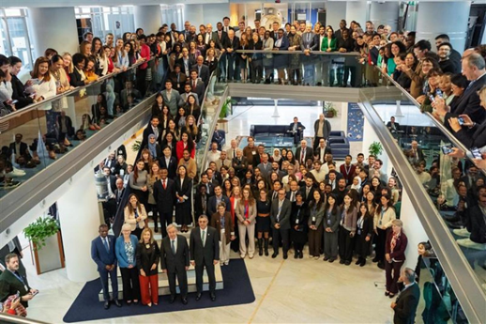
Congress Extraordinary Session (Geneva, Oct 2025):
Endorsed AI for forecasts & warnings – enhancing Early Warnings for All (EW4All)
Approved technical regulations for national early warning services
Confirmed continuation of G3W within WIGOS/WIS/WIPPS (i.e., expanded WWW) & GAW framework
Launched Task Force on Programmatic Prioritization for sustainable financing
Adopted Youth Action Plan 2025–2027

Slide 7
SG proposal to eliminate Space Weather as a priority for WMO was rejected
“Decides to discontinue the coordination and implementation of space weather activities funded under the Regular Budget...”
Congress decision:
Space weather activities managed in Space Programme, both space-based and surface-based observations
“Decides to continue the implementation of space weather activities within existing resources, recognizing that this and other programmatic activities will be considered by the Task Force.”

Slide 8
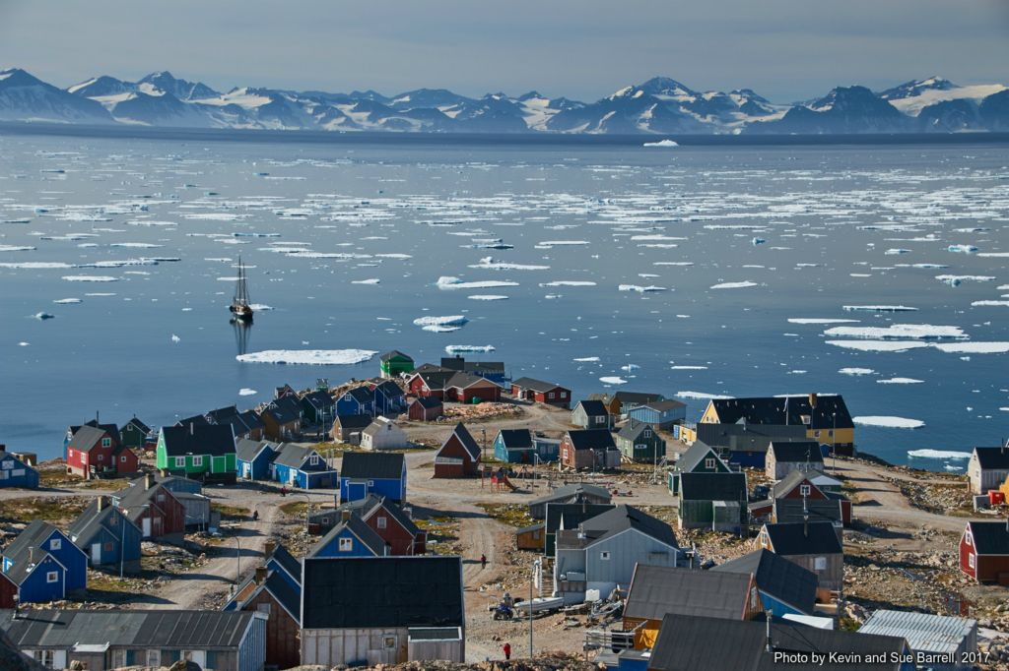
Global Cryosphere Watch (GCW)
EC-78 (2024) requested INFCOM to
  work with the Research Board and the satellite community, especially through CGMS, for multi-satellite coordinated cryosphere monitoring products to improve the spatial and temporal resolution and coverage”
  organize consultations towards WMO pursuing closer links with the international satellite community on the monitoring of the cryosphere, such as through CGMS,
EC-79 (2025) The 5th International Polar Year, 2032-33
  WMO to support “the realization of benefits from the constellation of polar orbiting and other satellites monitoring the cryosphere by engaging interested Agencies.”

Slide 9
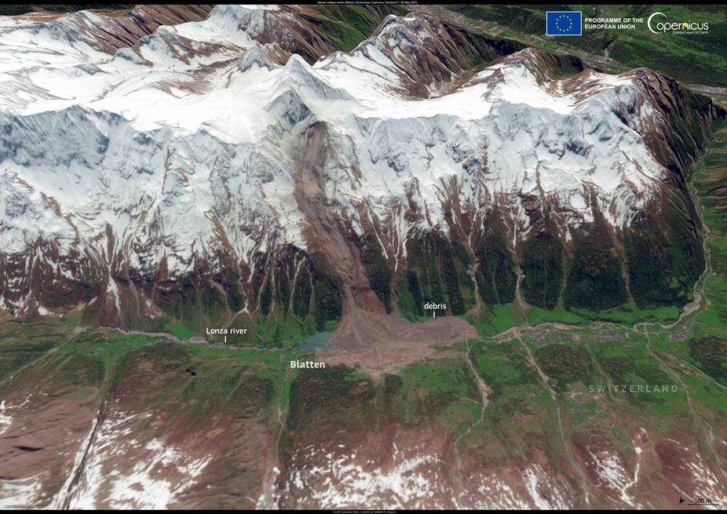
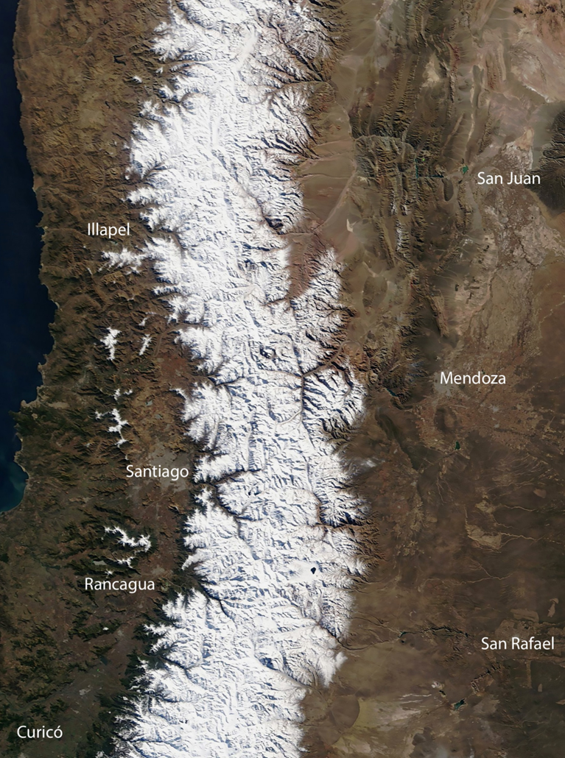
Task Team on Cryosphere and Polar Observation from Space (TT-CPOS)
Established as a substructure of AG-GCW (link to research and operations)
Building on the former Polar Space Task Group
ToRs developed based on broad consultations
Endorsed by INFCOM MG to work with ET-SSU
Nominations were collected at the end of 2025
Kick-off meeting planned soon.
Copernicus Sentinel-2 image (30.05.2025) - extent of the affected area following the high-alpine slope failures and collapse of Birch glaciers (Blatten, Switzerland)
Snow accumulation in the Andes is a crucial water resource for the region
Notes:
WMO is the right mechanism to bring together representatives from agencies across the world alongside the scientific community to address the scientific questions that require the collaboration with the interested Agencies operating satellite systems that provide information on the cryosphere.
The developed countries are well served through engagements like Copernicus, for example. WMO’s role in extended those benefits to the communities of scientists, practitioners and users in the developing countries, the Global South, is essential. E.g. the monitoring along the Andes.

Slide 10
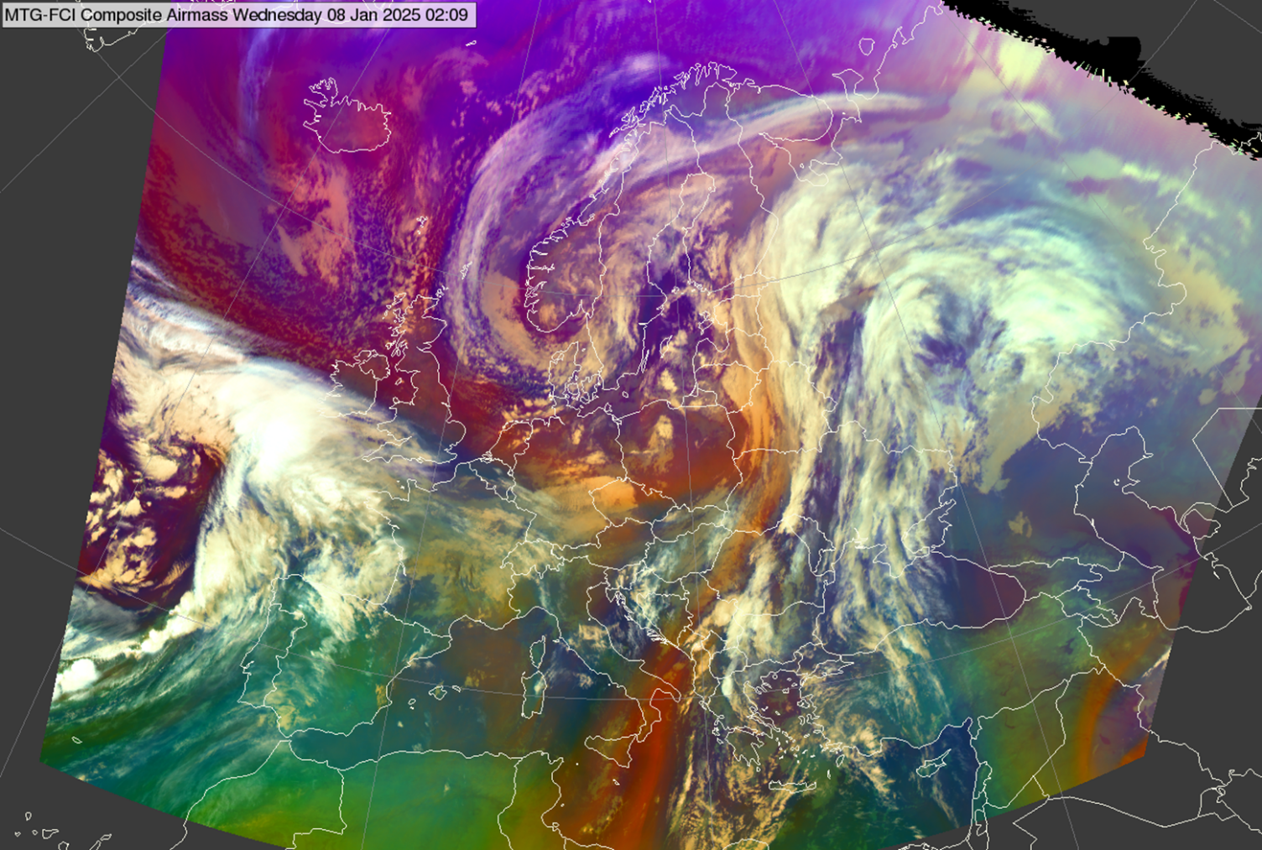
WMO guide for standard RGB recipes
After successful continuation of the expert workshops since 2007, set of standard RGB recipes were developed
After recent launch of MTG, time is right to publish the WMO guide for standard RGB recipes, concentrating on new-generation GEO imagers onboard (“GEO ring”),
The document explains how to create WMO-recommended standard RGB composites
Will be approved in INFCOM-4, Q4/2026
Final Report of 2025 Workshop
Final Report of 2022 Workshop
Final Report of 2017 Workshop
Final Report of 2012 Workshop
Final Report of 2007 Workshop

Slide 11
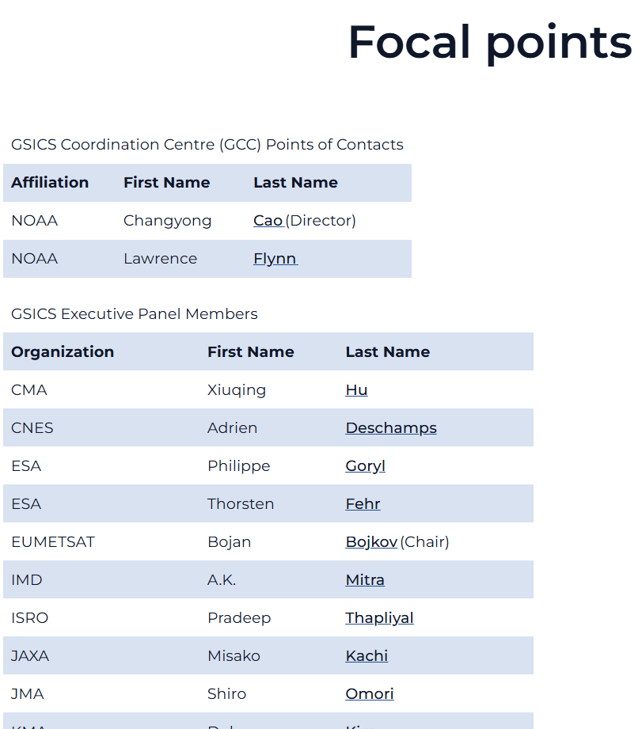
Reminders
Last chance to comment on GSICS ToRs to be approved in EP meeting tomorrow
  Please see my email for the shared file to be edited.
Update agency focal points listed at https://gsics.wmo.int/
  Please see my email for the shared file to be edited.
WMO SC-MINT/ET-QTC is interested in GSICS work
  Standing Committee on Measurements, Instrumentation and Traceability (SC-MINT)
  Expert Team on Quality, Traceability and Calibration (ET-QTC)

Slide 12
Thank you!

Slide 13
Back Up

Slide 14

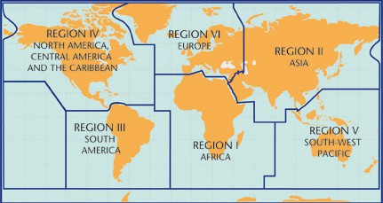
Regional Coordination on Satellite Data Requirements
EW4All
Established in 2013 (Resolution 12 (EC-65))
Serve as platforms for WMO Members to express their needs for satellite data and products
Facilitate regional coordination on:
  Satellite data reception equipment
  Visualization tools
  Related training and capacity building
  Act as a bridge between Members and satellite data providers active in each region
  Support user engagement by:
    Facilitating communication with space agencies
    Assisting with technical aspects of data access and processing
    Responding to specific user requests and needs
RA-I Dissemination Expert Group
RA-II and RA-V Coordination mechanism established through Asia-Oceania Meteorological Satellite Users Conferences (AOMSUC)
RA-III and RA-IV Coordination Group on Satellite Data Requirements
RA-II-V
via
AOMSUC
RA-III-IV-SDR-Group
RAIDEG
Notes:
WMO established Regional Coordination Groups on Satellite Data Requirements in RA-I, RA-II/V, and RA-III/IV, in accordance with Resolution 12 (EC-65) in 2013.

Slide 15
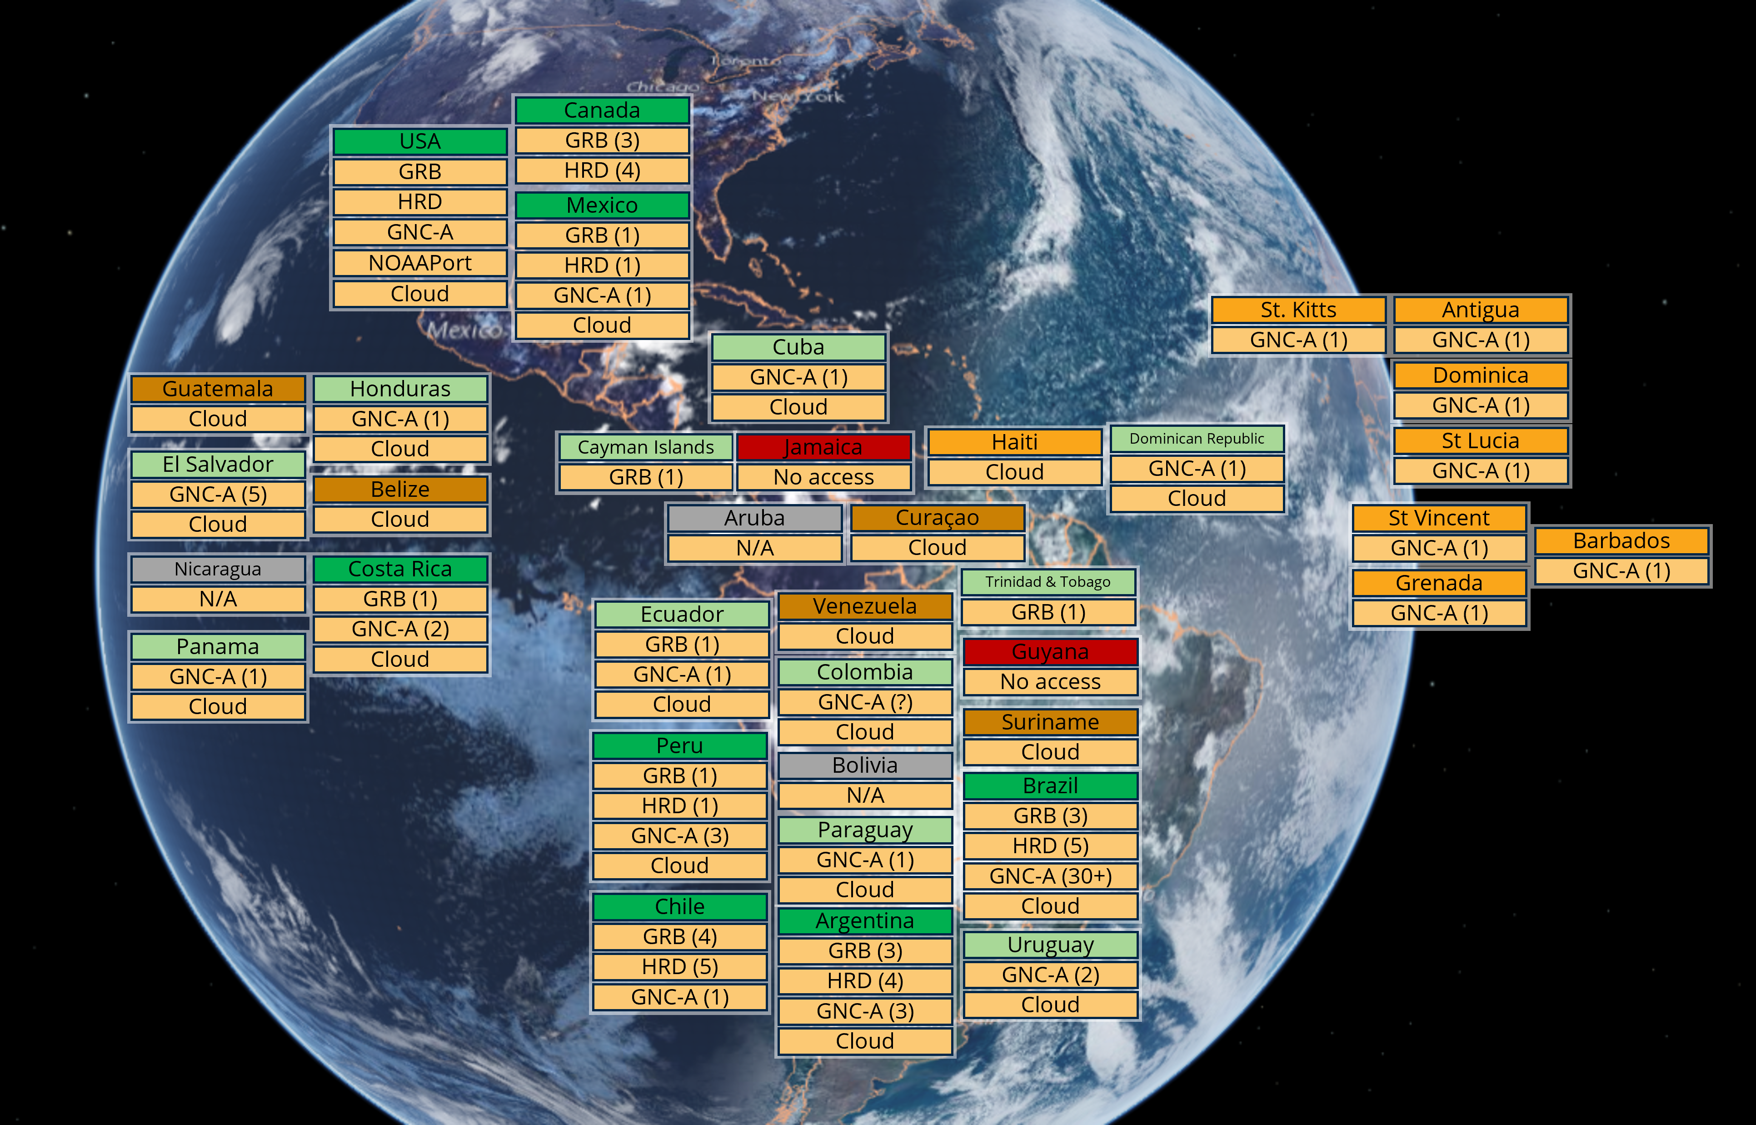
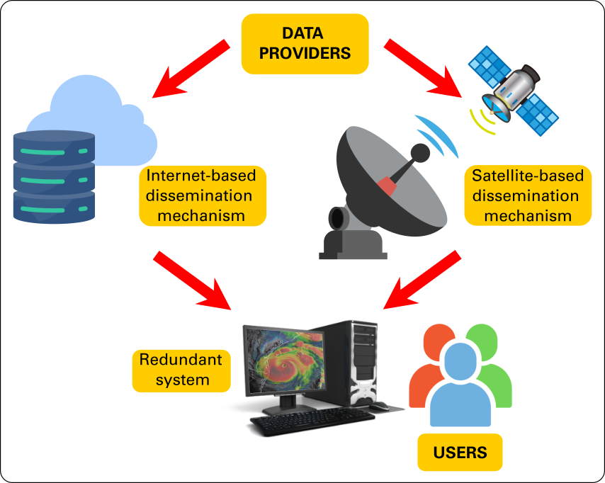
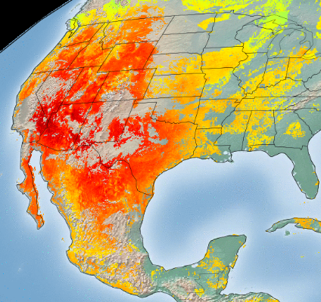
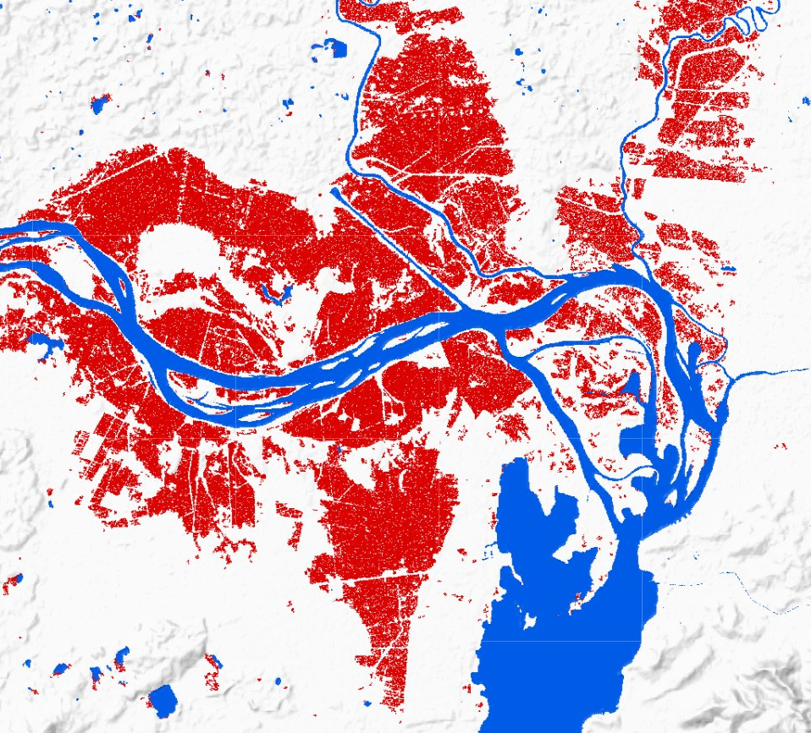
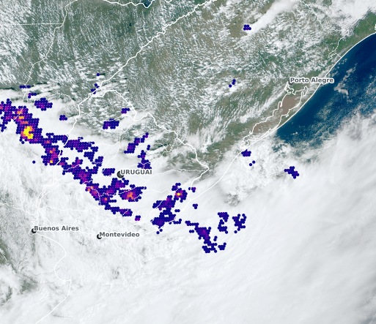
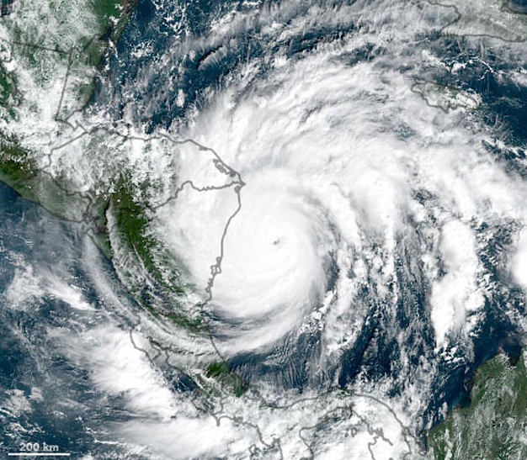
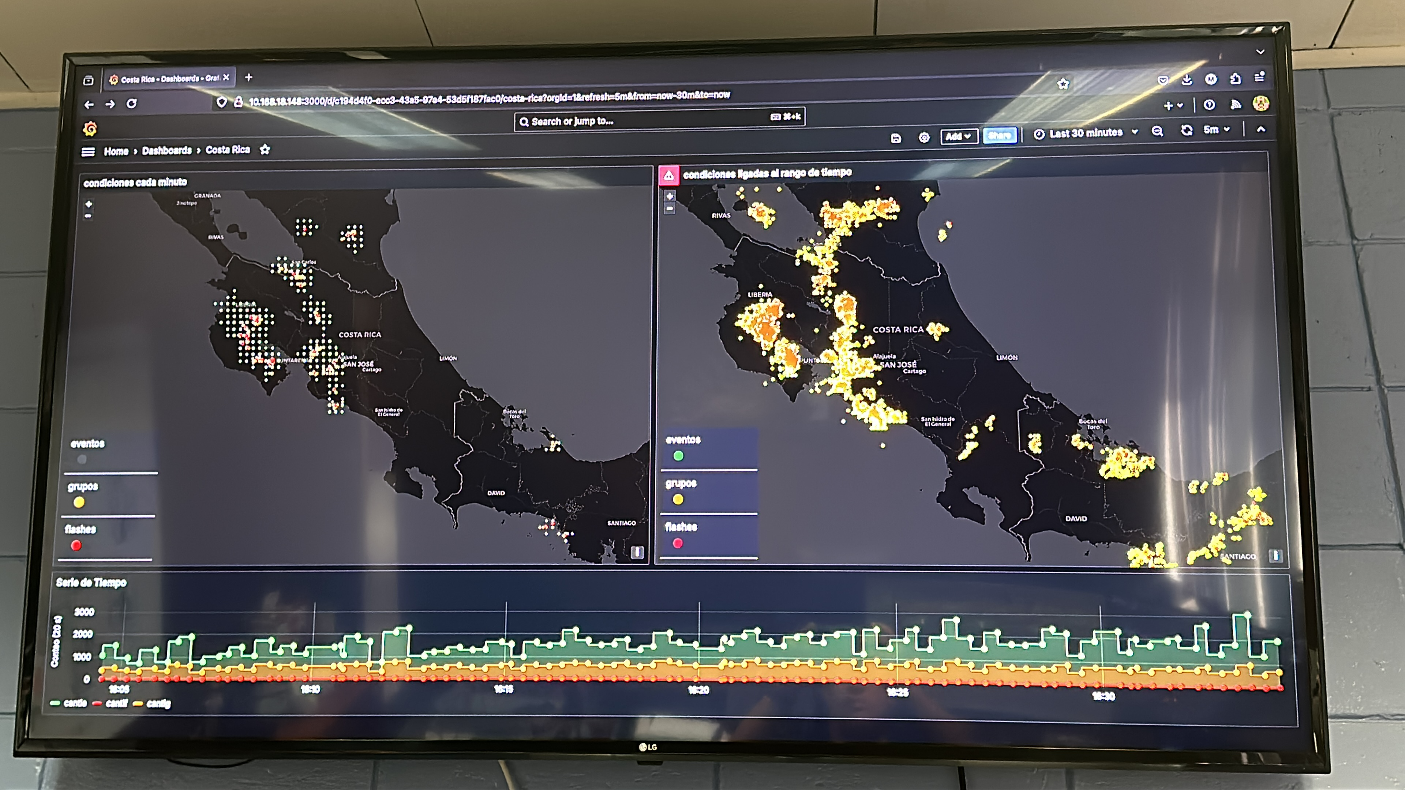





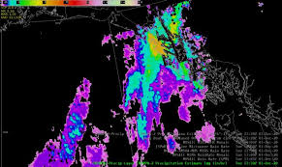
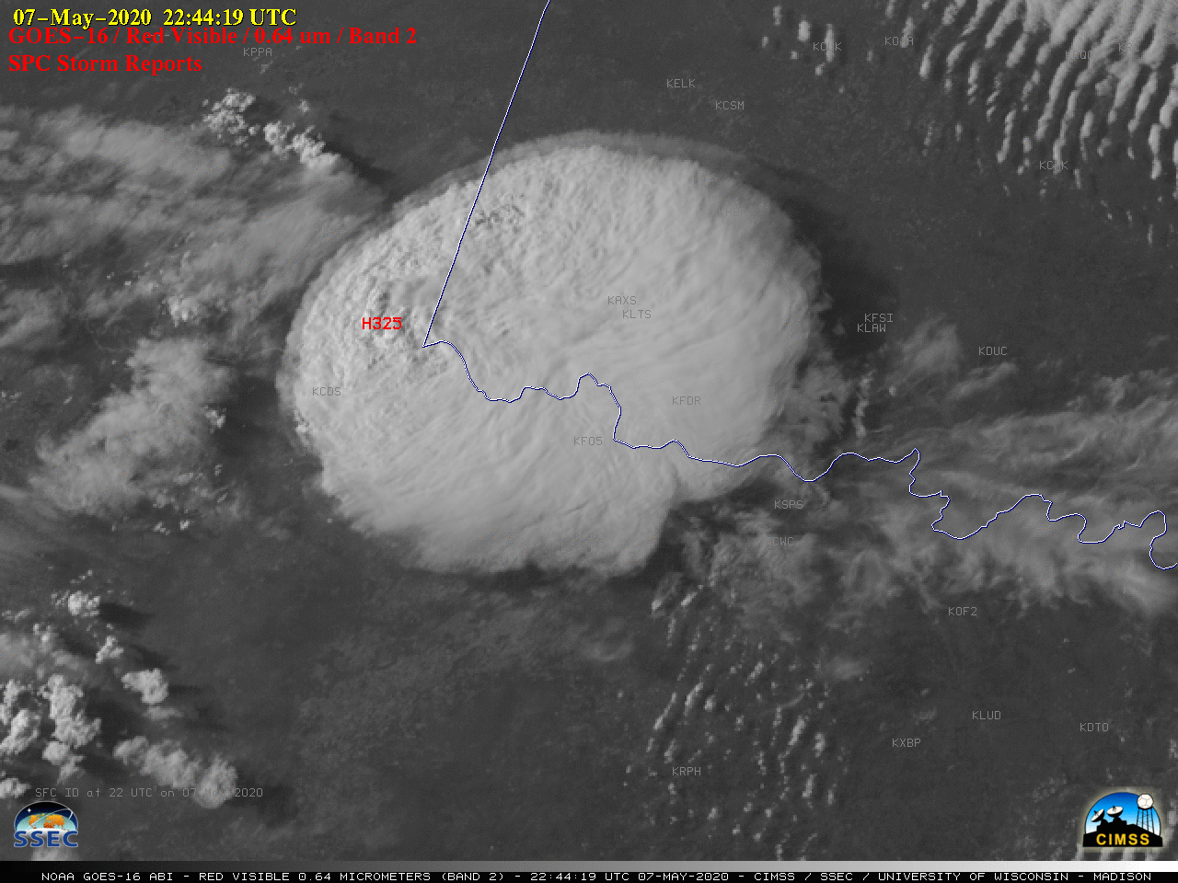
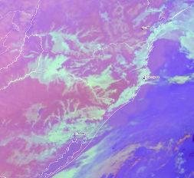
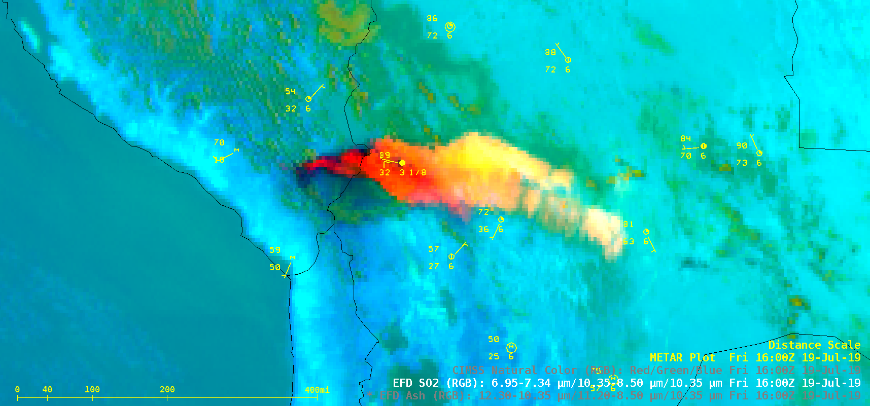








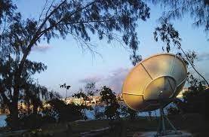
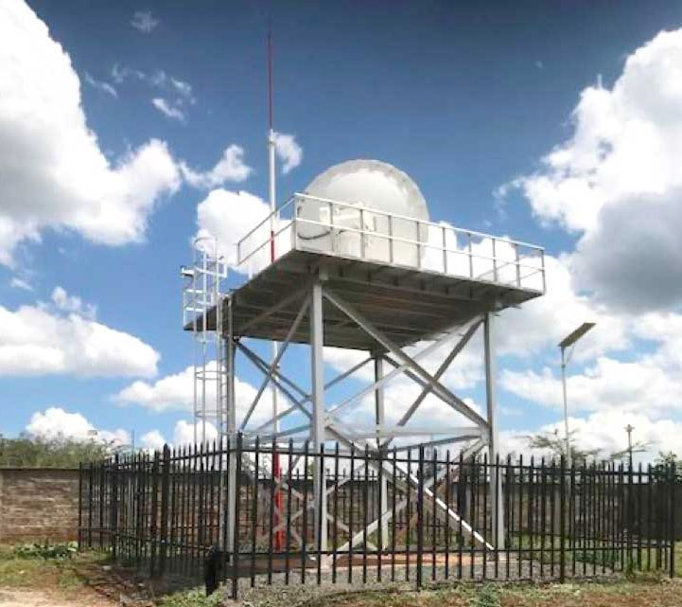
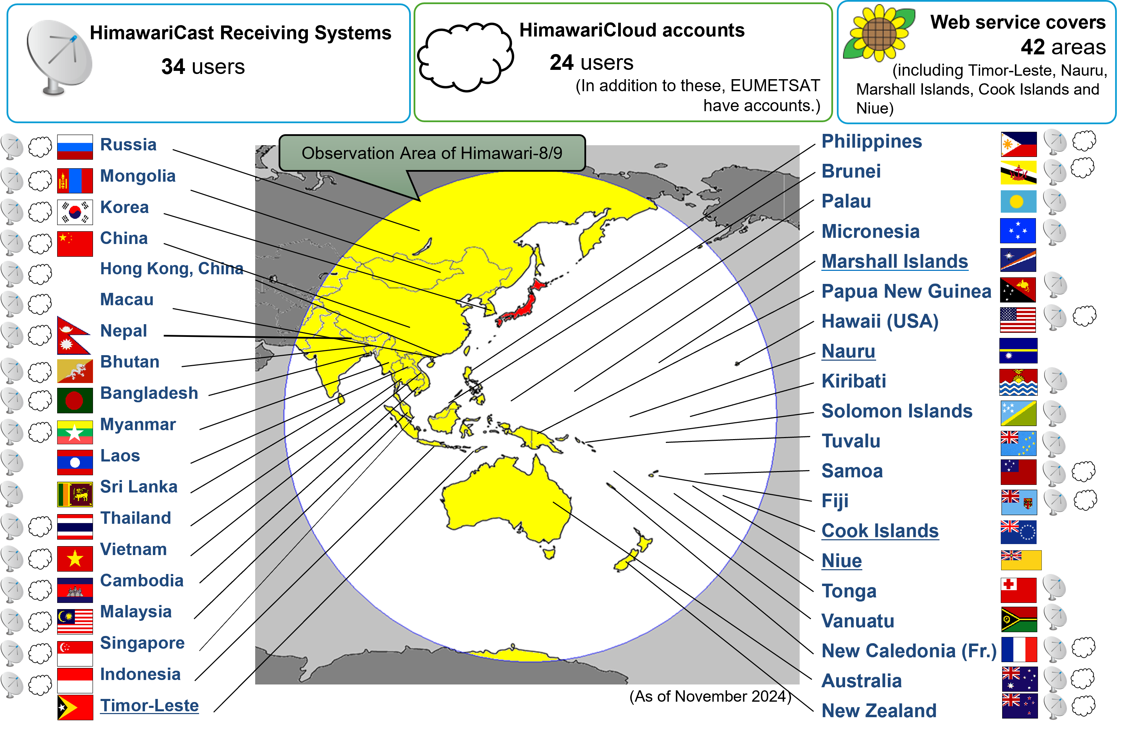
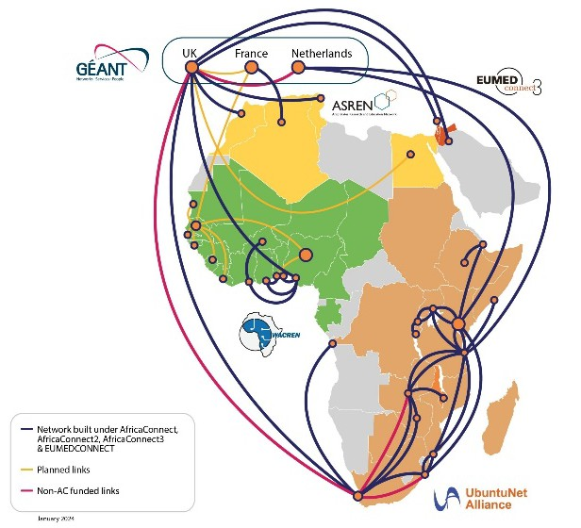
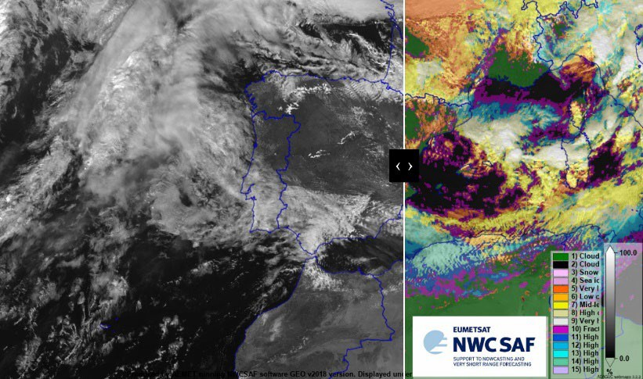
EW4All
Regional activities supporting EW4All (Space-Based)
c
Heatwaves
Floods
Thunderstorms
/ Squall Lines
Tropical Cyclones
Lightning
RA-III & RA-IV
Infrastructure challenges
Technical support
Comprehensive training
Rain / Wet Spell
Hail
Fog
Volcanic Ash
Pilot Project: Strengthening Early Warning Systems in pilot countries
Pilot Project: Development of Training Resources for Priority Hazards by VLab Centers of Excellence
Status of satellite data access in the Region
c
  Consolidate existing infrastructure
    Further upgrade of PUMA-2025 stations for Early Warning applications
    Upgrade and maintenance of the four RARS-Africa
  Provide new access mechanism
    EUMETCast-Terrestrial (for all MTG data) via NRENs
    Cloud-computing for Nowcasting
Project: HimawariCast upgrade in 19 NMHSs (JMA and WMO)
RA-I
RA-II & RA-V
Status of Himawari satellite data access in Asia-Pacific
Project: Space for Early Warning in Africa
Other bilateral regional projects supporting satellite data access and utilization (CMA (FY-2/4) and KMA (GK-2A))​

Slide 16
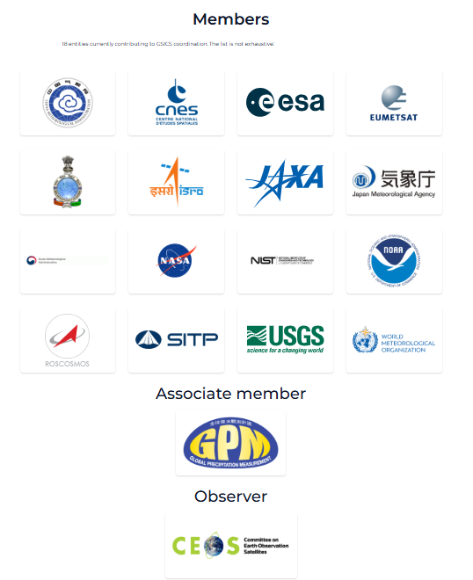

Global Space-based Inter-Calibration System (GSICS)
What is GSICS?
  Established by WMO and CGMS in 2005
  GSICS aims to ensure consistent accuracy among space-based observations worldwide for climate monitoring, weather forecasting, and environmental applications.
What are the basic strategies of GSICS?
  Monitoring instrument performances
  Operational inter-calibration of satellite instruments (GEO-LEO, LEO-LEO etc.)
  Tying the measurements to absolute references and standards, and recalibration of archived data
  Best practices for calibration & characterisation
This will allow us to:
  Improve consistency between instruments towards Interoperability
  Reduce bias in Level 1 and 2 products
  Support Cal/Val of new instruments
  Provide traceability of measurements
  Better specify future instruments
CGMS= Coordination Group for Meteorological Satellites
Notes:
16
Well, what is GSICS?
The Global Space-based Inter-Calibration System (GSICS) is an initiative of CGMS and WMO, which aims to ensure consistent calibration and inter-calibration of operational meteorological satellite instruments.
One of the basic strategies of GSICS is to develop an integrated on-orbit cal/val system - initially by LEO-GEO Inter-satellite/inter-sensor calibration.
This will then allow us to provide corrections to improve the consistency between instruments, produce less biased level 1, and therefore, level 2 data, and ultimately, retrospectively re-calibrate archive data, which is of great interest in the climate monitoring community
CGMS= Coordination Group for Meteorological Satellites

