Slide 1

GSICS 2026 Agency Report
Japan Aerospace Exploration Agency (JAXA)
Misako KACHI*, Hiroshi MURAKAMI,
Keiichi OHARA, Kei SHIOMI, Takeo TADONO, Takeshi Motohka

Slide 2
GSICS Activities, Actions, and Achievements
Current GSICS Activities
  Monthly lunar calibration of GCOM-C/SGLI by GIRO is updated regularly and all GIRO I/O files have been submitted to GLOD
  Lunar calibration of GOSAT-2/CAI-2 by GIRO is updated regularly and the gain degradation is estimated (presented by K. Shiomi at UVN-S Break-out Session)
  Cross calibration activities among GOSAT, GOSAT-2, and OCO-2 were conducted (presented by K. Shiomi at UVN-S Break-out Session)
  ALOS-2 and ALOS-4 L-band SAR calibration results are regularly updated, and currently good agreement are observed.
  Cross calibration of GOSAT-GW/AMSR3 and GCOM-W/AMSR2 or GPM-Core/GMI are currently underway. (presented by M. Kachi at MW Break-out Session)
Status of Agency’s GSICS Actions
  Ongoing discussion/preparation of standardized landing pages for JAXA sensors upon request from GDWG in January 2024
2

Slide 3
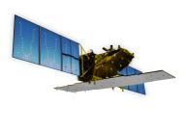





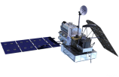


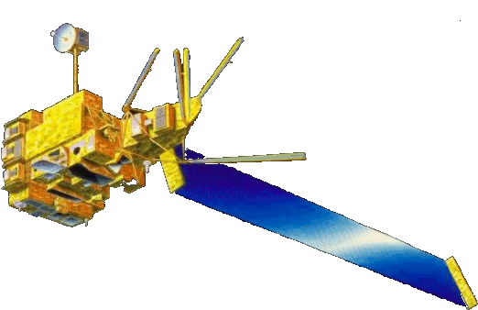
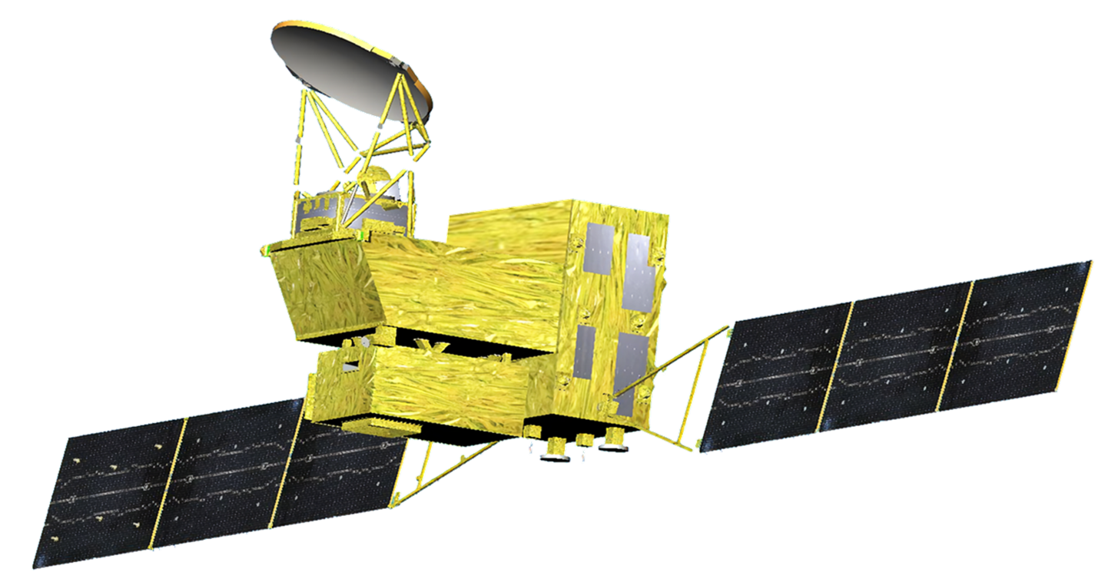


Recent & Planned launches and Instrument Updates that are relevant to GSICS (1) JAXA Missions
Targets (JFY: Apr-Mar) |  | 2018 | 2019 | 2020 | 2021 | 2022 | 2023 | 2024 | 2025 | 2026 | 2027 | 2028 | 2029 | 2030 | 2031
Disasters Management & Land Monitoring JERS1/OPS, SAR (1992-1998) ADEOS-I/AVNIR ALOS/AVNIR2, PALSAR (2006-2011)
Climate System Climate change ADEOS-I/OCTS (1996-1997) ADEOS-II/GLI (2003)
Water Cycle TRMM/PR (1997-2015) ADEOS-II/AMSR (2003) Aqua/AMSR-E (2002-2011)
Greenhouse gases
[Land and disaster monitoring]
ALOS-2 / PALSAR-2
[Land and disaster monitoring]
ALOS-4 (Radar)
[Land and disaster monitoring]
ALOS-3 (Optical) *Failed to enter orbit
[Vegetation, aerosol, cloud, SST, ocean color]
GCOM-C / SGLI
[Cloud and aerosol 3D structure]
EarthCARE / CPR
with ESA
[Precipitation 3D structure]
with NASA
GPM / DPR
[Wind, SST, water vapor, rainfall]
PMM (precip. radar w/doppler)
GCOM-W / AMSR2
[Wind, SST, water vapor, rainfall]
JAXA mission
GOSAT-GW / AMSR3
GOSAT-GW / TANSO-3
[CO_{2,} CH₄]
with MOE
[CO_{2,} CH₄, NO₂]
MOE mission
GOSAT
[CO_{2,} CH₄, CO]
with MOE
GOSAT-2
Mission status
Completed
On orbit
Developing
Planning

Slide 4
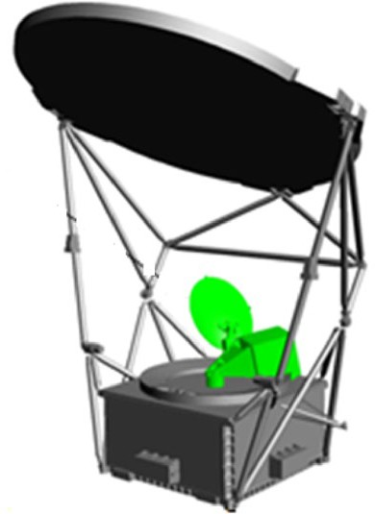
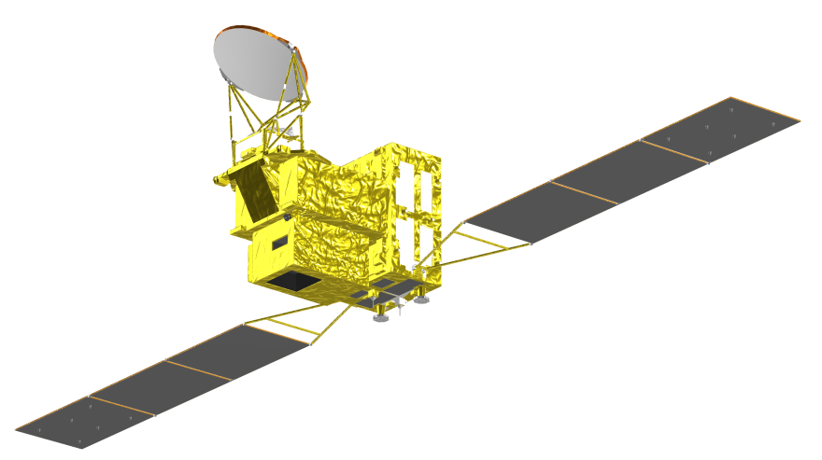
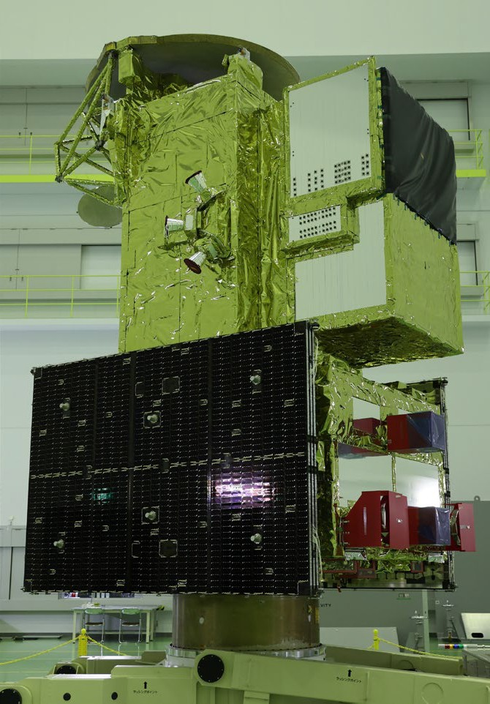
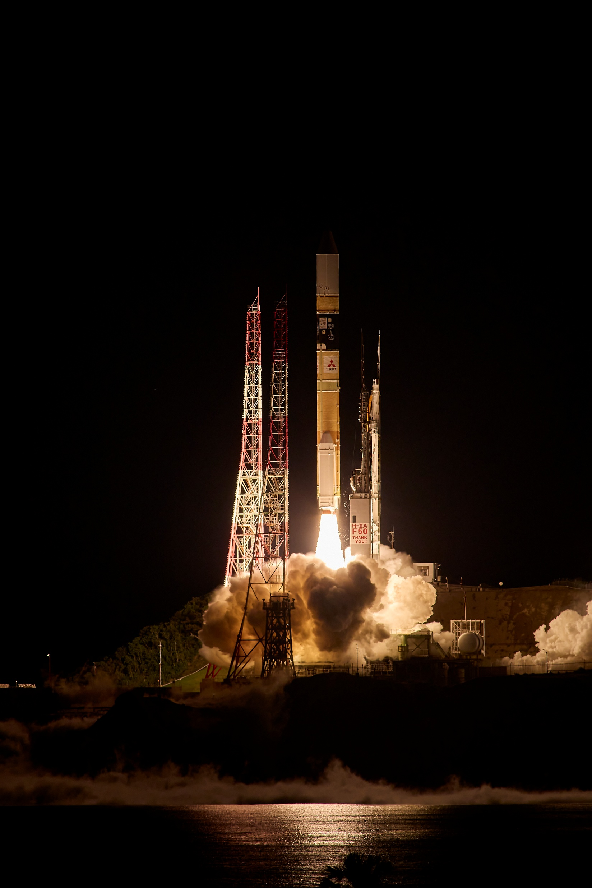
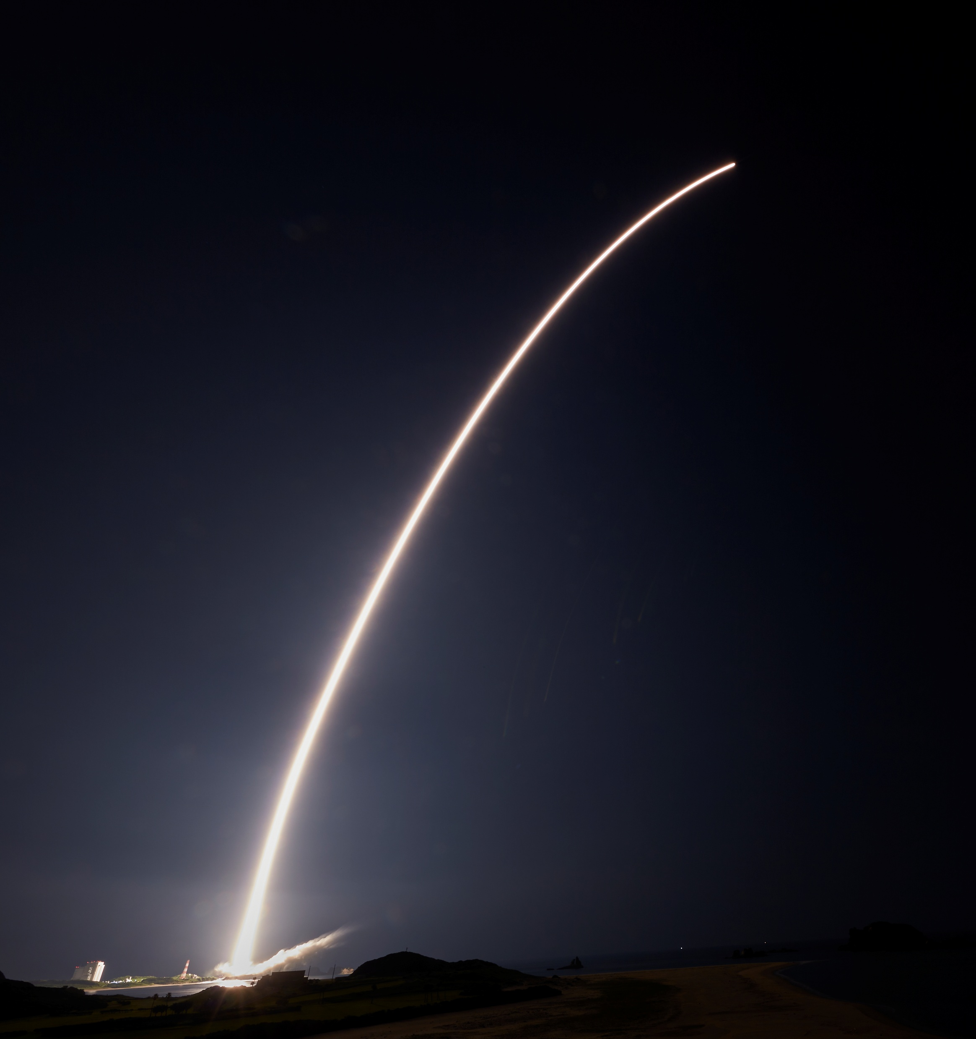
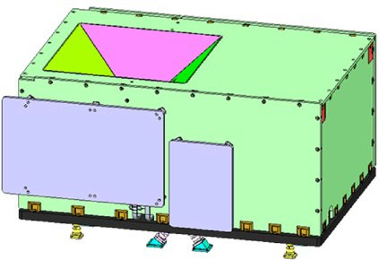
Recent & Planned launches and Instrument Updates that are relevant to GSICS (2) GOSAT-GW
AMSR3
(Advanced Microwave Scanning Radiometer 3)
GOSAT-GW: Global Observation SATellite for
Greenhouse gases and Water cycle
AMSR3
AMSR3, led by JAXA, succeeds AMSR series observations adding new high frequency channels for solid precipitation retrievals and water vapor analysis in NWP
GOSAT-GW was launched at 1:33 JST on 29 Jun. 2025
TANSO-3
GOSAT-GW Satellite Specifications
Mission Instruments |  | AMSR3 (JAXA) TANSO-3 (MOE/NIES)
Orbit | Type | Sun-synchronous, Sub-recurrent orbit
 | Altitude | 666km, recurrent cycle 3days (same as GOSAT)
 | Local sun time at ascending | 13:30+/-15min (same as GCOM-W)
 | Revisit time | 3 days
Satellite Mass |  | 2.6 tons (including propellant)
Designed lifetime |  | > 7 years
Launch |  | 29 June 2025 (JST) by H-IIA #50
TANSO-3
(Total Anthropogenic and Natural emissions mapping SpectrOmeter-3)
TANSO-3, led by Japanese Ministry of the Environment (MOE) and National Institute of Environment Studies (NIES), improves observation capability of greenhouse gases from GOSAT-2/TANSO-2

Slide 5
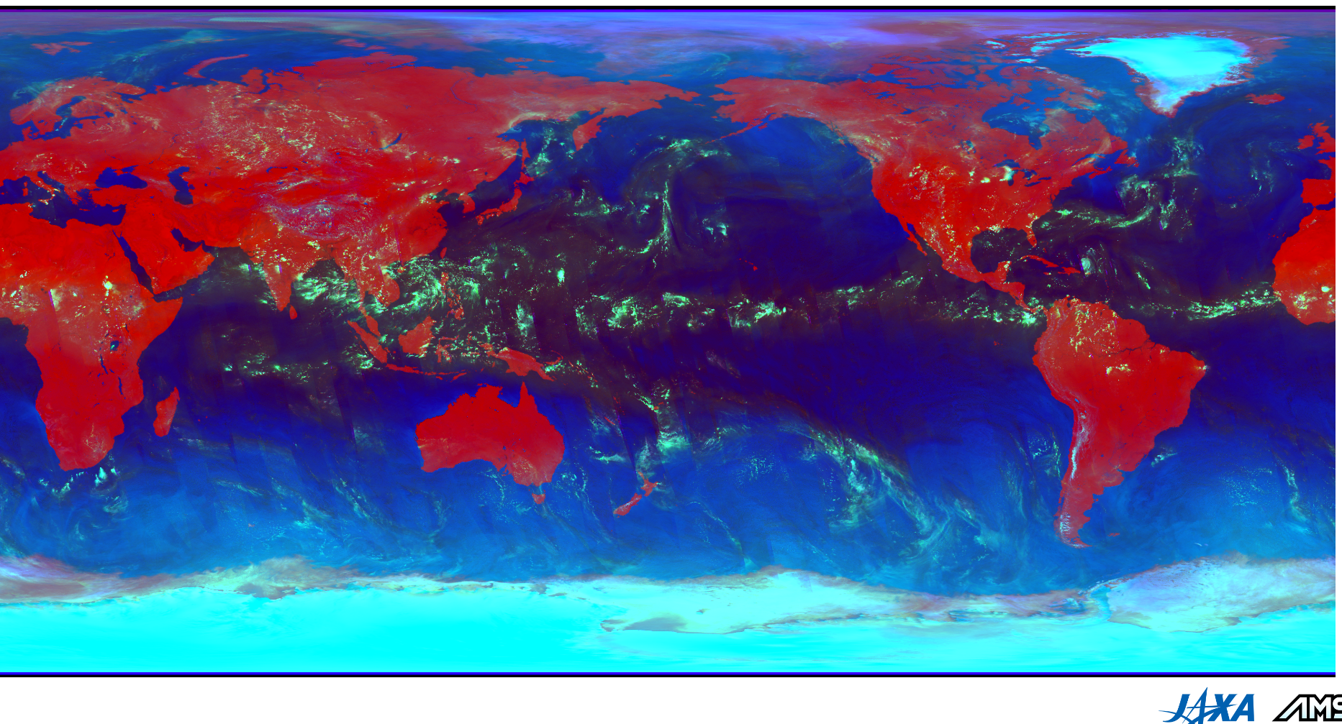
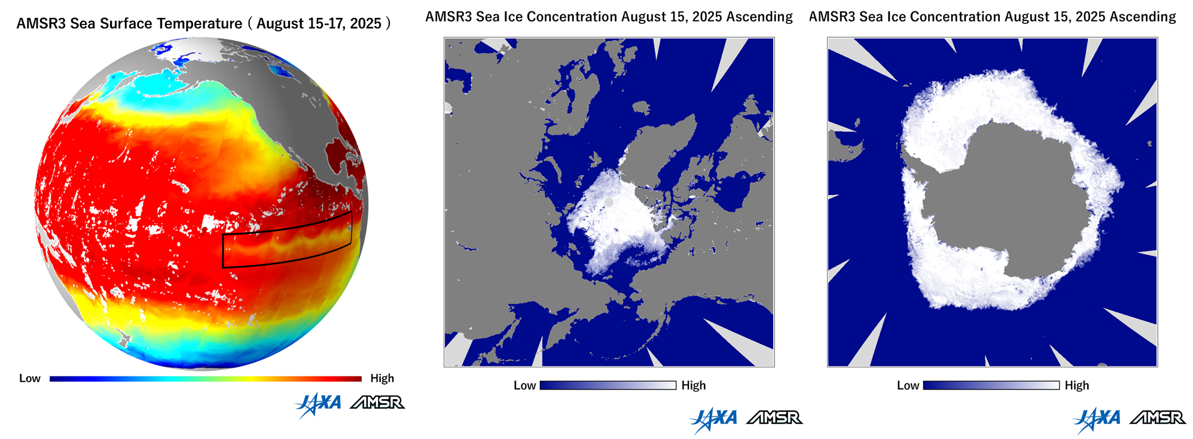
Recent & Planned launches and Instrument Updates that are relevant to GSICS (3) AMSR3
AMSR3 started scientific observation from 11 Aug. 2025 and released first images on 5 Sep. 2025.
It is currently in calibration/validation phase for preparing public data release (Ver.1.0) scheduled in the end of June/early Jul. 2026. Early data (Ver.0.1) has been provided to partner agencies since Nov. 2025.
AMSR3 RGB composite image using 18.7, 89.0, and 165.5 GHz V-Pol. TB to highlight cloud/precipitation area in light green (15-17 Aug. 2025, Ascending)
https://global.jaxa.jp/press/2025/09/20250905-1_e.html
Initial cal/val phase until Jun. 2026

Slide 6
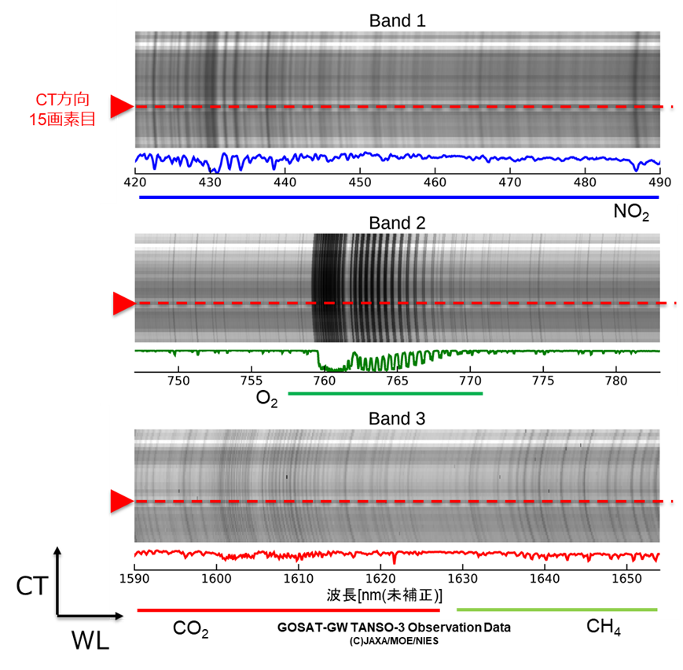
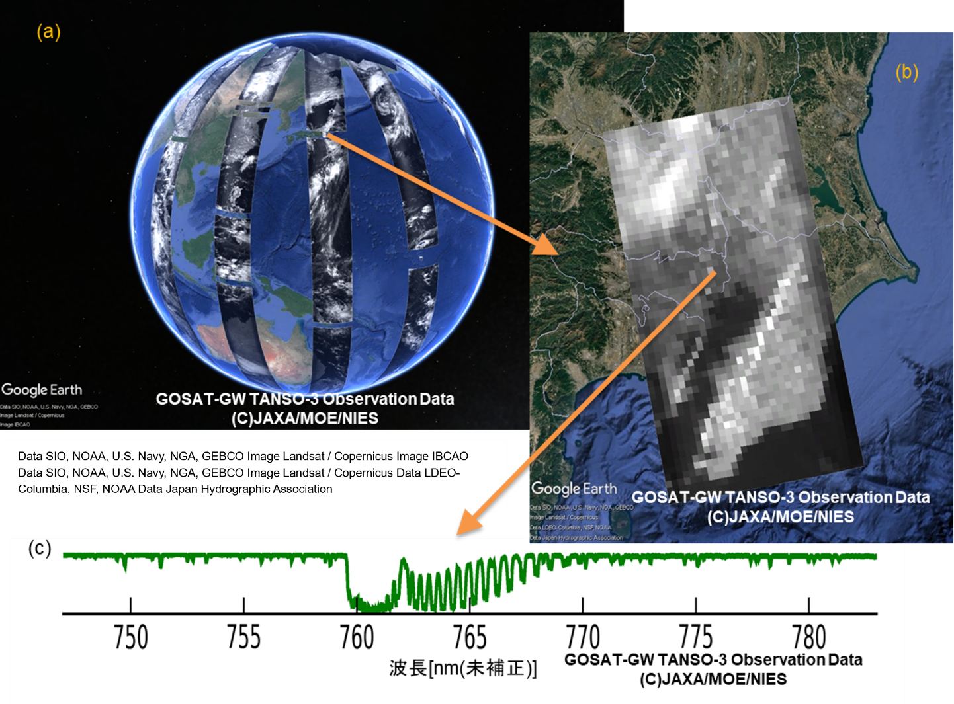
Recent & Planned launches and Instrument Updates that are relevant to GSICS (4) TANSO-3
July14-20, 2025: TANSO-3 acquired first spectral images
July17: Focus mode spectra over Greater Tokyo
Wide mode: 10km-res with 910km-swath
Focus mode: 1,2 or 3km-res with 90km-swath
July14:
Daily global coverage
Central
Tokyo
July17: Focus mode 3km
CT
O₂ absorption spectrum at Central Tokyo
spatial axis (CT)
spectral axis
Initial cal/val phase until April 2026
https://www.jaxa.jp/press/2025/08/20250808-1_j.html (Japanese only)

Slide 7

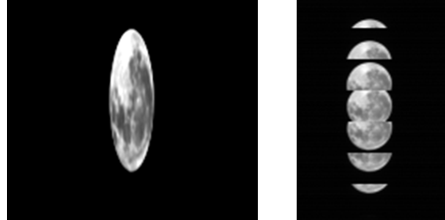
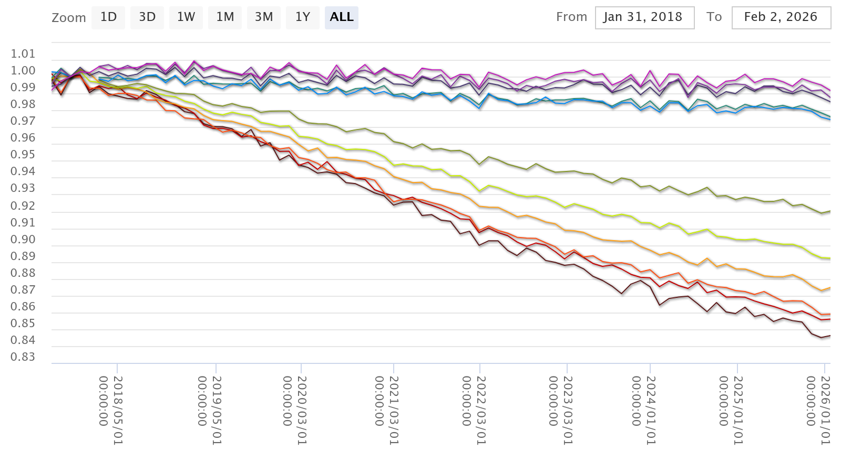
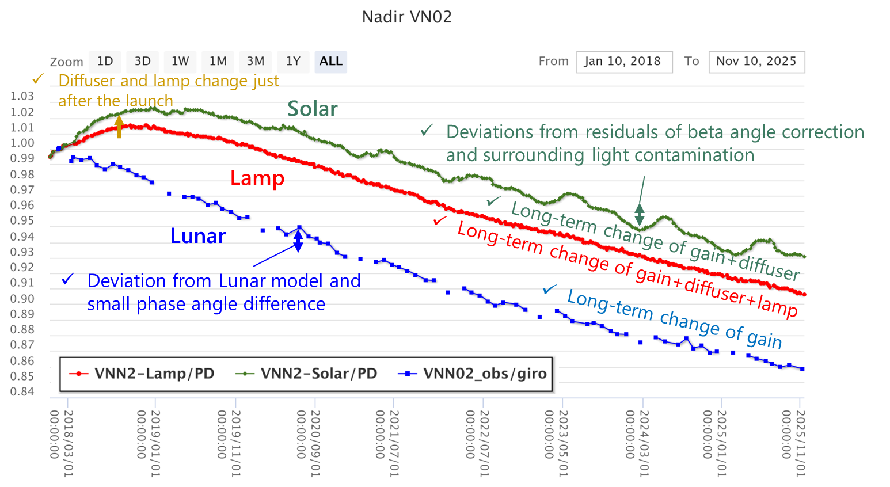
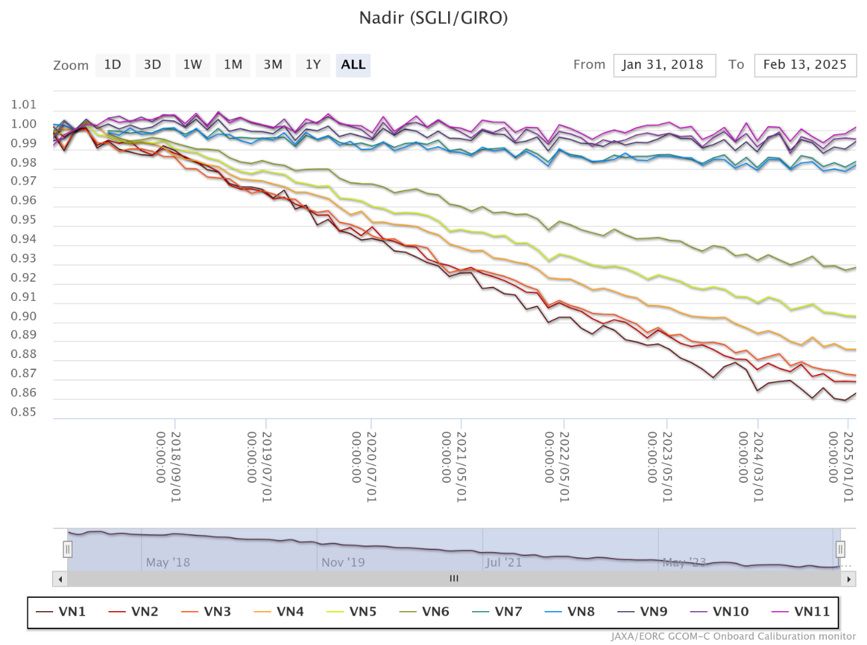
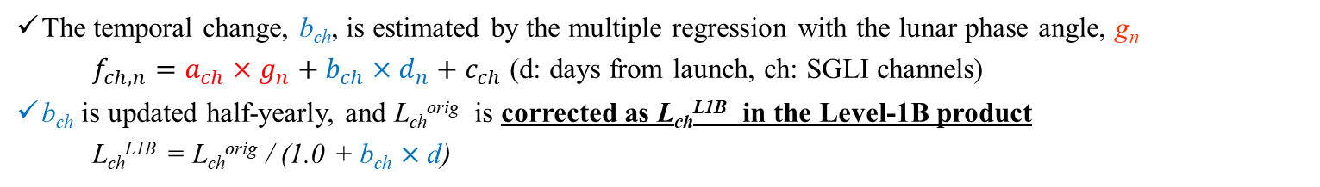
Calibration Major Updates
(1) SGLI Lunar CAL by GIRO
GCOM-C SGLI lunar calibration is regularly updated by the monthly (phase angle ~+7°) lunar observation operations (by the pitch maneuver; 104 times from Jan. 2018 to Mar. 2026) with GIRO
All SGLI lunar observation data (GIRO input/output files) have been submitted to GLOD
VNR
IRS
The temporal change, b_{ch}, is estimated by the multiple regression with the lunar phase angle, g_{n}
    $f_{ch,n}=a_{ch}×g_{n}+b_{ch}×d_{n}+c_{ch}$ (d: days from launch, ch: SGLI channels)
b_{ch} is updated half-yearly, and L_{ch}^{orig} is corrected as L_{ch}^{L1B} in the Level-1B product
  L_{ch}^{L1B} = L_{ch}^{orig} / (1.0 + b_{ch} $×$d)
Urabe et al. (2020). DOI: 10.3390/rs12010069;
Urabe et al. (2019) DOI: 10.1109/IGARSS.2019.8897892
1.01
SGLI/GIRO
Consistency among calibration methods (Solar diffuser, lamp, and lunar) has been confirmed.
VNR 380nm~865nm
0.83
2018/01
2026/01
Time series of SGLI/GIRO trend (Normalized by 2018/2/1)
Temporal change of Solar, Lamp and Lunar calibrations (VN02: 412nm)

Slide 8

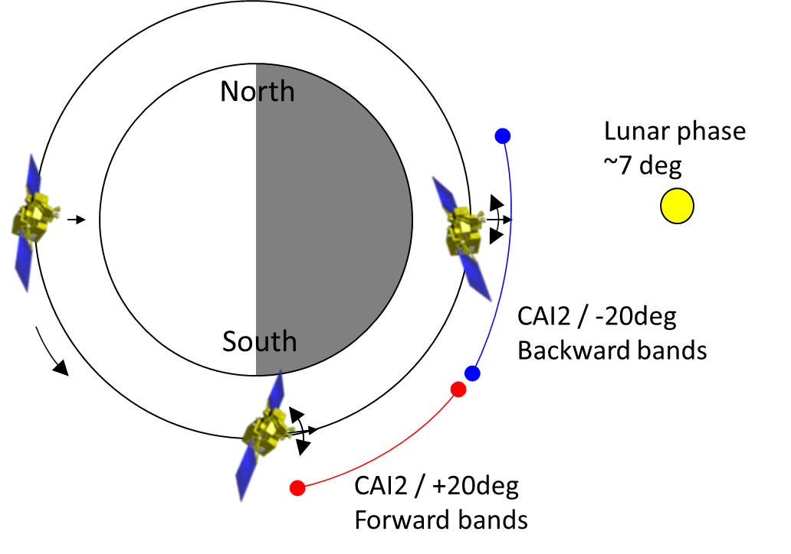
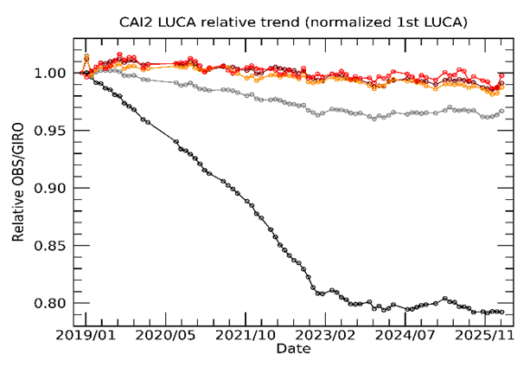
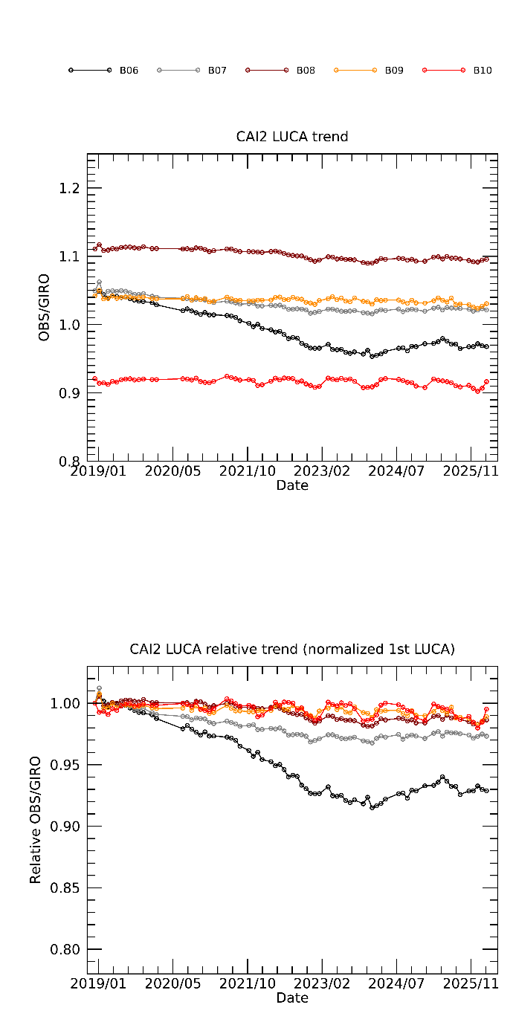
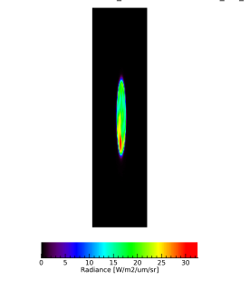
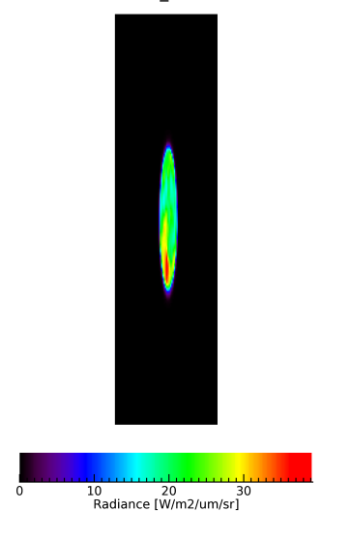
Calibration Major Updates
(2) GOSAT-2 Lunar CAL by GIRO
Details were presented by
K. Shiomi at UVN-S Break-out Session
CAI-2 has been operated the lunar calibration for radiometric calibration by along-track (AT) scans (satellite pitch rotations) once a month since December 2018. The lunar phase angle is targeted around 7 deg.
CAI-2 observes at 340, 380, 440, 550, 670, 870, and 1630 nm and compered with GIRO. 340nm is compared with the extrapolated model.
CAI-2 B1 340 nm band degraded around 20 %, B6 380 nm band around 8 % in 5 years. Degradation has become slowly since 2023.
CAI-2 radiance degradation factor is implemented to L2 pre-processing.
Illustration of GOSAT-2 lunar calibration
Band1 (340nm)
Band6 (380nm)
B02(0.441μm)
CAI-2 radiance compared with GIRO
B06(0.377μm)
B01(0.339μm)
B01-B05(Forward-view)
B06-B10(Backward-view)

Slide 9
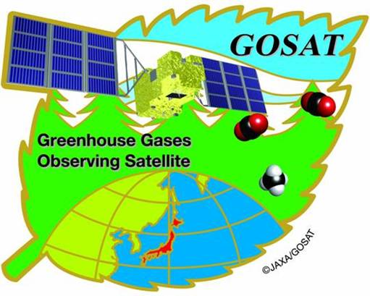
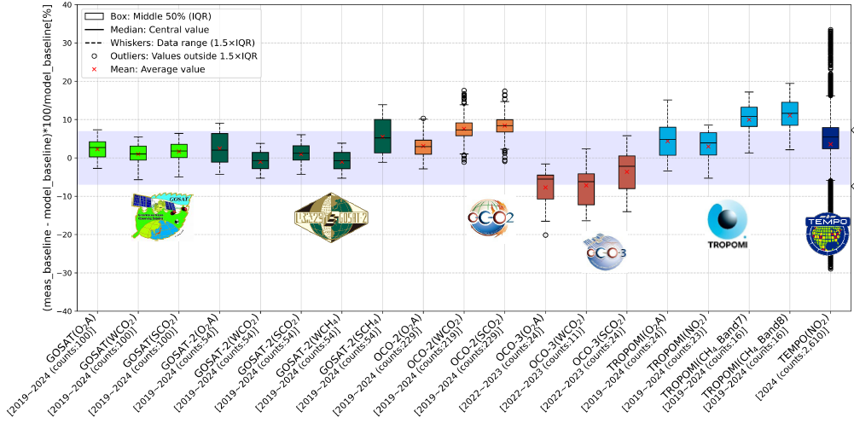
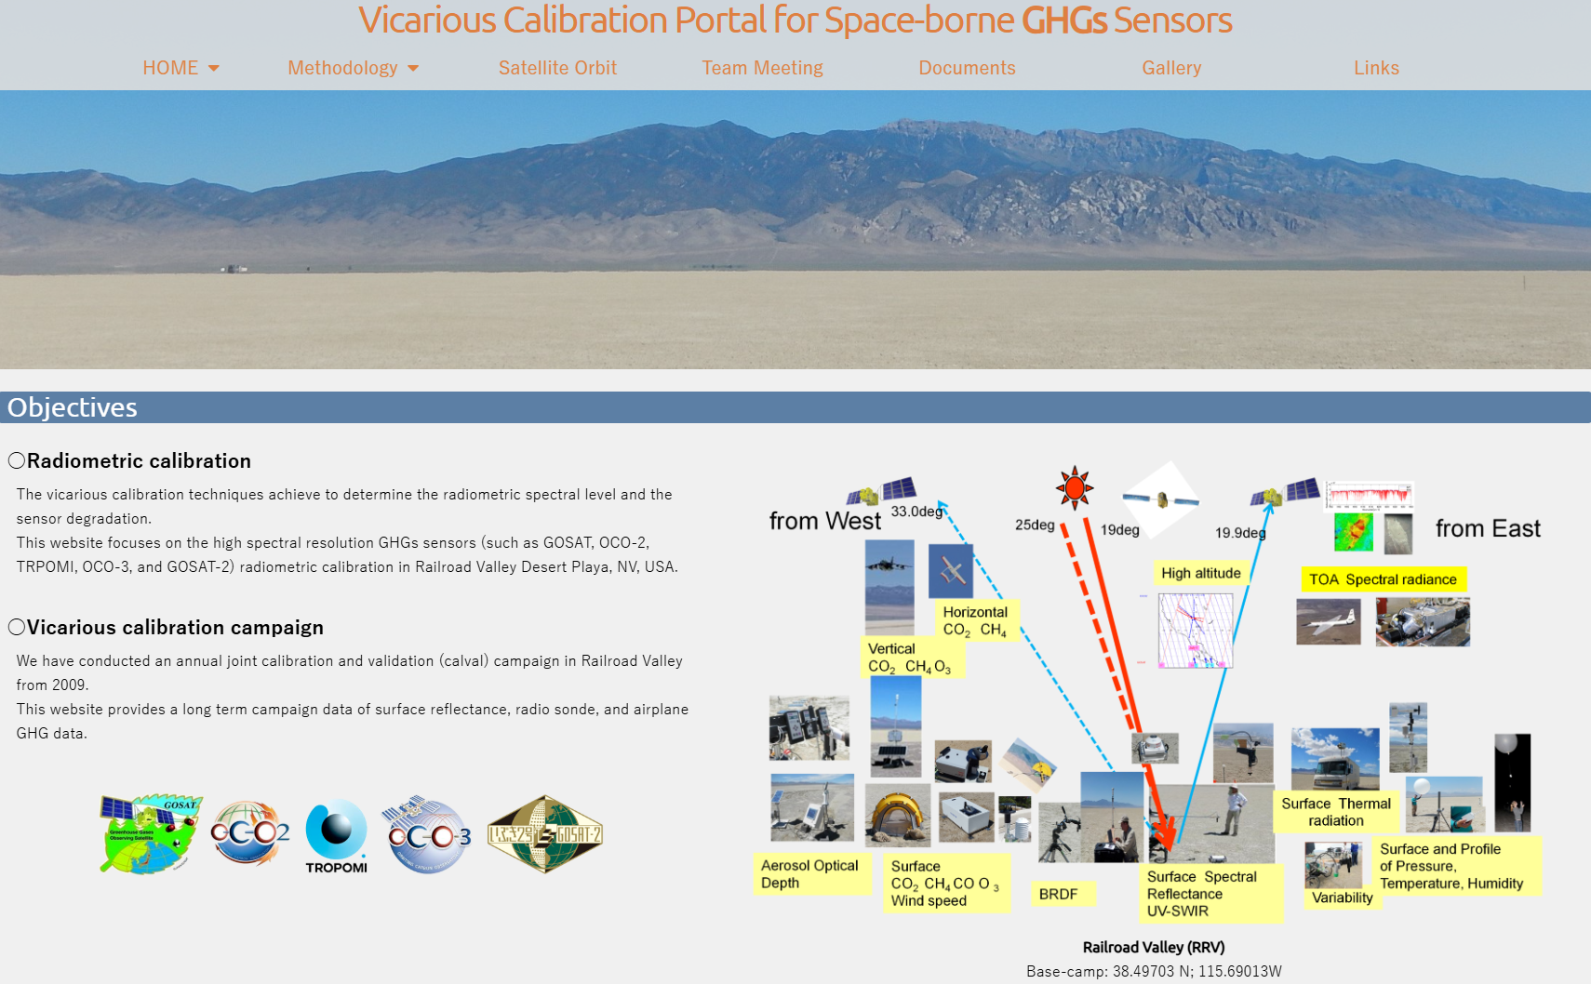
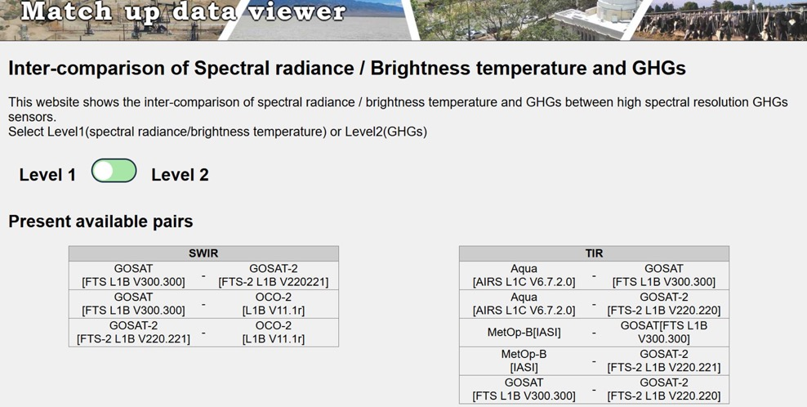
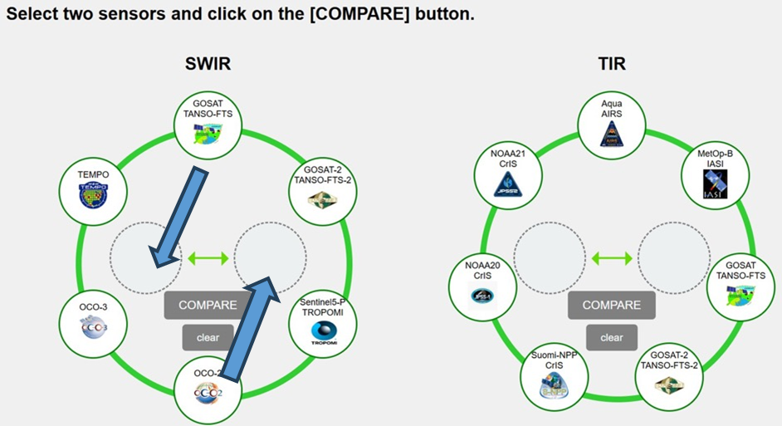
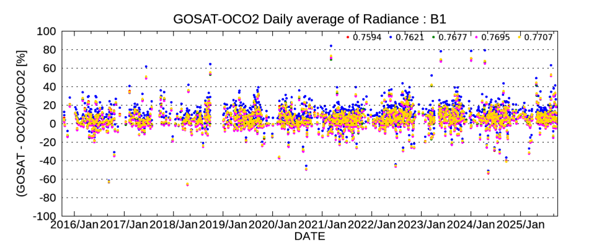
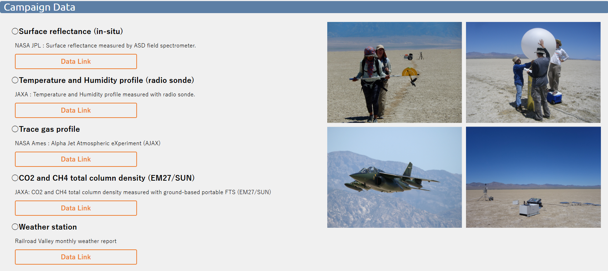
Calibration Major Updates
(3) Cross calibration of GOSAT/GOSAT-2/OCO-2
Details were presented by
K. Shiomi at UVN-S Break-out Session
Vicarious calibration at desert site as a common calibration target for space-borne GHG sensors [from Vi-cal portal site]
Inter-comparison of GHG sensors for radiometric and retrieved parameters time-trend [from Match-up viewer site]
Vi-cal results of 6 GHG sensors
Vi-cal portal site for GHG sensors
Match-up viewer site for GHG sensors
Match-up results of GOSAT-OCO2 O2A radiance
GOSAT V300 vs OCO-2 V11
https://www.eorc.jaxa.jp/GOSAT/GHGs_Vical/index.html
https://www.eorc.jaxa.jp/GOSAT/Matchup_forCal/top_matchup_viewer.html

Slide 10


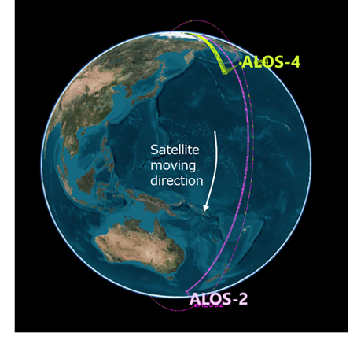
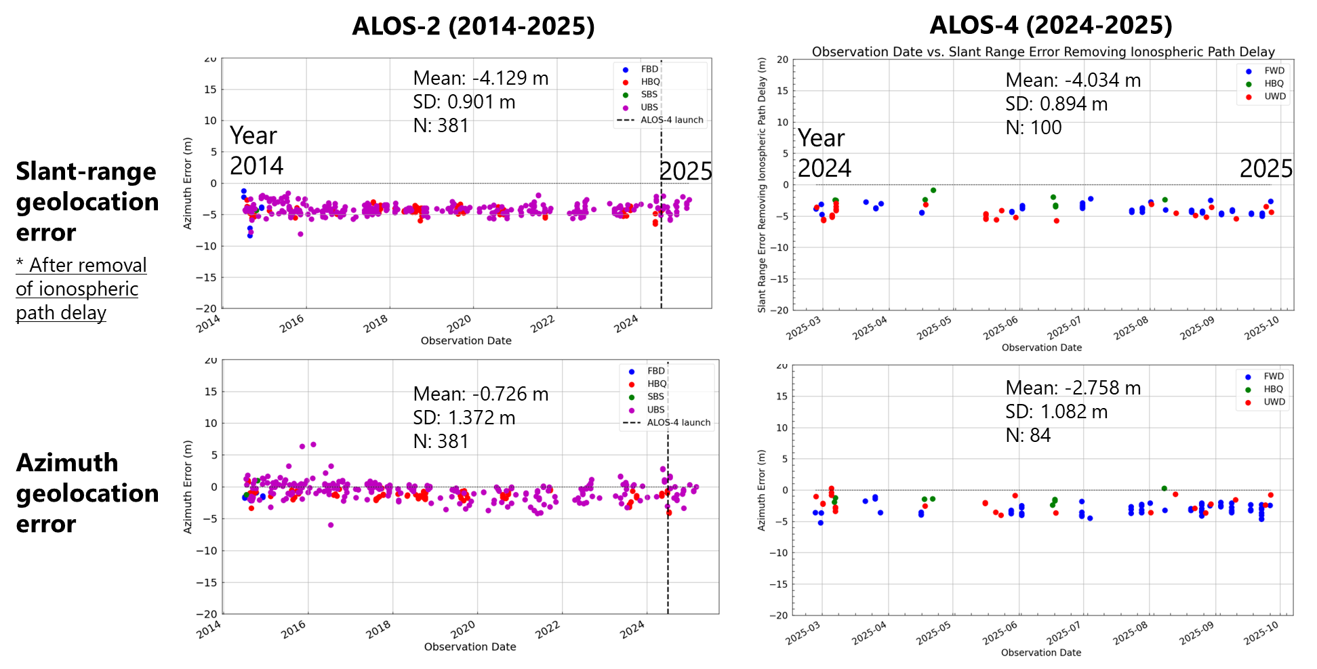
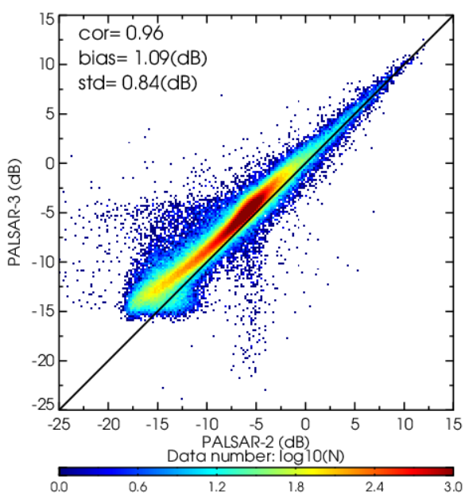
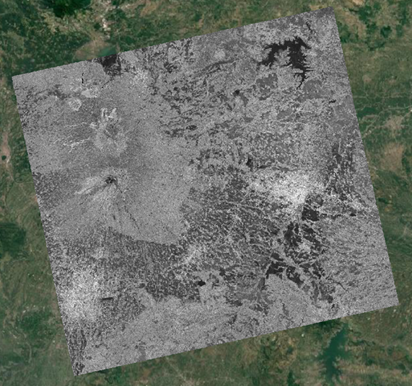
Calibration Major Updates
(4) Cross calibration of ALOS-2 & ALOS-4
Initial calibration of ALOS-4 L-band SAR (Synthetic Aperture Radar) was completed in March 2025. After cross calibration between ALOS-2 and ALOS-4, good agreement was confirmed for geometric, radiometric, and polarimetric accuracy.
ALOS-4 flies on the same reference orbit as ALOS-2
Comparison of ALOS-2 and ALOS-4 products
Geometric accuracy
Radiometric (backscatter)
ALOS-4
ALOS-2

Slide 11

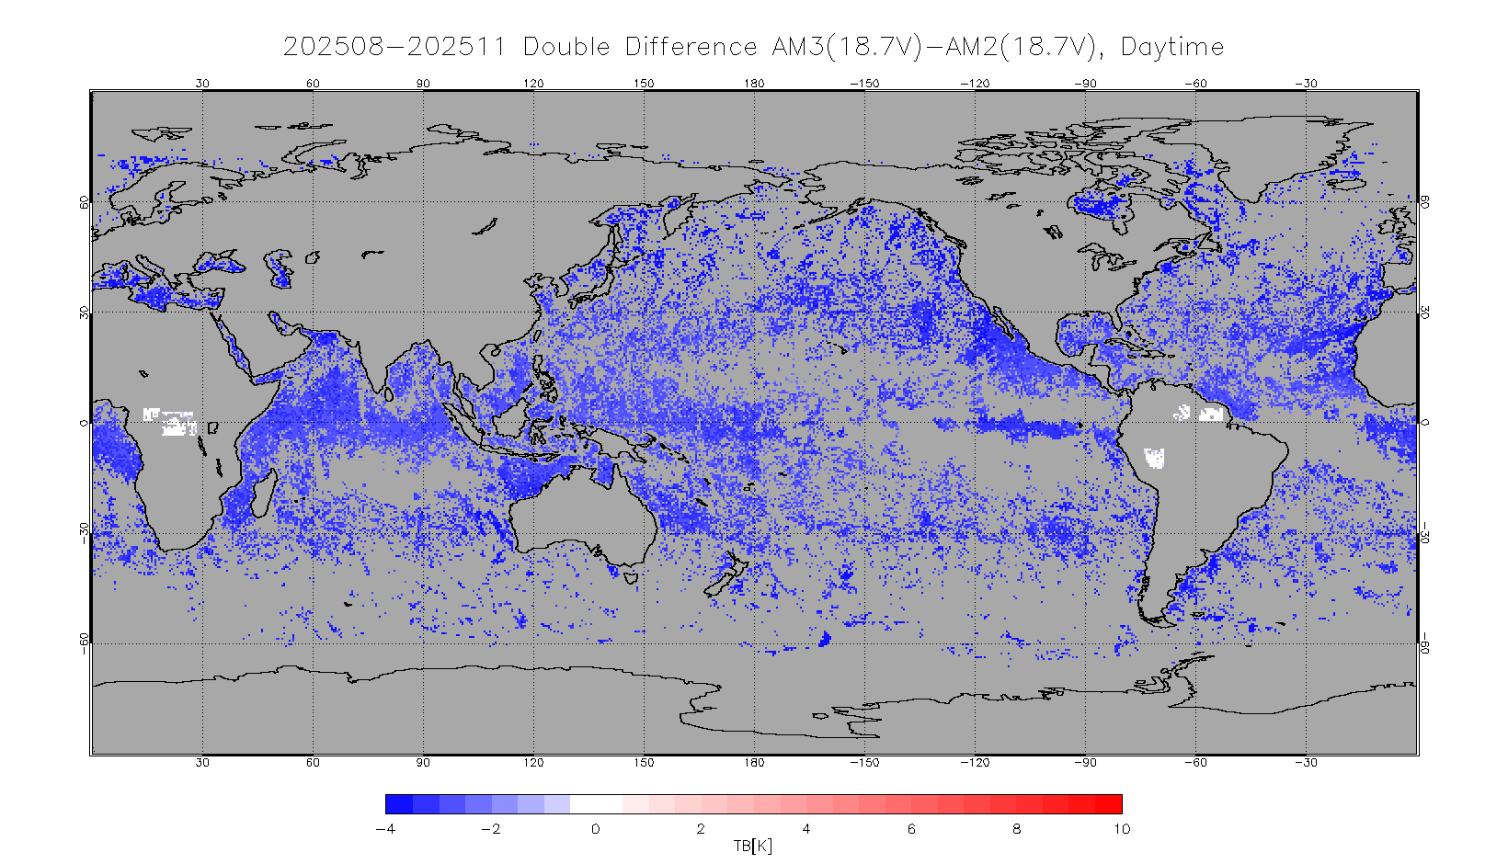
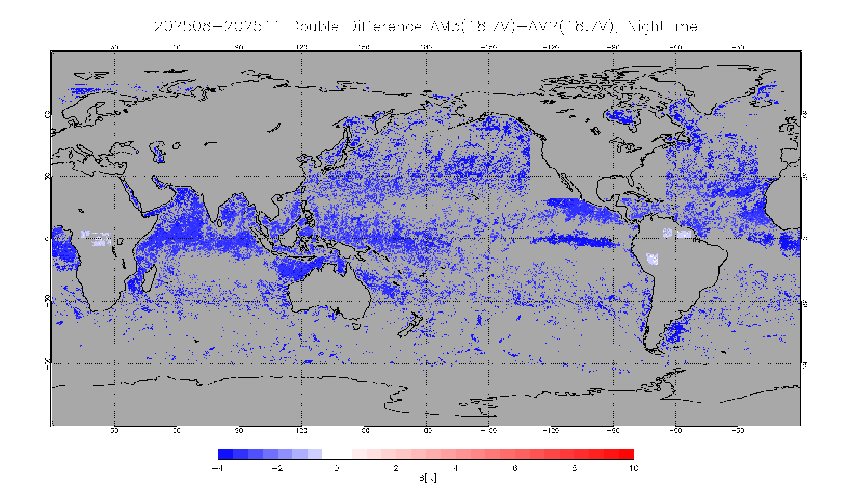
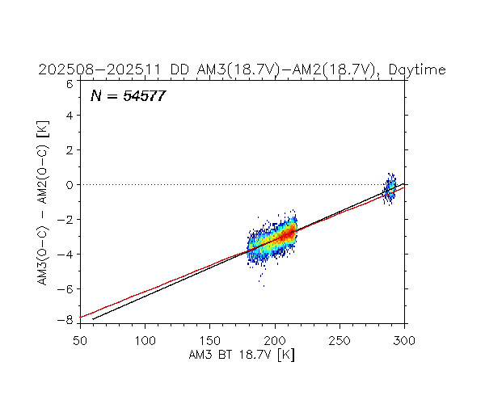
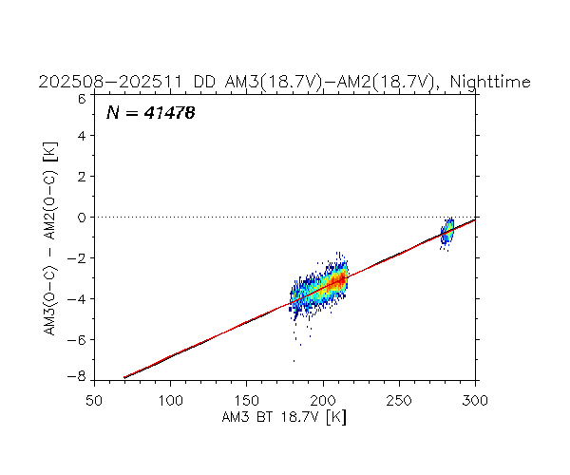
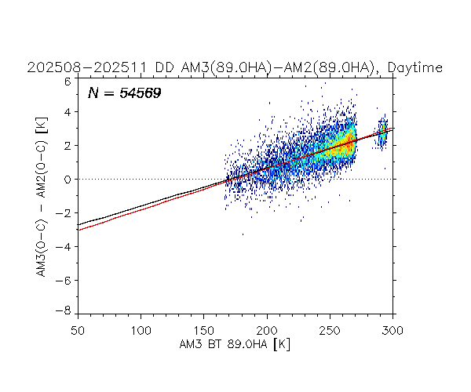
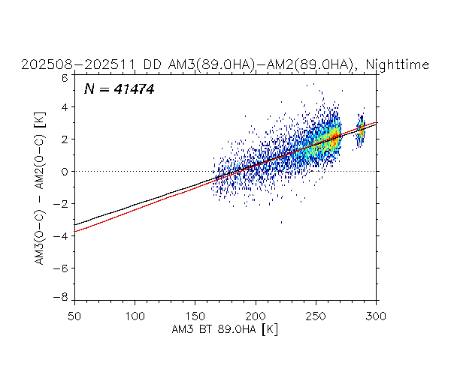
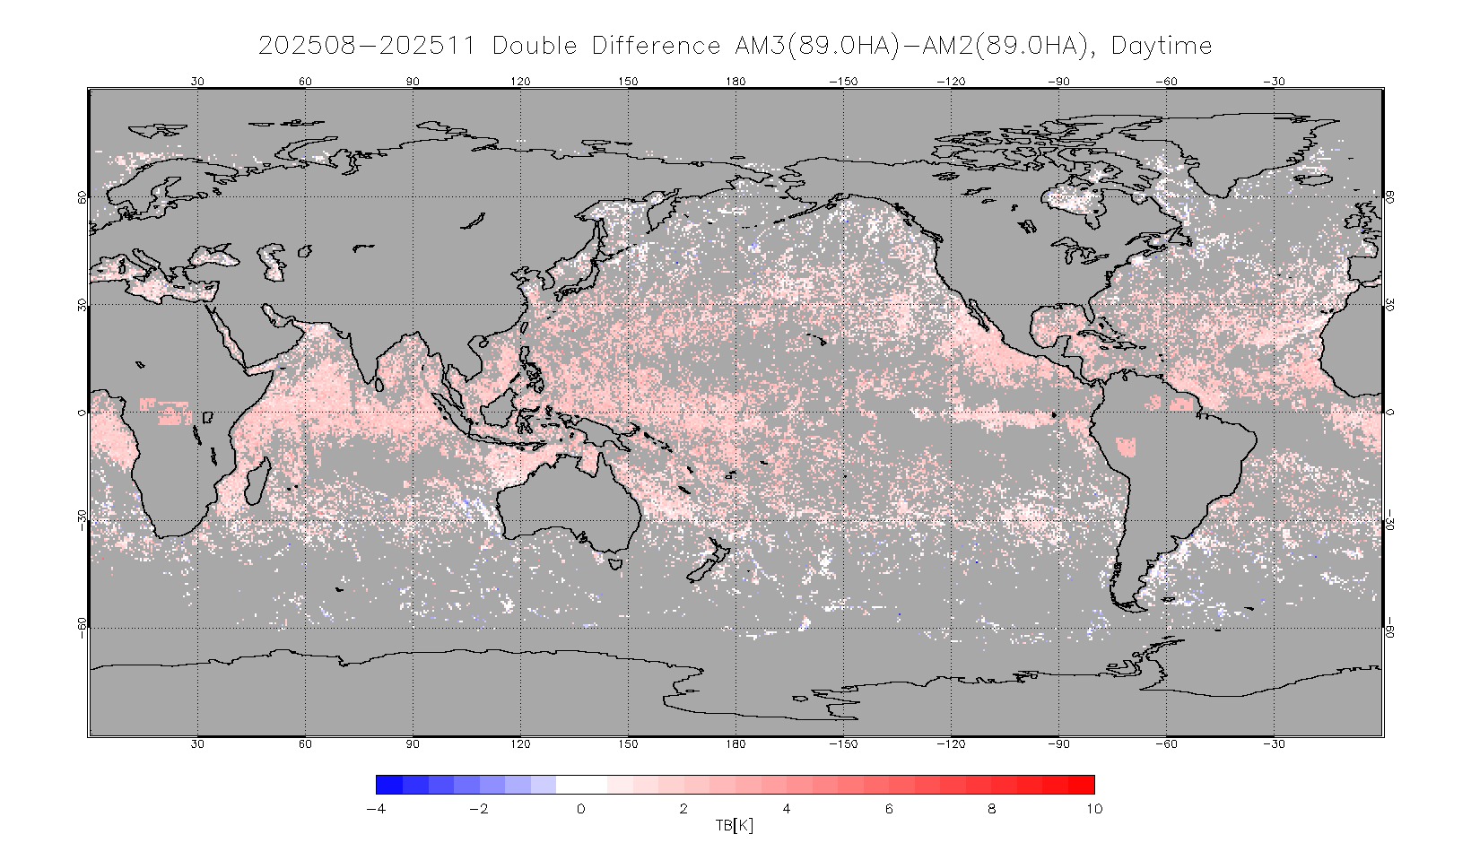
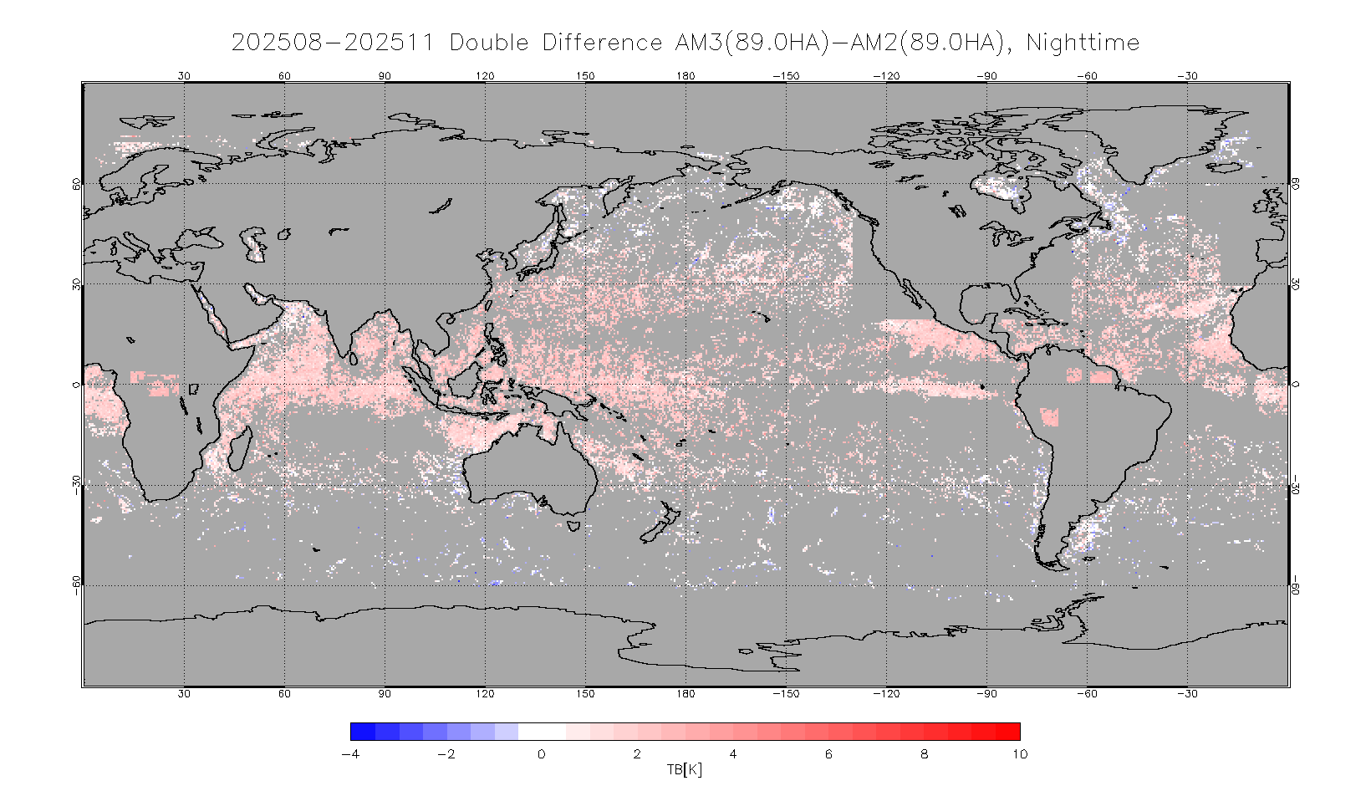
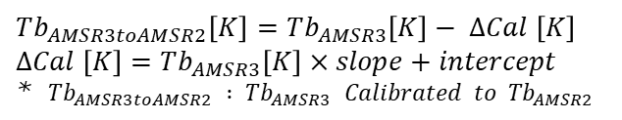
Calibration Major Updates
(5) Cross-calibration of AMSR3 VS AMSR2 (and GMI)
Details were presented by
M. Kachi at MW Break-out Session
Double Difference (DD) method is applied to evaluate calibration error between AMSR3 and AMSR2 (6-89GHz) and GMI (10-183GHz).
Below are examples of comparison results between AMSR3 early data (Ver.0.1, released Nov. 2025) and AMSR2 (Ver.2.2) from Aug. 11 to Nov. 30, 2025. Comparison using updated version of AMSR3 (Ver.0.2, released Mar. 2026) for longer period is currently underway.
DD (Ascending )
DD (Descending)
Asc.
Desc.
18V
18V
AMSR3 DD – AMSR2 DD
18V
AMSR3 TB
AMSR3 TB
89HA
89HA
89HA
AMSR3 DD – AMSR2 DD
AMSR3 TB
AMSR3 TB
$$Tb_{AMSR3toAMSR2}\left[K\right]=Tb_{AMSR3}\left[K\right]− ΔCal \left[K\right]$$
$$ΔCal \left[K\right]=Tb_{AMSR3}\left[K\right]×slope+intercept$$
* $Tb_{AMSR3toAMSR2} : Tb_{AMSR3} Calibrated to Tb_{AMSR2}$

Slide 12
GSICS Team Updates
Points of contacts/meeting participants:
  EP Focal Point: Misako Kachi
  GRWG members: Hiroshi Murakami (optical & IR imager) ,
  Misako Kachi (MW), Kei Shiomi (UVN-S)
  Other Key Agency Personal
    GHGs: Hiroshi Suto
    SAR: Takeo Tadono & Takeshi Motohka
    Precipitation radar: Takuji Kubota & Kosuke Yamamoto
    MW: Keiichi Ohara
    Overall coordination: Toshiyuki Kurino

