Slide 1
GSICS 2026 Agency Report
JMA
OMORI Shiro (EP), TAKAHASHI Masaya (GRWG & GDWG), KOYAMATSU Shin (GRWG), and TOMA Tsuguyoshi (GRWG)
Japan Meteorological Agency / Meteorological Satellite Center

Slide 2
JMA GSICS Activities
Recent main activities: preparation for observation performance monitoring/validation of Himawari-10 VIS/IR imager (GHMI) and IR sounder (GHMS)
  Updates of existing algorithms for AHIs on Himawari-8/-9
    VNIR Ray-matching: use of LOS vector difference, optimal spatial/temporal resolution for stats, SBAF handling, ...
    Lunar: use of new reference model in LSICS, improving observed irradiance computation, …
    IR: extension of inter-calibration algorithm for GEO imager to GEO sounder
  Development of integrated L1 performance monitoring system (for internal purpose at this moment)
Other activities
  Level-1 reprocessing for Himawari series imagers is not carried out at JMA, but we are involved with GIAD (Geostationary Image Anomaly Detection) project led by EUMETSAT, which is a part of GEO-Ring activities
Action status
Action ID | Summary | Lead | Status
A.GIR.2025.5g.1 | Evaluate how many samples reduced after used LOS collocation method | Shin Koyamatsu | Ongoing
A.GVNIR 20240313.12 | JMA to report AHI Ray-matching result at the future web meeting | Masaya Takahashi | Open

Slide 3
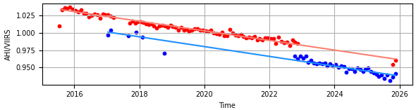
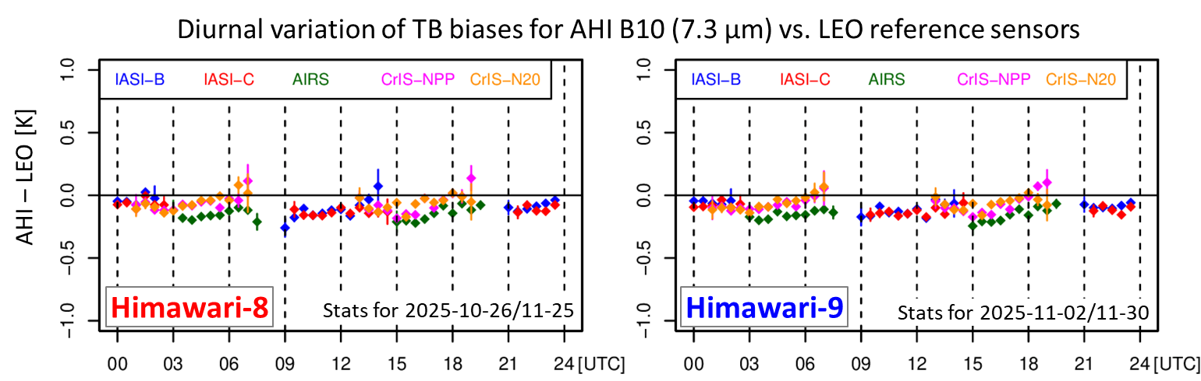
Current Satellite System: Himawari-8 and -9
GEO at around 140.7 deg. E
16-band VIS/IR imager called AHI (Advanced Himawari Imager)
Operation
  Himawari-8: 2015-07-07 to 2022-12-13
    Currently in-orbit standby
  Himawari-9: 2022-12-13 to JFY 2030
Backup operation by Himawari-8 2025-10-11 to 11-26
  Due to a communication error within the Himawari-9 satellite
  Observation quality of Himawari-9/AHI remained high and stable
Calibration trend for AHI B03 (0.64 μm) vs. S-NPP/VIIRS I1 (0.64 μm)
(Ray-matching Inter-calibration slope)
Himawari-8
Himawari-9

Slide 4
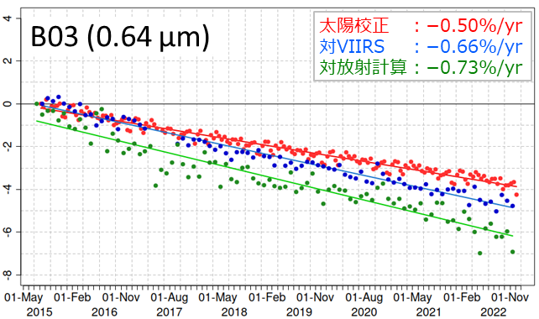
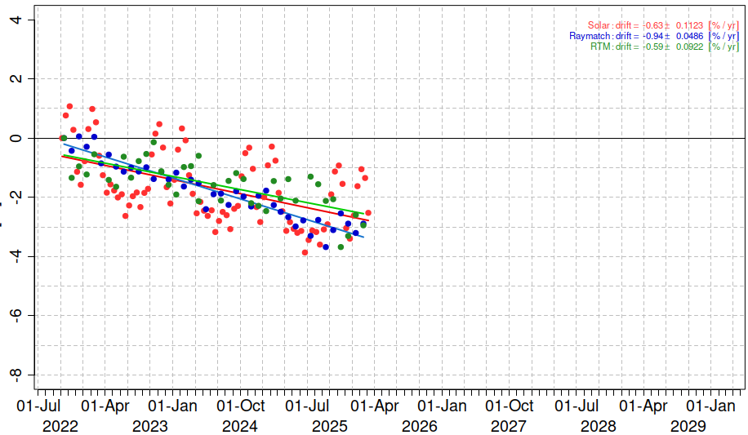
Calibration Major Updates: VNIR Cal. Correction Info for Himawari-9/AHI
Calibration trend for AHI B03 (0.64 μm)
Normalized to 0% by the 1st result for each method
VNIR calibration using solar diffuser
  Solar observation has been performed twice a month, but operational calibration gain has not been updated due to large seasonal variation
Himawari-8
  Calibration trend is estimated on annual basis and included in the level-1 product (Himawari Standard Data) as a trend correction info
Himawari-9
  Larger seasonal variation than Himawari-8, but the same approach was applied to operational level-1 product on 2025-12-16 (by S. Naiki of JMA/MSC)
[%]
Himawari-8
Solar cal. : -0.50%/yr
Ray-matching: -0.66%/yr
RT simulation : -0.73%/yr
[%]
Himawari-9
Solar cal. : -0.63%/yr
Ray-matching: -0.94%/yr
RT simulation : -0.59%/yr
  https://www.data.jma.go.jp/mscweb/en/oper/eventlog/Update_of_Calibration_Information_2025-2.pdf
~7.5 years

Slide 5
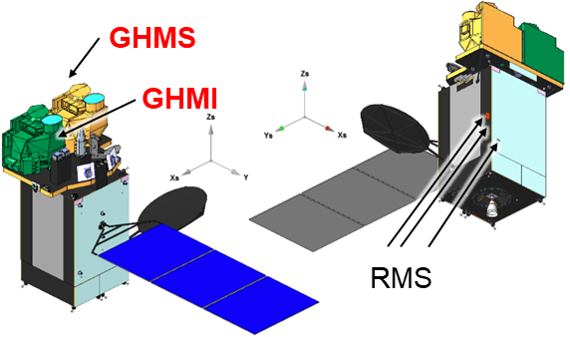
Future Satellite System: Himawari-10
GEO at around 140.7 deg. E
Missions
  Geostationary HiMawari Imager (GHMI) – 18-band VIS/IR imager
  Geostationary HiMawari Sounder (GHMS) – infrared FTS
  Data Collection System
  Radiation Monitors for Space weather (RMS) – proton & electron flux measurements by NICT
Planned launch: JFY 2030
  Nov 2025: sensor CDR completed
  Jan 2026: system CDR completed
JFY Apr. – Mar. | 2024 | 2025 | 2026 | 2027 | 2028 | 2029 | 2030 | 2031 | 2032-
Himawari-9 operation/utilization
Himawari-10 manufacturing
Himawari-10 operation/utilization
Launch
Today

Slide 6
Geostationary HiMawari Imager (GHMI)
Spectral Band Characteristics
 | Center Wavelength [µm] | Bandwidth [µm] | Horizontal Resolution at Nadir [km]
 |  |  | Requirement | Design at CDR | AHI
VIS | 0.46 - 0.48 | ≤ 0.07 | ≤ 1 | 0.5 | 1
 | 0.54 - 0.56 | ≤ 0.05 | ≤ 1 | 0.5 | 1
 | 0.63 - 0.65 | ≤ 0.12 | ≤ 0.5 | 0.25 | 0.5
NIR | 0.85 - 0.87 | ≤ 0.06 | ≤ 1 | 1 | 1
 | 1.375 - 1.385 | ≤ 0.04 | ≤ 2 | 2 | N/A
 | 1.60 - 1.62 | ≤ 0.08 | ≤ 2 | 1 | 2
 | 2.24 - 2.27 | ≤ 0.06 | ≤ 2 | 1 | 2
IR | 3.75 - 3.95 | ≤ 0.50 | ≤ 1 | 1 | 2
 | 5.10 - 5.20 | ≤ 0.20 | ≤ 1 | 1 | N/A
 | 6.05 - 6.45 | ≤ 1.20 | ≤ 2 | 2 | 2
 | 6.90 - 7.00 | ≤ 0.50 | ≤ 2 | 1 | 2
 | 7.27 - 7.43 | ≤ 0.60 | ≤ 2 | 2 | 2
 | 8.44 - 8.76 | ≤ 0.50 | ≤ 2 | 2 | 2
 | 9.55 - 9.70 | ≤ 0.50 | ≤ 2 | 2 | 2
 | 10.3 - 10.5 | ≤ 0.90 | ≤ 2 | 1 | 2
 | 11.1 - 11.3 | ≤ 1.00 | ≤ 2 | 2 | 2
 | 12.25 - 12.55 | ≤ 1.20 | ≤ 2 | 2 | 2
 | 13.2 - 13.4 | ≤ 0.70 | ≤ 2 | 2 | 2
L3Harris’s new 18-band VIS/IR imager based on the same concept with its GeoXO Imager (GXI)
Observing sequence & band configuration improved/changed for Himawari-10
Observing Area & Interval
Observing Area | Minimum Coverage | Interval
Full Disk |  | 10 min
Japan | EW 2500 km x NS 2000 km | 2.5 min
Target Area1 | EW 1000 km x NS 1000 km | 2.5 min
Target Area2 |  | 2.5 min
Target Area3 |  | 2.5 min
Target Area4 |  | 2.5 min
Target Area5 (*) | EW 1000 km x NS 500 km | 30 sec
*Mainly used for CAL/VAL activities

Slide 7
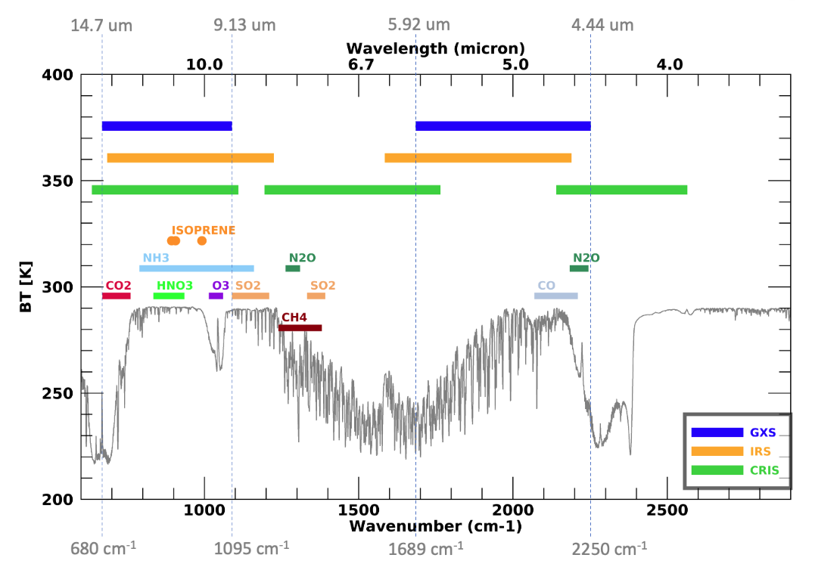
Geostationary HiMawari Sounder (GHMS)
Spatial & Spectral Characteristics
L3Harris’s infrared FTS sounder
Horizontal Resolution |  | ≤ 4.2 km (req.) 4.1 km (design)
Spectral Coverage | LWIR | 680 - 1095 cm⁻¹ (14.7 - 9.13 µm)
 | MWIR | 1689 - 2250 cm⁻¹ (5.92 - 4.44 µm)
Spectral Resolution |  | ≤ 0.754 cm⁻¹
Spectral Sampling Distance |  | ≤ 0.625 cm⁻¹
GHMS
GXS
IRS
CrIS
Observing Area & Interval
Observing Area (min. coverage) | Interval
Sounding Disk （zenith angle ≤ 60 deg） | 60 min
Japan （EW 2500 km x NS 2000 km） | 15 min*
Target Area （EW 1000 km x NS 1000 km） | 15 min
GHMS is added to Heidinger et al., ITSC-24
* Sounding Disk observation over Japan area is regarded as one of the "Japan" observations in the 60-min repeat cycle (i.e., three "Japan" observations to be conducted in 60 minutes).

Slide 8
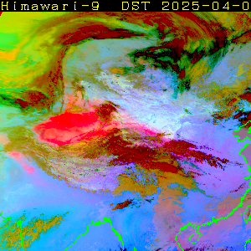
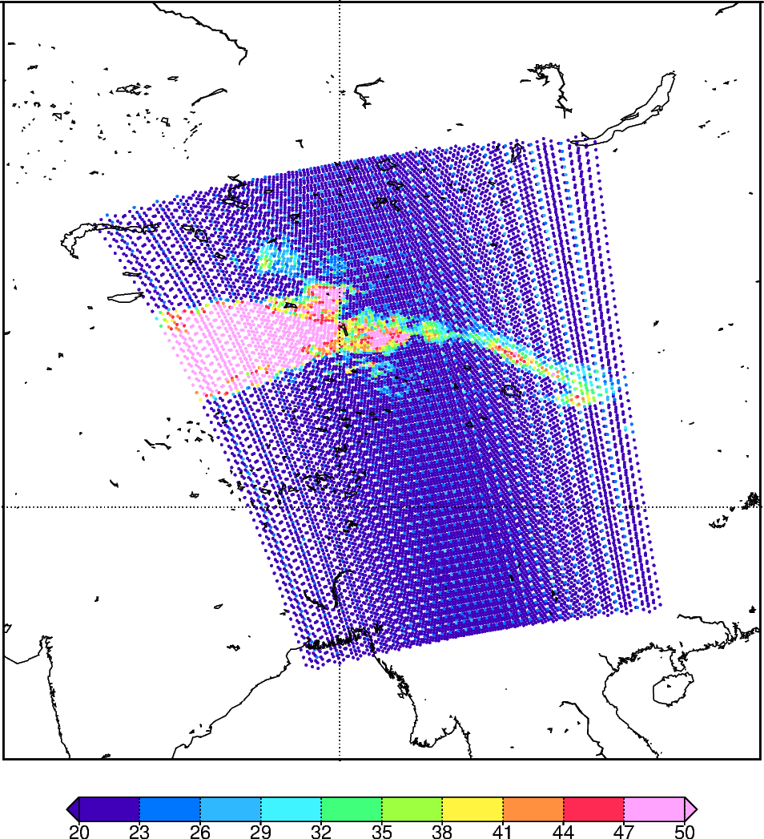
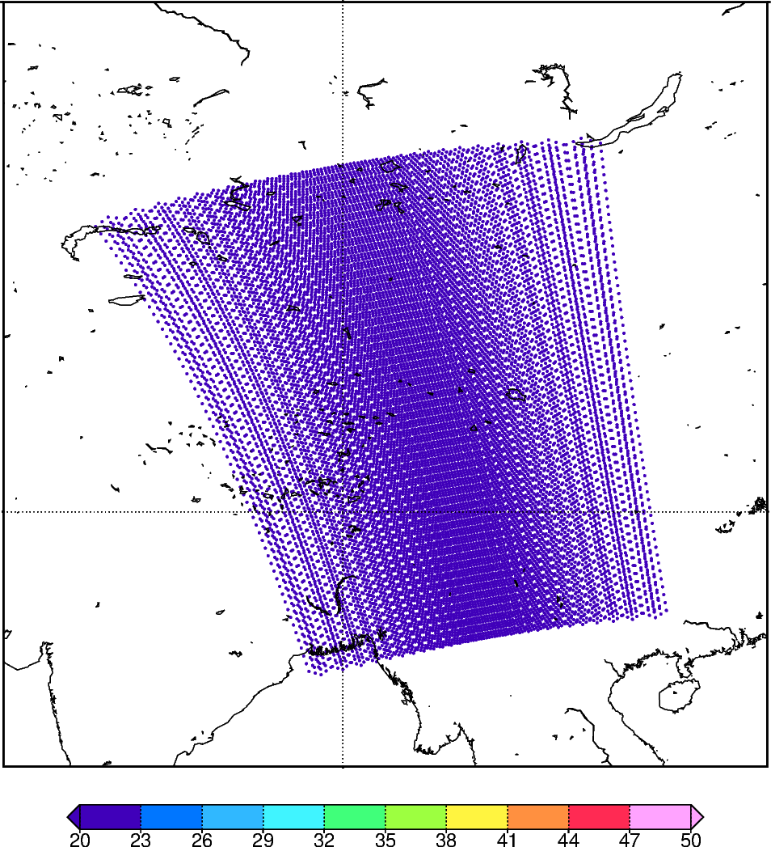
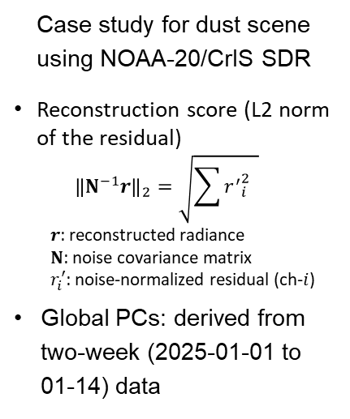
PCA Product for Himawari-10/GHMS
Himawari-10/GHMS Level-1 product will be compressed by Principal Component Analysis (PCA) to reduce its data volume
Hybrid (global + local) PC approach based on EUMETSAT algorithm is under development using LEO hyperspectral IR sounder (e.g., CrIS, IASI) data
Himawari-9/AHI Dust RGB
(2025-04-01)
Reconstruction Score
w/o Local PCs
Reconstruction Score
with Local PCs (up to the 5th component)
Case study for dust scene using NOAA-20/CrIS SDR
Reconstruction score (L2 norm of the residual)
  $${\left\|N^{−1}r\right\|}_{2}=\sqrt{\sum{{r^{′}}_{i}^{2}} }$$
$r$: reconstructed radiance
$N$: noise covariance matrix
$r_{i}^{′}$: noise-normalized residual (ch-$i$)
Global PCs: derived from two-week (2025-01-01 to 01-14) data
Koyamatsu (2026) @ AMS Annual Meeting
mW/m²/sr/cm⁻¹

Slide 9
Thanks for your attention!

Slide 10
JMA’s Personnel Supporting GSICS Activities
EP
  OMORI Shiro
GRWG
  TAKAHASHI Masaya
    VNIR Ray-matching, Lunar, IR, GEO-GEO
  KOYAMATSU Shin
    IR
  TOMA Tsuguyoshi (new)
    VNIR Ray-matching & vicarious calibration (RTM approach using LEO)
GDWG
  TAKAHASHI Masaya

