Slide 1
GSICS 2026 Agency Report
EUMETSAT
Mounir Lekouara and the EUMETSAT team

Slide 2
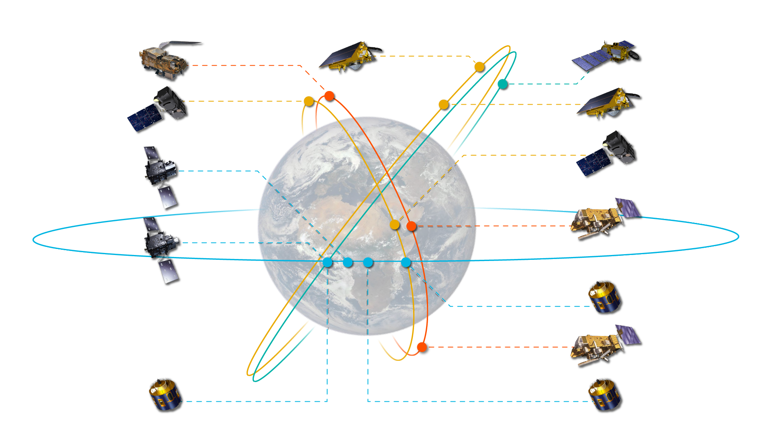
Current EUMETSAT satellites
Launched in 2025
Sentinel series
Low Earth orbit
Marine and atmospheric composition missions for Copernicus.
Sentinel-3A and -3B (98.7° incl.)
Sun-synchronous orbit.
Sentinel-6 Michael Freilich and its replacement, Sentinel-6B (66° incl.)
Non-synchronous orbit.
Meteosat series
Geostationary orbit
Imagery for weather forecasting and climate monitoring.
Meteosat Second Generation
Meteosat-9 (45.8° E)
Imagery over Indian Ocean
(every 15 min).
Meteosat-10 (0°)
Imagery over Europe
(every 5 min).
Meteosat-11 (9.5° E)
Imagery over Europe and
North Africa (every 5 min).
Meteosat Third Generation
Meteosat-12 (0°)
Full-disc imagery
(every 10 min).
MTG-S1 (3.4° W)
Air quality monitoring
instruments, including
Sentinel-4.
Metop-SGA1
Sentinel-6B
Jason-3
Sentinel-3A
Sentinel-6
Michael Freilich
Sentinel-3B
MTG-S1
Jason-3 (66° incl.)
Low Earth, non-synchronous orbit
Global sea surface height observations.
Metop-B
Meteosat-12
Metop series
Low Earth, sun-synchronous orbit
Global observations for weather
forecasting and climate monitoring.
Metop First Generation
Metop-B and -C (98.7° incl.)
Metop Second Generation
Metop-SGA1 (98.7° incl.)
Carries six instruments, including
Sentinel-5.
Meteosat-9
Metop-C
Meteosat-10
Meteosat-11

Slide 3
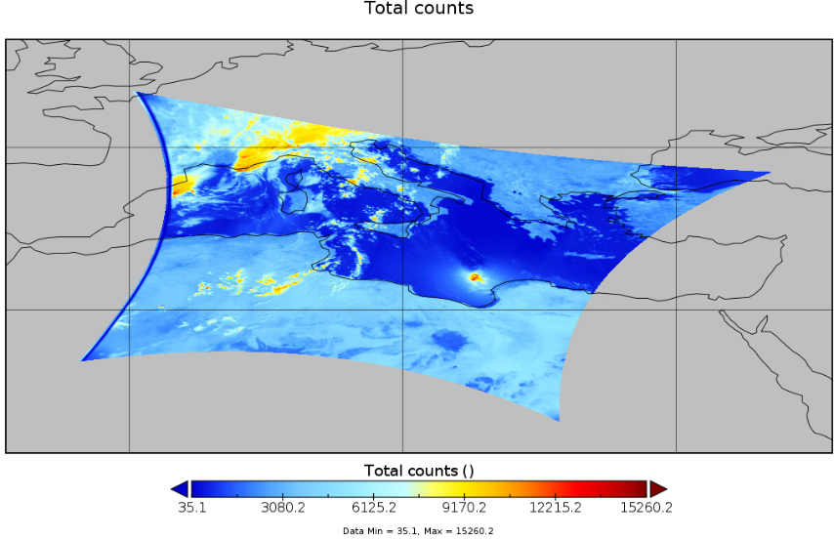
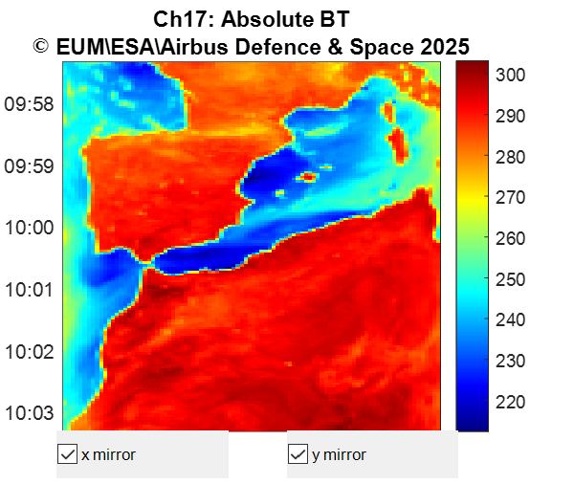
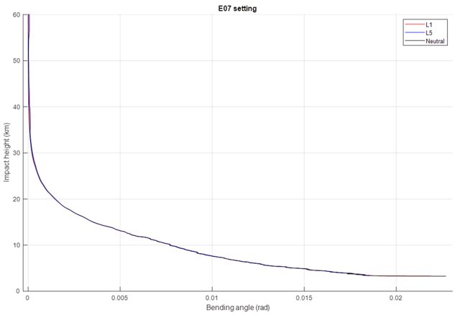
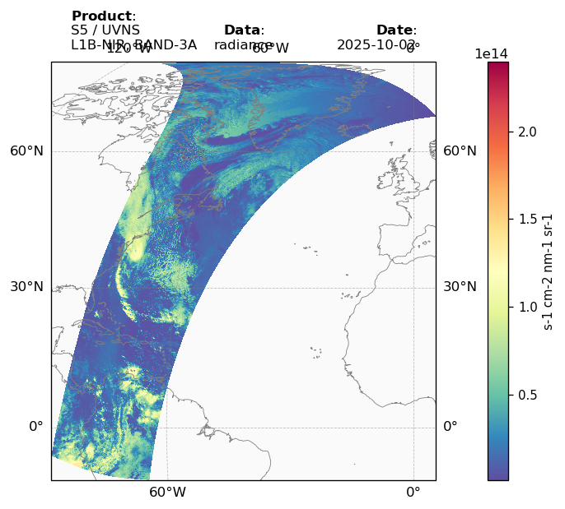
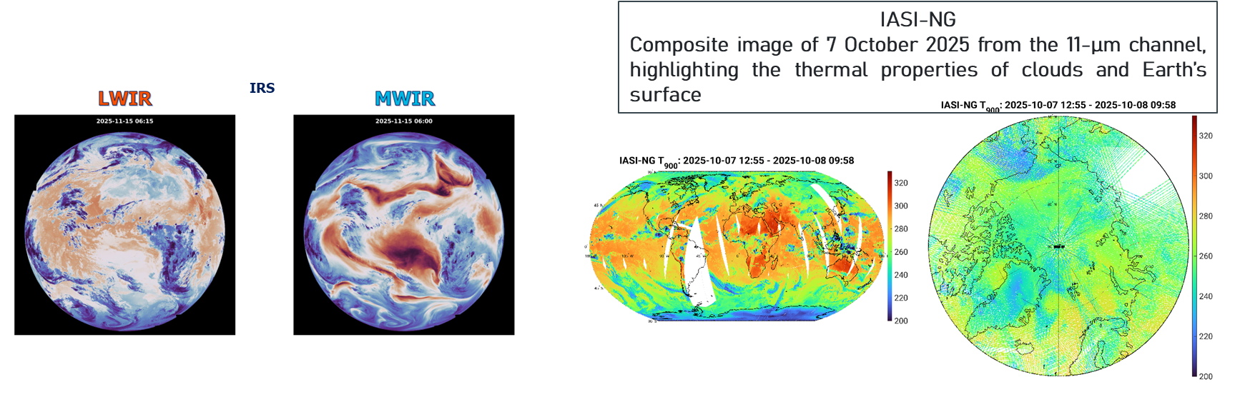
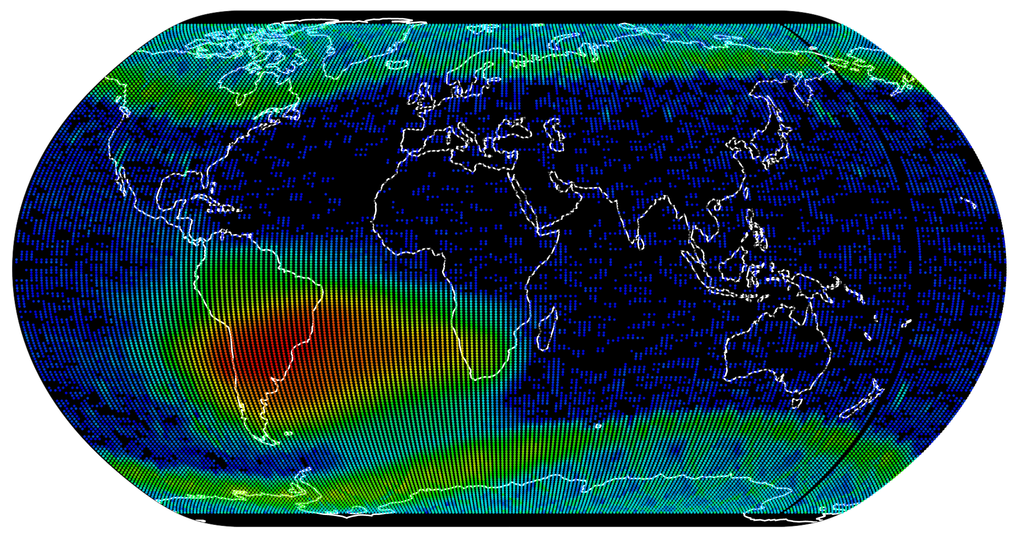
First Images in 2025
3MI
MWS
RO
RMU
IASI-NG
Sentinel-5 UVNS

Slide 4
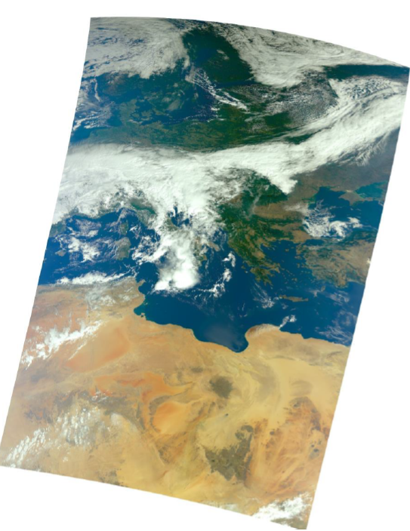
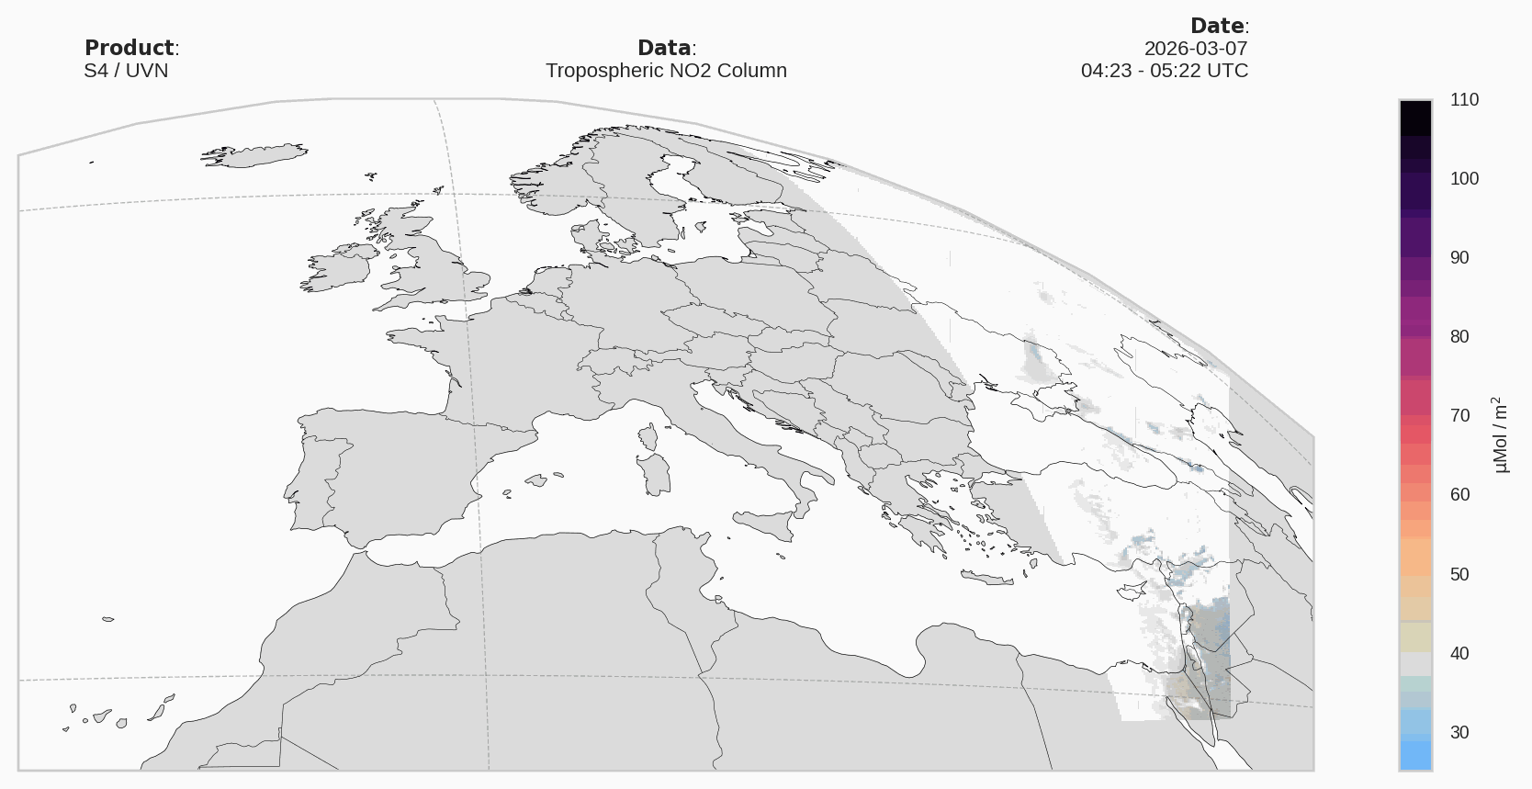
First images in 2025
IRS
METimage
UVN

Slide 5
Meteosat Third Generation (MTG) – status update
MTG-I (Imager)
MTG-S (Sounder)
MTG-I1 (now Meteosat-12)
  Was launched on 13 Dec 2022 and was declared operational on 4 Dec 2024.
  Currently it provides the 0º Full Disk service in parallel with Meteosat-10 (from Meteosat 2nd Gen).
MTG-I2
  Launch expected not earlier than end-July 2026, commissioning at 3.5ºE.
  After LEOP, satellite commissioning to take place until end-2026, with system commissioning continuing up to Launch+9 months.
  To be relocated to the 9.5ºE position to provide the Rapid Scanning Service (Meteosat-11 as RSS backup).
MTG-S1
  Launch 1 July 2025, commissioning at 3.5ºW.
  Satellite & system commissioning with nominal progress ongoing.
  To be relocated to 0º before being declared operational.
  IRS:
    First data for Cal/Val users released in Dec 2025. Pre-operational release of L1 data for all users expected in July 2026.
  Sentinel-4/UVN:
    First for Cal/Val users expected by mid-2026.
    Handover of Sentinel-4 mission from ESA to EUMETSAT expected in July 2026.
Full Operational Capability (FOC) is reached when MTG-I1, MTG-I2 and MTG-S1 are all providing an operational service

Slide 6
EPS-SG Status Update
  EPS-SG A1 was launched on 13 August 2025
  During Cal/Val, products will be made available to SAFs, expert teams, and key Cal/Val users for early feedback on product quality when “demonstrational status” is reached;
Product | Cal/Val Start | Demonstrational Status | Pre-operational Status
RO L1b | 30 October 2025 | 6 November 2025 | 27 November 2025
MWS L1b | 30 October 2025 | 11 December 2025 | March 2026
METimage L1b | 26 January 2026 | March 26 | July 2026
3MI L1b | 2 February 2026 | TBC | July 2026
IASI-NG L1c | 17 November 2025 | April 26 | August 2026
3MI L1c | April 2026 | TBC | August 2026
METimage L2CM | February 2026 | May 2026 | August 2026
Sentinel-5 L1 | February 2026 | TBC | November 2026
Sentinel-5 L2 (Priority A) | April 2026 | TBC | April 2027

Slide 7

EUMETSAT mission planning
EUMET
Upcoming launches in 2026!
MTG-I2 : July 2026
Sentinel-3C : Q4 2026
Metop-SGB1: October 2026

Slide 8
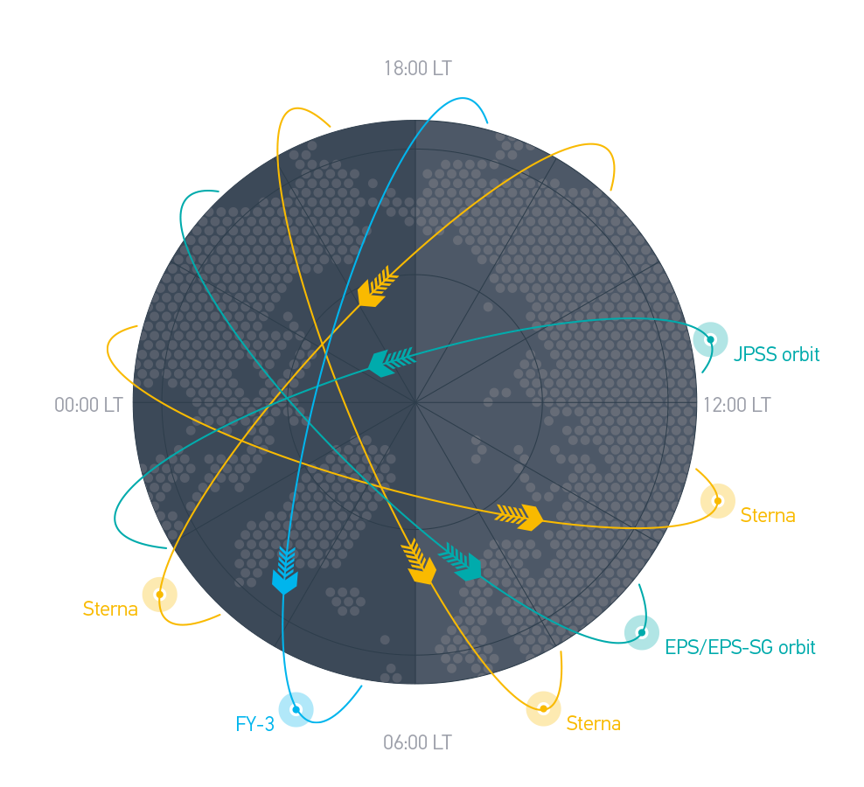
EPS-Sterna constellation
EPS-Sterna orbits will
be complementary to the US’ JPSS and China’s FY-3 satellite orbits
The mission was approved in 2025 and is planned to be launched in 2029

Slide 9
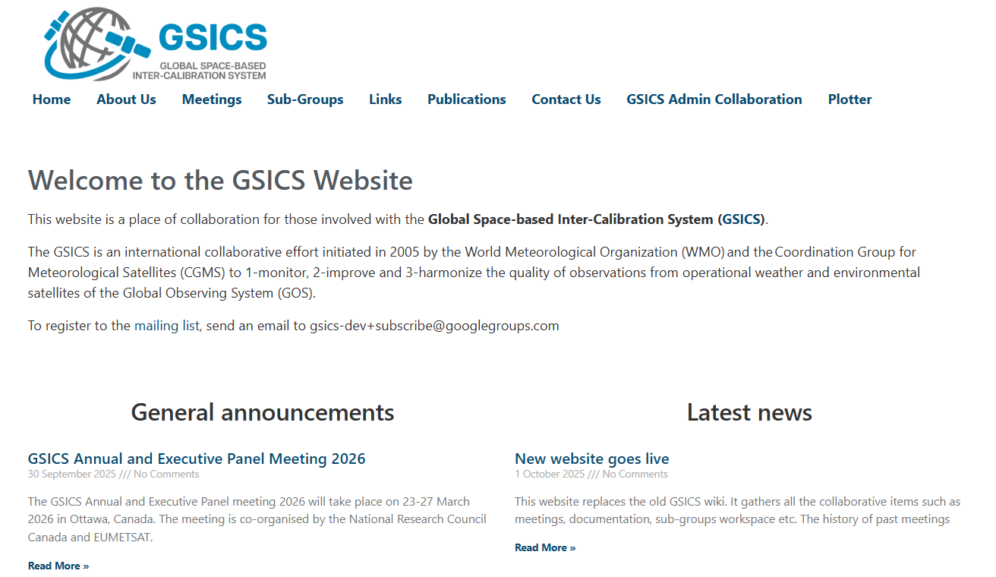
GSICS activities: new website
Developed the new gsicsweb.eumetsat.int website in replacement of the GSICS wiki decommissioned mid-2025.
On-going:
  Consolidation of the three websites (WMO, GCC and the new website)
  Definition of new cooperative tools (forums, mailing lists, gitlab)
  Import of the relevant old content of the wiki
  Assignment of the contributors for the various sections
https://gsicsweb.eumetsat.int

Slide 10
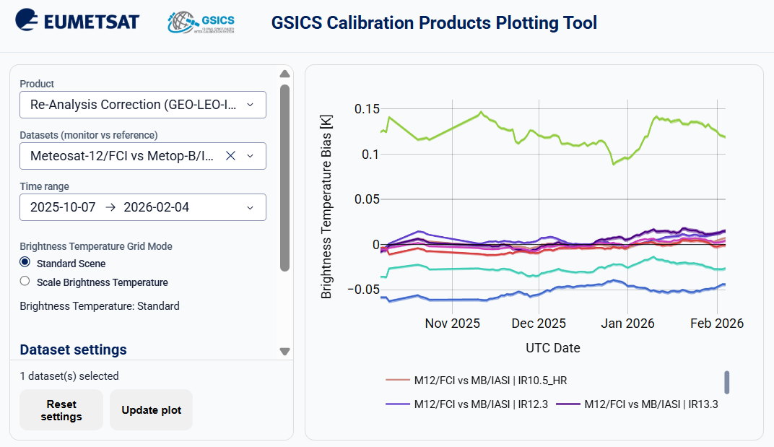
GSICS activities : mockup GSICS dashboard
GSICS-centralized plotting tool for GSICS products generated by the agencies.
Purpose:
  Mockup to support the definition of the requirements
  Support the State of Observing System reporting to CGMS
  Increase visibility for the GSICS achievements
On-going:
  Discussion with the sub-groups to define the further products to be included
https://gsicsweb.eumetsat.int/gsics-plotter/

Slide 11
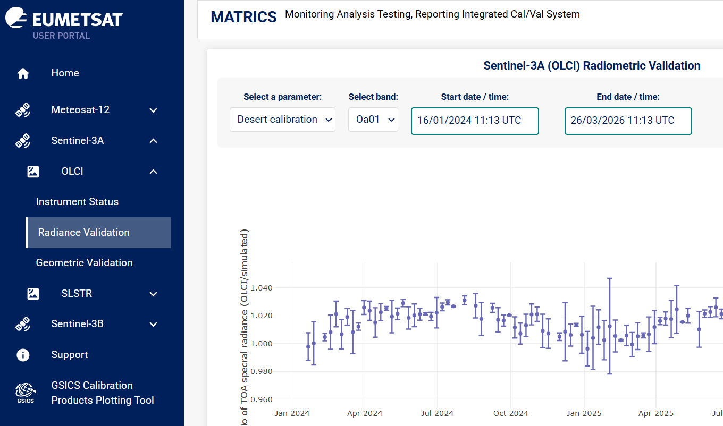
GSICS activities : MATRICS
MATRICS is the EUMETSAT platform for public reporting on the L1 products quality
Features Met-12 FCI/LI as well as Sentinel-3A/B SLSTR/OLCI
Further missions monitoring will be deployed in the next months
https://matrics.eumetsat.int

Slide 12
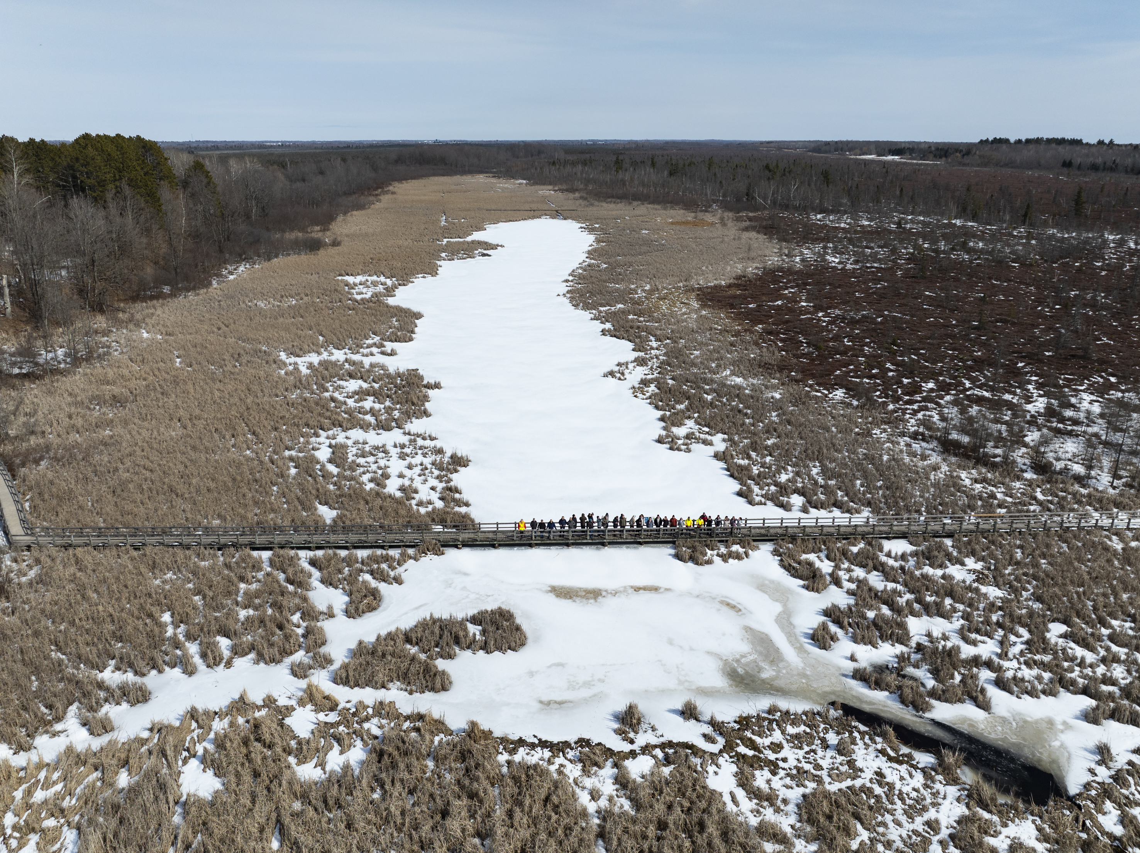
GSICS activities : meetings
EUMETSAT and NRC co-organised the 2026 annual meeting in Ottawa.
EUMETSAT is organising/hosting the 5th Joint CGMS GSICS / CEOS WGCV Lunar Calibration Workshop on 16-20 November 2026 in Darmstadt.

Slide 13
GSICS activities : decommissioning of the EUMETSAT GSICS products and server
For security reasons, EUMETSAT will decommission the EUMETSAT GSICS server.
Server functions:
  Sharing of IASI L1c data in GSICS format with CMA : transitioned to the Data Store
  GSICS Plotting Tool: replaced by MATRICS and the GSICS Dashboard
  EUM GSICS products repository: discontinued (as per discussions at 2025 annual meeting)
  Mirror repository of JMA GSICS products: discontinued
  Intermediate colocation files: discontinued

Slide 14
GSICS activities: Microwave
Sterna Inter-Calibration ​
  Spectral Band Adjustment Functions & Cloud Detection algorithm​
  OCTM (“Warm SNO”) inter-calibration algorithm​
  Vicarious Inter-Calibration algorithm​
  Uncertainty Analysis – potential application to other GSICS Sub-Groups​
  Study Report and ATBDs to be published at https://www.eumetsat.int/science-studies ​
  Implementation Plan: derive corrections to Calibration Coefficient DataBase (CCDB), ​based on biases found in inter-calibration algorithms​
Leading SNO/Vicarious Inter-Calibration Focus Group​
  3 meetings​
Contribution to Microwave Moon Focus Group​
  Analysis of AWS lunar intrusions for pointing and FOV validation​
Contribution to Technology & Testing Focus Group​
  Recommendations for on-ground tests, SRF format​

Slide 15
Lunar calibration
Realignment of the GIRO with ROLO ==> GIRO v2.0
After a check on the IPR, distribution of the GIRO v2.0 to the licensees
Continued the LSICS development initiated by NOAA
Contribution to the discussions on LSICS and implemented LESSR v2.0 and GIRO v2.0
Creation of a lunar calibration mailing list to ease the communication within the lunar calibration community
Resolved (still to be confirmed with the next acquisition in August) the pointing issue with GOME2 C ==> will allow the use of GOME2 C lunar observations to expend the range of the LESSR model
Initial results with lunar calibration applied to SLSTR-A and SLSTR-B

Slide 16
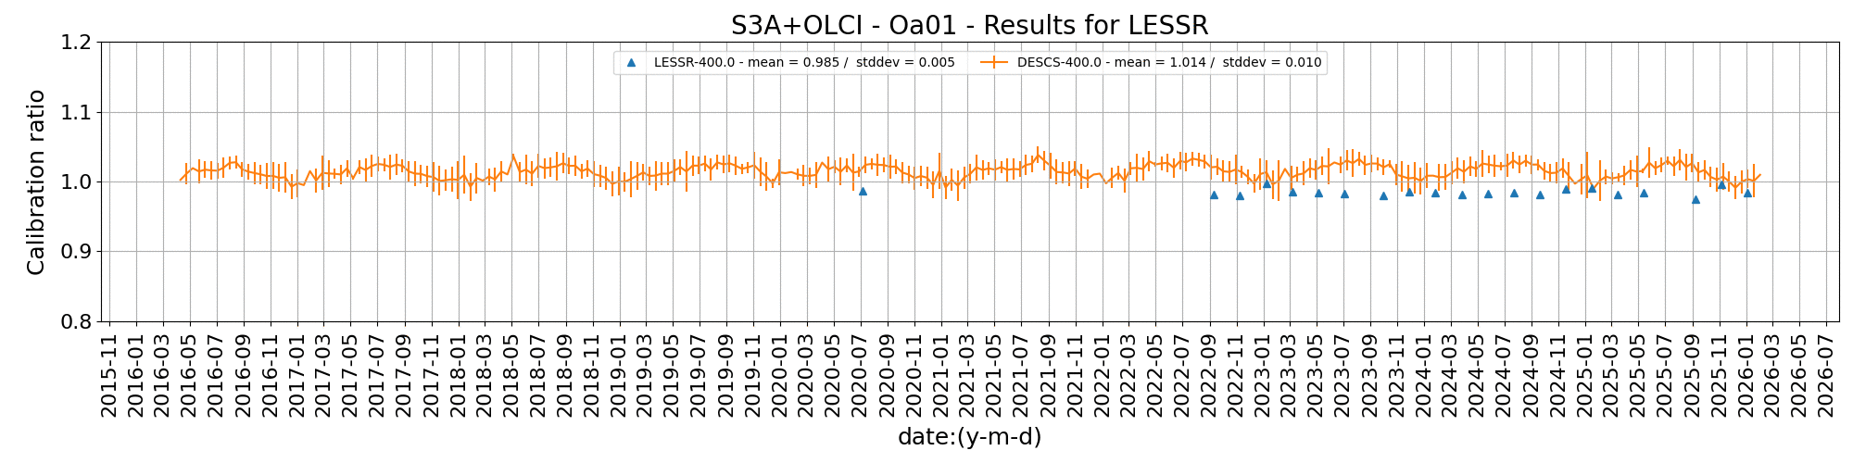
Lunar calibration : reaching high absolute accuracy with LESSR
MICMICS vicarious desert calibration
MICMICS LESSR lunar calibration

Slide 17
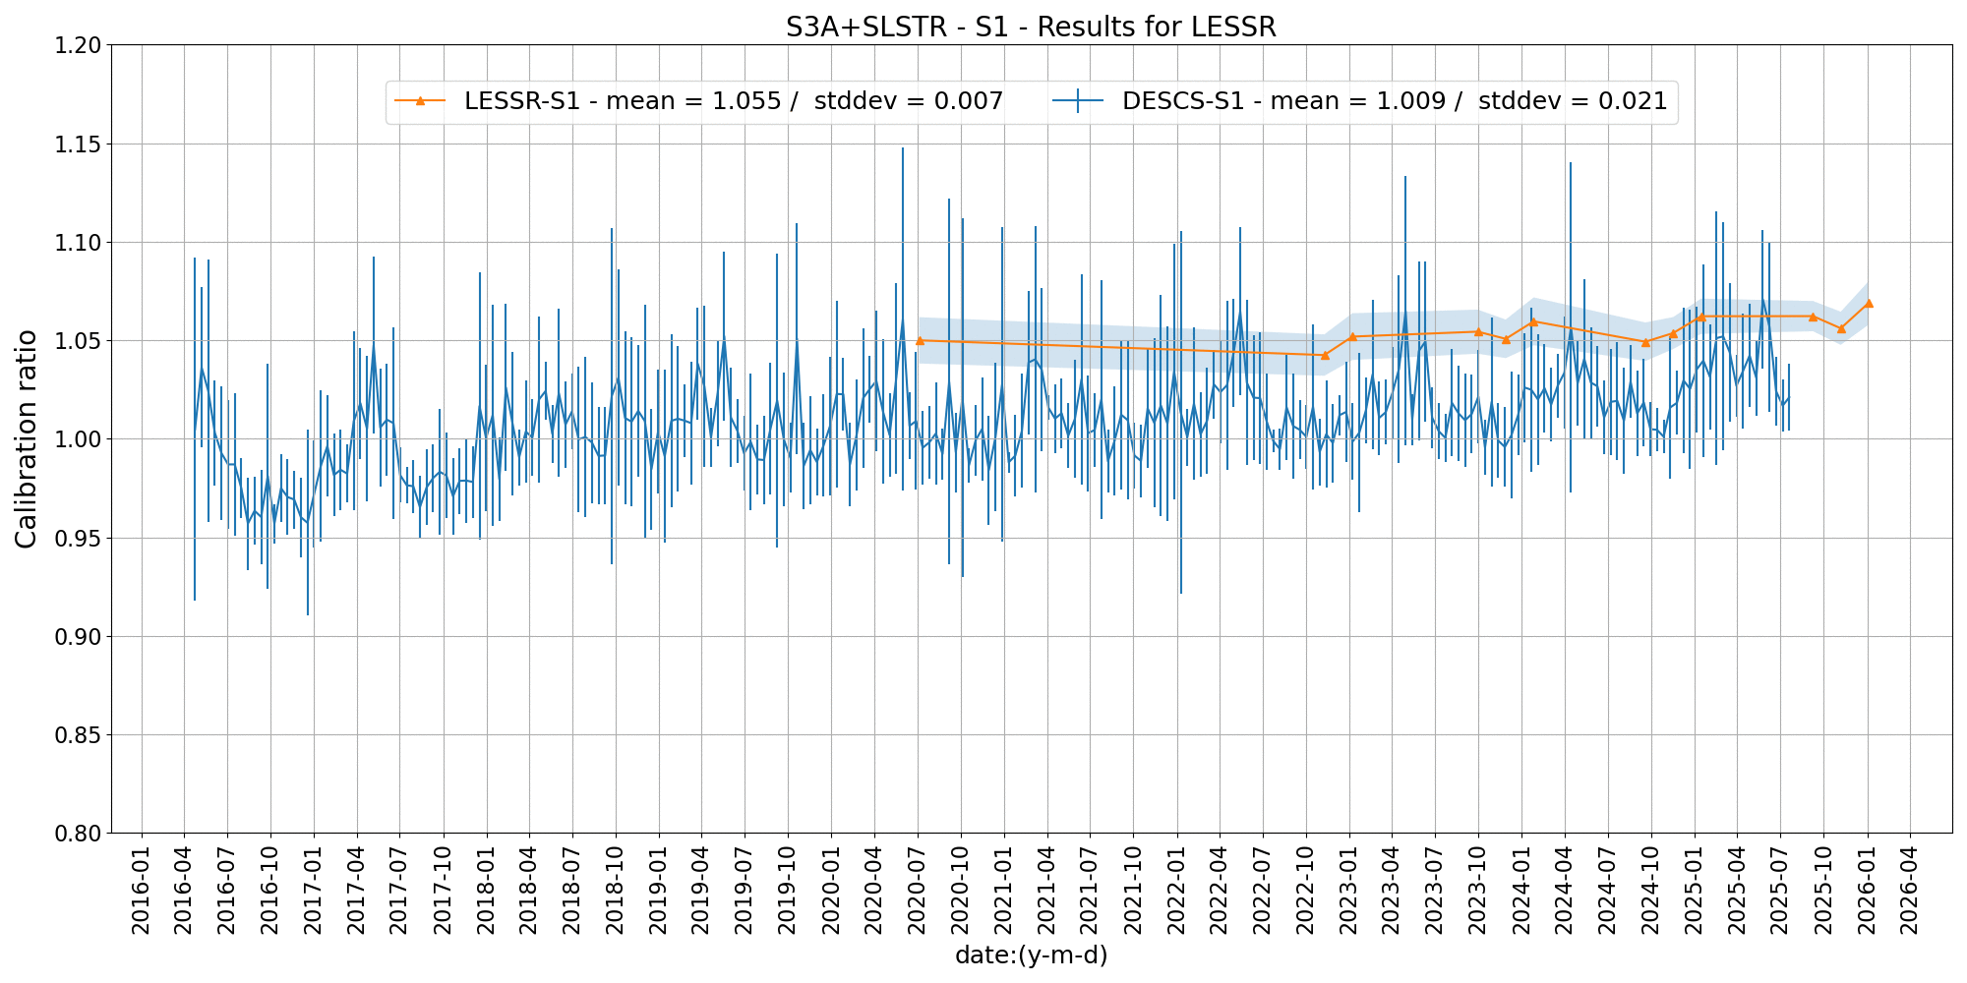
Lunar calibration: deployed for Sentinel-3 SLSTR

Slide 18
GSICS activities
Ray-Matching for Calibration Monitoring of MTG-I1 FCI VNIR Channels: An Initial Assessment
  Improved filtering, uncertainty handling, and parametrisation have enhanced calibration results.
  Additional instruments increased robustness, with ongoing refinements to further improve accuracy.
Desert Calibration and Intercalibration: State-of-the-Art Methods and Challenges
  State-of-the-art desert calibration methods were assessed, including sensitivity analyses of key parameters.
  Challenges were identified, and future improvements were outlined.
Intercomparison of the GSICS Engine and MICMICS for IR GEO–LEO Intercalibration
  Three intercalibration implementations show good agreement, with MICMICS offering lower uncertainty and variability.
  Transition from GSICS to MICMICS is planned by year-end.
Support of ESA FDR4ATMOS project for generation of harmonised FDR covering GOME-1, SCIAMACHY and GOME-2
Calibration analyses for the SIOV and Cal/Val of MTG-S IRS/UVN and EPS-SG METimage/3MI/UVNS/IASI-NG/MWS

Slide 19
Calibration updates
Met-12 FCI
  IR are still calibrated by the MICMICS implementation of GEO-LEO
  IR gain ingestion frequency improved from daily to hourly
  VIS-NIR gains will be calibrated by MICMICS in a few months
Met-9-10-11 SEVIRI
  VIS-NIR gains (bias and drift) calibrated by MICMICS as of March 2026
Sentinel-3 A-B SLSTR
  VIS-NIR gains (bias and drift) calibrated by MICMICS as of April 2026
Metop-B-C AVHRR
  VIS-NIR gains calibrated by MICMICS as of April 2026

Slide 20
Climate Data Records production
Completed several data records in 2025, some pending final delivery reviews:​
5 IR sounding/imaging radiance records (IASI L1c R2, SSH R1, AVHRR GAC R1.1, MVIRI R2.1, and SEVIRI R1) ​
3 Microwave sounding radiance records (SSMIS R1, MSU R1, and Harmonised Multi-Humidity Sounder R1)​
Radio occultation: GRAS Fundamental Data Record, Release 4​
Radar scatterometry: ASCAT Fundamental Data Record, Release 3

Slide 21
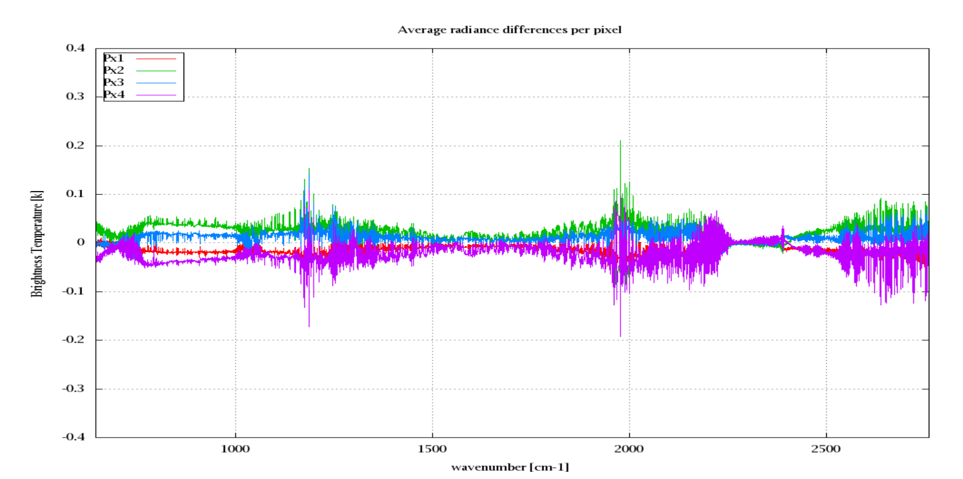
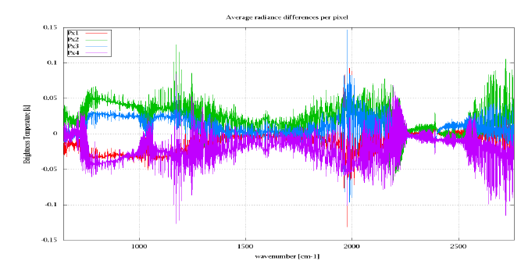
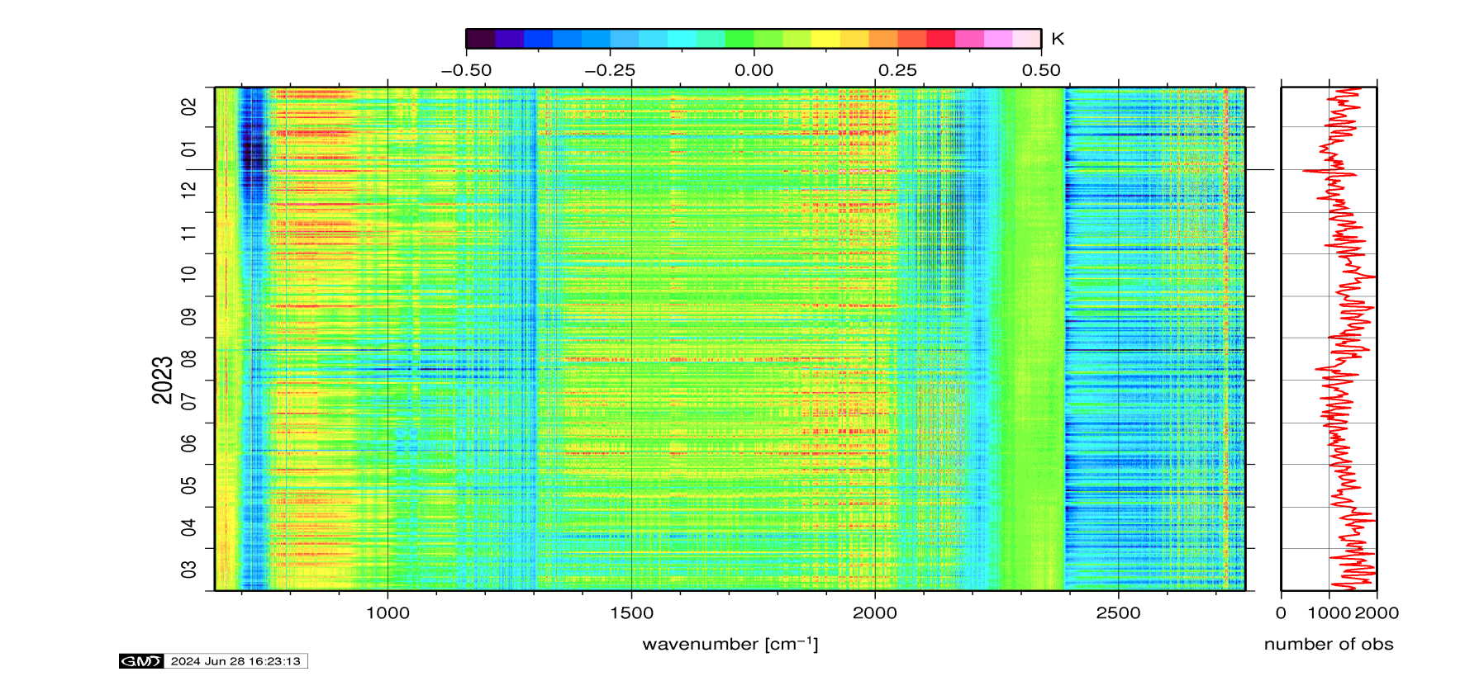
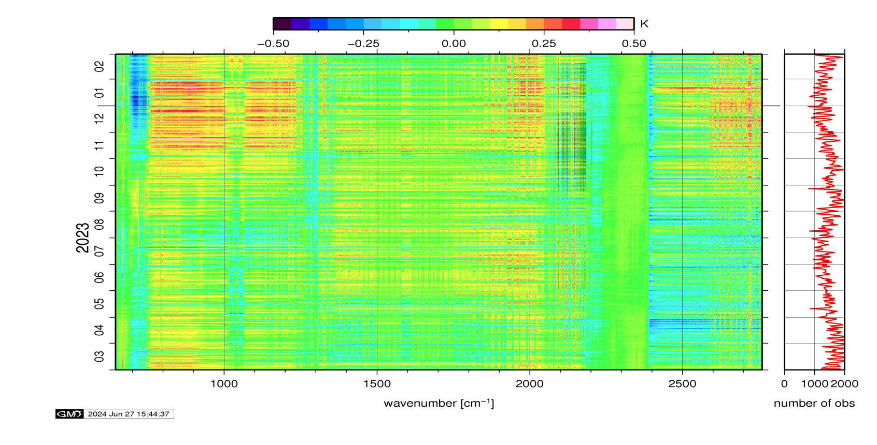
No change of IASI status onboard Metop-B and -C
IASI/Metop-B:
The IASI PFM-R instrument is fully operational and its performance is still nominal. No degradation has been observed.
IASI/Metop-C:
The IASI FM3 instrument is fully operational and its performance is still nominal. No degradation has been observed.
+0.15
+0.15
Inter-pixels consistency
-0.15
-0.15
Radiances anomaly
over the last annual
period report

Slide 22
EUMETSAT GSICS team
Executive Panel
Bojan Bojkov | EUMETSAT representative
Data Working Group
Simon Elliott | Global Data Exchange Expert
Research Working Group
Mounir Lekouara | incoming vice-chair of GRWG
Tim Hewison | MW Sub-Group PoC
Sébastien Wagner | VIS/NIR + Lunar calibration PoC
Ali Mousivand | MICMICS + Radiative Transfer Modelling + Desert Calibration
Rasmus Lindstrot | UVN spectrometers expert
Dorothée Coppens | Hyperspectral IR expert
Christophe Accadia Vinia Mattioli | Microwave experts
Rüdiger Lang | UVN spectrometers and VIS-NIR for CO2M
Viju John | FCDR, IR, MW
Bertrand Fougnie Thomas Honig Rob Roebeling | VIS/NIR polarimetry MICMICS + GSICS dashboard Event logging
Point of Contact for Operational Matters
Simon Elliott

Slide 23
Thank you

Slide 24
BACKUP SLIDES

Slide 25
EUMETSAT instruments update: many new sensors to calibrate
mission | launch | instruments | GSICS sub-groups
MTG-I1 | 2022 | FCI | VIS-NIR and IR
 |  | LI | VIS-NIR
MTG-S1 | 2025 | IRS | IR
 |  | UVN | UVN spectrometers
EPS-SG A1 | 2025 | METimage | VIS-NIR and IR
 |  | 3MI | VIS-NIR
 |  | IASI-NG | IR
 |  | UVNS | UVN spectrometers
 |  | MWS | MW
EPS-SG B1 | 2026 | MWI | MW
 |  | ICI | MW
CO2M | 2027 | CO2I | UVN spectrometers
 |  | MAP | VIS-NIR
 |  | CLIM | VIS-NIR

Slide 26
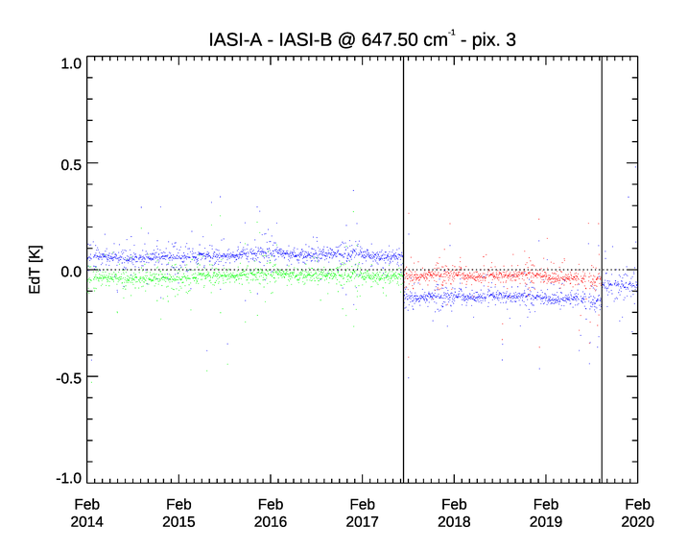
Recall of the last IASI FCDR release 2.0
Motivation:
The on-board non-linearity (NL) correction has been improved for both IASI-A (in 2019) and IASI-B (in 2017) → But no reprocessing was possible until now;
EUMETSAT has developed a NL post-processing to be applied on the IASI L1c products → To restore the time consistency of the IASI radiance archive in the CO₂ band at 15 mm, as well as the consistency between the instruments.
Example of Pixel 3
The reprocessing has proven that:
The residual error of the on-board non-linearity correction has been corrected with the right order of magnitude;
The temporal consistency of the data record has been reinstated and the inter instrument difference between IASI-A and IASI-B has been corrected, removing the effects of the non-linearity correction update of the instruments in August 2017 and September 2019;
New IASI FCDR version 2 is available.
IASI-A – IASI-B
IASI-A_{rep} – IASI-B
IASI-A_{rep} – IASI-B=A_{rep}
IASI-B update
IASI-A update

