Slide 1

GSICS Agency Report
2026
Dimitrios Kilymis
Contributions from CNES colleagues: Thierry Amiot, François Bermudo, Caroline Bès, Isabelle Clermont, Gilles Codou, Camille Desjardins, Christel Guy, Elsa Jacquette, Denis Jouglet, Sébastien Marcq, Aimé Meygret, Didier Pradines, Adrien Deschamps, Carole Deniel, Murielle Lafaye
CNES

Slide 2
Presentation Overview
IASI status and on-going studies
IASI-NG program and Cal/Val status
MicroCarb development status and Cal/Val
C²OMODO French contribution to AOS
MUSCLE-NEO Multi Sensor Calibration Environment

Slide 3
IASI status and on-going studies
IASI-B and IASI-C instruments are currently operational and stable.
IASI Global Radiometric Uncertainty budget published (Kilymis et al AMT, 18, 6513–6525, 2025).
  Global budget < 0.2 K for all types of scene taken into account and fully correlated uncertainties.
  Calculated using IASI-B data but globally transferable to the other two IASI instruments.
  Negligible evolution over time, primarily due to an excellent thermal stability.
Radiometric inter-comparisons routinely performed at CNES between IASI-B, IASI-C and with CrIS/NOAA-20 and CrIS/NOAA-21.
IASI-B / IASI-C inter-comparison
  MetOp-B in a drifting orbit since the end of 2022. A series of OoP maneuvers were performed in September 2025 to decrease the drift rate and extend the mission.
  The routine inter-comparison tool yields a higher than usual bias due to the drift of the MetOp-B orbit plane.
  In this context, inter-comparisons using CrIS as a proxy are used to assess stability.
  The inter-comparisons with both instruments remain particularly stable, therefore the ± 0.1 K bias between IASI-B and IASI-C is conserved.

Slide 4
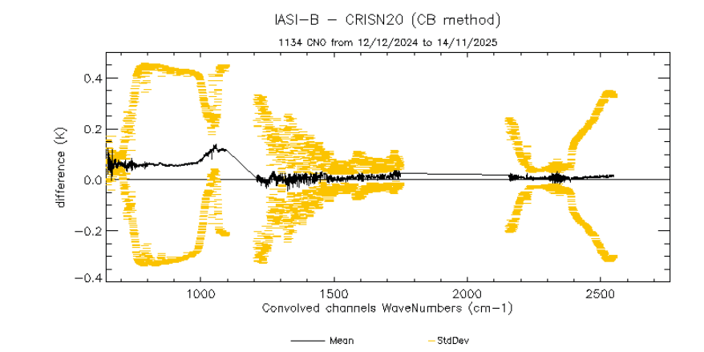
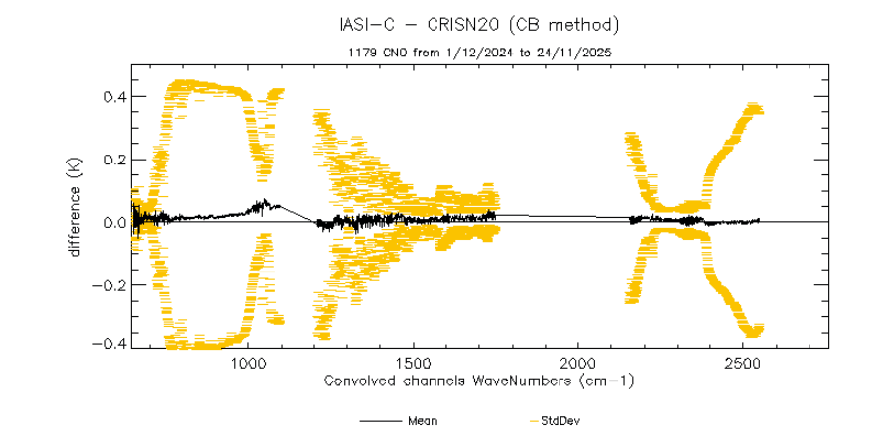
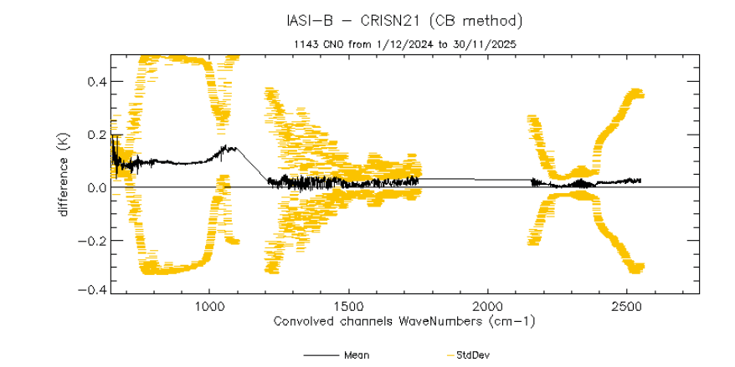
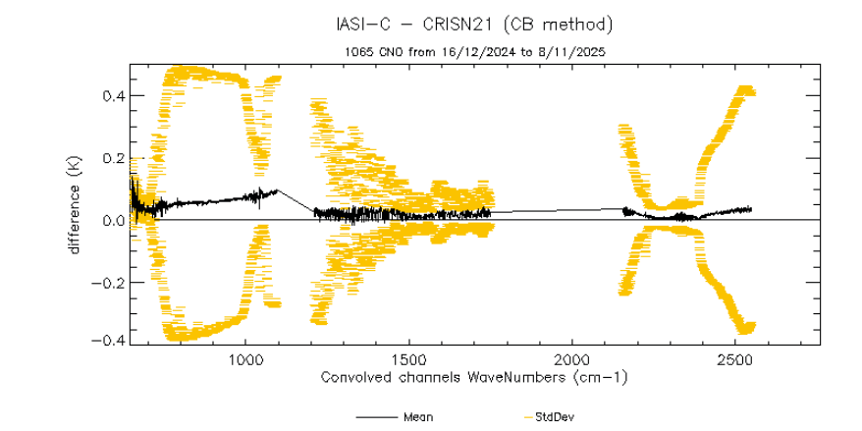
IASI status and on-going studies
Inter-comparisons between IASI and CrIS
  Bias between IASI-B and C and CrIS/NOAA-20 very consistent and stable ≤ ± 0.15 K
  Bias between IASI-B and C and CrIS/NOAA-21 very consistent and stable ≤ ± 0.15 K

Slide 5
IASI : planned activities in 2026
September 2025: EUMETSAT decision to extend MetOp-B mission until 2030 instead of 2028
➔ Shift in the planning of list of experiments for IASI-B End Of Life.
Inter-comparisons: integration of IASI-NG products in CNES software
  IASI-NG Vs IASI-B/C → delivered, validation is ongoing
  IASI-NG Vs CrIS/NOAA-20 and CrIS/NOAA-21 → to be delivered in Q2 2026
IASI in support to IASI-NG commissioning:
  Moon acquisitions IASI-C / IASI-NG (January to May 2026)
  Tandem flight between MetOp-C (IASI-C) and MetOp-SG-A1 (IASI-NG) from mid-April to mid-June 2026

Slide 6
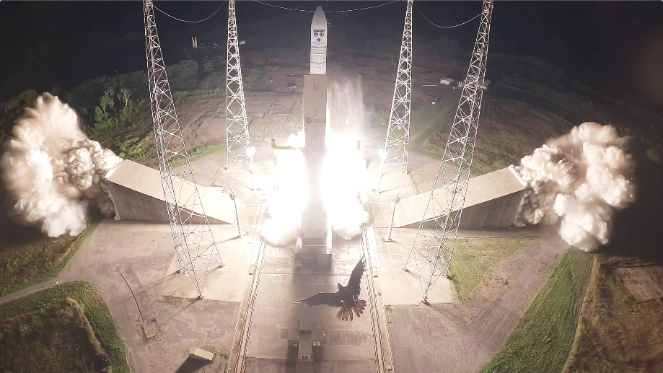
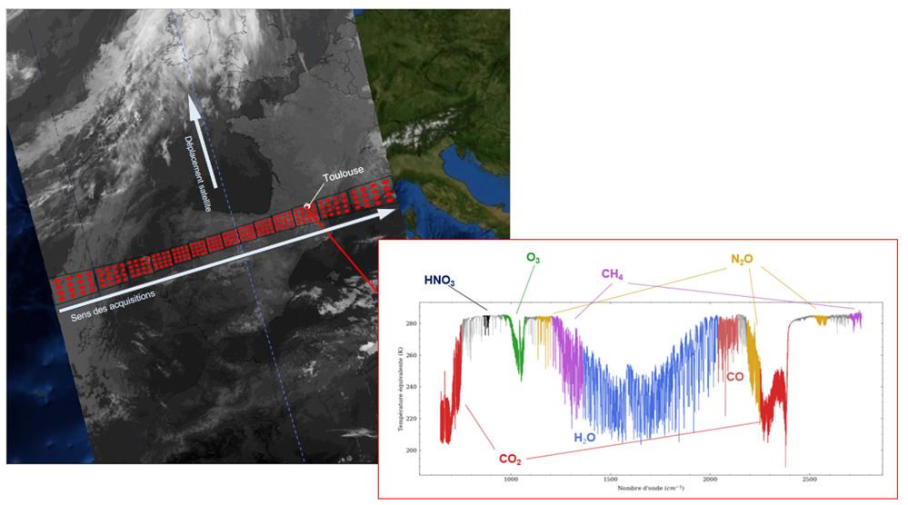
IASI-NG Program Status
Launch with Ariane 6 V3 successfully held on 12 August 2025
The IASI-NG FM2 on-board the Metop-SGA1 successfully concluded all System In-Orbit Verification activities
First spectrum from the IASI-NG instrument released in October 2025 as the satellite was flying over Toulouse, France.
IASI-NG entered the Calibration and Validation phase end of 2025 : the performances analyzed so far are excellent and largely in line with the expectations
L1C Processor V3 Version for Commissioning phase running nominally in the EUMETSAT Temporary Ground Segment developed to perform the Cal/Val
IASTEC (IASI-NG Technical Expertise Center) operated by CNES team supporting nominally the Cal/Val
IASI-NG/IASI FM3 (Metop C) tandem flight in April/May 2026
Products will be released to the user community in summer 2026 after validation milestone is achieved

Slide 7
IASI-NG Program Status :
SIOV/CALVAL Global Overview
Launch
November 2025
Start of L1 early dissemination
March 2026
Level 1 nominal dissemination
July 2026
SIOV
CAL/VAL PART A
EARLY VALIDATION OF L1 PRODUCTS
CAL/VAL PART B
IN DEPTH VALIDATION OF L1 PRODUCTS
IASI TANDEM FLIGHT
9 WEEKS
16 WEEKS
15 WEEKS.
SYSTEM IN ORBIT VERIFICATION MAIN OBJECTIVES :
• End of the SIOV activities :
1st IASI-NG spectra
CAL/VAL PHASE A MAIN OBJECTIVES :
• End of phase A : start of early dissemination of L1 products to selected users
CAL/VAL PHASE B MAIN OBJECTIVES :
• End of phase B : Conclusion of IASI-NG Cal/Val activities and start of the routine operation

Slide 8
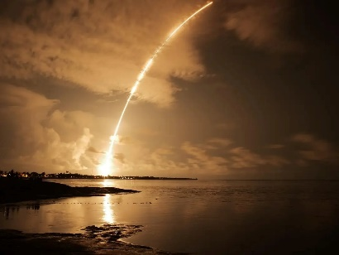
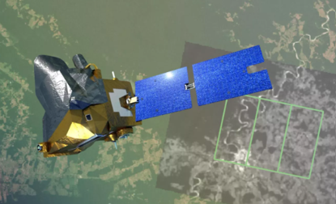
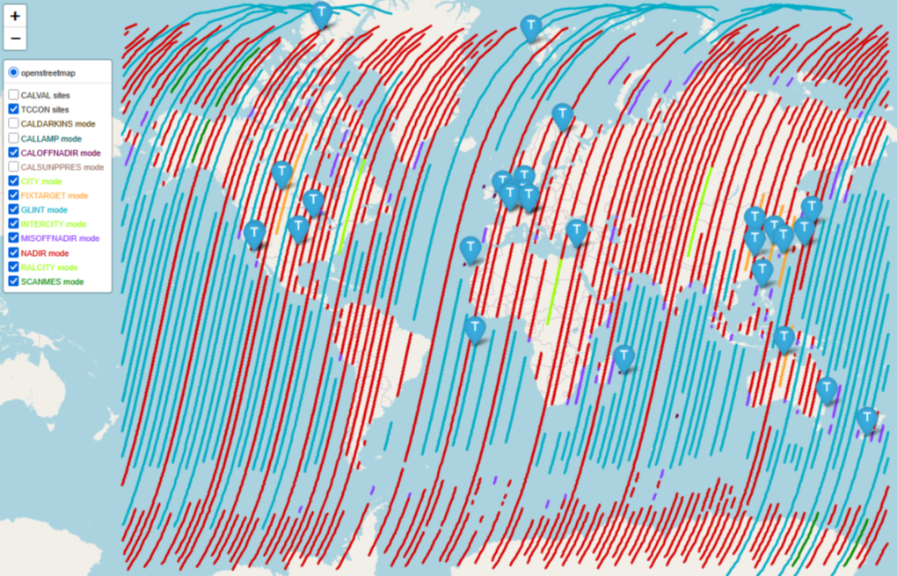
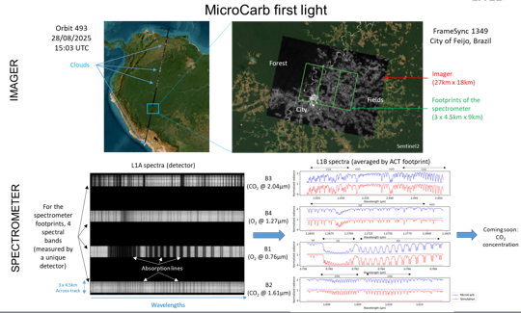
MicroCarb Status after 7 months in orbit
Launch on VEGA-C on 26/07/2025, from CNES Guiana Space Center
Start of Calibration/Validation activities in September, after in flight commissioning operations and instrument decontamination
Cal/Val1 which aims to calibrate the instrument is in progress:
  Many observation methods and sources are used to characterize the instrument (radiometry, spectral, geometry)
  Instrument tuning (Temperatures, Internal Lamp for cancelling detector remanence) based on the observations
  L1 algorithms adjustment
  L2 retrievals first attempts
Then, Cal/Val2 (6 months) for L2 CO2 products with the help of ancillary data (TCCON, EM27, AIRCORE,…)
  L2 validation and L2 algorithm tuning
  L1 calibration consolidation
  Massive computation of products and reprocessing
Products freely downloadable from AERIS & EUMETSAT portals after Cal/Val2 (by the end of 2026)

Slide 9
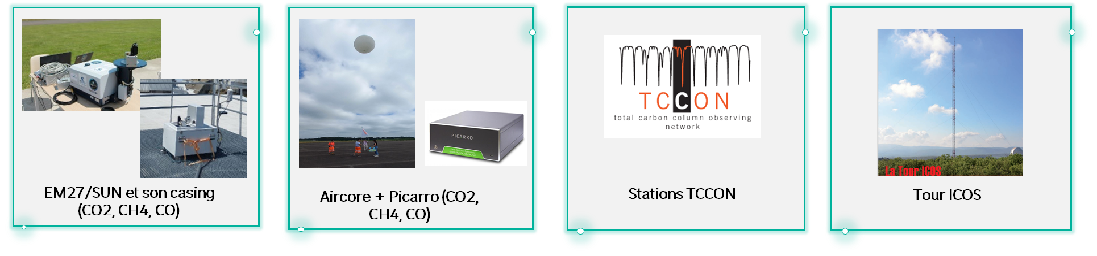
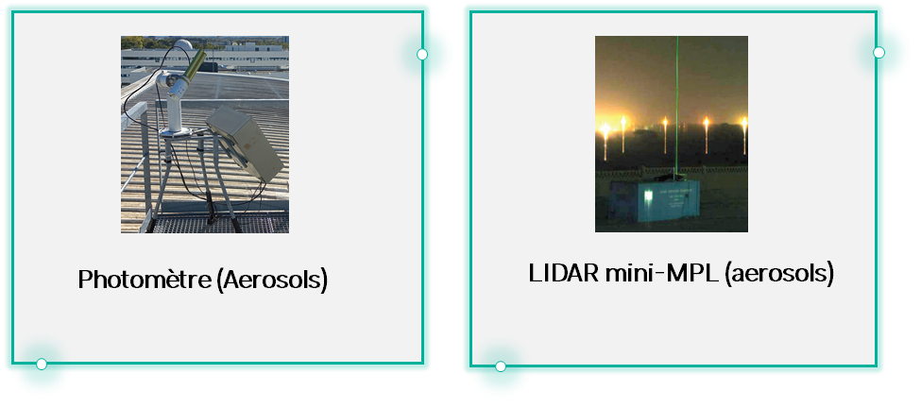

MicroCarb Calibration and Validation
Ground based instruments :
French Processing chain
French Processing chain
Aerosols products
(Aeronet)
TCCON products
EM27 products
Aircore products
MicroCarb Data
Processing
ICOS products
For other missions
or scientists users
All products
AERIS
MicroCarb products
MicroCarb products
Other Satellites
OCO-2, GOSAT, etc..
MicroCarb Technical Expertise Center
Satellites products

Slide 10

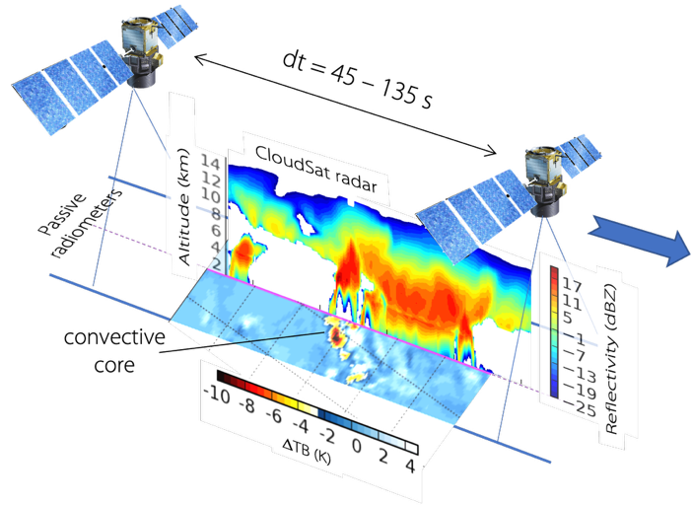
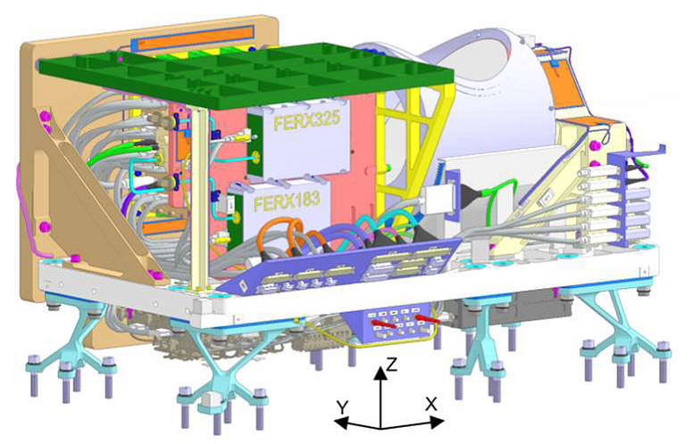
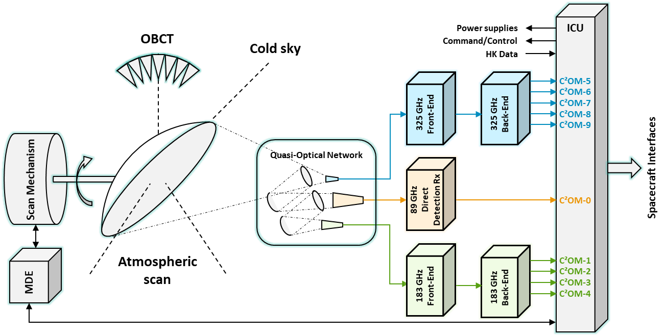

Atmosphere Observing System (AOS) an international cooperation to characterize, monitor
and link aerosols, clouds and precipitations, storms and convection
C²OMODO (Convective Core Observations through MicrOwave Derivatives in the trOpics)
  Based on a tandem of microwave radiometers aboard PMM (JAXA) and C²OMODO-Sat
  To observe deep convection in order to monitor and characterize storm formation
Radiometers developed by Airbus DS, currently at the end of phase B, launch planned in 2030
C²OMODO for deep convection
characterization
C²OMODO Radiometer
CAD Model @ ADS
C²OMODO instrument
functional diagram

Slide 11

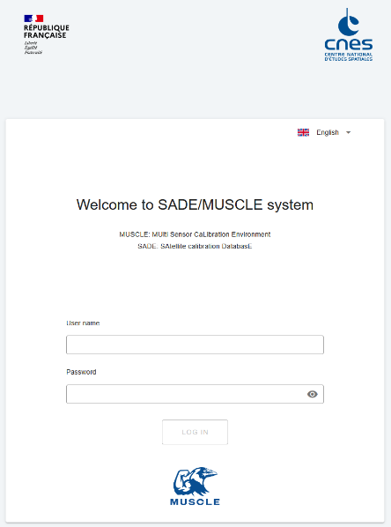
CNES Calibration environment SADE/Muscle
All the vicarious calibration methods developed in CNES are included into a unified software called Muscle and a common database called SADE which:
  ensure traceability;
  perform massive cross-comparison between sensors (more than 33,000,000 reference measurements coming from 50 different sensors);
  reduce validation time and costs to integrate new sensors;
  propagate any methodology improvement to all available sensors.
A new major version is currently under Operational Qualification.
What’s new?
Redesigned user interface
New calibration capacities: thermal infrared, polarisation, uncertainties, …
Broader range of sensors: hyperspectral, geostationary, …
Increased computing capacity (CNES HPC)
Accessible online via web browser.
2024
2027
S2C commissioning phase performed on the new SADE/MUSCLE version
The tool will be opened to external partners. (Since July 2025, EUMETSAT has already a prior access for the 3MI commissioning phase.)
2025-2026
Both legacy and new SADE/MUSCLE are run together.
3 commissioning phases use the new version: CO3D, 3MI and Microcarb.

Slide 12
Thank you, any questions ?
dimitrios.kilymis@cnes.fr

