Slide 1

GSICS 2026 Agency Report
Changchun Institute of Optics, Fine Mechanics and Physics
Wu Duo, Ye Xin
Changchun Institute of Optics, Fine Mechanics and Physics, Chinese Academy of Sciences

Slide 2
Proposed outlines
Introduction
CIOMP Fengyun Satellite Optical Payload R&D:
  Solar Radiation Monitoring Payload
  Space Weather Payload
  Atmospheric Sensing Payload
Recommendations for Future Payloads

Slide 3
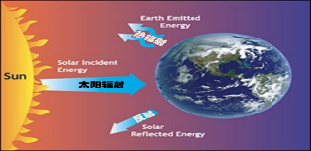
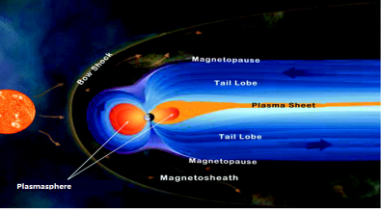
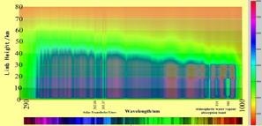
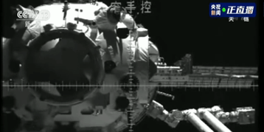
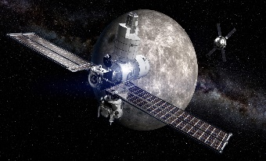
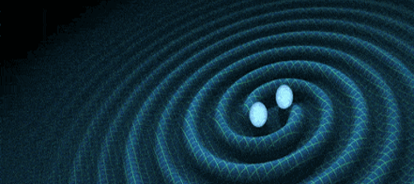
Introduction
Primarily engaged in research on space remote sensing technology, Focus on Atmosphere, Meteorology, Space Weather and other fields.
Research directions : Earth radiation budget measurement, sun-earth space detection, gravitational waves, atmospheric remote sensing, rendezvous and docking, and deep space exploration.
Earth’s Radiation Budget
Sun-Earth Space weather
Atmospheric Remote Sensing
Rendezvous and Docking Imaging
Deep Space Exploration
Gravitational Wave Detection
Notes:
CIOMP focuses on space remote sensing for meteorology[ˌmiːtiəˈrɑːlədʒi ], atmosphere, and space weather. Today's focus is on Radiation Measurement, Sun-Earth Space weather, and Atmospheric Remote Sensing.

Slide 4
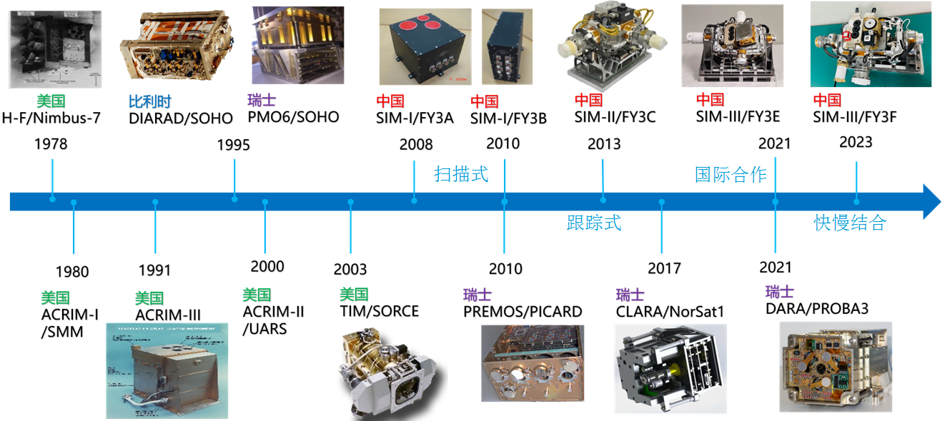
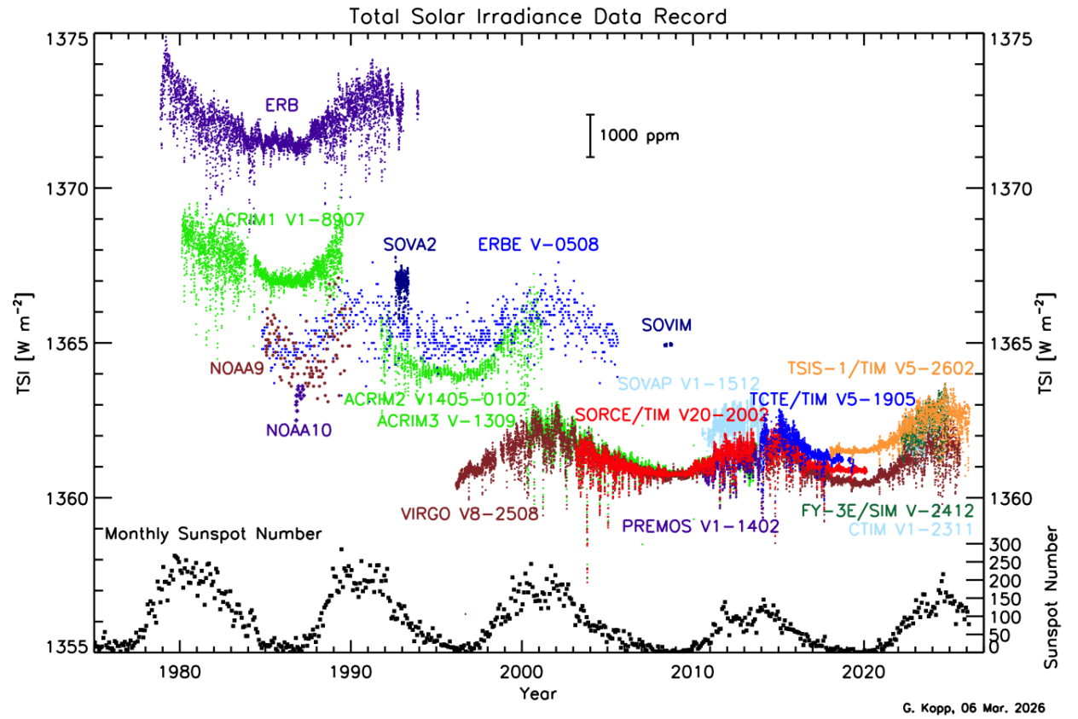
Fengyun Satellite Optical Payload Development
Solar Irradiance Monitor Payloads
Evolution Path:
FY-3A/B: Wide-field Scanning
FY-3C: Active Solar Tracking
FY-3E: Cooperation with PMOD/WRC. SIAR and DARA radiometer together
FY-3F: with SPRR to measure the TSI and EOR(Earth's Outgoing Radiation) together
FY-3J: 80K Cryogenic Observation (developing)
FY-3E SIM
Kopp et al. (2026).
Notes:
let's start with Solar Radiation Monitoring. We have made progress over a long time. On the FY-3A and 3B satellites, we used a wide-field Scanning type; moving to the C satellite, we improved to a high-precision Tracking type; on the E satellite, we started International Cooperation; on the F satellite, we allowed Sun-Earth Synchronous observations; and for the J satellite, we will use 80K Cryogenic observation. Our measurement accuracy and stability have improved step-by-step.

Slide 5
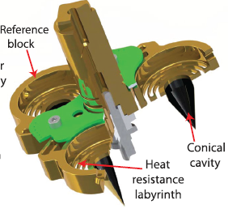
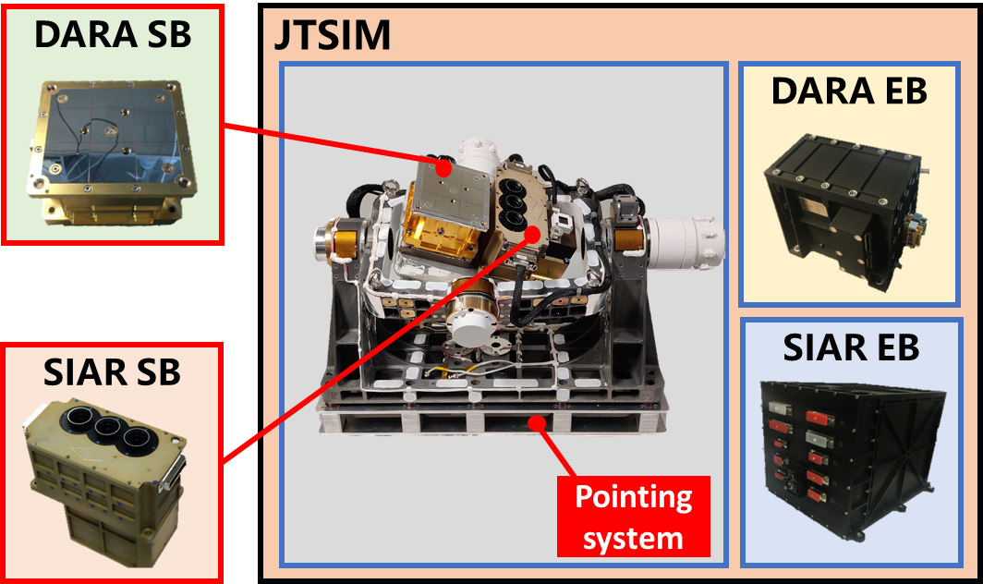
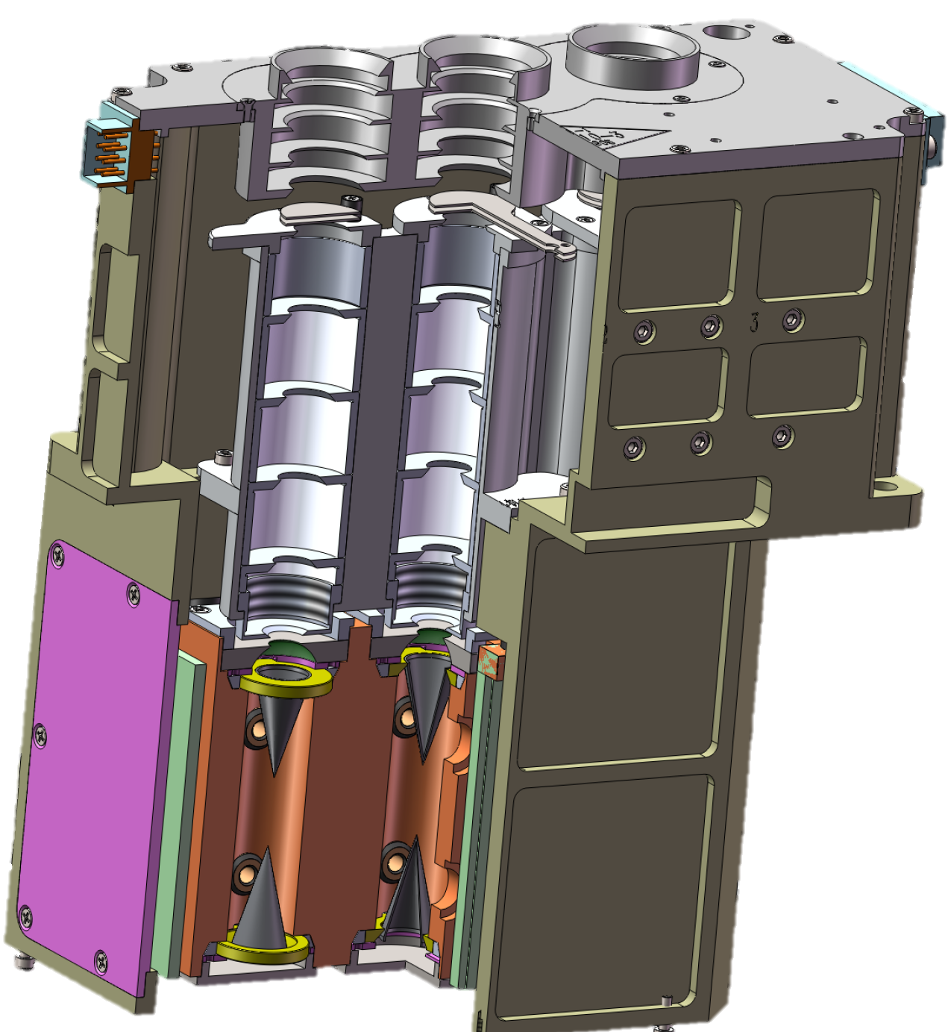
Fengyun Satellite Optical Payload Development
Solar Irradiance Monitor Payloads
SIM/FY-3E was launched in 2021, jointly developed with PMOD/WRC of Switzerland, adding the DARA radiometer.
Co-platform, synchronous monitoring of TSI changes with different types of radiometers.
I. Main Instrument Composition:
Three-channel SIAR absolute radiometer
Three-channel DARA absolute radiometer
2-axis pointing gimbal
Digital sun sensor
Electronics control box
III. Key Breakthrough :
Three-channel integrated absolute radiation detector design
Fast measurement algorithm, single observation time significantly shortened from 8 min to 2 min, achieving synchronous measurement with DARA
On-orbit channel degradation auto-correction technology, reducing the impact of degradation by 50%
II. Main Performance :
Spectral range: 0.2~20μm
Measurement sensitivity: ≤0.05W/m⁻²
On-orbit stability: ≤0.01%/year
Total solar irradiance calibration accuracy: ≤0.1%
Sun tracking accuracy: <0.1°
Notes:
Let's focus on the Solar Radiation Monitor on the E-satellite. Its main feature is 'International Comparison' [ˌɪntərˈnæʃnəl kəmˈpærɪsn]. We worked together with PMOD/WRC of Switzerland. It carries both our SIAR radiometer and the Swiss DARA radiometer. This is the first time to have different types of radiometers monitoring side-by-side on the same platform [seɪm ˈplætfɔːrm]. To make them work together in time , we developed a fast measurement method [ˈmɛθəd], cutting the observation time from 8 minutes down to 2 minutes.

Slide 6
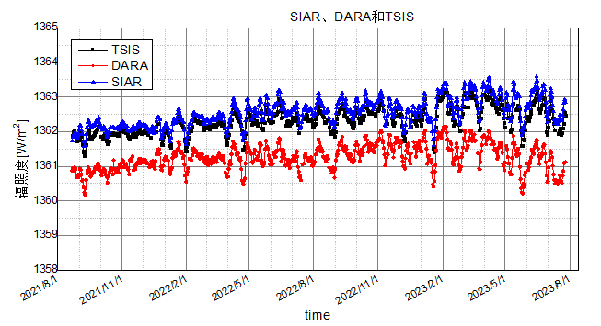
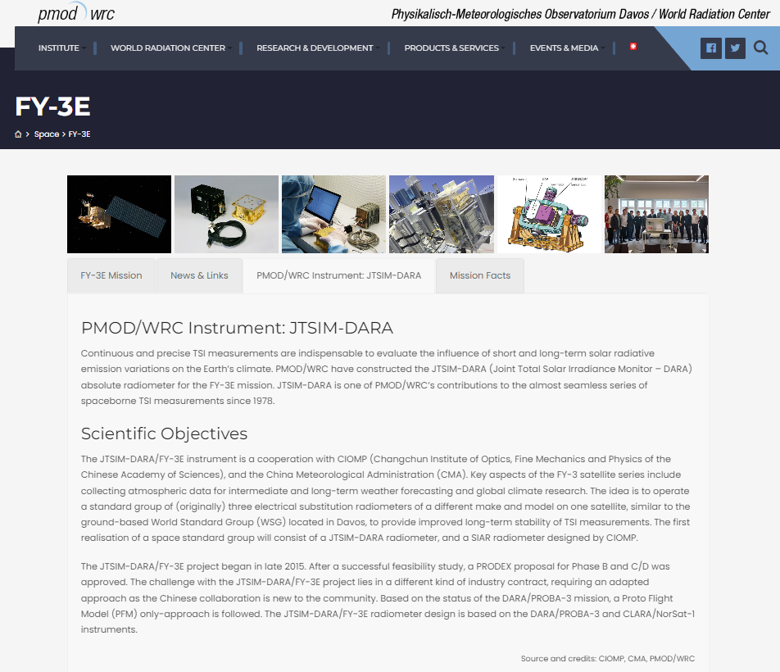
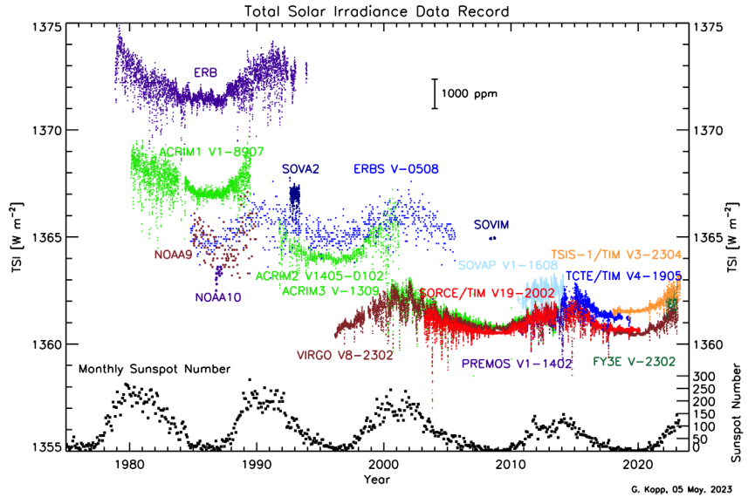
Fengyun Satellite Optical Payload Development
SIM/FY-3E
Calibration model traceable to SI units, in cooperation with PMOD/WRC
PMOD/WRC: Established the first space-based reference group, significantly improving the long-term measurement stability of TSI.
$TSI=（E−Eb）∙fAU∙fpointing∙fWRR∙fDA∙$ $fT∙fde∙$ $fdopp∙$ $fWRR−SI$
FY-3E data has been included in the world's TSI observation series
SIAR calibration accuracy 0.018%, on-orbit stability 0.005%
DARA calibration accuracy 0.07%, on-orbit stability 0.008%
Consistency of relative variation with TIM/TSIS is better than 0.01%

Slide 7
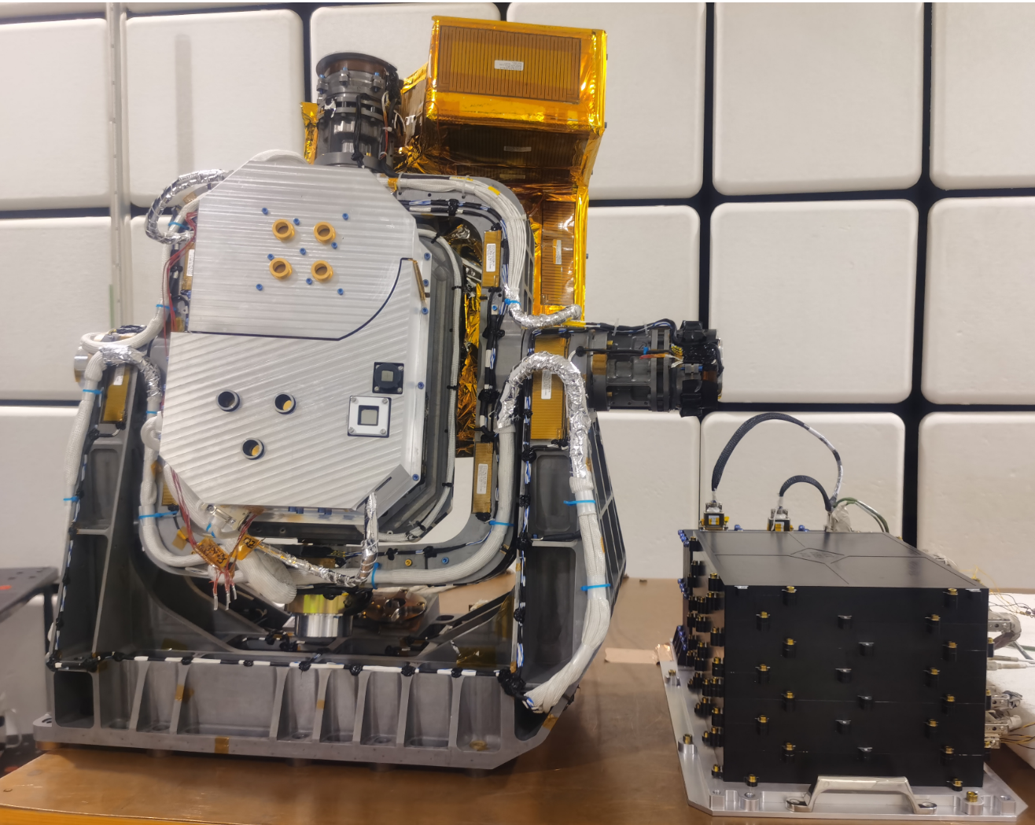
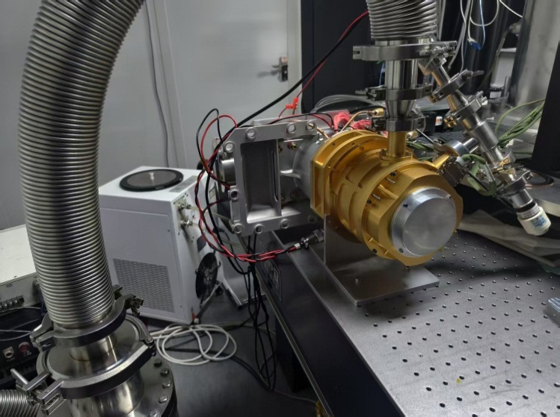
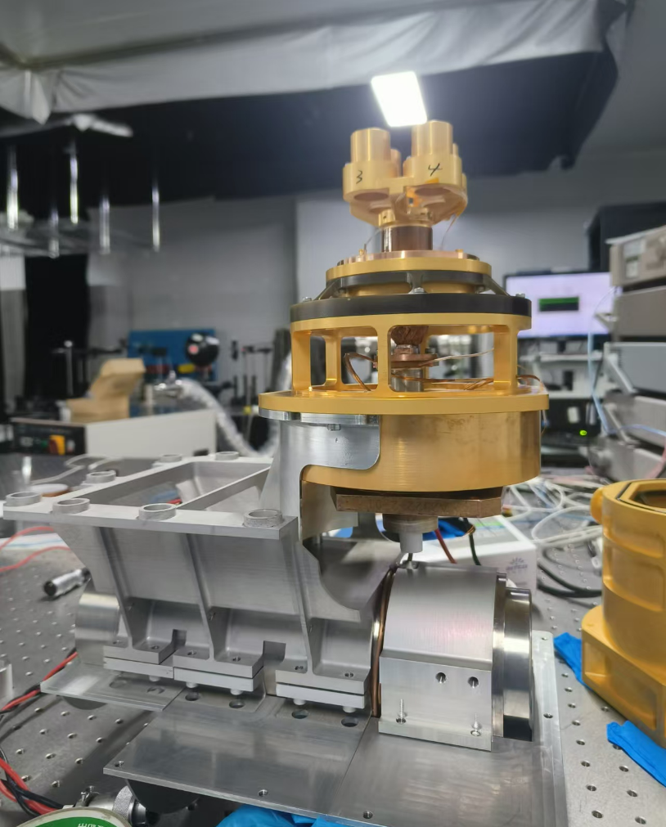
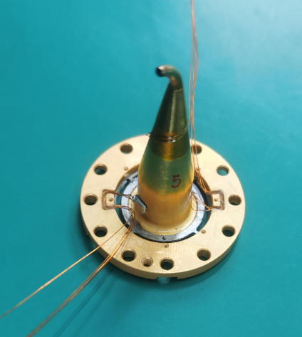
Fengyun Satellite Optical Payload Development
SIM/FY-3J (under development)
A new 80K cryogenic radiometer is added to reduce measurement thermal noise, improve measurement accuracy, and capture the true variations in Total Solar Irradiance.
The development of the qualification model is complete. Scheduled for launch in 2026, it will become the world's first space-based cryogenic radiometer.
I. Main Instrument Composition:
Three-channel SIAR ambient-temperature radiometer
Four-channel CAR cryogenic radiometer
Pulse tube cooler
II. Main Performance :
Measurement Accuracy: ≤0.1%
Three-channel Consistency: ≤0.1%
Cryogenic Temperature Range: 80K - 93K
On-orbit Long-term Stability: ≤0.01%/year
III. Key Breakthrough :
High-absorptance 80K cryogenic detectors
High-efficiency space pulse tube cooler.
Notes:
For the Fengyun -3J-satellite, we will add a new 80K cryogenic radiometer. The purpose is to reduce the detector's thermal noise, further improve measurement accuracy and sensitivity, and capture the true variations in Total Solar Irradiance. Currently, the product is complete. It is scheduled for launch in 2026, and it will become the world's first space-based operational cryogenic radiometer.

Slide 8
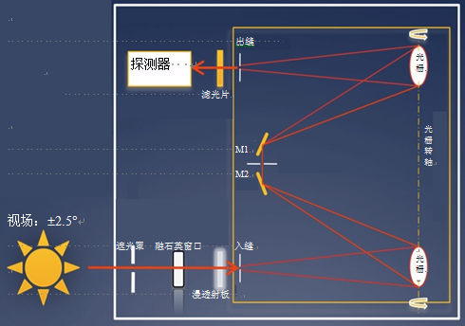
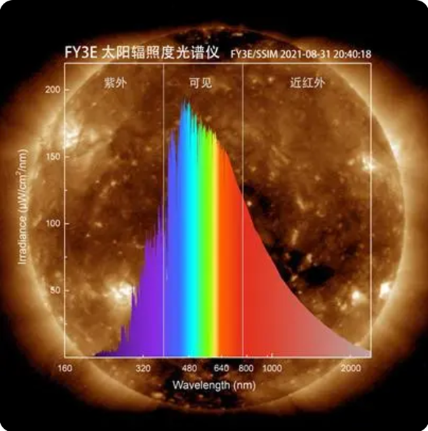
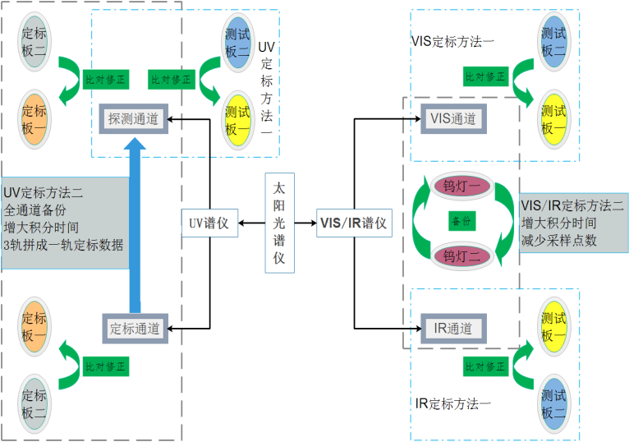
Fengyun Satellite Optical Payload Development
Solar Irradiance Spectrometer/FY-3E
Measure Solar Spectral Irradiance (SSI) - the Sun's energy distribution by wavelength.
I. Key Technologies:
Compact tandem spectrometer design and assembly technology;
High-precision, wide-dynamic-range spectral detection technology;
High-stability on-orbit radiometric calibration technology;
II. Key Indicators: :
Spectral Range: 165 nm – 2400 nm
Absolute Calibration Accuracy: ≤ 2% ~ 3%
Stability: ≤0.2%/year
Notes:
Besides measuring total energy (TSI), we also developed the Solar Irradiance [ɪˈreɪdiəns] Spectrometer [spɛkˈtrɒmɪtər] on FY-3E. It measures how the sun's energy is spread out across different wavelengths ,covering UV to IR.
Launched in 2021, it's working well .This is China's first space-based full solar spectrum image.

Slide 9
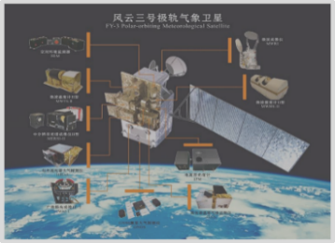
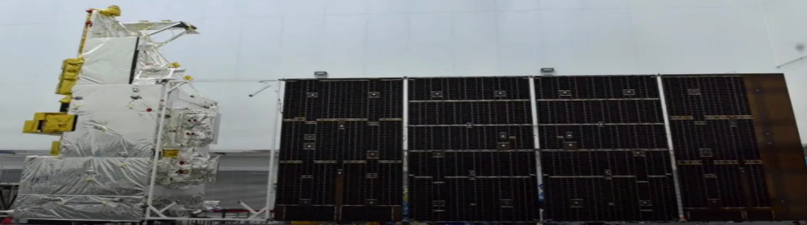
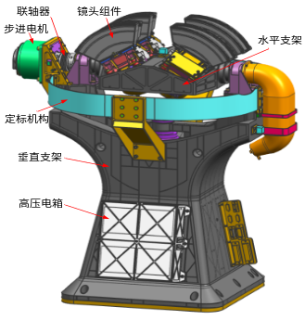
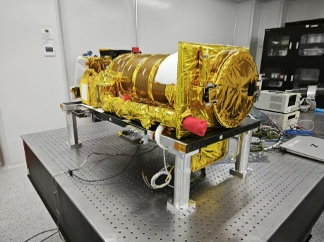
Fengyun Satellite Optical Payload Development
Space Weather Payloads
To meet the demands for operational space weather monitoring, Solar X-ray and Extreme Ultraviolet (X-EUV) and Wide-field Auroral Imager (WAI) detection technologies have been developed. Starting with the Fengyun-3D satellite, continuous observation of space environment elements such as solar activity, geomagnetic storms, and ionospheric weather has been achieved, providing crucial data support for China's space weather forecasting and warning systems.
2017
2021
2025
2025
2026
FY-3D WAI
FY-3E XEUV
FY-4C EUVI
FY-3H WAI
FY-4D EUVI
Notes:
Okay, let's move to the second section: Space Weather Payloads. To meet the needs for space weather monitoring, starting from the FY-3D satellite, we have developed the Wide-field Auroral Imager (WAI) and the Solar X-EUV Imager . This has helped us continuously watch solar activity and geomagnetic storms.

Slide 10
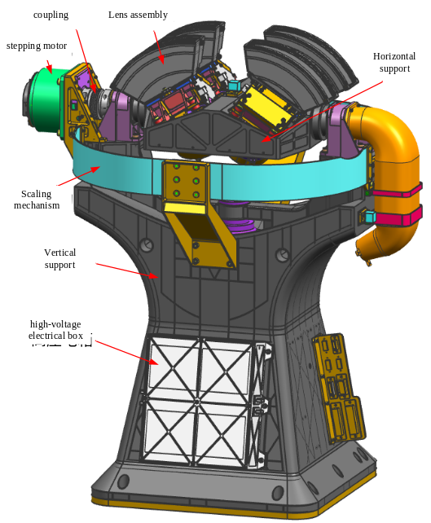
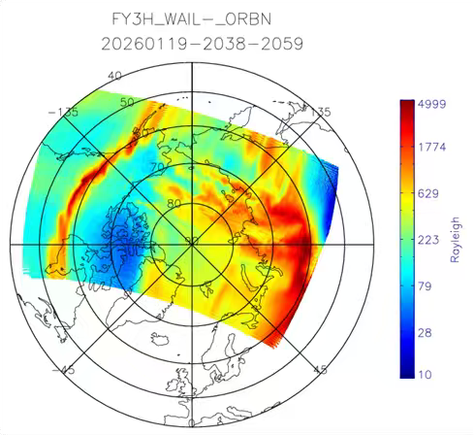
Fengyun Satellite Optical Payload Development
WAI/FY-3H
Wide-field aurora imager in the solar polar orbit through 130°×130° large field of view,
the N2 molecular radiation LBH band (140nm~180nm) of the Earth‘s northern and southern auroras were imaged
Aurora radiation intensity information with the spatial resolution of 10km in the auroral oval was obtained.
Forecast geomagnetic storm, magnetospheric substorm and ionospheric weather in polar region.
Wide-ﬁeld auroral imager （WAI） onboard the FY-3Hsatellite was developed by CIOMP
 | Parameter | Main technical index
1 | Working waveband | route1：140 ~160nm；route2：160 ~180nm
2 | Accuracy of on-board radiometric calibration | ≤15%
3 | Sensitivity | better than 6.0 counts/Rayleigh/s
4 | Uniformity of field of view | ≤15%
5 | Detect total field of view | ≥130°×130°
6 | Spatial resolution | Substellar point resolution：≤10km（110km）
7 | pointing accuracy | ≤0.2°
8 | Out-of-band response | Less than 5% of the in-band response in 120-220nm
the auroral images that were captured by FY-3H WAI
Three-dimensional image
of the imager

Slide 11
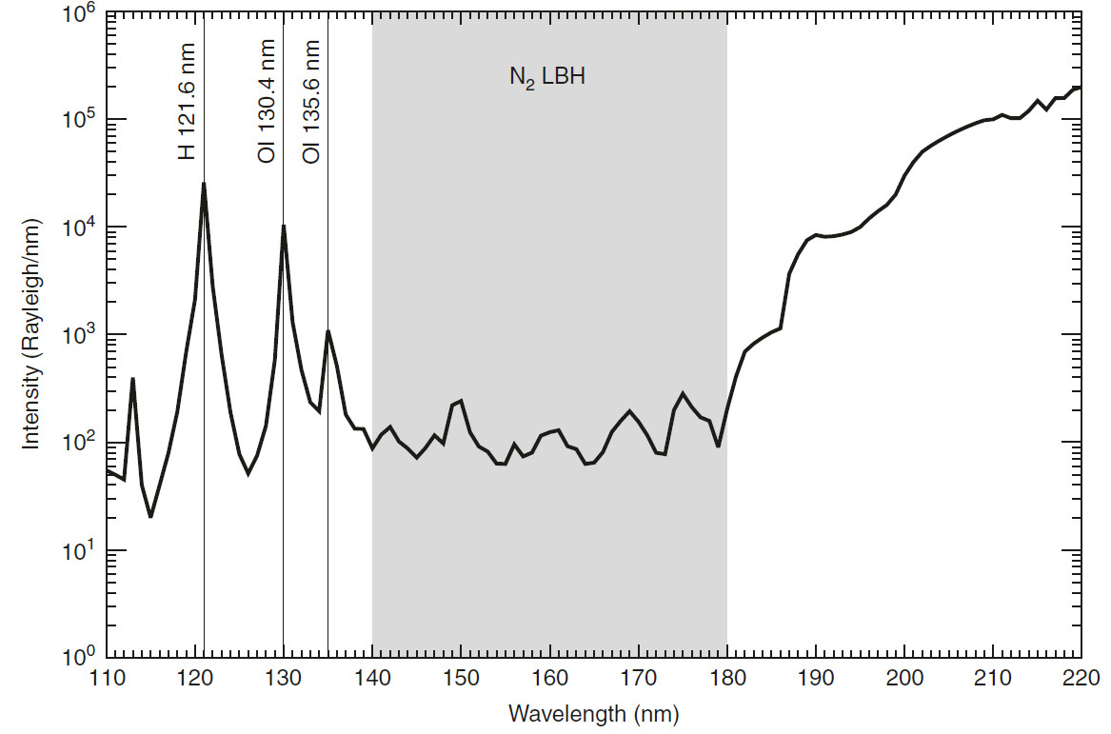
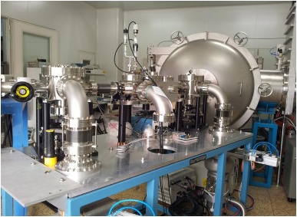
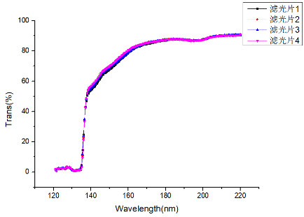
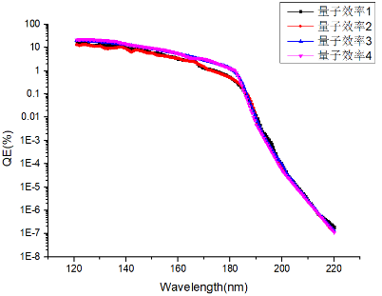
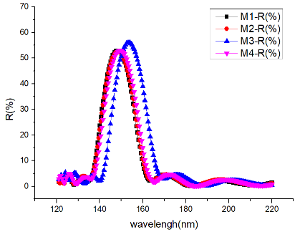
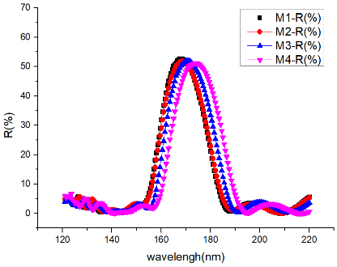
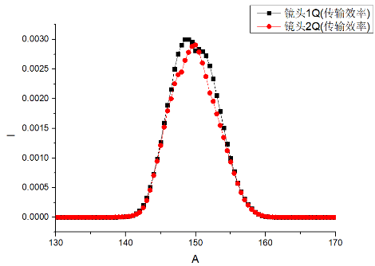
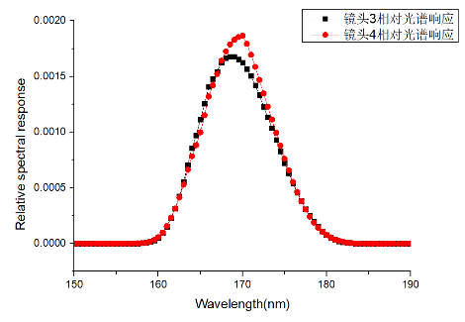
Fengyun Satellite Optical Payload Development
WAI/FY-3H Spectral response calibration
To ensure accurate inversion of the observed emission intensity, the most important indicator of an imager is the spectral response.
There is no high brightness light source in the far ultraviolet band, the component-level calibration method is adopted. The responses of different optical elements are measured respectively, and the response of WAI-Ⅱ is calculated .
Auroral spectrum of 1-nm resolution with the passband overlaid.
The shaded region corresponds to the response wavelength of WAI-Ⅱ
Filter response(left) and quantum efficiency(right) of four camera
140-160nm channel（left）and 160-180nm channel（right）response of four mirrors
Spectral response of 140-160 channel(left) and 160-180 channel(right)

Slide 12
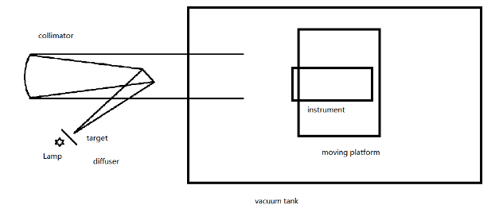
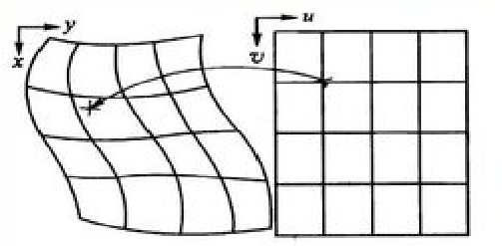

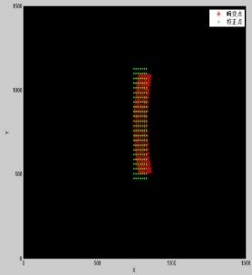
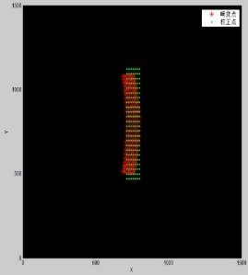
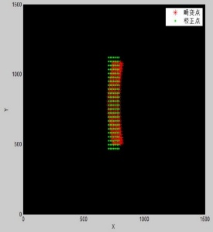
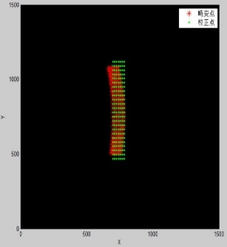
Fengyun Satellite Optical Payload Development
WAI/FY-3H Geometrical calibration
Photon-counting detectors obvious imaging nonlinearity on its edge, and the optical systems also have large geometric distortion due to large FOV.
These two factors cause high nonlinearity in WAI-Ⅱ’s image plane; Therefore, it is necessary to correct the nonlinearities in the detectors and the optical systems. The first step is to correct the detector distortion and the second step is to correct the camera distortion that is produced by the optical systems.
Each photon-counting detector images an equally spaced pinhole array, respectively;
The actual positions of the pinholes in the images deviated from their ideal positions, the difference between them are the distortion .Interpolation with the difference matrix of these two control points, the distortion correction query table is obtained.
Each camera images the pinhole array to obtain the difference between the actual positions and ideal positions , and the optical distortion correction table can be obtained.
Corrections of the geometrical nonlinearities for the four cameras( left→right: camera1→camera4 )

Slide 13
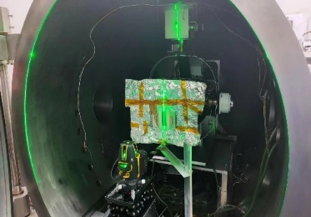
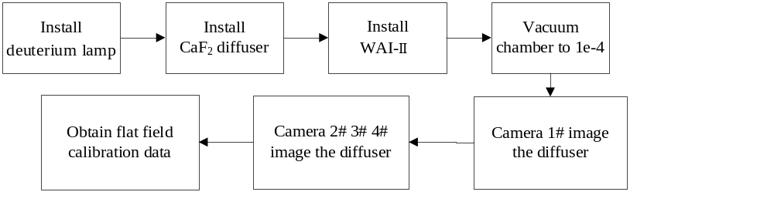
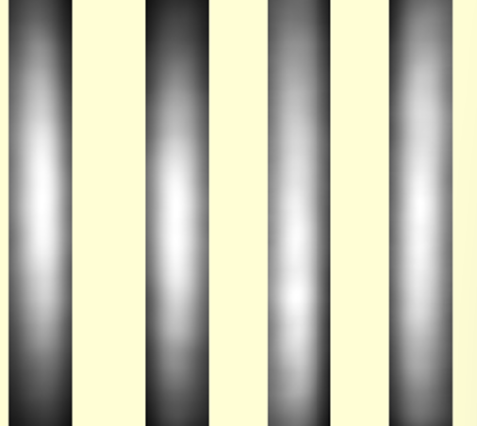
Fengyun Satellite Optical Payload Development
WAI/FY-3H Flat field calibration
To calibrate the nonuniformity in the intensity response among various positions of the image plane.
This nonuniformity could be caused by the vignetting of the optical system and the nonuniform reflectivity of the mirrors, the transmission of the filters and the quantum efficiency of the detectors.
Flat-field calibration is typically implemented by imaging a uniform target, which must cover the full aperture and the full FOV of the instrument. WAI-Ⅱ operates in the FUV band and there is no Lambertian extended uniform source in this wavelength that is sufficiently large to cover WAI’s full FOV.
A target by using an FUV deuterium lamp to illuminate an CaF2 diffuser are constructed. This target can be viewed as a Lambertian uniform target in approximately 20° FOV. Only the uniform region of the target was used during the calibration process. Both the cameras and the diffuser were placed in a vacuum chamber. The cameras were rotated and imaged the uniform portion of the diffuser target at various parts of their FOVs. The cameras acquired images with the same exposure time. Then, all the images were combined to form a full-FOV flat-field image.
Flat field distribution ( left→right: camera1→camera4 )

Slide 14
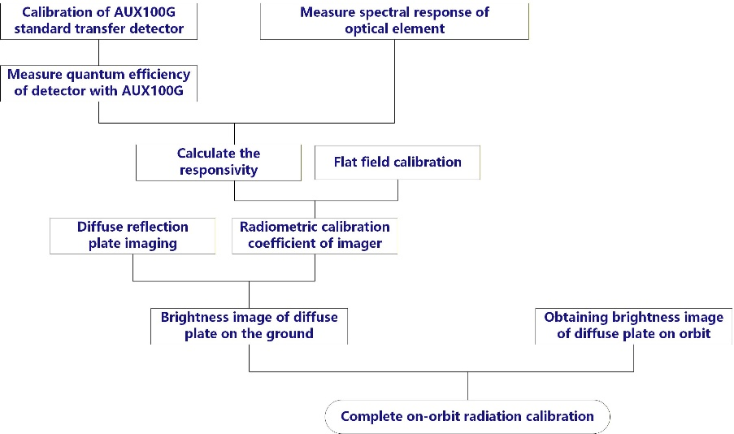
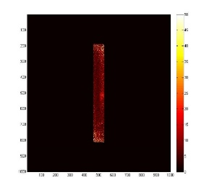
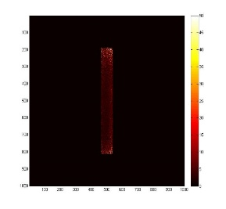
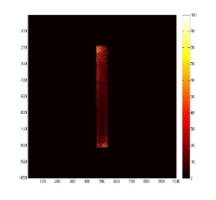

Fengyun Satellite Optical Payload Development
WAI/FY-3H On-orbit radiation calibration
Working life is 8 years, It is very important to calibrate the response of imager in orbit.
Before launching, the radiation brightness of the satellite calibration device (diffuse reflection plate) is calibrated on the ground;
On-ground radiation calibration → imaging of diffuse plate on the ground → geometric distortion correction→ flat field calibration → radiation brightness distribution L of on-board calibration device by imager.
On-ground radiation calibration( left→right: camera1→camera4 )
 | error term | Calibration result
1 | On-ground radiation calibration error | 11.8%
2 | Signal-to-noise ratio error of on-orbit image | 4.5%
3 | Correction of light source attenuation error | 2.0%
4 | Attenuation error of corrected diffuse plate | 5.0%
5 | On-orbit radiation calibration | 13.7%

Slide 15
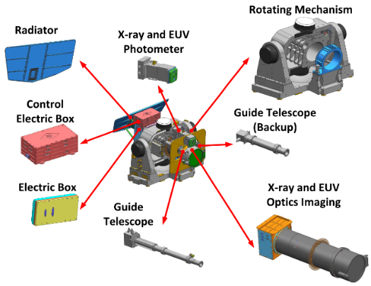
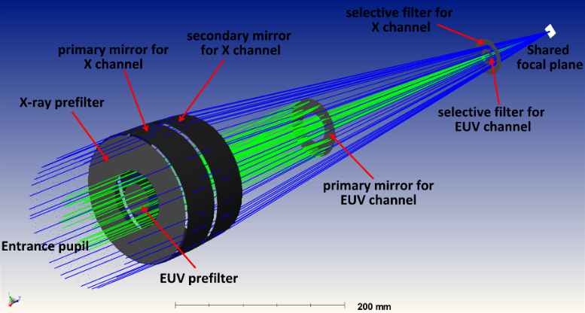

Fengyun Satellite Optical Payload Development
Solar X-EUV Imager/FY-3E
Key Tech 1: Dual-band compound optical system
Key Tech 2: High-precision sun-tracking
Key Tech 3：High-Precision Solar Image Stabilization
Instrument Composition
Main Specifications:
Imaging channels: 6 X-ray channels, 1 EUV channel
Spatial resolution: 2.5" (arcseconds)
Spectral bandwidth: 1.0nm
Field of View: 42' (arcminutes)

Slide 16





Fengyun Satellite Optical Payload Development
Solar X-EUV Imager/FY-3E
Conducts long-term, continuous, high-temporal-resolution imaging observations of the full solar disk and low corona in the X-ray and extreme ultraviolet (EUV) bands.
Integrated into the operational system of the National Space Weather Monitoring and Warning Center to forecast space weather.
FY3E/X-EUVI 19.5nm observation (The black area on the solar disk is a coronal hole, 2022/04/19)
X-ray images and extreme ultraviolet images
National Space Weather Monitoring and Warning
Space Weather Analysis Report

Slide 17



Fengyun Satellite Optical Payload Development
Solar EUV Imager/FY-4D,C
Platform: FY-4C/D Geostationary Satellite
Key Method: One optical system, one detector with Four-band partitioned mirror coating.
Wavebands: 9.4nm, 17.1nm, 21.1nm, and 30.4nm.
Advantage: Continuous, high-temporal-resolution imaging of the Sun
Launch: C 2025, D TBD
Specification | Value
Wavelength Bands | Fe XVIII 9.4nm 、Fe IX 17.1nm 、Fe XIV 21.1nm、He II 30.4nm
Reflecting Mirror | Multilayer film - microcrystalline substrate
Field of View | 42×42 arcminutes
Resolution | 3.5 arcseconds
CMOS Detector | 2048×2048
Temporal Resolution | 5s

Slide 18




Fengyun Satellite Optical Payload Development
Solar EUV Imager/FY-4D,C
Key Application: Multi-layer monitoring for hazardous space weather warnings
Wavelength Band | Response Temperature | Observation Area
9.4nm/10.8nm | Approx. 6.7 million degrees | Core regions of active areas, plasma heated during flare processes; CME current sheets, high-temperature magnetic ropes, and other high-temperature structures.
17.1nm/17.4nm | Approx. 1 million degrees and partial transition region temperatures | Coronal structures with relatively lower temperatures such as coronal holes and active regions; Monitoring activities like filaments/prominences, jets, etc.
21.1nm | Approx. 1.8 million degrees | Typical coronal structures such as coronal holes, active regions, etc.; Flare loops, coronal dimming caused by CMEs, and EUV waves, etc.
30.4nm | Approx. 50,000 degrees | Structures like spicules, network structures, filaments/prominences, etc.; Jets, flare ribbons, flare loops, and CMEs.
9.4nm
17.1nm
21.1nm
30.4nm

Slide 19






Fengyun Satellite Optical Payload Development
Atmospheric Sensing Payloads
Our "Traditional Advantage": 40-year history of development (since 1985)
Provided a wealth of data for atmospheric dynamics research in the upper troposphere and stratosphere
Major Payloads Include: Tiangong-2 Ultraviolet Limb Imaging Spectrometer 、Fengyun-3 Ultraviolet Limb Ozone Profile Sounder
Tiangong-2 Ultraviolet Limb Imaging Spectrometer
Tiangong-2 Ultraviolet Annular Imaging Spectrometer
Ultraviolet Hyperspectral Ozone Sounder (Limb)
Limb XX Payload1
Limb XX Payload2

Slide 20




Fengyun Satellite Optical Payload Development
Ultraviolet Hyperspectral Limb Imager /FY3F
Mission: Detect trace gases O₃, CO, SO₂, NO₂, CH₄, and CO₂
Application: Monitoring pollution and climate change
I. Key Technologies:
Design and integration of a low F-number aspheric hyperspectral system.
Wide dynamic range detection and high-precision pointing.
High-precision spectral calibration and on-orbit polarization correction.

Slide 21


Fengyun Satellite Optical Payload Development
Ultraviolet Hyperspectral Limb Imager /FY3F
I.On-orbit Situation:
Successfully launched: August 3, 2023.
Filled a critical gap for China's Fengyun satellite series.
Clearly demonstrates layered detection of atmospheric composition in the stratosphere
Retrieves the global vertical distribution of trace gases, filling a key gap.

Slide 22







Fengyun Satellite Optical Payload Development
Future:FY-5 Solar Irradiance Monitor
For the first time: A 60K cryogenic radiometer will be used for operational observations.
Goal: Comprehensively enhance measurement accuracy and stability by another order of magnitude.
I.Performance Indicator Enhancements:
Measurement Accuracy: Improved from ≤0.1% to ≤0.05%.
Long-term Stability: Improved from ≤0.01%/year to ≤0.005%/year.
Measurement Sensitivity: Improved from ≤0.05 Wm⁻² to ≤0.03 Wm⁻².
Cryogenic Temperature Range: Changed from 80K-93K to 60K-69KMaximum
II. Breakthrough Key Technologies
Development of a 60K Deep Cryogenic High-Performance Radiometer
Development of a Fast-Response Planar Detector
Space-Grade Precision Measurement Electronics
Self-Traceability for Cryogenic Measurement
Irradiance Comparison for Traceability to SI Units

Slide 23


Fengyun Satellite Optical Payload Development
Future: FY-5 Atmospheric Payload
A Major Leap: Combining Nadir (Wide Coverage) + Limb (Vertical Detail) for more complete and sensitive atmospheric monitoring
Nadir Payload: Wide Swath Coverage
2. Lim Payload: High Vertical Resolution
通道1
通道3
通道2
光栅
狭缝
色散棱镜
扫描镜
Nadir Telescope System
Limb System Structure

Slide 24


Fengyun Satellite Optical Payload Development
Future:FY-6 Large Field-of-View
Extreme Ultraviolet Solar Disk and Corona Imager
1. Field of View (FOV) Bottleneck: Cannot see the full initial phase of a CME
Current (FY-4): 42' FOVProblem: CME quickly travels outside this limited view
Result: Cannot observe crucial early development
2. Lack of Key Wavelengths: Cannot see the source of the eruption clearly.
Missing 121.6 nm: To capture the initial eruption of solar flares
Missing 28.4 nm: To track coronal hole boundaries (solar wind source)
Cover the near-solar corona out to 2.5 solar radii
GOES-R SUVI :53′
FY-3/FY/4：42′
Technical Indicator | This Project's Payload (Proposed for FY-6) | FY4-03 Satellite | GOES-19 SUVI (USA)
Field of View | > 80 arcminutes | ~42 arcminutes | ~53.3 arcminutes
Spatial Resolution | ≤ 2.5 arcseconds | ~3.5 arcseconds | 5 arcseconds
Wavelength Configuration (nm) | 9.4, 17.1, 28.4, 121.6 | 9.4, 17.1, 21.1, 30.4 | 9.4, 13.1, 17.1, 19.5, 28.4, 30.4

Slide 25
Summary
Involved in the development of optical payloads for Fengyun satellites, including solar radiation monitoring, space weather observation, and atmospheric sounding.
Related work has covered absolute radiometry, spectral observation, imaging, and on-orbit calibration.
Several payloads have been launched and operated in orbit, supporting meteorological observation, climate-related studies, and space weather monitoring.
Current efforts are focused on the development of next-generation payloads with improvements in accuracy, stability, spectral coverage, and operational performance.
Cooperate with GSICS on calibration, intercomparison, and space-based observations.

Slide 26
Thank You
Changchun Institute of Optics, Fine Mechanics and Physics, Chinese Academy of Sciences

