Slide 1
Update on SNO/Vicarious Calibration Focus Group
Tim Hewison
2026 Annual GSICS Meeting

Slide 2
Review of SNO/Vicarious Focus Group Meetings 2025/26
2025-06-24
  Lukas Muser (DWD): Analysis of inhomogeneities within satellite footprints
    Now with added Gaussian responses
  Shannon Brown (NASA-JPL): Vicarious Calibration algorithms applied to Sentinel-6 AMR/HRMR
    Potential resource for MWSG
  Tim Hewison (EUMETSAT) – EPS-Sterna Inter-calibration Constellation Implementation Plan
    Implementation plan in agenda item 4m
2025-11-13
  Noemie Lalau (Magellium) – Contribution of microwave radiometer calibration to altimeter uncertainty budgets
    Should GSICS focus more on the inter-calibration of altimeter microwave radiometers?
    Could they be considered as reference instruments for some spectral bands?
  Jorge Gill (Deimos-Indra) – Spectral Band Adjustment Factors to account for SRF differences
    Contribution to study below
  Joe Munchak (Tomorrow.io) – Inter-calibration of Tomorrow.io Microwave Sounder constellation
    See agenda item 4v + 4w: Discussion on inter-calibration of small satellites
2026-03-18
  Indra-Deimos + UPC – Sterna Inter-Calibration Study Final Presentation

Slide 3
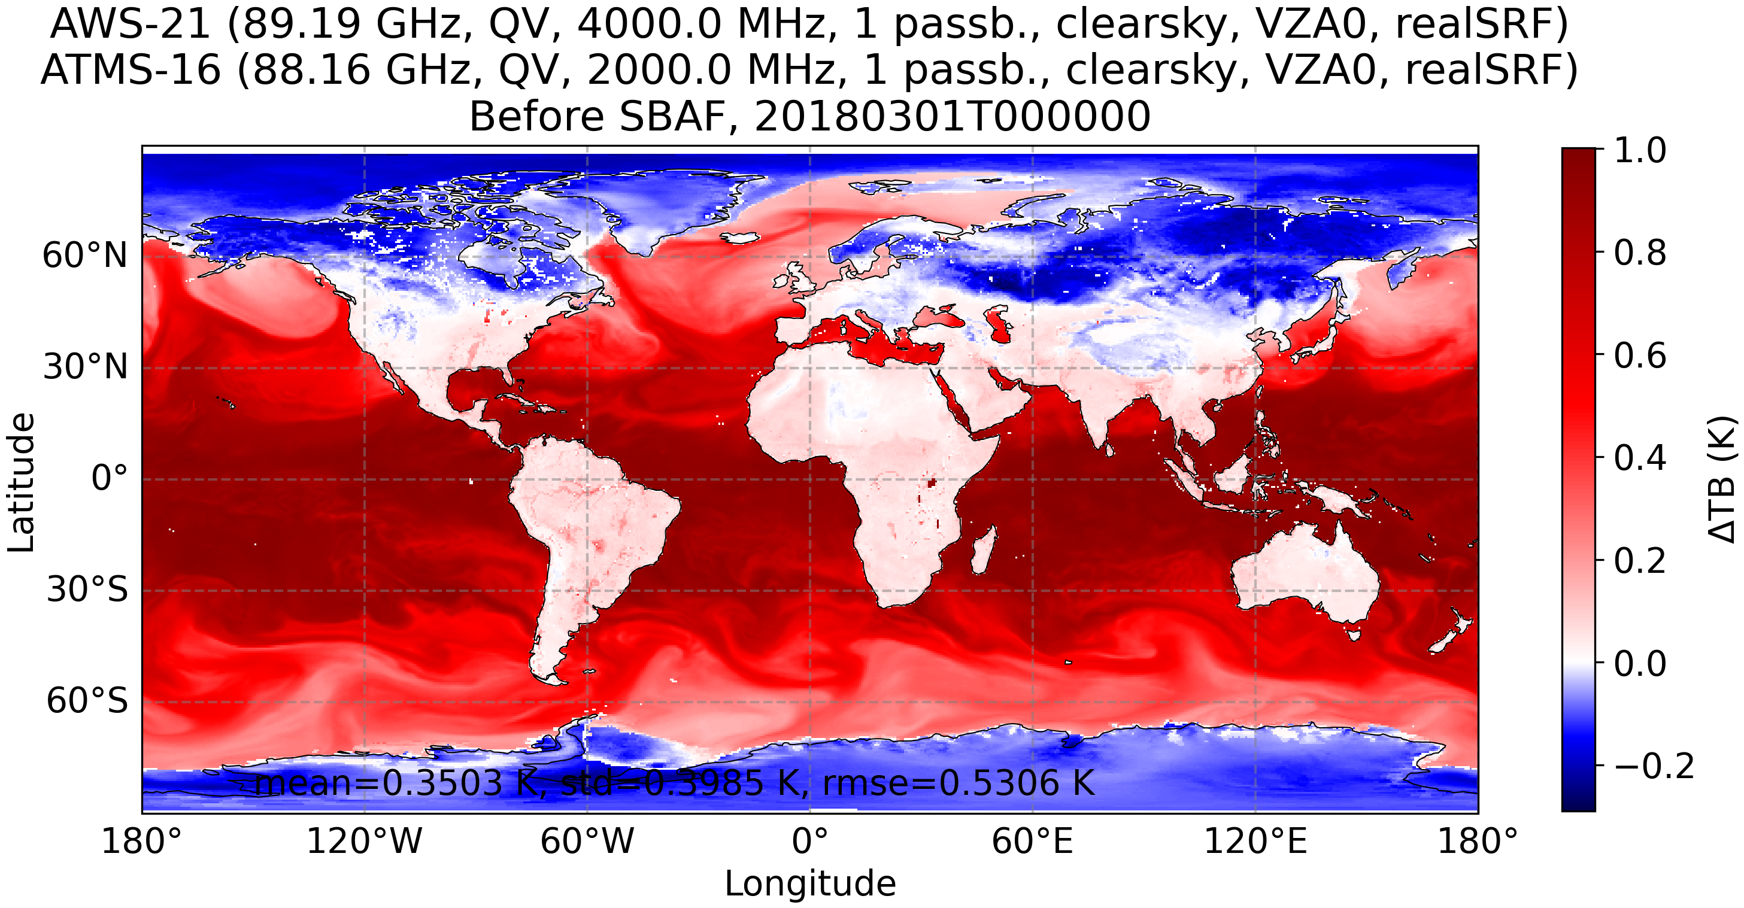
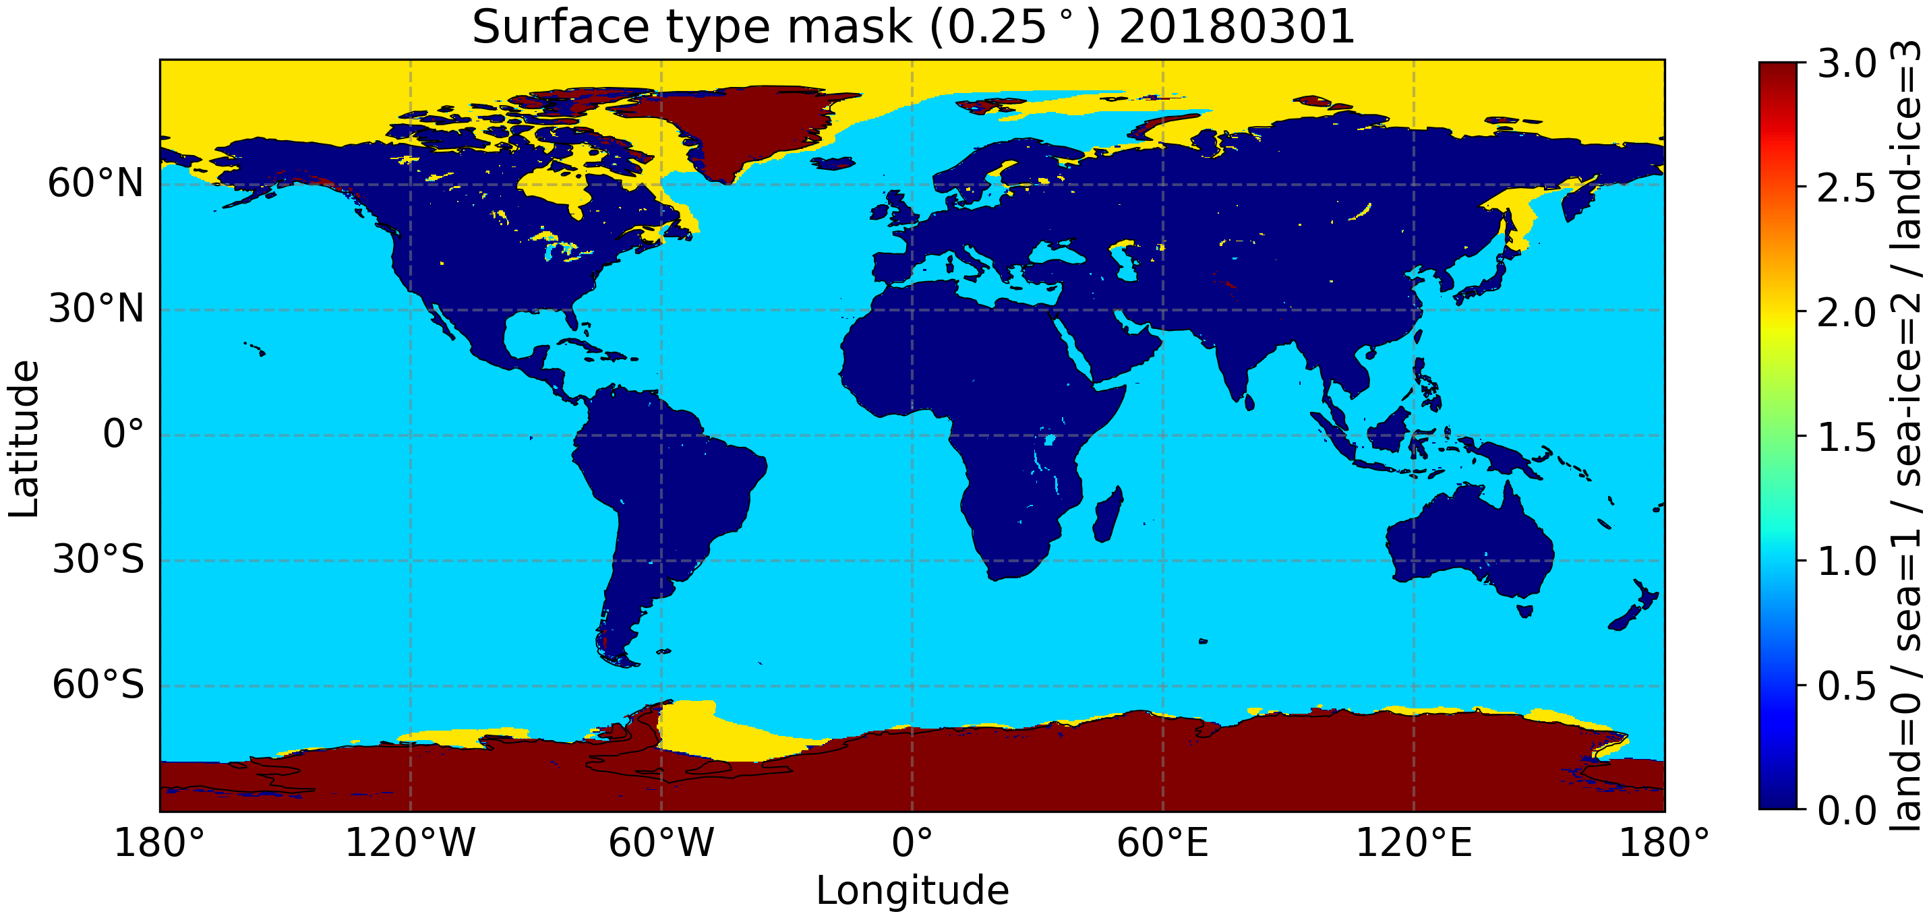
Sterna Inter-Calibration Study – Indra + UPC
Spectral Band Adjustment Functions
  Based on CDF-matching of synthetic observation – clear sky + cloudy
  Coefficients derived to transfer AWS, ATMS, AMSU-A, MHS at nadir (+ICI at 53°)
  Not needed when using NWP Double-Differencing

Slide 4
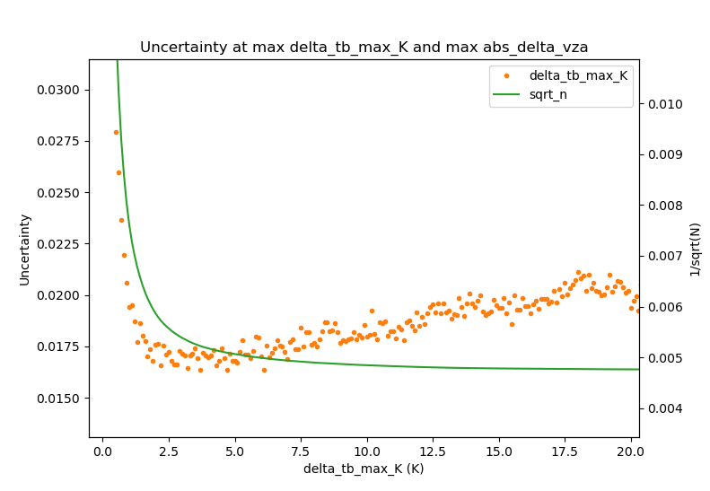
Sterna Inter-Calibration Study – Indra + UPC
Spectral Band Adjustment Functions
  Based on CDF-matching of synthetic observation – clear sky + cloudy
  Coefficients derived to transfer AWS, ATMS, AMSU-A, MHS at nadir (+ICI at 53°)
  Not needed when using NWP Double-Differencing
OCTM (“Warm SNO”) method
  Humidity channels – using variance from collocated GEO channels with similar WFs
  Tropospheric temperature channels – using GEO WV
  – with a little benefit of adding CO2 + IR window channels
  Not applicable to stratospheric temperature channels
Uncertainty (K) under |ΔTB_SEVIRI| conditioning .
1/√N is shown at a different scale for reference

Slide 5
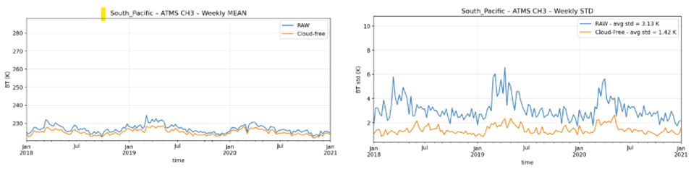
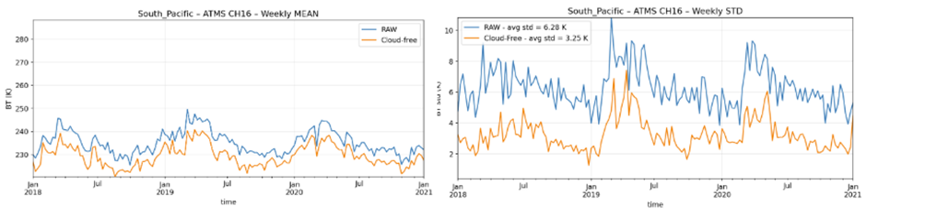
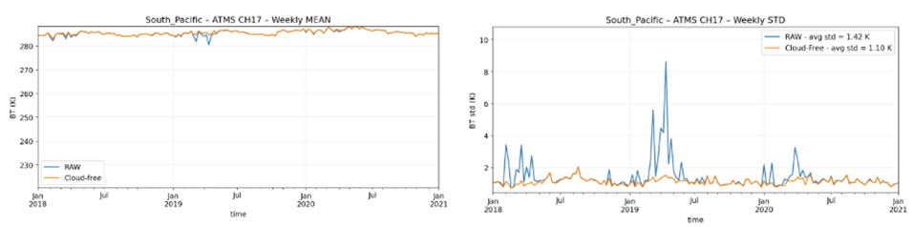
Sterna Inter-Calibration Study – Indra + UPC
Spectral Band Adjustment Functions
  Based on CDF-matching of synthetic observation – clear sky + cloudy
  Coefficients derived to transfer AWS, ATMS, AMSU-A, MHS at nadir (+ICI at 53°)
  Not needed when using NWP Double-Differencing
OCTM (“Warm SNO”) method
  Humidity channels – using variance from collocated GEO channels with similar WFs
  Tropospheric temperature channels – using GEO WV
  – with a little benefit of adding CO2 + IR window channels
  Not applicable to stratospheric temperature channels
Vicarious Inter-Calibration method
  Includes Cloud Detection
  QRNN-based for single channels, using real NEΔT (sensitivity will change with time)
  - Difficulty applying in polar conditions
  Application to Window channels: 50.3, 89, 166GHz using South Pacific + Amazon PICTs
  – monthly results < required uncertainty
  Dome-C strong seasonal cycle increases uncertainty above required levels
Mean Standard Deviation
ATMS channel 3 (50.3GHz)
ATMS channel 16 (89 GHz)
ATMS channel 17 (166 GHz)

Slide 6
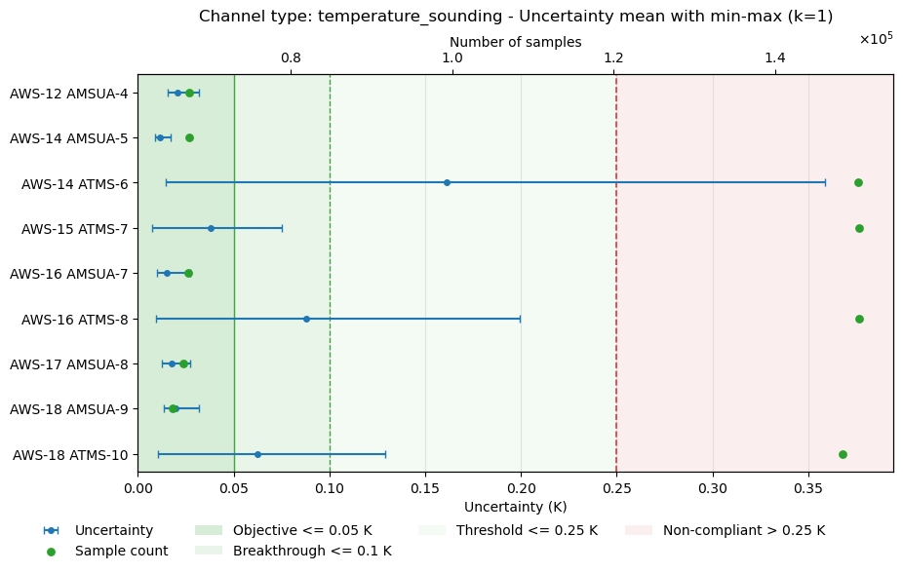
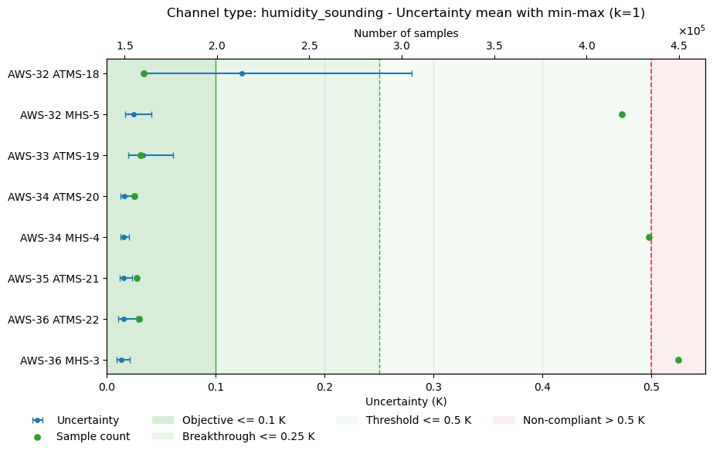
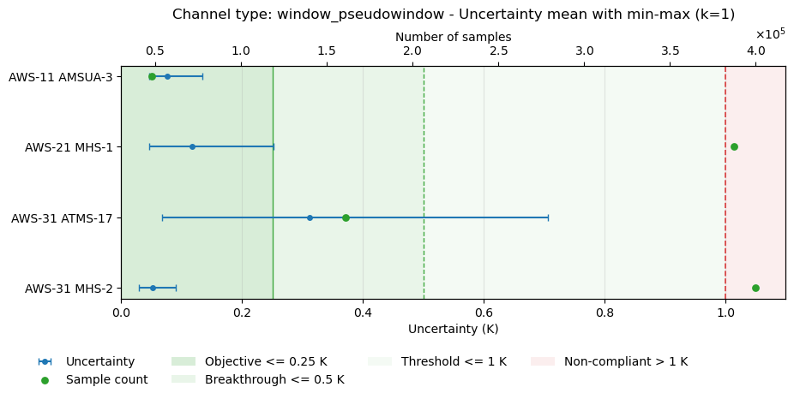
Sterna Inter-Calibration Study – Indra + UPC
Spectral Band Adjustment Functions
  Based on CDF-matching of synthetic observation – clear sky + cloudy
  Coefficients derived to transfer AWS, ATMS, AMSU-A, MHS at nadir (+ICI at 53°)
  Not needed when using NWP Double-Differencing
OCTM (“Warm SNO”) method
  Humidity channels – using variance from collocated GEO channels with similar WFs
  Tropospheric temperature channels – using GEO WV
  – with a little benefit of adding CO2 + IR window channels
  Not applicable to stratospheric temperature channels
Vicarious Inter-Calibration method
  Includes Cloud Detection
  QRNN-based for single channels, using real NEΔT (sensitivity will change with time)
  - Difficulty applying in polar conditions
  Application to Window channels: 50.3, 89, 166GHz using South Pacific + Amazon PICTs
  – monthly results < required uncertainty
  Dome-C strong seasonal cycle increases uncertainty above required levels
Uncertainty Analysis
  For OCTM and Vicarious Inter-Calibration, SBAF, Cloud Detection
  Also applied to classic SNO method to optimise inter-calibration algorithm – See figures ➔
  Using innovative Bootstrap resampling approach => Dedicated web meeting in 2026
Report and ATBDs will be published in May at https://www.eumetsat.int/science-studies

Slide 7
Inter-calibration Uncertainty Approaches
Sensitivity to input uncertainties
  Estimate uncertainties on algorithm inputs
  And assumptions
  Establish sensitivity of algorithm output to input uncertainties
  Combine!
Bootstrap method
Allows trade-off of algorithm parameters
  To optimise uncertainty
Tedious!
https://arxiv.org/html/2403.20182v2
https://www.nature.com/articles/s41524-022-00794-8
Faster?

Slide 8
No Update to SNO Literature Review Spreadsheet
Review published SNO algorithms
Also limited review of
  Vicarious inter-calibration
  NWP Double-Difference
SharePoint Spreadsheet
  UMD SharePoint Recovered
  WMO SharePoint from now!
Need to populate columns for
  Spectral Band / View Angle Adjustment Factor (SBAF/VAAF)
Further Extension:
  Hybrid SNO+NWP-DD
Contributions welcome!
Class | Reference | Collocation Area (km) | ds (km) | dt (s) | dVZA (°) | VZAmax (°) | Method | Filter | SBAF /VAAF | L | C | X | K | V | W | F | D | G | H | J | Applicable Sensors
 |  |  |  |  |  |  |  | incl azi angle | Spectral/View adj. | 1.4 | 6.8 | 10.65 | 12-40 | 50-60 | ~89 | ~118 | ~157 | ~183 | ~229 | ~325
Temp Sounders | Zou et al. 2006 | 1x1 | 111 | 100 |  | 5° | SNO |  |  |  |  |  |  | X |  |  |  |  |  |  | MSU Ch2
Temp Sounding | Iacovazzi & Cao, 2007 | 4SDP x 5TDP | 100 | 30 |  | 5° | SNO + bilinear Interp. |  |  |  |  |  | a | X | a |  | a | a |  |  | AMSU-A
 | Iacovazzi & Cao, 2008 | 4SDP x 5TDP | 100 | 30 |  | 5° | SNO + bilinear Interp. | SD<3xNEdT |  |  |  |  | X | X | a |  | a | a |  |  | AMSU-A, ATMS
Temp Sounders | Zou and Wang 2011 | 1x1 | 45 | 50 |  | 5° | SNO |  |  |  |  |  |  | X |  |  |  |  |  |  | AMSU-A , ATMS
Temp+ Humidity Sounding | Ackermann 2020 | 1SDP x 1TDP | 10 | 30 | 10° 3.6° | 10° | SNO + B-G resample |  |  |  |  |  | X | X | X |  | X | X |  |  | AMSU-A AMSU-B+MHS
Humidity Sounding | Moradi et al. 2015 |  | 50 | 3600 |  | Nadir | SNO |  |  |  |  |  |  |  |  |  |  | X |  |  | ATMS SAPHIR
 | John et al. 2012 | 3SDP x 3TDP | 5 | 300 |  | 3.9° | SNO |  |  |  |  |  |  |  |  |  |  | X |  |  | MHS
 | EUMETSAT MHS FCDR 2023 |  | 10 | 300 3600 | 5% | 15° | SNO | SD(3x3)<NEDT *sqrt(2) |  |  |  |  |  |  |  |  |  | X |  |  | MHS
 | Dou et al. 2022 | 1SDP x 1TDP | 3 | 1200 |  | 5° | SNO | +SD(3x3)<1K |  |  |  |  |  |  |  |  |  | X |  |  | MWHS-MHS
 | Xie et al, 2024 | 1SDP x 1TDP | 3 | 900 |  | 5° | SNO |  |  |  |  |  |  |  |  |  |  | X |  |  | MWHS2-ATMS
Window SNO | Yan & Weng, 2008 | 1SDP x 1TDP | 12.5 | 60 |  | All | SCO | SD<1K |  |  |  |  | X | X | X |  |  |  |  |  | SSMIS-SSM/I
 | Song Yang et al., 2011 |  | 3 | 120 |  | All | SCO | SD<2K, |dTb|<10K |  |  |  |  | X |  | X |  |  |  |  |  | SSM/I
 | Zou et al. 2014 |  | 15 | 60 |  |  | SNO + B-G resample | +1-sigma |  |  |  |  | X | X | X |  |  |  |  |  | AMSU-ATMS
 | Yang et al., 2020 "IMICA" | 2SDP x 1TDP | 50-75 | 50 |  | 3.3° | SNO | +SD |  |  |  |  | X |  | X |  |  |  |  |  | AMSU-A
 | Yan et al., 2020 |  | 30 | 80 |  |  | SNO | +SD<2K |  |  |  |  | X | X | X |  |  |  |  |  | AMSU
Generic SNO | Hewison 2023 - Proposal for Sterna inter-calibration (STC) |  | 7.5 | 900 | 5° /1?° | 5° /55?° | SNO+OCTM /SCO |  | SBAF /TBD |  |  |  |  | X | X |  | X | X |  | X | Sterna-MWS/ATMS Sterna-ICI

Slide 9
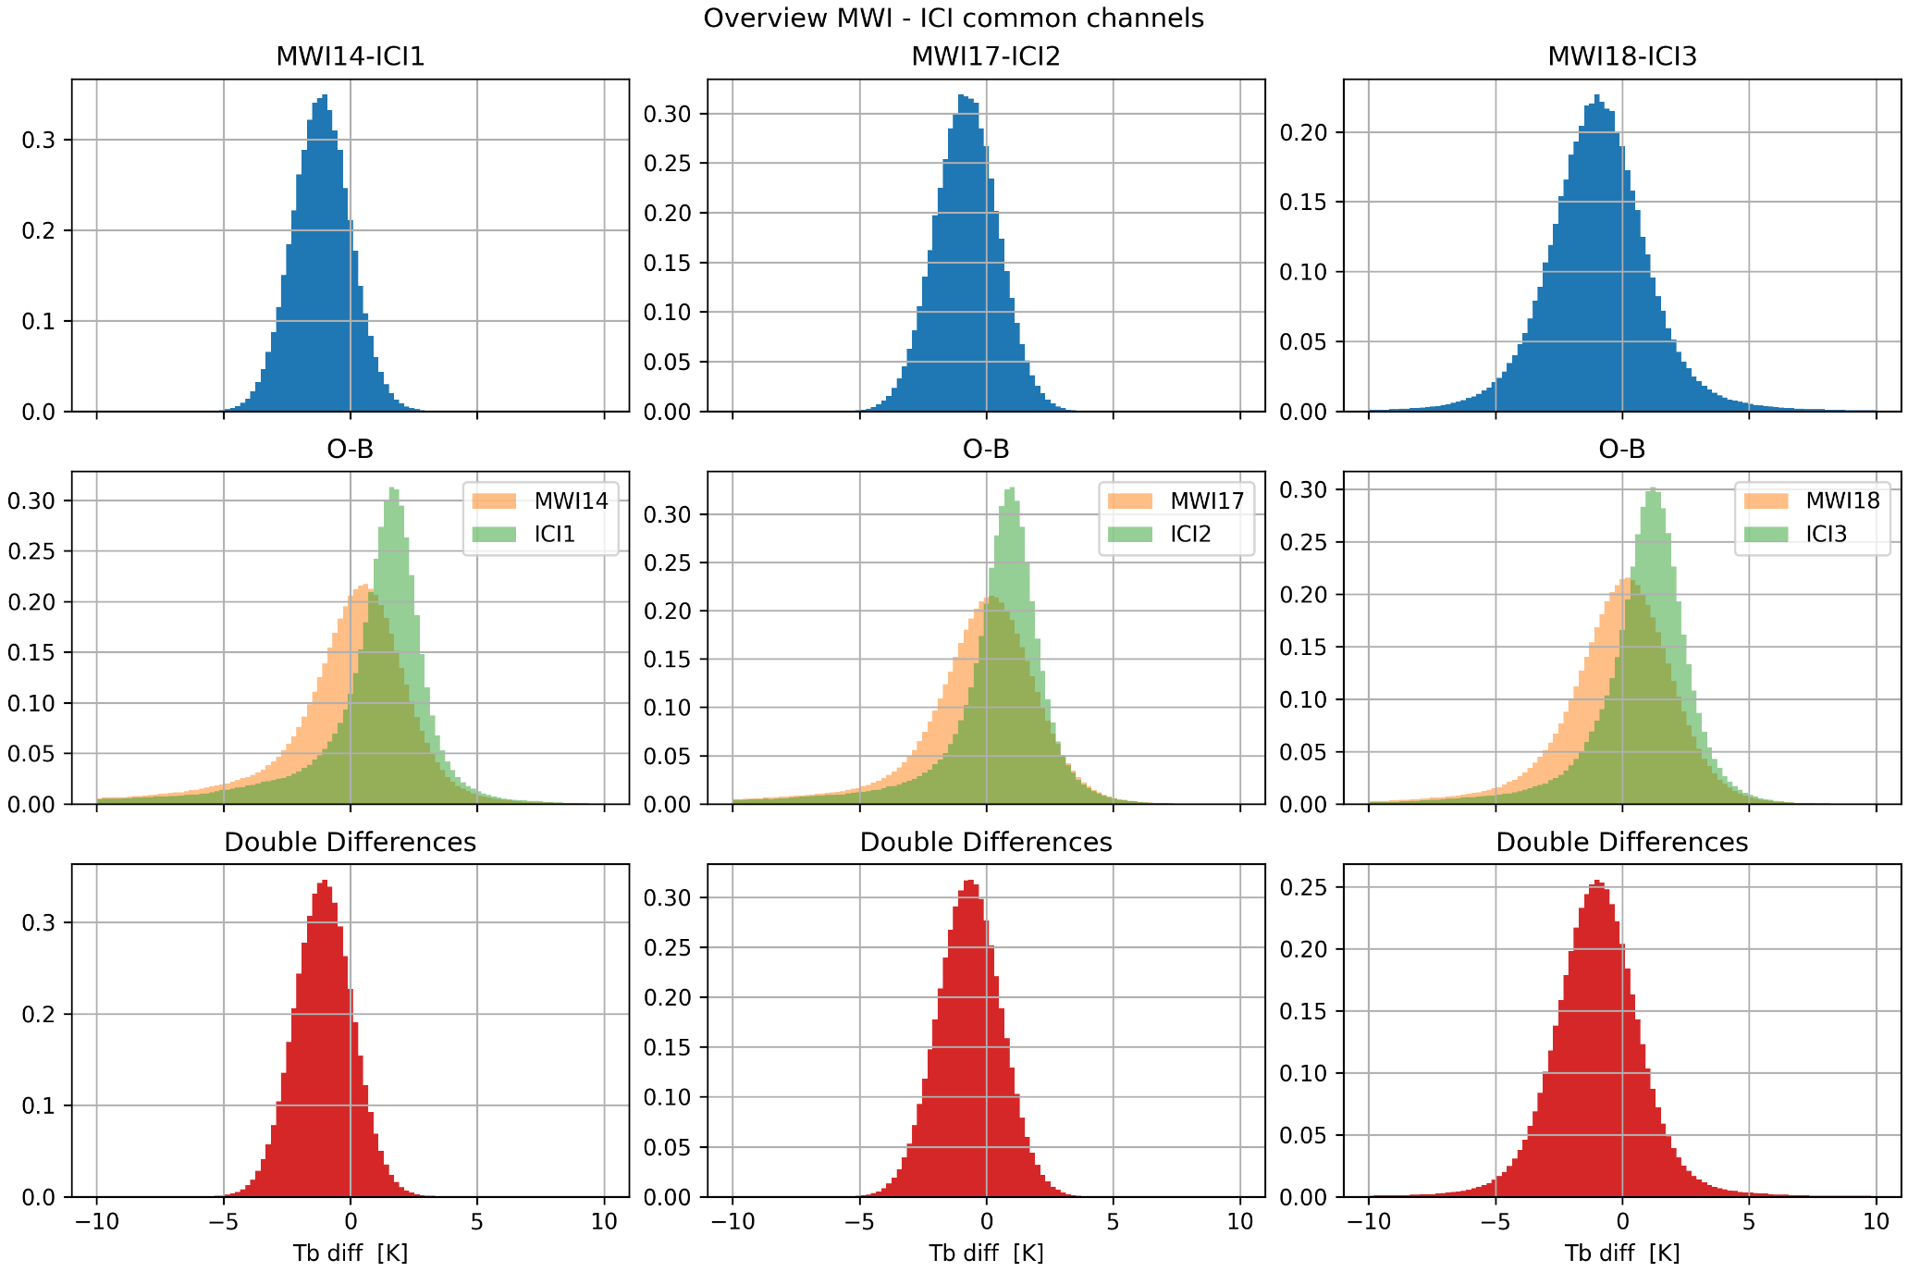
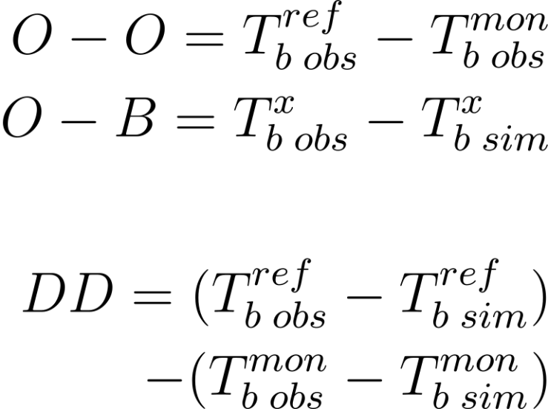
NWP+RTM Double Difference
Classic NWP DD method
- untargetted
Example using MWI-ICI common channels around the 183.3 GHz water vapour absorption line
Multiple products:
Based on Slide from Davide Ori (EUMETSAT)

Slide 10
Hybrid Vicarious/SNO + NWP+RTM Double Difference
As for NWP DD method
But using subsets of input data:
Vicarious inter-calibration:
  Observations over PICTs
SNO inter-calibration:
  Collocated observations
Advantages:
  No need for SBAF
    SRF Differences implicitly accounted for in RTM
  Could also account for geometric differences (VZA, …)
  Accounts for changing conditions between MON + REF observations
    E.g. diurnal variations
Disadvantages:
  Need NWP model data and RTM
  Assume systematic errors mostly cancel
  Difficult to trace uncertainty analytically
    Bootstrap approach may still be applicable?

Slide 11
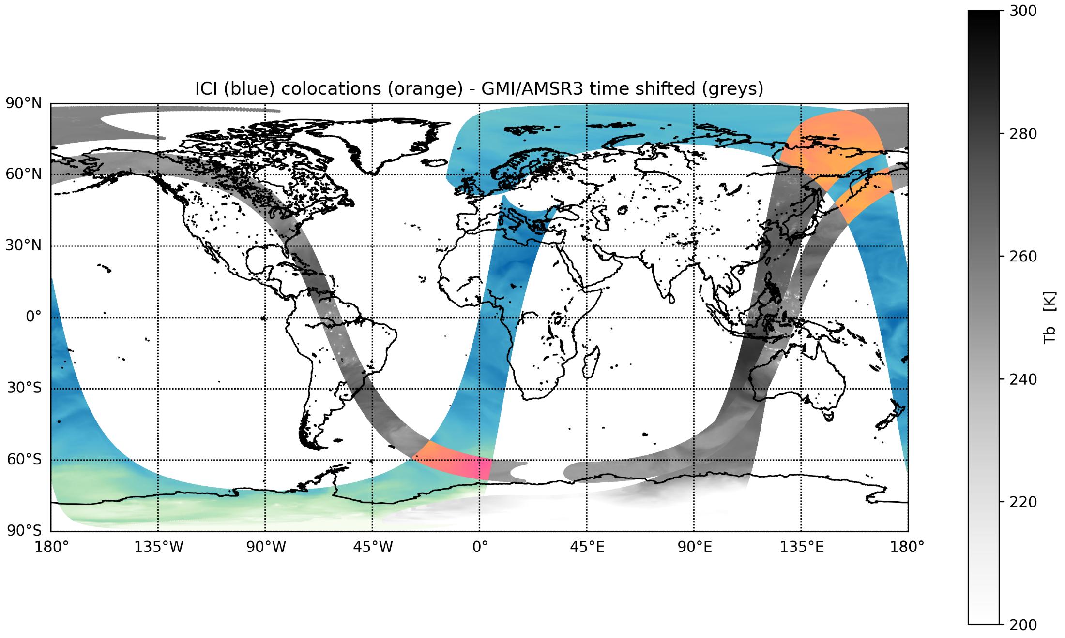
SCO Simultaneous Conical Overpasses for MWI/ICI
Use other reference instruments to inter-calibrate specific MWI-ICI channels provided that suitable co-locations among the radiometers FOVs are found
Reference instruments (grey color scales):
GMI (2023.01.01)
AMSR3 (test data 2023.09.18)
both time-shifted to match ICI TDP
(blue color scale)
Results of the collocation algorithm are highlighted in with an orange color scale
SBAFs may introduce excessive uncertainty [Sterna inter-cal Study]
Based on slide from Davide Ori (EUMETSAT)

Slide 12
SCO Challenges
  Different azimuths ↔ different optical paths
    Add azimuth angle constraint? (Too restrictive?)
    Rely on large number of collocations to average out?
  Different distances at surface and above (sounding channels)
    Could introduce systematic differences?
D > d
d
Based on Slide from Davide Ori (EUMETSAT)

Slide 13
Lessons from developing GSICS IR products
Build on existing developments, where possible:
  Look at what has already been done and consider re-use
  GSICS Data and Products Servers, GSICS File name convention
  GSICS Procedure for Product Acceptance – Maturity Index – iterative peer review process
Consider use case:
  Monitoring calibration of operational missions
  Recommending inter-calibration algorithms suitable for
  Calibration corrections – for NRT, case studies (RAC), Archive re-calibration of single/multiple missions (FCDRs)
  Make it easy to use – consider integration into satpy readers
  Best practices – who for?
Keep it Generic
  Think ahead – to other channels, instruments, …
  Don’t hard code options and assumptions – variable names, correction formulae
Start simple – but start now!
  E.g. start with a strawman algorithm
  Identify issues with the algorithm and work in teams to solve
  Agree a common baseline algorithm
  Aim to iterate – e.g. tuning baseline algorithm for particular applications, instruments, …
  Draft manuscripts collaboratively – really helps identify little differences
Agree a community reference for inter-calibration products
  Agree ways to compare references
  Consider combining where possible (consistent)

Slide 14
SNO/Vicarious Calibration Focus Group Plan for 2026/27
Review Bootstap approach to uncertainty estimation of inter-calibration algorithms
  Jointly with other GRWG Sub-Groups
Consolidate proposal for a baseline SNO algorithm + how to optimise thresholds
  and uncertainty framework
  for independent evaluation by different groups – with different sensors
  Consider extension to hybrid NWP+SNO approach
  Consider extension to SCO (Simultaneous Conical Overpass)
Continue Review of Vicarious inter-calibration algorithms
  Inviting experts to present at web meetings
  Consider extension to hybrid VIC+SNO approach
Review IPWG inter-calibration requirements
  Establish requirements for inter-calibration:​ Target instruments, channels, dynamic range​, Inter-calibration uncertainty, traceability​
  Timeliness – lead time and update frequency​
  Form of inter-calibration product: Algorithm, Coefficient Updates, Corrections, Re-calibration, …​
  Compare requirements with capability of current algorithms​
  Propose way forward​
Plan to be updated following group discussions:
  4w - Inter-calibration of small satellites
  4y - Defining methods for hyperspectral MW sounders inter-calibration

Slide 15
Thank you!
Questions are welcome.

Slide 16
EUMETSAT Microwave GSICS Activities 2025/26
Sterna Inter-Calibration
  Spectral Band Adjustment Functions & Cloud Detection algorithm
  OCTM (“Warm SNO”) inter-calibration algorithm
  Vicarious Inter-Calibration inter-calibration algorithm
  Uncertainty Analysis – potential application to other GSICS Sub-Groups
  Study Report and ATBDs to be published at https://www.eumetsat.int/science-studies
  Implementation Plan: derive corrections to Calibration Coefficient DataBase (CCDB),
  based on biases found in inter-calibration algorithms
Leading SNO/Vicarious Inter-Calibration Focus Group
  3 meetings
Contribution to Microwave Moon Focus Group
  Analysis of AWS lunar intrusions for pointing and FOV validation
Contribution to Technology & Testing Focus Group
  Recommendations for on-ground tests, SRF format

