Slide 1
The future of the NASA SBAF tool presentation and discussion
David Doelling, NASA-Langley
September 10, 2026

Slide 2
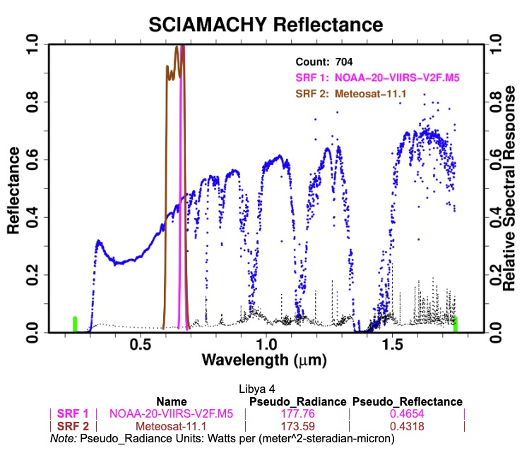
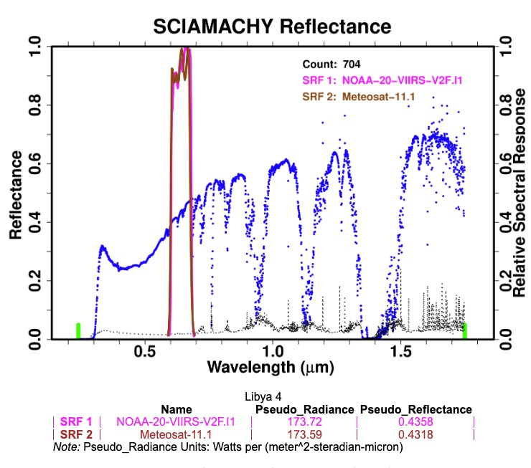
Comparison of N20-VIIRS I1 and M5 bands with Met-11 B1 (0.65 channels)
https://cloudsgate2.larc.nasa.gov/cgi-bin/site/showdoc?mnemonic=SCIAMACHY-SPECTRA-ENHANCED
Libya-4
Libya-4
Δ7. 8%
Δ0. 8%

Slide 3
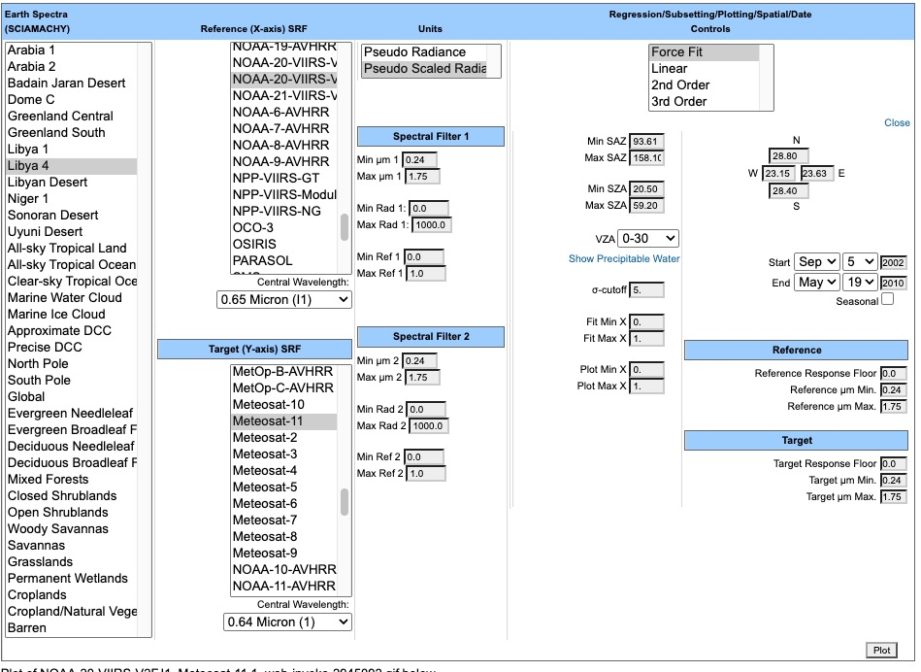
SCIAMACHY SBAF TOOL
https://cloudsgate2.larc.nasa.gov/cgi-bin/site/showdoc?mnemonic=SBAF#

Slide 4
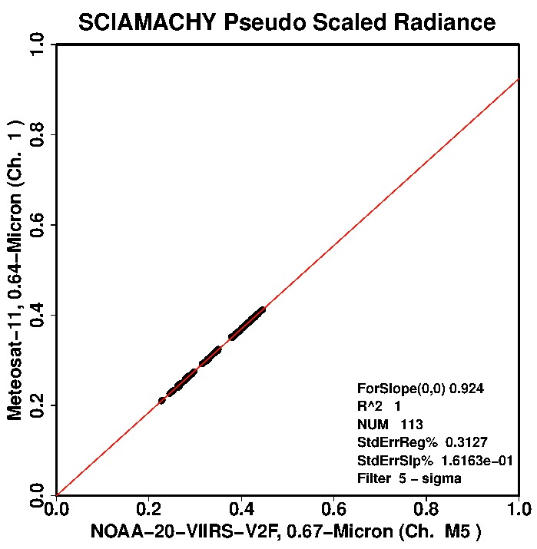
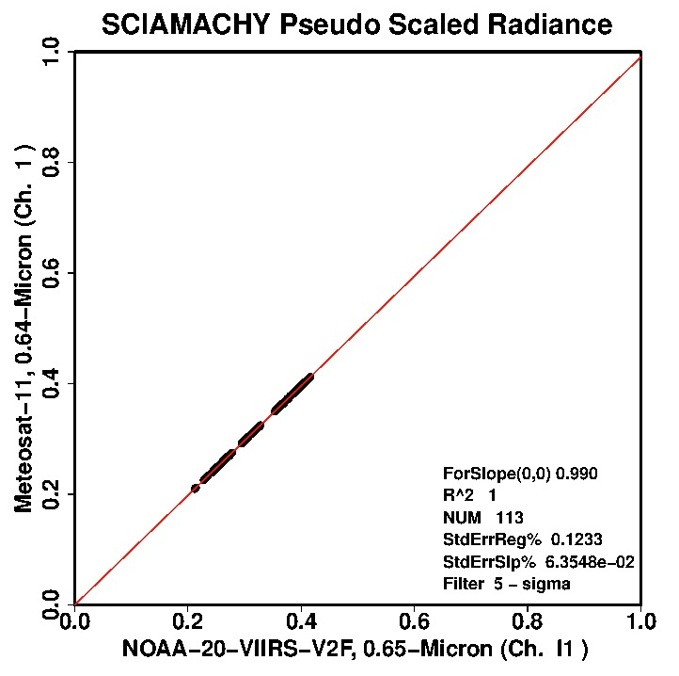
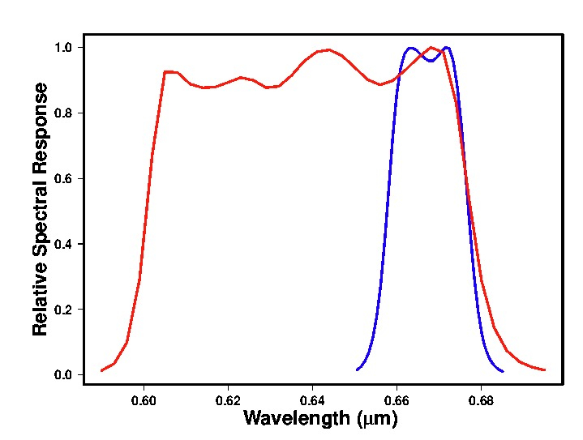
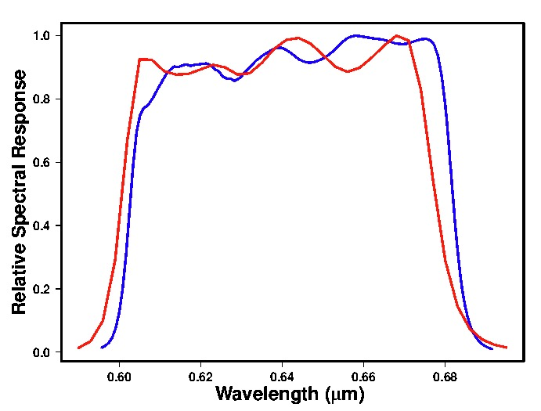


Libya-4
N20-VIIRS M5
Met-11 B1
Libya-4
N20-VIIRS I1
Met-11 B1
Although SCIAMACHY has high spectral resolution the footprint size makes it difficult to locate over Libya-4

Slide 5
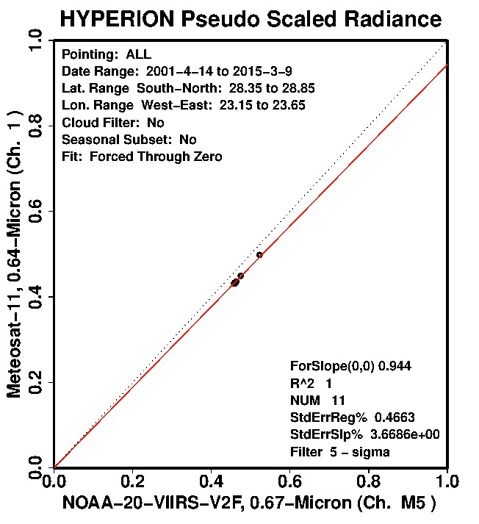
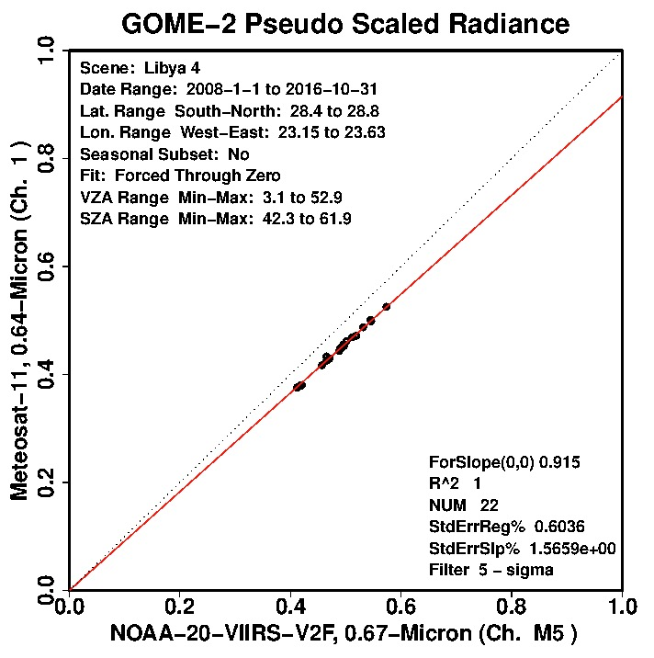
Libya-4
N20-VIIRS M5
Met-11 B1
Slope=0.924
Libya-4
N20-VIIRS M5
Met-11 B1
Slope=0.944
Libya-4
N20-VIIRS M5
Met-11 B1
Slope=0.915
High spectral, low spatial
low spectral, high spatial
High spectral, low spatial
 | Footprint | MLT | Swath | Spectral resolution | Spectral coverage | Spatial coverage
SCIAMACHY | 30x240 km | 10 AM envisat | 960-km | 0.2 nm - 1.5 nm | 214 nm - 2,386 nm | continuous
GOME-2 | 40x80 km | 9:30 AM Metop-A | 1920km | 0.26-0.51 nm | 240-790nm | continuous
GOME-2 narrow | 40x40 km | 9:30 AM Metop-A | 960km | 0.26-0.51 nm | 240-790nm | continuous
Hyperion | 30 m | 9:45 desc | 7.5km | 10 nm | 400-2500nm | tasked

Slide 6
 | Footprint | MLT | Swath | Spectral resolution | Spectral coverage | Spatial coverage
SCIAMACHY | 30x240 km | 10 AM envisat | 960-km | 0.2 nm - 1.5 nm | 214 nm - 2,386 nm | continuous
GOME-2 | 40x80 km | 9:30 AM Metop-A | 1920km | 0.26-0.51 nm | 240-790nm | continuous
GOME-2 narrow | 40x40 km | 9:30 AM Metop-A | 960km | 0.26-0.51 nm | 240-790nm | continuous
Hyperion | 30 m | 9:45 desc | 7.5km | 10 nm | 400-2500nm | tasked
DESIS | 90 m | ISS prec | 30 km | 2 nm | 450-915nm | tasked
ENMAP-HSI | 30m | 11AM desc | 30-km | 10nm | 420-2450 | land
EMIT | 60 m | ISS prec | 80 km | 7.6 nm | 380-2500nm | deserts
PACE-OCI | 1.2 km | 13 LT desc | 2700 km | 5 nm | 340-888nm | continuous
Tanager-1 | 30 m | 12 LT desc | 18 km | 5 nm | 400-2500 nm | tasked
EMI | 13x48 | 13:30 | 2500km | 0.3-0.5nm | 240-790 nm | continuous
HAOC | 250 m | FY-3G prec | 50 km | 4 nm | 440-1060 nm
CLARREO | 0.5 km | ISS prec | 70 km | 3 nm | 350-2275nm | gimbal

Slide 7
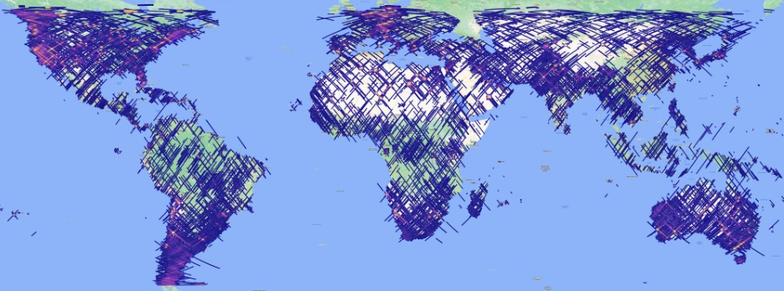
DESIS

Slide 8
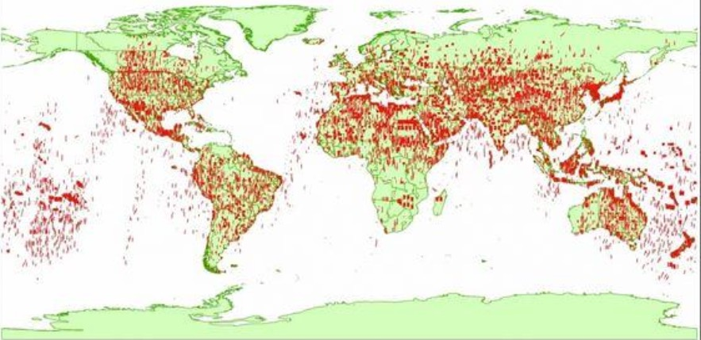
Hyperion

Slide 9
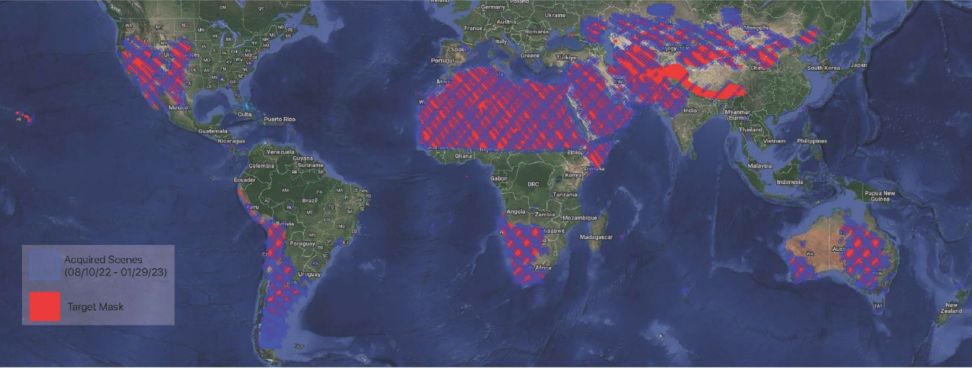
NASA EMIT coverage

Slide 10
Meeting Notes
Include Railroad Valley, need coordinates
Consider ENMAP hyper-spectral dataset
Ability to upload user spectral response functions (SRF)
API interface
Add version numbers with the hyper-spectral dataset
Provide link to the GSICS web site
Include a IASI-NG tool – follow on SBAF tool versions
Maintain a GitHub SBAF python repository to allow users to add functionality to the tool
Obtain list of user requirements – Lets discuss in November 2026

